Slide 1


Physical Therapist Assistant Information Session

Slide 2
Statement Regarding Candidate Physical Therapy Education Programs
Effective 26 April 2022, The Physical Therapist Assistant Program /Pikes Peak State College (Pikes Peak Community College) has been granted Candidate for Accreditation status by the Commission on Accreditation in Physical Therapy Education (CAPTE), 3030 Potomac Ave., Suite 100, Alexandria, Virginia 22305-3085; phone: 703-706- 3245; email: accreditation@apta.org). If needing to contact the program/institution directly, please call Joseph Miller, PT, DPT, DSc at 719-502-3486 or email joseph.miller@ppcc.edu.

Slide 3
Physical Therapist Assistant Information Session Outline
Introduction to PTA and Program
Accreditation Status-Timeline
Program Length and Requirements
Clinical Requirements
Technical Standards
Application Process
Question and Answer

Slide 4
Introduction to PTA and Program
Physical therapist assistants (PTAs) provide physical therapy services under the direction and supervision of a physical therapist.
PTAs help people of all ages who have medical problems, or other health-related conditions that limit their ability to move and perform functional activities in their daily lives.
PTAs work in a variety of settings including
Hospitals, outpatient clinics, home health, nursing homes, schools, sports facilities, and more

Slide 5
Introduction to PTA and Program
The average United States Salary for a licensed PTA: $64,510 in 2022.
Colorado average salary for a licensed PTA: $60,270 in 2022
Job Outlook
Overall employment of physical therapist assistants and aides is projected to grow 33 percent from 2019 to 2029, much faster than the average for all occupations.
PTAs must complete a 2-year associate's degree and are licensed all states.
Care provided by a PTA may include
Demand for physical therapy is expected to increase in response to the healthcare needs of an aging population and individuals with chronic conditions, such as diabetes and obesity.
Teaching patients/clients exercise for mobility,
Strength and coordination, training for activities such as walking with crutches, canes, or walkers, and soft tissue mobilization
The use of physical agents and electrotherapy such as ultrasound and electrical stimulation.

Slide 6
Introduction to PTA and Program
The Program at Pikes Peak State College will be a two-year program
Must be taken in consecutive years
If 1st year not completed must start over
If 2nd year not completed must wait for second year opening
There will only be limited spots for hold overs
Prerequisites are not required to apply but completing and passing prerequisites increase points on your application
General education is built into the program but can be taken prior
Education will be in the form of classroom, labs, and clinical rotations

Slide 7
PTA Requirements
Lifting light weight frequently
Lifting moderate weight frequently
Lifting heavy weight occasionally
Exposure of areas of the body to do treatment and practice
Immunizations required for clinics
Frequent standing

Slide 8
Accreditation Status and Timeline
Candidacy Program 26 April 2022
First Cohort Enroll August 2022
Second Cohort 2023
Graduation of the first cohort May 2024 Apply for Accreditation May 2024
If Approved
Accreditation
Continue to enroll classes
Accreditation denied
Not approved
No further enrollment
Students will be Notified
Degree conferred by MCC
Eligible for degree and sitting for licensure upon graduation

Slide 9
Admission Requirements
Application submission
  Selective application process online
  Not open enrollment
  Application open for 2024 from 1 December 2023 until 15 May 2024.
Not a concurrent enrollment program
  Must be a high school graduate prior to technical course start (first fall)
  Have the prerequisites complete and passed by first fall

Slide 10
Math and English Requirements
Accuplacer (taken at PPCC within the last 3 years)
  246 or higher on Next Generation Writing
  240 or higher on Next Generation QAS
OR
Applicants with an Associate’s Degree or Higher with a minimum GPA of 2.5 or better overall in the last 10 years may be exempted from taking the Accuplacer test by the program director (will need Math 107 equivalent or higher and English 121/131 equivalent or higher passed). Incomplete degrees or certificate do not qualify for exemption and the applicant must take the Accuplacer test within the last 3 years of the application deadline.
OR
Take MAT 107 and either ENG 131 or ENG 121 and pass with a “C” or better.

Slide 11
Program Length and Requirements
Summer I (prerequisites) must be taken by Fall I
Human Anatomy and Physiology I
Medical Terminology
Conceptual Physics with a lab
Career Math (will accept higher level math courses)
Fall I
Basic Care in Physical Therapy
Principles and Practices of Physical Therapy
Anatomical Kinesiology (specific PTA section during program only)
English 131 or English 121 (General Education)
Rehab Principles of Medicine I
Principles of Communication I
Spring I
Professional Communication II
Modalities in Physical Therapy
Clinical Kinesiology
Rehab Principles of Medicine II
Public Speaking will accept Interpersonal Communication (General Education)
Summer II
PTA Internship I (4 weeks)
Fall II
Neurological Assessment and Management Techniques
Orthopedic Assessment and Management Techniques
Professional Communication III
Psychological Issues in Healthcare
Spring II
PTA Seminar
PTA Internship II (6 weeks)
PTA Internship III (6 weeks)
General Psychology I (General Education)
All General Education must be taken by Fall II

Slide 12
Clinical Requirements
Three clinic placements
4-week Summer at the end of first year.
Two 6-week placements in the last semester
40 hours a week required
Can work out schedule with CI but based on clinic

Slide 13
Estimated Program Costs (2022)
Total tuition in state: ~$17,885.15 (additional fees not included)
Total tuition in state with College Opportunity Fund: ~$11,316.40 (additional fees not included)
The student fee rate for 2018-2019 is $9.93 per credit hour plus a $13.75 registration fee, and a $10.00 Bus Pass Fee.
Out of state tuition 610.90 per credit (additional fees not included)
Professional Liability Insurance~$39.00 per year
Any travel and housing costs associated with internship.
Total estimated: $1600- + expenses during Internship
ESTIMATED ADDITIONAL EXPENSES*
Books ~1200 total
Registration/payment for background check and drug screen ~$90.00 (estimate, depending on contract)
PTA exam study guide ~$85
APTA membership ~$200 (100 per year) @ www.apta.org
Physicals ~ $50.00 @ provider of choice
CPR - Health Care Provider ~$50.00/8 hours (program provides information)
PTA Program Polo Shirt ~$50.00
Lab Uniform ~$20.00 for t-shirt plus other clothing
Total: $12,916.50-$19,085.15 (depending on tuition status) + expenses during internships
*Subject to change, depending on vendors

Slide 14
Technical Standards
Math and Science proficiency
Typing and writing proficiency
Reading proficiency
Communication proficiency
Exercise proficiency

Slide 15
Technical Standards
Should a student be unable to meet a technical standard or course requirement after a reasonable accommodation has been made, the offer of admission or status in the program will be withdrawn
Reasonable Accommodations evaluated through PPSC Accessibility office
Essential Functions
Affective/behavioral skills
Cognitive skills
Communication skills
Observation skills
Physical and emotional health

Slide 16
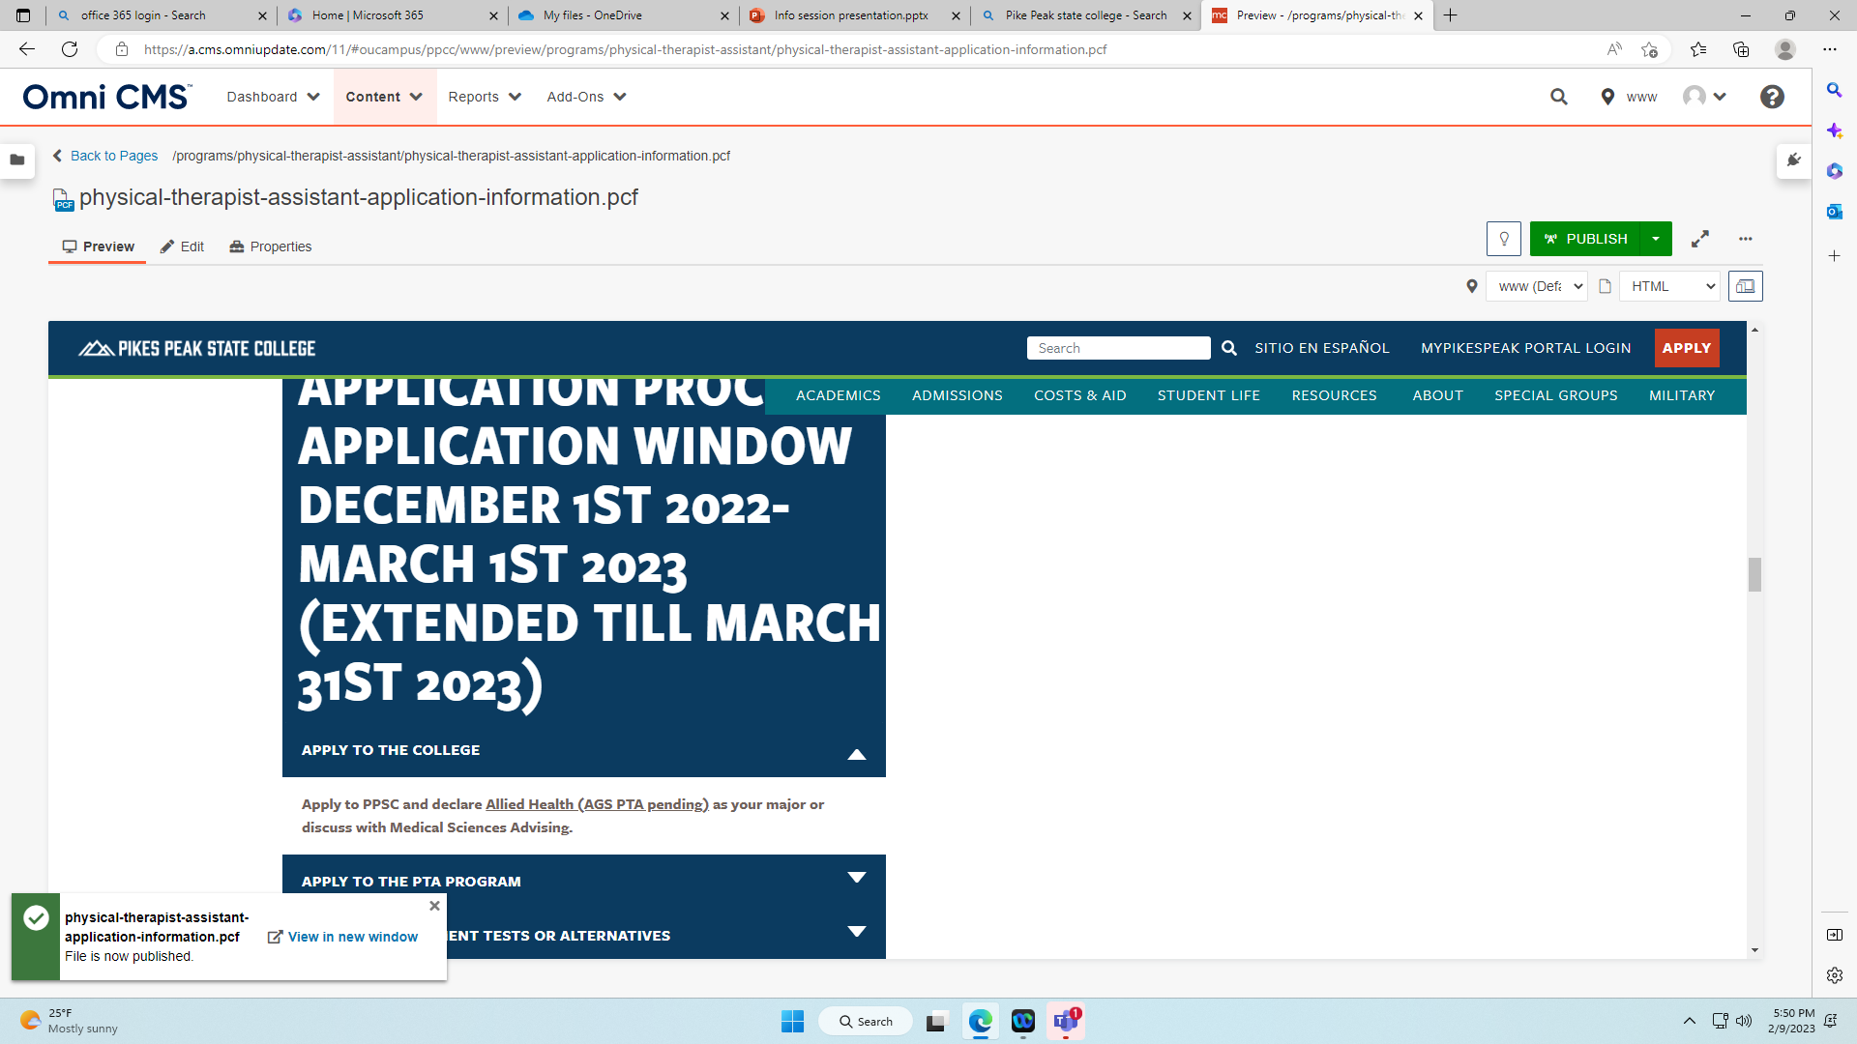
Website navigation: ppcc.edu → Academics→ Program Search → Physical Therapist Assistant Degree → Application and Information Tab

Slide 17
Application Process
The Special Admissions process has been instituted as a means of providing an orderly annual admission of up to 20 students in the fall semester.
Application to Pikes Peak State College Physical Therapist Assistant (PTA) program must be submitted online.
Complete the Physical Therapist Assistant Program Application Packet and submit no later than April 1st prior to the desired summer/fall admittance.
We suggest you submit your application as soon as possible. (Completing early does not get you extra points)
Completed Application Packet to include:
Completed application dated within the last current year
Official College Transcripts on file in Admission and Records Office from all colleges and universities (prior to Fall of the start of the program). All courses must be verified with official transcripts indicating the course has been completed with a grade of “C” or better.
Completion of online application and all forms (posted on PTA website under Application and Information).
INCOMPLETE APPLICATIONS WILL NOT BE CONSIDERED FOR ENTRANCE INTO THE PROGRAM*
Associates of Science Pre-PTA concentration can be selected in order to: Help students qualify for Financial Aid and/or VA benefits prior to acceptance in order to take prerequisites (in works but need to discuss with Advisor-Military or Medical Sciences.)
It is required to also send a copy of outside college/university official transcripts to the PTA Program Office if exemptions are requested or no official transcripts are on file at PPSC.
Please make sure they are your most up to date transcripts.
Pikes Peak State (Community) College transcripts should not be sent in with PTA Application.
Completion of two recommendation forms from an employer and an instructor (no personal friends or family members) found in the application forms packet.

Slide 18
Application Scoring

Slide 19
After Application Submission
If more than 20 qualified applicants
  Will interview top 30
If 20 or less qualified applicants
  Will interview all
If you continue to take courses
  Must maintain 2.5 overall GPA
  Must pass any pending prerequisites with a “C” or better
  If you do not pass all prerequisites by Fall 2024 or overall GPA falls below 2.5, offer for admission will be rescinded

Slide 20
Drug Screening/Background Checks
Although possession and use of marijuana is consistent with Colorado Constitution requirements is no longer a crime, the possession and use of marijuana remains illegal under federal law.
  Consistent with federal law, including the Controlled Substances Act and the Drug-Free Schools and Communities Act of 1989, the use and/or possession of marijuana is strictly prohibited.
  Students/instructors will not be under the influence of unprescribed controlled substances while on campus, in a clinical experience, or acting in the capacity of a college representative.
A criminal background check and drug test are required upon acceptance to the program (completed by the start of Fall I).
  A fee and the applicant’s social security number are required for the background check.
  Accepted Students will be referred to PPSC Human Resources to schedule background checks and drug tests.

Slide 21
Immunizations
Students must meet the following immunization requirements prior to the first clinical (Summer II):
  Two-step TB skin test
  Tetanus-diphtheria-Pertussis (Tdap) within the last 10 years)
  Measles/Mumps/Rubella vaccinations or serological confirmation of immunity
  Varicella vaccination or serological confirmation of immunity
  Three-injection hepatitis B vaccination series or serologic confirmation to hepatitis B virus (this series can take up to 6 months to complete).
  Initial COVID-19 series (booster not required at this time)
  Health insurance coverage may be required for some clinical rotations (more information to come)

Slide 22

Question and Answer

