Slide 1

Physical Therapist Assistant Information Session

Slide 2
Accreditation Credential
The Pikes Peak State College Physical Therapist Assistant Program is accredited by the Commission on Accreditation in Physical Therapy Education, 3030 Potomac Ave., Suite 100, Alexandria, Virginia 22305-3085; telephone: 703-706-3245; email: accreditation@apta.org; website: Commission on Accreditation in Physical Therapy Education. To contact the program/institution directly, please call Dana Gregory, PT, DPT, MPH, MS at 719-900-8685 or email dana.gregory@pikespeak.edu

Slide 3
Physical Therapist Assistant Information Session Outline
What is a PTA?
PTA Program Length and Requirements
Clinical Requirements
Technical Standards
Application Process
PTA Job Outlook

Slide 4
What is a PTA?
Physical therapist assistants (PTAs) provide physical therapy services under the direction and supervision of a physical therapist.
PTAs help people of all ages who have medical problems, or other health-related conditions that limit their ability to move and perform functional activities in their daily lives.

Slide 5
Essential Functions of a PTA
Affective/Behavioral Skills – attention, professionalism
Cognitive Skills
Communication Skills
Observation Skills
Physical and Emotional Health

Slide 6
PTA Job Physical Requirements
Lifting light weight frequently
Lifting moderate weight frequently
Lifting heavy weight occasionally
Exposure of areas of the body to do treatment and practice
Immunizations required for clinics
Frequent standing

Slide 7
Where do PTAs work?
Hospitals
Outpatient clinics
Home health
Nursing homes
Schools
Sports facilities
Military / VA

Slide 8
PTA Salary and Employment Outlook
Average salary for a licensed PTA in the US:
$65,860 per year as of 2023 ($31.66/hr).
Average salary for a licensed PTA in Colorado:
$63,220-$66,310 per year as of 2023.
www.bls.gov
Job Outlook
PTA employment is projected to grow 16 to 19 percent from 2024-2034, much faster than the average for all occupations.
Demand for physical therapy is expected to increase due to the healthcare needs of an aging population and individuals with chronic conditions, such as diabetes and obesity.

Slide 9
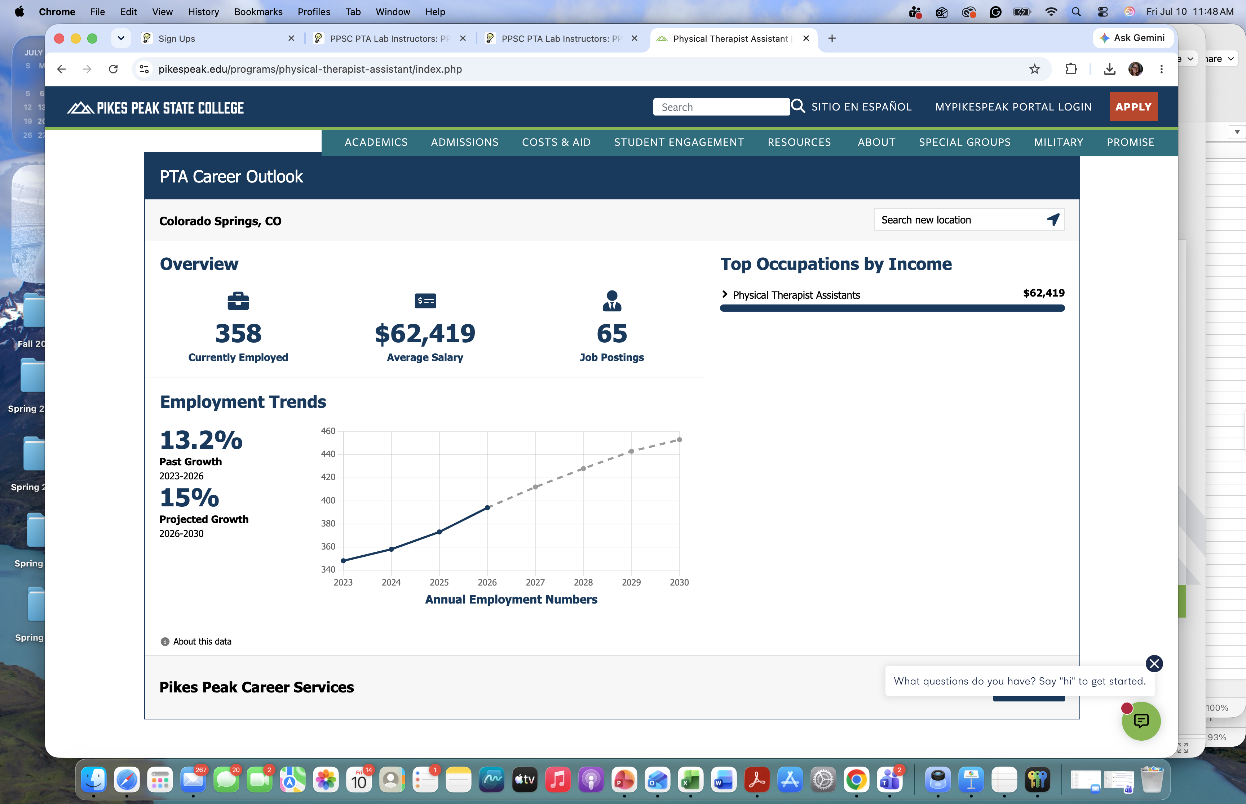

Slide 10
How to become a PTA…
Three step-process
  Graduate from an accredited PTA program (like ours at PPSC!)
  Pass the National Physical Therapy Licensure Examination for PTAs
    Visit the Federation of State Boards of Physical Therapy website for more information
  Apply for a PTA license in the state in which you want to work
    In Colorado, this done through the Department of Regulatory Agencies (DORA)

Slide 11
PTA Program Technical Standards
Math and Science proficiency
Typing and writing proficiency
Reading proficiency
Communication proficiency
Exercise proficiency
Accommodations are evaluated by the PPSC Accessibility office.

Slide 12
Tell me more…
One cohort starts each year in August with up to 22 students using a selective admission process
Two-year, full-time, in-person program at PPSC Center for Healthcare Education and Simulation (CHES) campus – 1850 Cypress Semi Dr., Colorado Springs
  Must be taken in consecutive years
    If 1st year not completed, have to reapply and start over
    If 2nd year not completed, have to wait for a second-year opening AND retake all first-year final exams, skills checks, and practical exams.
Courses are lab/lecture, lecture, and clinical rotations

Slide 13
Selective Admission Process
Online application open from December 1 to May 15 of the following year
Admission Requirements
  All prerequisite courses passed with a C or better before the program starts – do not have to be complete to apply
    MAT 1140 or higher, COM 1260 (no substitutions), HPR 1039, BIO 2101
  2.5 or higher cumulative undergraduate GPA – Must submit all transcripts
  TEAS test for allied health 55% or higher
  10 observation hours in a PT clinic w/ 500-word essay
  2 academic or professional recommendations
  Complete general education courses in the first year
    ENG 1021 or ENG 1031, PSY 1001
Optional: service hours, work experience, elective courses for extra points
Not a concurrent enrollment program
  Must be 18 years old and a high school graduate prior to technical course start (first fall)
  Have the prerequisites complete and passed by first fall

Slide 14
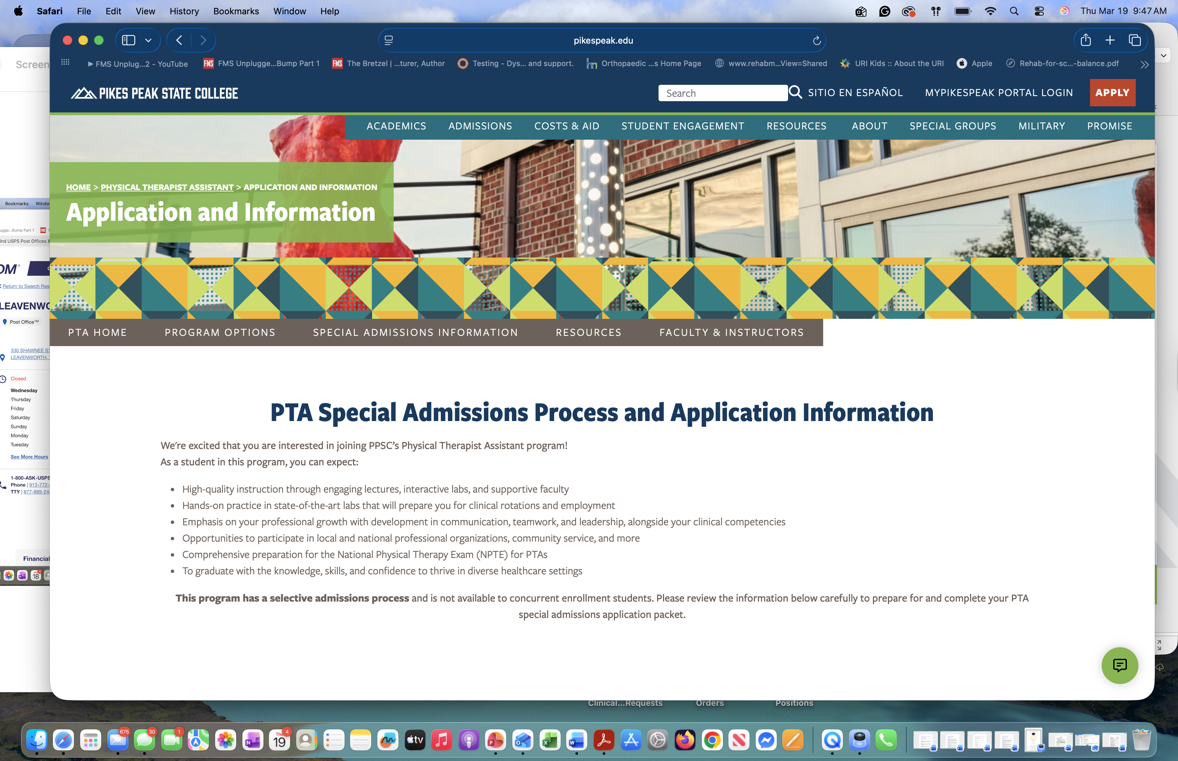
Website navigation: pikespeakstatecollege.edu → Academics→ Program Search → Physical Therapist Assistant Degree → Application and Information Tab

Slide 15
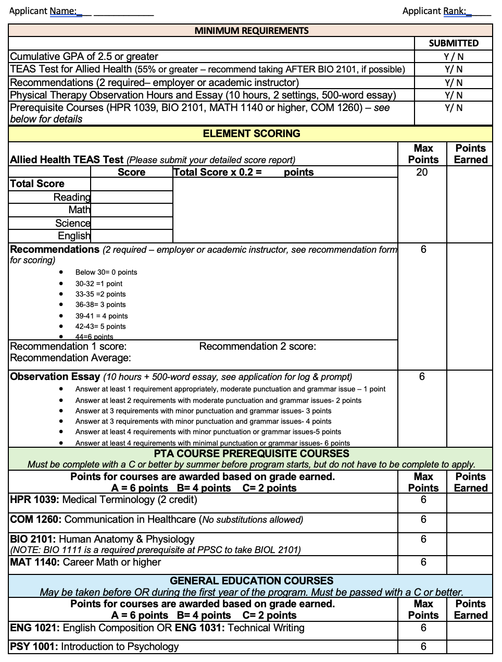
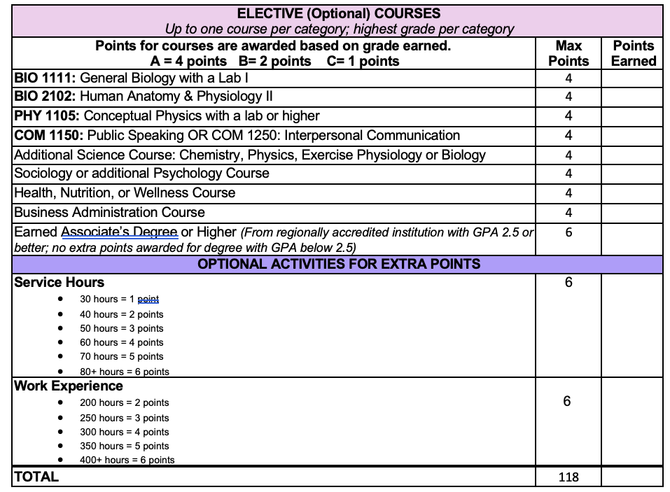
Application Scoring

Slide 16
Drug Screening/Background Checks
A criminal background check and drug test are required upon acceptance to the program (completed by the start of Fall I).
  A fee and the applicant’s Social Security number are required for the background check.
  Accepted Students will be referred to PPSC Human Resources to schedule background checks and drug tests.
Although possession and use of marijuana is no longer a crime for adults over the age of 21 in Colorado, the possession and use of marijuana remains illegal under federal law.
  Consistent with federal law, including the Controlled Substances Act and the Drug-Free Schools and Communities Act of 1989, the use and/or possession of marijuana is strictly prohibited.
  Students/instructors will not be under the influence of unprescribed controlled substances while on campus, in a clinical experience, or acting in the capacity of a college representative.

Slide 17
Immunizations, Physicals, and BLS
Students must meet the following immunization requirements before the first clinical (Summer II):
  Two-step TB skin test
  Tetanus-diphtheria-Pertussis (Tdap) within the last 10 years)
  Measles/Mumps/Rubella vaccinations or serological confirmation of immunity
  Varicella vaccination or serological confirmation of immunity
  Three-injection hepatitis B vaccination series or serologic confirmation to hepatitis B virus (this series can take up to 6 months to complete).
  Seasonal Influenza
  COVID-19 series
  Health insurance coverage may be required for some clinical rotations (more information to come)
Physical Exam form completed by your doctor to verify ability to perform physical requirements
Basic Life Support (BLS CPR and AED)
  American Heart Association strongly recommended due to requirements by clinical sites
  PPSC AHA Classes

Slide 18
PTA Program Course Sequence
Summer I (prerequisites) must be taken by Fall I
BIO 2101 Human Anatomy and Physiology I (NOTE: at PPSC BIO 1111 or test out is required to take BIO 2101)
HPR 1039 Medical Terminology (2 credit)
Fall I
PTA 1010 Basic Care in Physical Therapy
Spring I
PTA 1020 Modalities in Physical Therapy
COM 1260 Communications in Healthcare (No substitutions)
MAT 1140 Career Math or higher
PTA 1011 Essential Lab Skills I
PTA 1015 Principles and Practices of Physical Therapy
PTA 1018 Functional Anatomy and Kinesiology
English 1031 or English 1021 or higher (General Education)
PTA 1024 Rehab Principles of Medical I
PTA 1021 PTA Essential Lab Skills II
PTA 1034 PTA Rehab Principles of Medical II
PTA 1040 Clinical Kinesiology
PTA 1041 Professional Communication II
Summer II
PTA 2080 Clinical Internship I (4 weeks – 40 hours/wk)
Fall II
PTA 2005 Psychological Issues in Healthcare
Spring II
PTA 2078 PTA Seminar
PTA 2081 Clinical Internship II (6 weeks – 40 hours/wk)
PTA 2082 Clinical Internship III (6 weeks – 40 hours/wk)
PSY 1001 General Psychology I (General Education)
PTA 2030 Orthopedic Assessment and Management
PTA 2051 Professional Communication III
PTA 2040 Neurological Assessment and Management
PTA 2041 Essential Lab Skills III
All General Education must be taken by Fall II

Slide 19
Clinical Requirements
Three clinical internships – deliberate matching process
One 4-week in June after the first year.
Two 6-week placements in the last semester
40 hours per week
Schedule varies based on the Clinical Instructor and the clinic
One outpatient ortho/sports, one inpatient or complex medical, one specialty (pediatrics, pelvic health, neuro/vestibular, military)

Slide 20
PTA Program Outcomes (as of June 2026)
86% of students who start the PPSC PTA Program, graduate
79% of graduates who have taken the test, have passed the NPTE on the first attempt
97% of graduates have ultimately passed the NPTE
100% of graduates who pass the NPTE seek licensure
100% of licensed graduates are employed or continuing formal education

Slide 21
Estimated Program Costs (2026)
Total tuition in-state with College Opportunity Fund: ~$184.05 per credit hour plus fees (~$13,475)
Total tuition in-state without COF: ~$291 per credit hour plus fees (~$22,407)
W.U.E. tuition $262.50 per credit hour plus fees (~$20,212.50)
Out of state tuition: $718.35 per credit + fees (~$55,312.95)
Student fees: $17.32 per credit hour (~$1304.38) plus a $17.55 registration fee, and a $10.23 Bus Pass Fee.
PTA course fees: ~$1500 across program
Professional Liability Insurance ~$60 for one year
Travel and housing costs associated with internship (~$1600, est.)
Evolve Compliance Training 14 Course Module $47 one-time fee
ESTIMATED ADDITIONAL/OPTIONAL EXPENSES*
Books ~ $1200 total
Registration/payment for background check and drug screen ~$93.49 (estimate, depending on contract)
PTA exam study guide ~$100
APTA membership ~$200 ($100 per year) @ www.apta.org
Physical: ~ $50.00 @ provider of choice
Vaccinations: costs will vary
CPR – BLS Heartcode Health Care Provider American Heart Association ~$82.00
PTA Program Polo Shirt ~$50.00
Lab Uniform ~$20.00 for t-shirt plus other clothing
Total: Approximately $19,791.38 in-state with COF
*Subject to change, depending on vendors

Slide 22

Email PTAssistant@pikespeak.edu or attend a Q & A session if you have questions or need more information

