Slide 1
Nursing Assistant Information
Cathy Fontenot and Ellie Yoder
Program Coordinator​
Lindsey Murphy
Instructional Coordinator
Lindsey.Murphy@pikespeak.edu
Lisa Heckel
Clinical Coordinator
Lisa.Heckel@pikespeak.edu

Slide 2
Overview of NUA Program
Must be 16 year or older​
NUA 1001
Nurse Aide Health Care Skills
NUA 1070/1071
Nurse Aide Clinical
Advanced Nurse Aide Clinical
5 Weeks Lecture/Lab (2 days a week) or 10 Weeks Lecture/Lab (1 day a week) Classes are offered Spring, Summer, and Fall. The 10 week program does not run during summer.
Total of 30 Hours Lecture and 45 Hours Lab
6 days at a skilled nursing, rehab, and/or hospital during the next 5 weeks. 3 days for NUA 1070 and 3 days for NUA 1071. Clinical days are 10-12 hrs long.
Total of 60 Hours for clinical
All three classes must be completed within 1 year from start to finish.

Slide 3
Lecture Expectations
Read the chapters in the book
Complete homework and quizzes on time
Punctuality and attendance
Active participation in class
74% to pass and advance to clinical

Slide 4
Lab Expectations
Meet class competencies
Pass 23 skills for the state test
Attendance and punctuality
Dress in solid colored matching scrubs
Watch your skills videos and come prepared
Respect your classmates and your instructor
Participate and utilize lab time responsibly

Slide 5
1070 and 1071 Clinical Expectations
Pass NUA 1001 with a 74%, pass terminal competencies, pass all 23 skills.
Complete clinical compliance paperwork, background check, and drug screen.
Arrive early to your scheduled days of clinical in your professional PPSC uniform (white scrub top with nursing patch, maroon scrub bottom, white socks, white non mesh shoes) per handbook guidelines.
You will also need a Nursing Assistant Student ID, black pen, small notebook, lunch, water bottle, analog watch with a second hand, tattoos covered, piercings per handbook.
Look and act professional, you represent yourself, PPSC, and your instructor as you work alongside a CNA.
Check your PPSC email and stay in contact with your Clinical Instructor

Slide 6
Attendance
Attendance is Mandatory
State requires a minimum number of hours for licensing.
Any missed lab MUST be made up
Missing more than 10% of any class could result in an incomplete or failure of the class.
If you do not show up for clinical and have not contacted your instructor you will fail clinical.

Slide 7
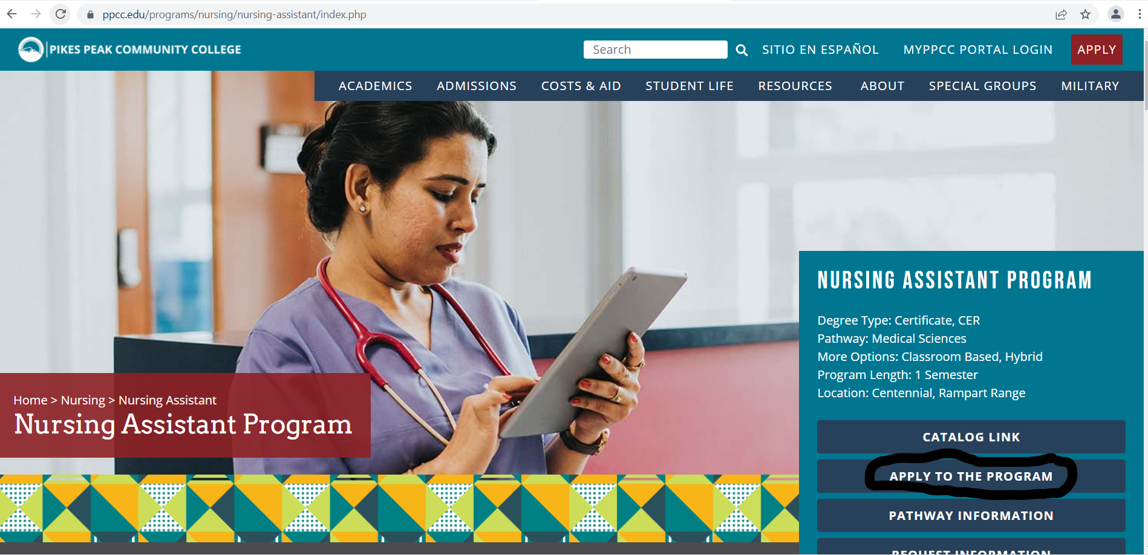
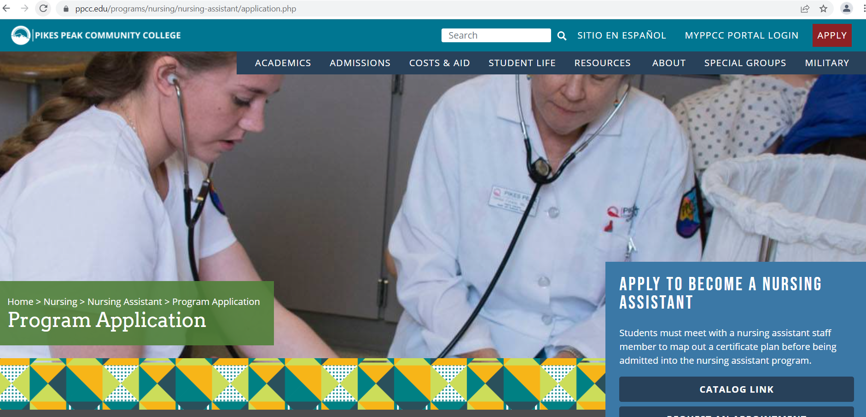
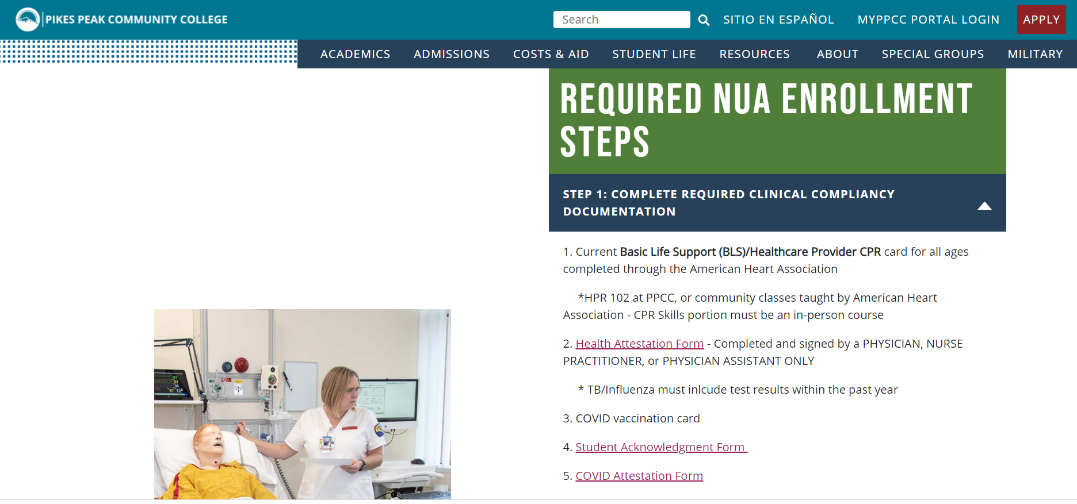
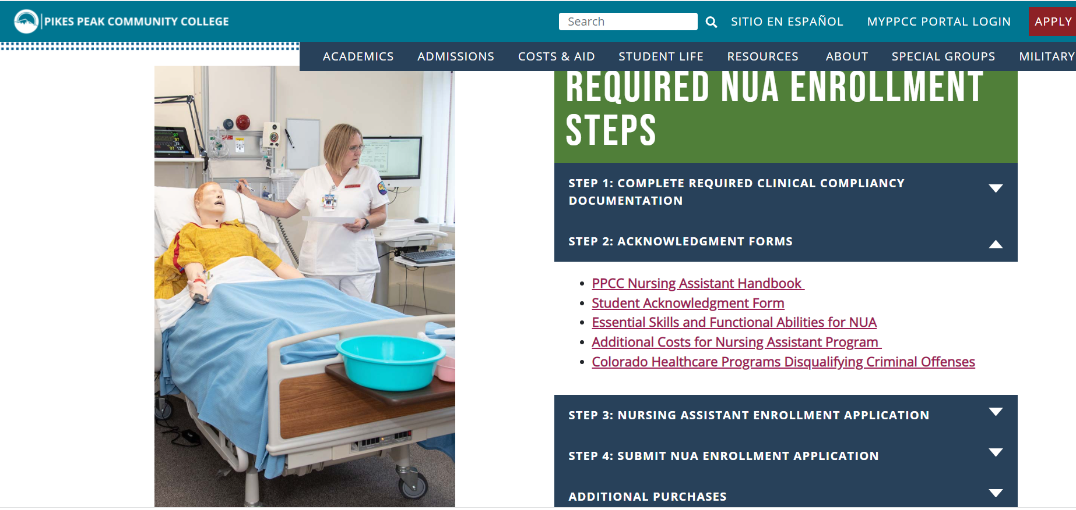
Documentation must be turned in prior to enrollment into the NUA program
www.pikespeak.edu/programs/nursing/nursing-assistant/application.php

Slide 8
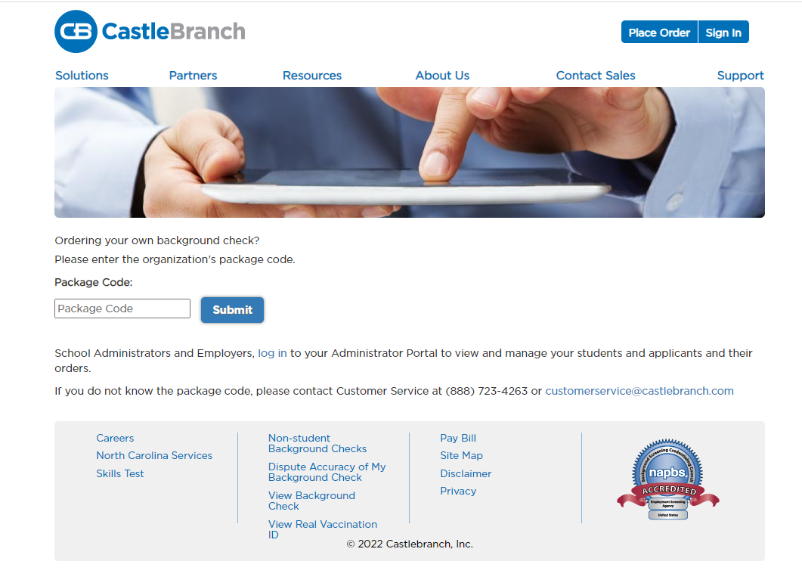
CastleBranch Data Repository Code PK35 https://www.castlebranch.com/online_submission/package_code.php
Health Form – Physical and Vaccination Record
MMR, Tdap, Varicella, Hep B, TB skin test, Influenza
Current CPR for Healthcare Providers or BLS
American Heart Association
COVID vaccine is not currently required , however clinical partners
often change requirements which could cause a disruption in your
clinical completion if you do not have the immunization.
Signed Student Acknowledgment Form
Background Check –ordered through CastleBranch
Drug Screening ordered through CastleBranch
Package code for Background Check/Drug Screen PK35
Will need to go to a QUEST lab for drug screen
A positive drug screen results in no clinical for 2 yrs; Marijuana is NOT federally acceptable – no exceptions!

Slide 9
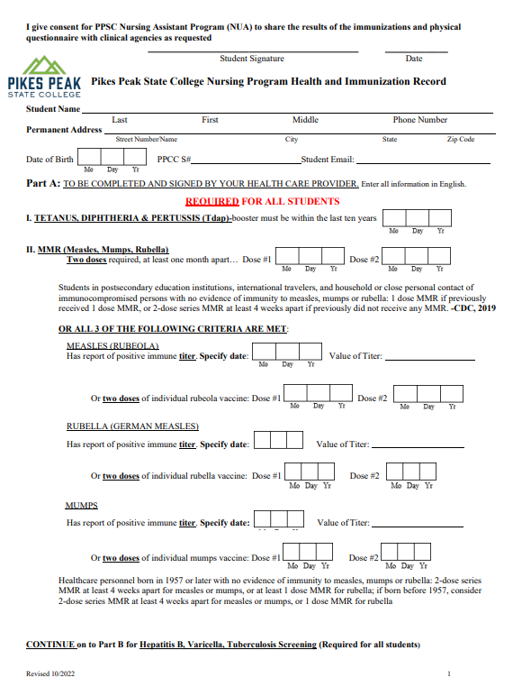
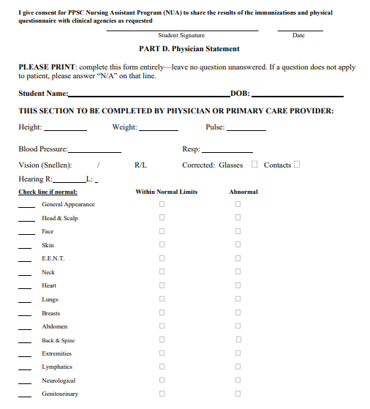
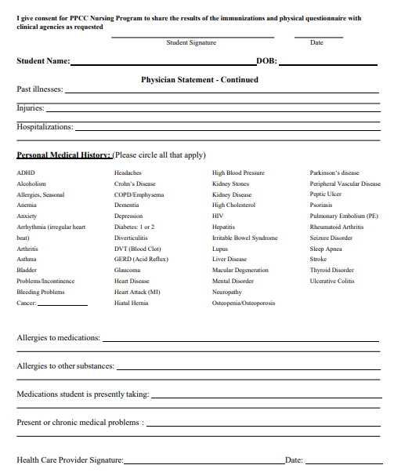
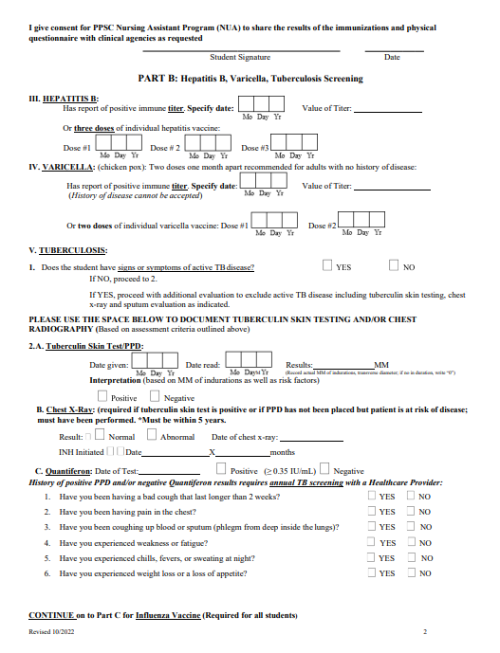
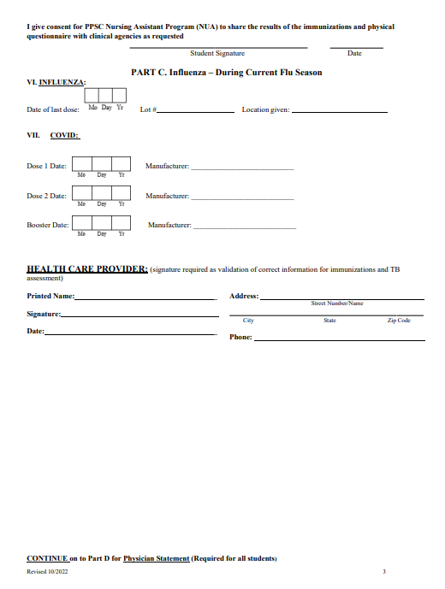
HEALTH IMMUNIZATION FORM
All 5 pages must be Filled OUT and signed by
you and the healthcare provider!!!
Tdap within the last 10 yrs
Proof of MMR, Varicella, and Hep B or current titer
Negative TB test within 1 year (skin test, blood test, or chest xray)
COVID vaccine
Current Flu immunization between September and March of the current season
The physical portion MUST be Signed by MD, PA or NP

Slide 10
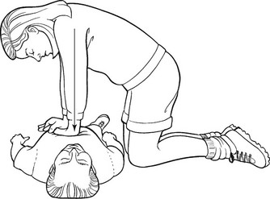
Must be taught by American
Heart Association:
BLS Basic Life Support
HPR 1011 at PPSC
Skills portion must be hands on. Online classes will not be accepted.

Slide 11
Student Acknowledgment Form
Agreeing to the following:
Have oriented self to D2L
Have read the NUA Student Handbook and agree to follow the requirements and guidelines including dress code and professionalism
Have read the course descriptions for NUA program
Agree to abide by NUA policies
Attest you can physically perform all Nursing Assistant duties

Slide 12
Additional Costs
Watch with 2nd hand
CastleBranch Account
Immunizations
Uniform, shoes, patch
Student ID
Black pen and small notebook
No workbook or stethoscope needed
CNA State Test

Slide 13
Thanks!
If you have any questions, please email Lindsey.Murphy@pikespeak.edu or
Lisa.Heckel@pikespeak.edu

