Slide 1
NUA Information Session

Slide 2
Hello!
Mark Vickers
Program Coordinator
Mark.Vickers@pikespeak.edu
Ritika Taylor
NUA Faculty
Ritika.Taylor@pikespeak.edu

Slide 3
Overview of NUA Program
NUA 1001
Nurse Aide Health Care Skills
NUA 1070/1071
Nurse Aide Clinical
Advanced Nurse Aide Clinical
5 Weeks Lecture/Lab (2 days a week) or 10 Weeks Lecture/Lab (1 day a week)
Total of 30 Hours Lecture and 45 Hours Lab
Clinical will be in person
60 hrs of clinical over 5-6 days at a skilled nursing and hospital

Slide 4
Lab Expectations
Watch your videos and come prepared
Dress Appropriately
Participate and utilize lab time responsibly

Slide 5
Attendance
Attendance is Mandatory
State requires a minimum number of hours for licensing.
Any missed lab MUST be made up
2 missed classes will require a student to drop and retake NUA 1001

Slide 6
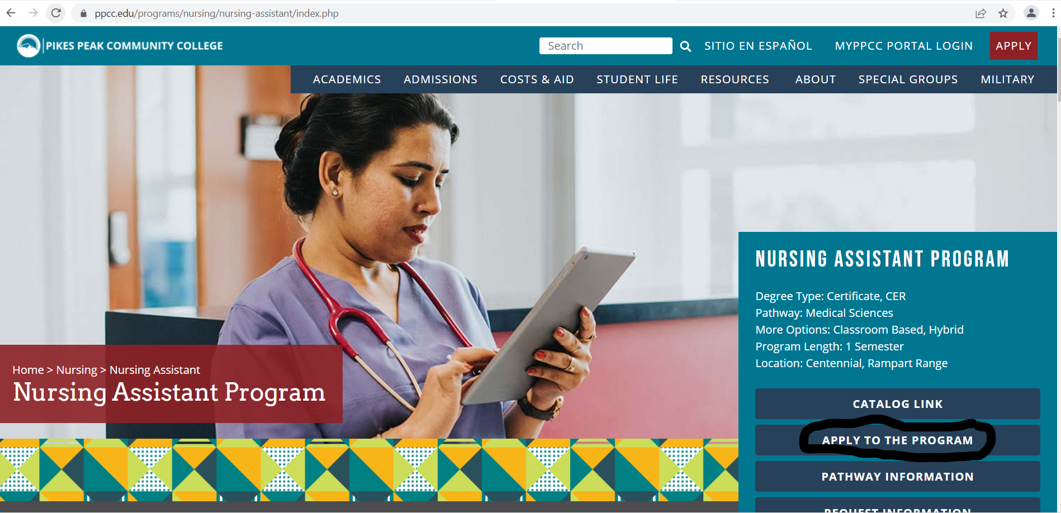
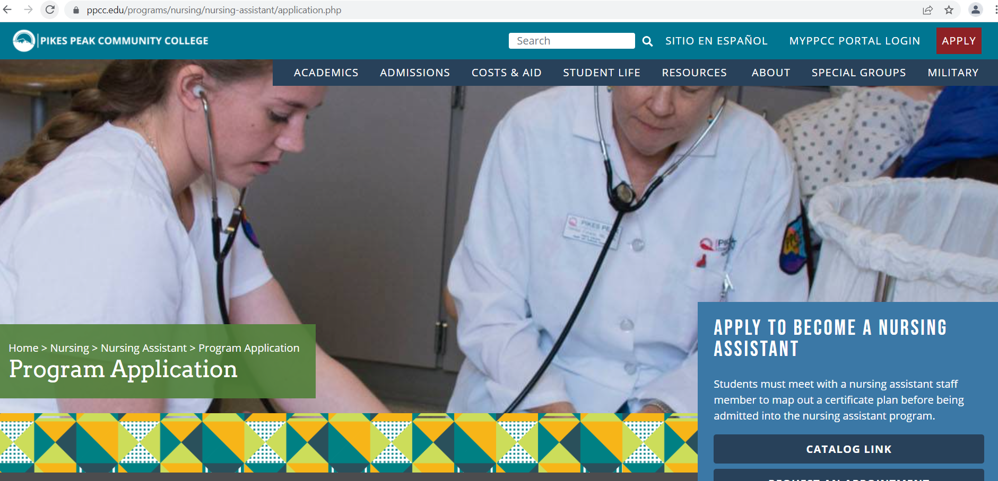
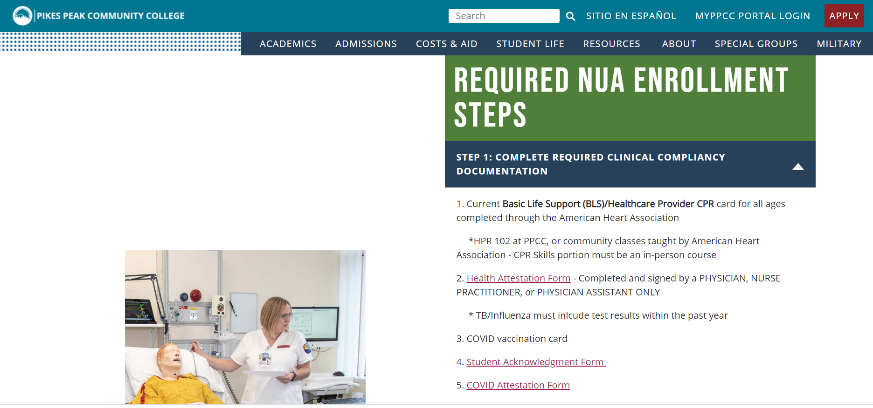
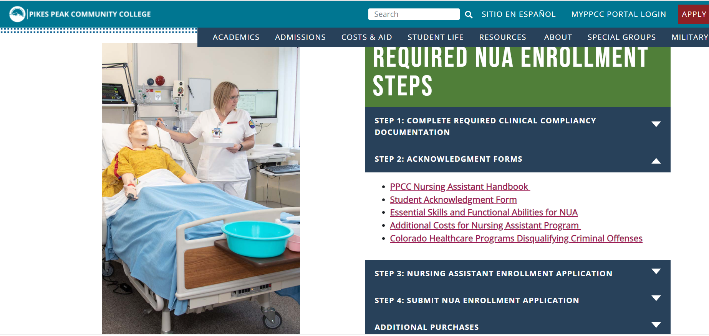
Documentation must be turned in prior to enrollment into the NUA program
www.pikespeak.edu/programs/nursing/nursing-assistant/application.php

Slide 7
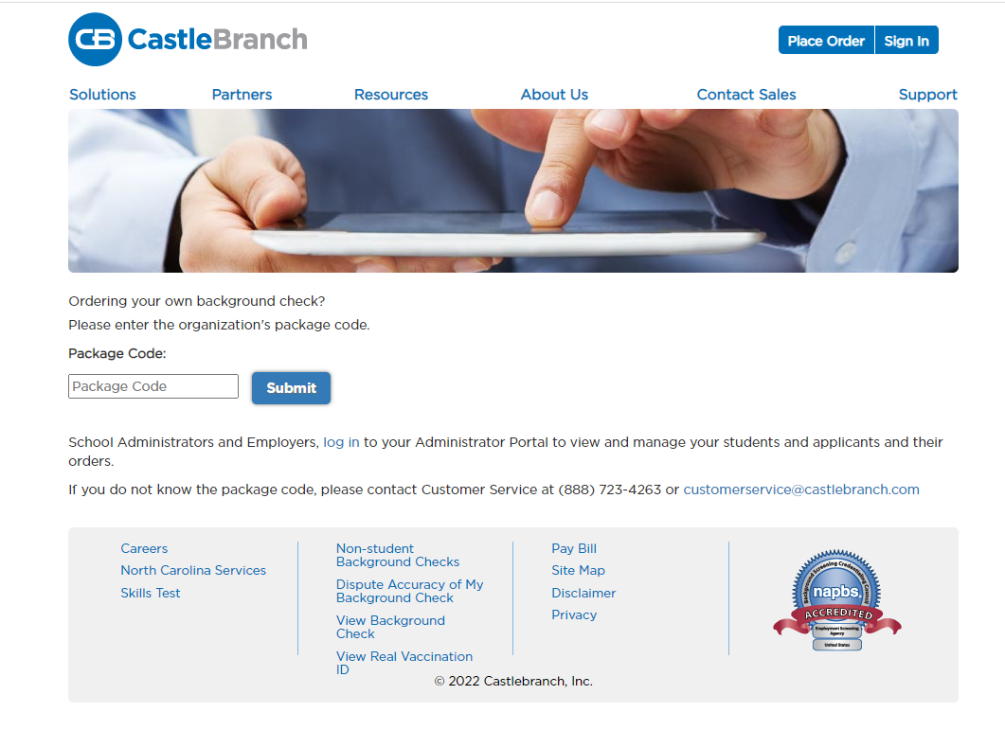
CastleBranch Data Repository https://www.castlebranch.com/online_submission/package_code.php
Health Form – Physical and Vaccination Record
MMR, Tdap, Varicella, Hep B, TB skin test, Influenza
Current CPR for Healthcare Providers or BLS
American Heart Association
COVID vaccination card
Signed Student Acknowledgment Form
Covid Attestation Form
Background Check –ordered through CastleBranch
Drug Screening ordered through CastleBranch
Package code for Background Check/Drug Screen PK35
Will need to go to a QUEST lab for drug screen
Marijuana is still not federally accepted. You will have to wait 2 years to retake the drug test if it comes back positive.

Slide 8
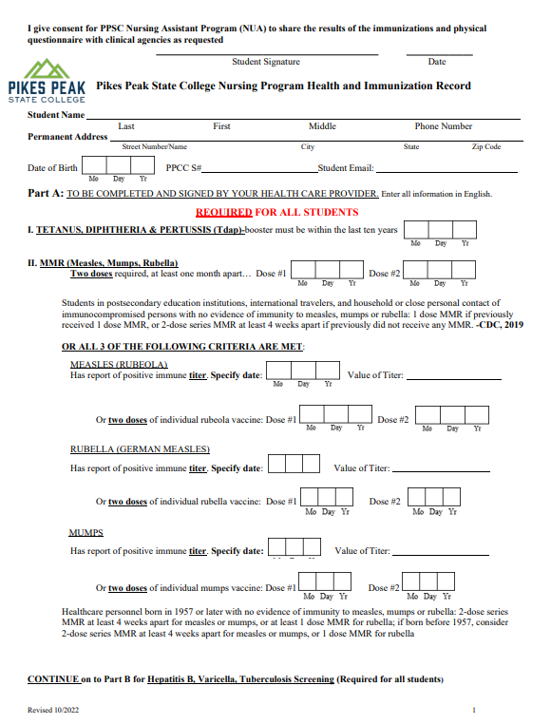
All 5 pages must be Filled OUT and signed by you and the healthcare provider!!!
Tdap < 10 yrs
MMR and Varicella in progress
Hep B Series – If not completed this requires a Hep B Waiver
Must be Signed by MD, PA or NP

Slide 9
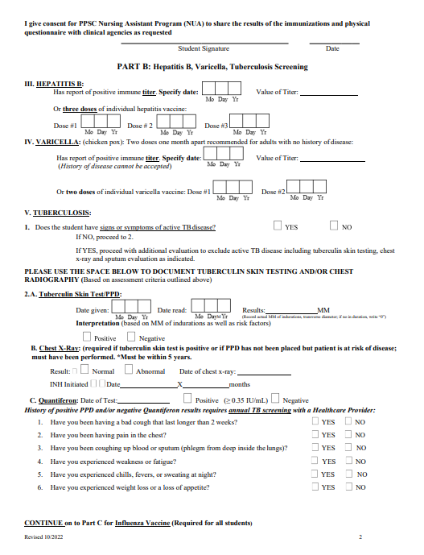
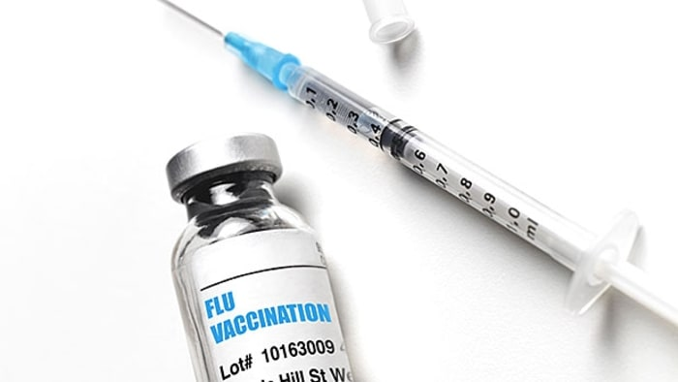
TB and Influenza
TB
Skin test or QuantiFERON
Skin test will need to be read 48-72 after administration
Positive TB
Will Require a Chest X-ray
Leave Appropriate Time!!
COVID
Fully Vaccinated means first 2 immunizations and the most recent
Flu Shot
Must be within the current flu season
Spring or Fall Clinical

Slide 10
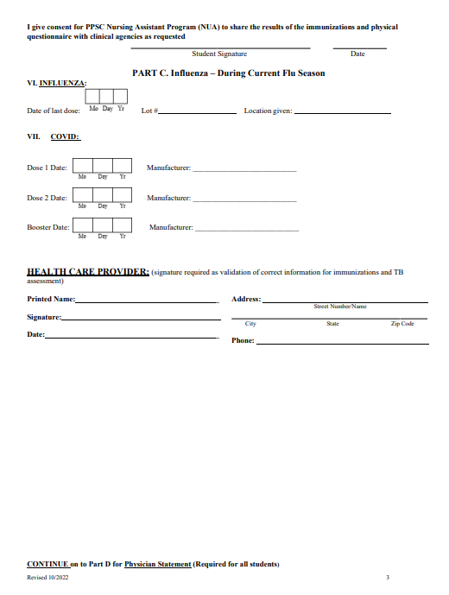
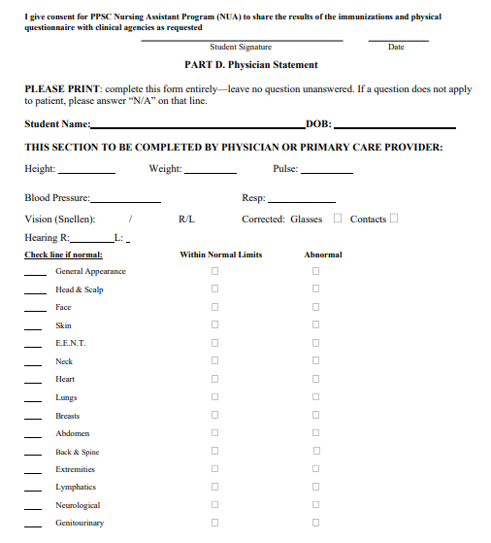
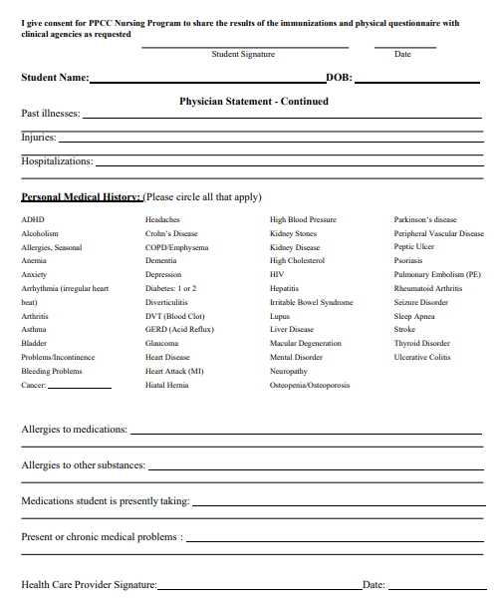

Slide 11
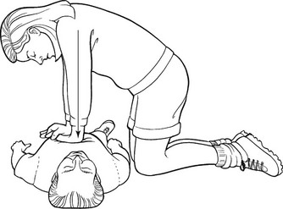
Must be taught by American
Heart Association:
BLS Basic Life Support
HPR 1002 at PPCC
Skills portion must be hands on

Slide 12
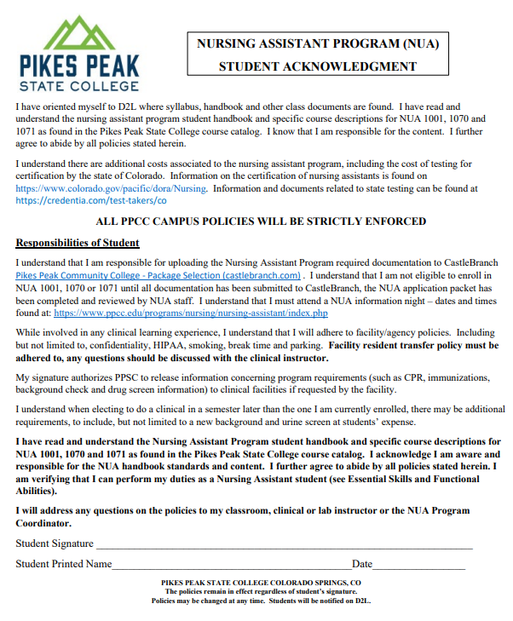
Student Acknowledgment Form
Agreeing to the following:
Oriented self to D2L
Read the NUA Student Handbook
Read course descriptions for NUA program
Agree to abide by NUA policies
Attest you can physically perform Nursing Assistant duties

Slide 13
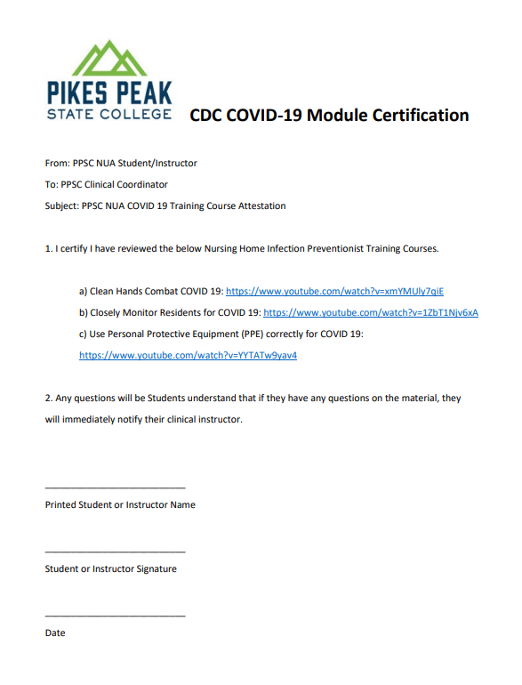
COVID Attestation Form
Found on
Nursing Assistant Program | Pikes Peak State College www.pikespeak.edu
Students must watch the videos and sign and date form prior to uploading to CastleBranch.

Slide 14
Additional Cost
Healthcare Care Forward can help
https://www.pikespeak.edu/landing-pages/care-forward.php
Watch with 2nd hand
CastleBranch Account
Immunizations
Uniform, shoes, patch
Student ID
Black pen and small notebook
No workbook or stethoscope needed

Slide 15
1070 and 1071 Clinical Expectations
Pass NUA 1001 with a 74%, pass terminal competencies, pass all 23 skills.
Arrive early to your scheduled days of clinical in your professional PPCC uniform ( white scrubs, white socks, white non mesh shoes, Nursing patch) per handbook guidelines.
You will also need a Nursing Assistant Student ID, black pen, small notebook, lunch, water bottle, analog watch with a second hand, tattoos covered, piercings per handbook.
Look and Act professional, you represent yourself, PPSC, and your instructor.
Check your PPSC email and stay in contact with your Clinical Instructor

Slide 16
Thanks!
Any questions?
Email: Ritika.Taylor@pikespeak.edu

