Slide 1




Professional Development Week
Professional Development Week
President’s Address
FALL 2024

Slide 2
Numbers

Slide 3
Enrollment | AFTE
Unduplicated Headcount
AY22/23 = 17,377 students
AY 23/24 = 17,740 students
Difference: 363 students

Slide 4

Graduation
Degrees & Certificates
3,970 | 17/18
4,060 | 18/19
3,879 | 19/20
3,562 | 20/21
3,051 | 21/22
3,242 | 22/23
3,122 | 23/24*
*Includes 70 BSN/BAS degrees
Numbers are not final

Slide 5

Commencement Stats
Commencement Stats
Thank you to Commencement Coordinator Brian Pumilia.
Record 633 graduates walked for commencement
6,000 guests
130 Volunteers
88% rated their experience very good or good

Slide 6
Achieving HSI Designation

Slide 7
Achieving HIS Designation
District Name | % Hispanic Pupils
Harrison 2 | 52%
Ellicott 22 | 41%
Hanover 28 | 39%
Colorado Springs 11 | 36%
Widefield 3 | 34%
District 49 | 31%
Fountain 8 | 30%
Miami/Yoder 60 JT | 30%
Academy 20 | 17%
Cheyenne Mountain 12 | 16%
Peyton 23 JT | 15%
Lewis-Palmer 38 | 13%
Edison 54 JT | 12%
Manitou Springs 14 | 11%
Calhan RJ-1 | 6%
Total | 29%
 | Fall 2023 as of 8/4/2023 | Fall 2023 End-of-Term | Fall 2024 as of 8/6/2024
 | % Hispanic FTE | % Hispanic FTE | % Hispanic FTE
Concurrent Enrollment | 16.7% | 19.9% | 18.2%
All Other | 25.7% | 25.4% | 25.7%
Total | 24.1% | 24.2% | 24.5%

Slide 8

Peak Education

Slide 9

Peak Education Video

Slide 10
Budget and Staffing

Slide 11
Reserve Balance History

Slide 12

Budget Assumptions 2024-2025
Current year activity:
On-Campus Tuition – Increase by 3%
Online Tuition – Increased by 3%
Raises for APT, Faculty & Instructors 3%
Co Wins Classified Step Increase estimated at $500k
Net COF & FFS - FY23 $29.7m, FY24 10.2% increase to $32.7m, FY25 9.2% estimated increase to $35.7m
35% of all PPSC COF earned is allocated in support of rural colleges
2.25% enrollment growth

Slide 13
Revenue & Expense Comparison FY24 & FY25*
 |  | “Projected” Fiscal Year 2024–2025
Revenue Summary | FY24 Actuals | FY25
Student Tuition | $47.4 | $55.2
State Support (A50/FFS) | $37.9 | $40.7
Other | $8.2 | $5.6
Total Revenues | $93.5 | $101.5
Expense Summary | FY24 | FY25
Total Expenses | $77.5 | $95.5
Total Gain (Loss) | $16.0 | $6.0
Capital Project DDOHCC/Other | ($7.1) | ($2.9)
Net Gain (Loss) | $8.9 | 3.1
*In $Millions

Slide 14
Staffing Overview
Total Hires | January – August
 | 2023 | 2024 | Difference
Classified Full Time | 8 | 14 | +6
Faculty Full Time | 6 | 25 | +19
Administrative, Professional, Technical Full Time | 50 | 53 | +3
Grand Total | 64 | 92 | +28
Hiring Season
28 more new hires than last year, with more still in progress.

Slide 15
Staffing Requests
Position Type and Total Requests
Classified to APT | 8
Classified New | 3
APT New Positions | 27
Faculty New | 14
Total | 52
Estimated Fiscal Impact +/- (all staffing changes)
Classified | $202,293
APT | $2,104,115
Faculty | $946,377
Total | $3,252,785
44 Total New Positions

Slide 16
Instructional Services

Slide 17
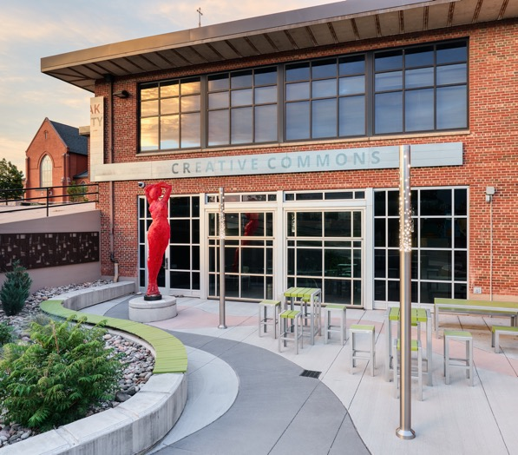
HLC 2025 Comprehensive Evaluation Visit
Every step matters. Everyone matters.
HLC 2025 Reaffirmation of Accreditation
April 14 & 15, 2025
A five-member review team will be on campus for 1 ½ days
Includes Meetings with faculty, staff, students

Slide 18
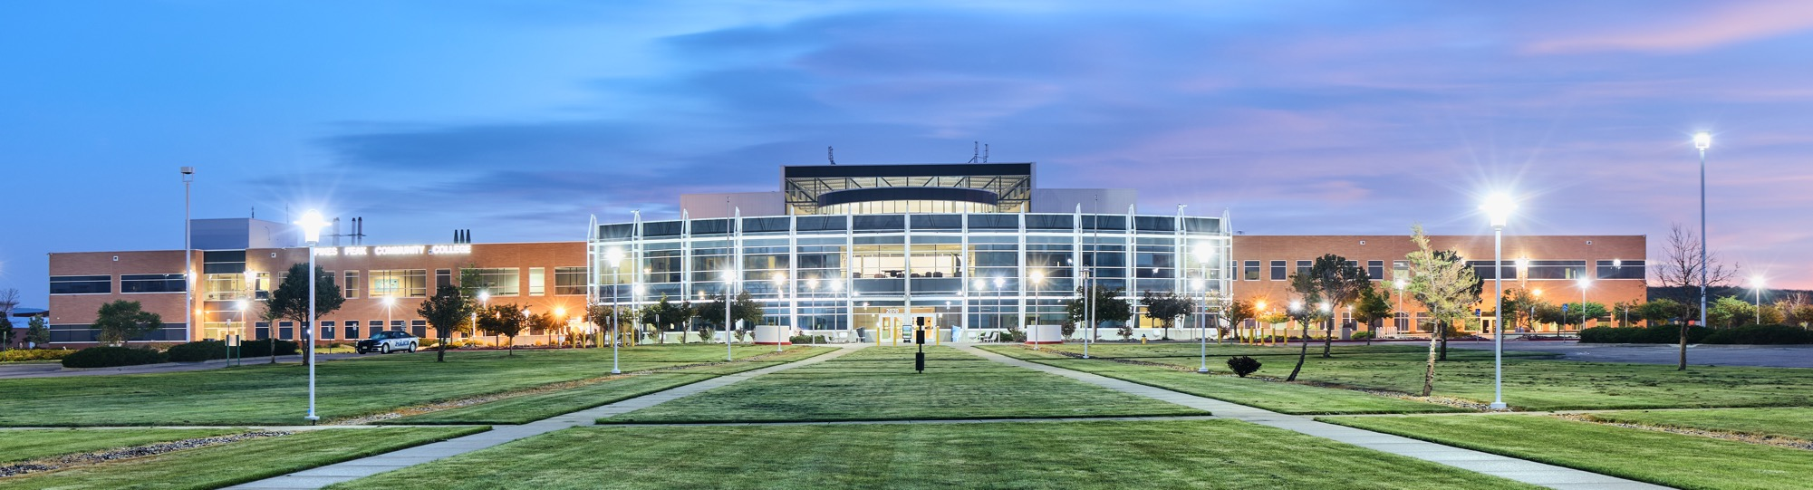
HLC 2025 Comprehensive Evaluation Visit
Work in progress with the Five criteria for accreditation:
Criterion 1 – Mission
Criterion 2 – Ethical and Responsible Conduct
Criterion 3 – Teaching and Learning /
Quality Resources, and Support
Criterion 4 – Teaching and Learning /
Evaluation and Improvement
Criterion 5 – Institutional Effectiveness,
Resources and Planning

Slide 19









HLC 2025 Comprehensive Evaluation Visit Timeline
Starting Now
October 2024: Fall Accreditation Town Hall
January 2025: Spring PDW Accreditation Workshops
Mock Visit: mid-February
March 2025: Spring Accreditation Town Hall
April 14 & 15, 2025: On-Campus Visit
May 2025: Results

Slide 20
Colorado Online
12.4%
(347)
34.9%
PPSC
7.6%
(213)
Systemwide Transition:
All asynchronous online courses have transitioned to Colorado Online.
Total courses transitioned: 802

Slide 21
Colorado Online Revenue vs. Expenses
Revenue
FY23 | Percentage of Total Revenue | FY24 | Percentage of Total Revenue | FY25 Est Budget | Percentage of Total Revenue
$33,809,913 | 36.1% | $36,200,629 | 39% | $40,119,533 | 39.6%
Expenses
4,963,957 |  | 4,844,891 |  | 5,216,508
Income
$28,845,956 |  | $31,355,738 |  | $34,903,025

Slide 22

AI
Notes:
PPSC will invest in a limited number of professional licenses for faculty

Slide 23

New & Upcoming Programs
Certificates
Electronics - Semiconductor Certificate - Spring 2024
Behavioral Health – Fall 2024
Associate Degree Programs
AAS Hospitality & Resort Management – Fall 2024
AAS Vet Tech – On Hold
AES Engineering Tech for Aerospace - Fall 2025
Behavioral Health – Fall 2024
Bachelor Degree Programs
BAS Cybersecurity – Fall 2024
BAS Business – Spring 2025
BAS Behavioral Health
  State Board: September
BAS Elementary Education Digital Literacy – Fall 2025
  State Board: Late Fall/Early Spring
BAS Dental Hygiene – Fall 2025

Slide 24
Promise Programs

Slide 25
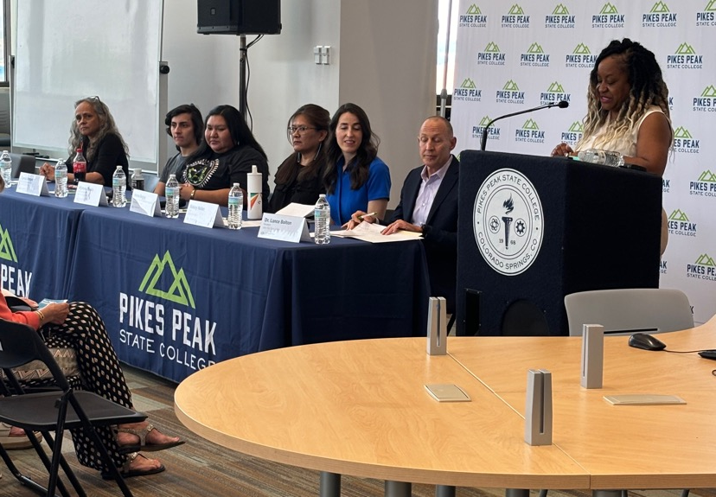

First Nations Promise
We have launched the First Nations grant with $500k from the Dakota Foundation and Daniels Fund to support Native Americans attending Pikes Peak State College.

Slide 26

District 2 Promise
Ballot measure

Slide 27

District 11 Promise
Impact: Enrollment of recent high school graduates from D11 increased by 85% since the announcement of D11 Promise.

Slide 28
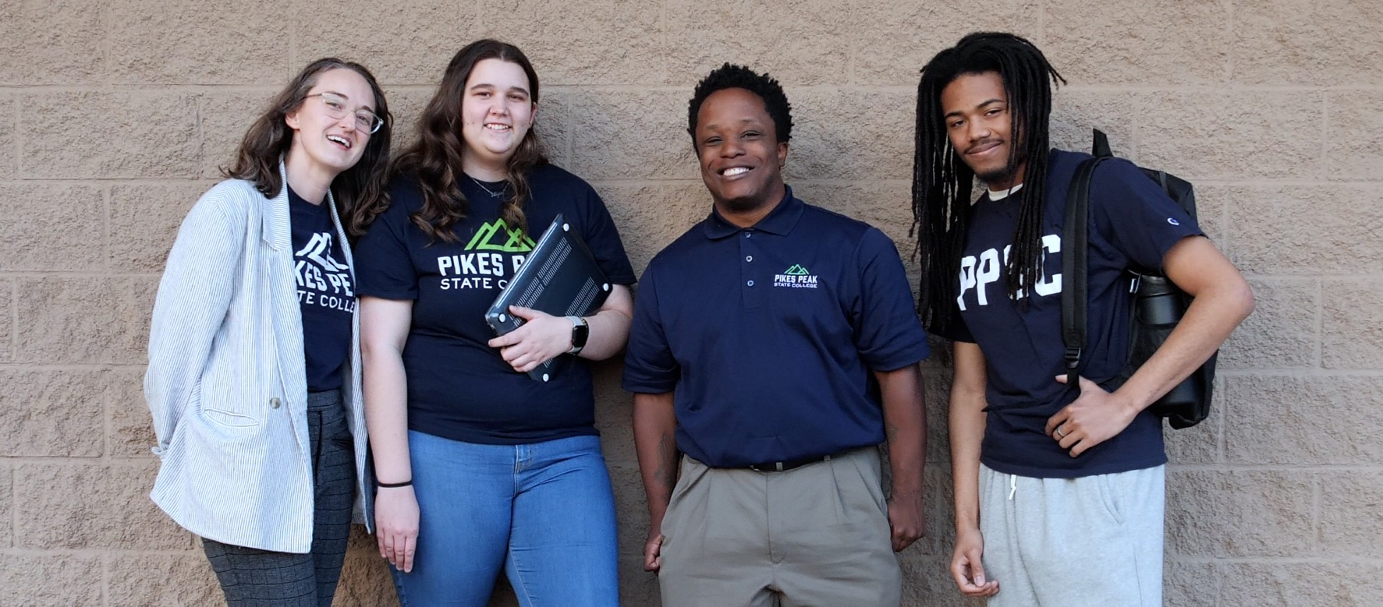
Promise Coaches

Slide 29
Student Services

Slide 30


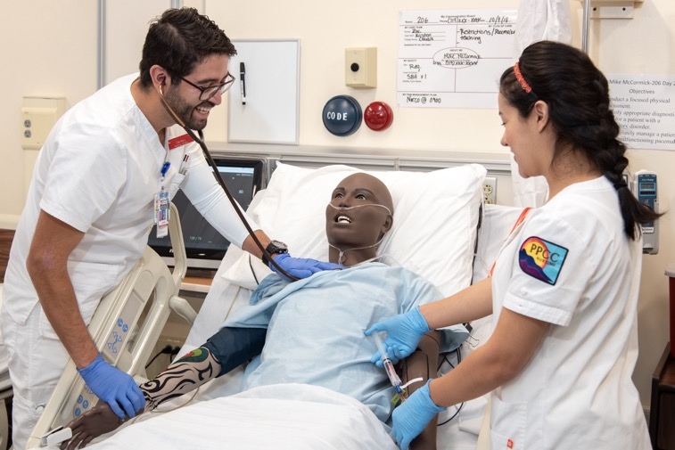
Opportunity Next
$952,500 awarded for AY24/25
So far have awarded 255 students around $1,500 each
About 50% awarded to students in Health Sciences programs
Also supports:
  Construction
  Advanced Manufacturing
  Engineering
  Computer and Information Sciences
  Education
  Family and Social Sciences
Finalizing contract for virtual coaching with Inside Track for these students.

Slide 31


Colorado Promise
New Tax Credit creates opportunity for more affordable college access
House Bill 21-1340 Colorado Promise
$90K Family Income Cap
Last Dollar Scholarship

Slide 32
Student Experience & Equity

Slide 33
Allocation of the Student Assistance Fee
Student Assistant Fee Rev FY24 | $813,000.00
FY Spending Plan
Scholarship Childcare, Basic Needs, Academic Needs | 135,000.00
Community Table and Single Stop | 30,000.00
2 Mental Health Counselors | 185,000.00
Director of Community Table/Single Stop | 90,000.00
3 Support Spec Community Table/Single Stop | 180,000.00
Virtual Counseling | 41,000.00
Student Experience Operations | 150,000.00
Total Planned Expenditures FY25 | $811,000.00

Slide 34


Student Technology Fee
$4.85 per credit for all students
Funds used for:
  Update technology on campus
  Subsidize computer purchases for students
Building up funds in Fall
Beginning purchases in Spring
Process under development

Slide 35
Food Pantry Numbers Served
AY23/24
Since 2019
5,504
10,460
Mobile Food Market Visitors
Mobile Food Market Visitors
33,025
58,790
Community Table Visitors
Community Table Visitors
> 88,000 lbs
> 266,000 lbs
Food Distributed
Food Distributed

Slide 36
Single Stop 23/24 Grant Cycle
July 1, 2023 – June 30, 2024
The Grant only required 200 participants,
but a total of 753 participants were served.
$5,585
Average Benefit per Student
54%
$9,239,347
Increase in Benefit
Assistance compared
to Y22/23
Benefit Assistance Captured
AY22/23 - $5,988,766
AY21/22 - $1,748,499

Slide 37



Student Assistance Scholarships
Given for Basic, Academic, and Childcare needs
149 Scholarships
$67,840 awarded since Spring 2024.

Slide 38
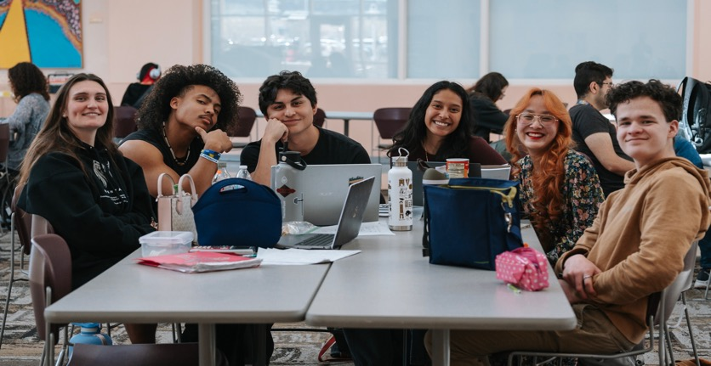
Student Experience & Leadership
Leadership and Mission Update: The Student Experience & Leadership office, now directed by Andrea Hernandez, M.Ed., has been renamed and restructured to focus on fostering an inclusive campus environment centered on diversity, equity, inclusion, belonging, and leadership.
New Programs and Engagement Opportunities: This fall, the office is launching new programs like “Ask an Aardvark” and Welcome Weeks, along with collaborative initiatives such as Coffee with Cops to enhance student engagement and campus connections.
Enhanced Student Support and Participation: The office is hiring additional student staff, restructuring roles, and updating the Clubs and Organizations Handbook to better support student leaders and advisors.
Recreation and Wellness Improvements: Under the new leadership of Jason Felts, Recreation and Wellness is enhancing user experiences with upgraded wellness center facilities, improved fitness center practices, and the introduction of intramural sports.
Sustainability Initiatives and Campus Enhancements: The office is strengthening sustainability efforts by launching new programs, developing outdoor spaces, and revitalizing the campus courtyard for a more welcoming environment.

Slide 39


Counseling Center
Expansion of Mental Health Services:
Hired Edith Cooper, a bilingual mental health counselor, and are in the process of hiring another counselor by September 2024.
Introduced in-person services with 6 sessions per semester per student.
Offering virtual mental health services through BetterMynd.
Services available at CHES one day per week and across all campuses Monday-Friday.
Student Utilization:
Fall 2023: 28 students received 70 sessions with one counselor.
Spring 2024: 47 students received 264 sessions with two counselors.

Slide 40

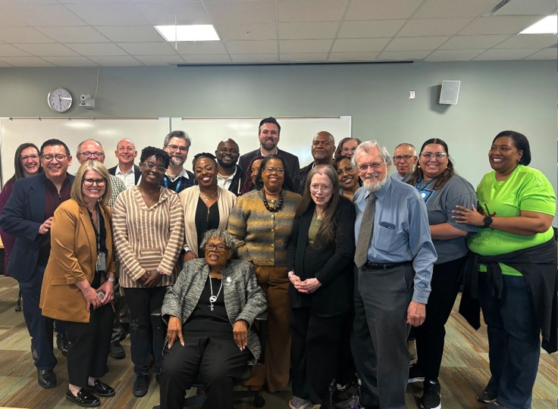
Equity Updates
Processes and Partnerships:
Finalized the Student Travel Process for Fall 2024, transitioning it to SEE.
Partnered with Student Government Association (SGA)
to pass the student technology fee.
Initiated the process to hire an HSI Coordinator and reactivated
the HSI task force.
Bringing back student clubs such as BSU
Submitted an application for the Insight Into Diversity HEED award.
Community Engagement and Events:
Participated in Fiestas Patrias, Juneteenth, and Pikes Peak Pride.
Hosted Dr. Opal Lee, the Grandmother of Juneteenth
Developing Native American Symposium for November
Collaborating with various institutional partners for the
Hispanic Heritage Festival.
BetterMynd added 300 credits for students, with 138 students using
the virtual services in 2023-2024.

Slide 41
Strategic Plan

Slide 42

CCCS Strategic Plan
Guiding Principles
Economic Mobility
Education for All
Partner of Choice
Power of 13
Empowered Talent

Slide 43
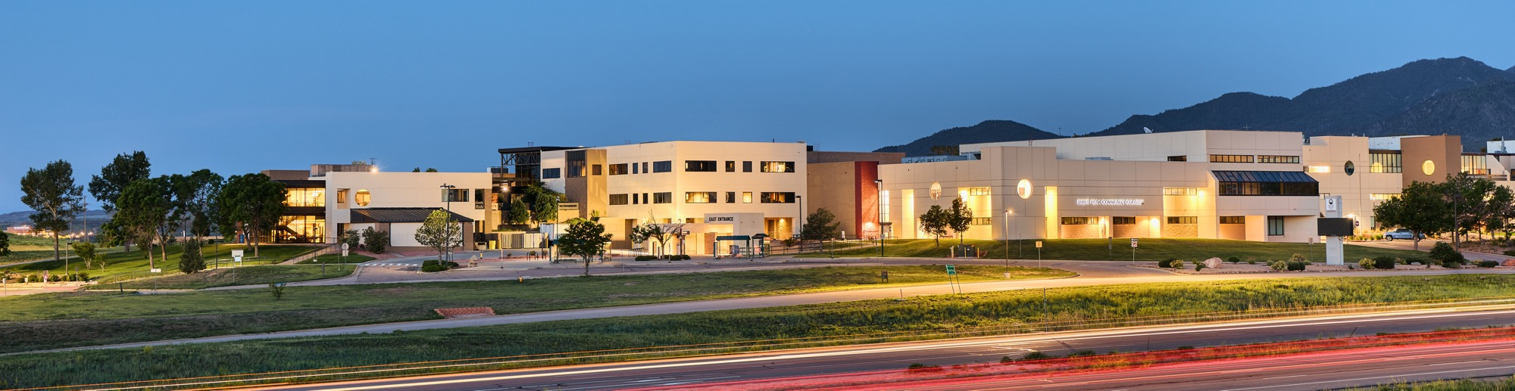
Focus Goals AY23/24
Strategic Scheduling
Employee Tuition Plan
Adult Learners
Employee Engagement and Campus Culture

Slide 44
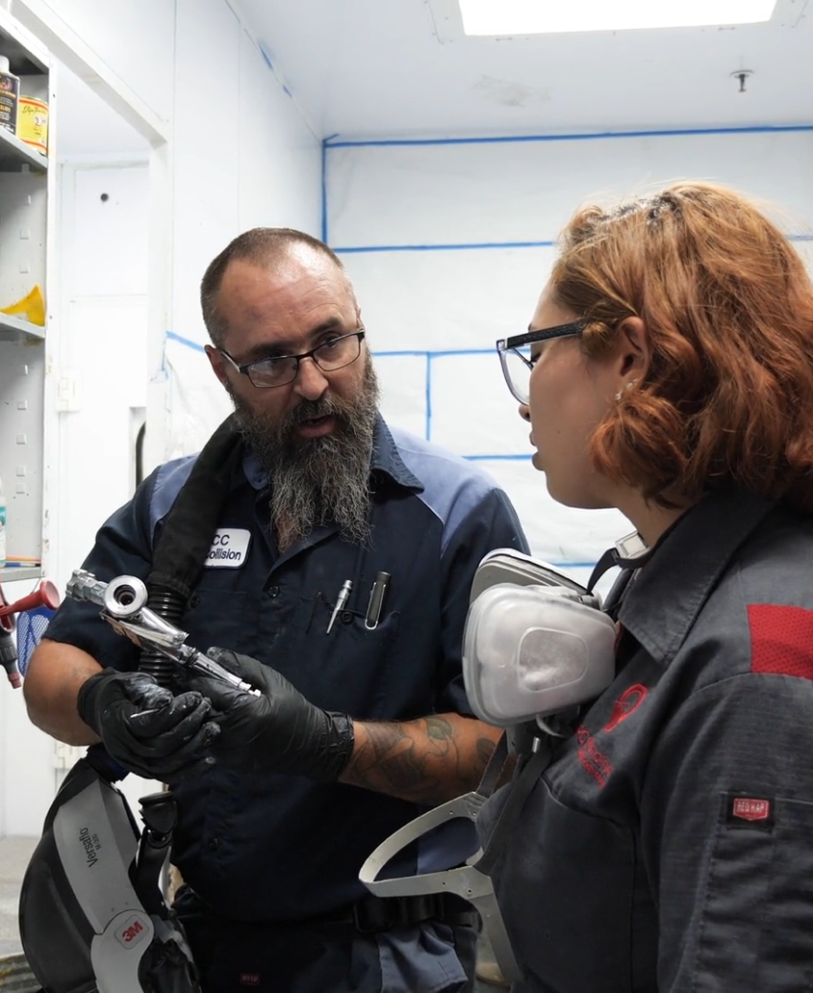
Strategic Scheduling
Starting in fall 2025, the Centennial Campus scheduling grid will be changed so the first block of classes will start at 7:30am. This change will increase classroom usage
and allow CE students to take more than one class per
day on campus.
For the upcoming academic year, the group is working
on scheduling related programs into neighboring spaces on each campus, creating general education scheduling blocks for CTE courses at Centennial, and taking a deeper look at evening offerings. To facilitate these changes,
and to develop a more efficient schedule, the group is also investigating the Ad Astra Integrated Academic Planning Module.

Slide 45

Employee Tuition Plan
This goal is complete.
The new Tuition Assistance program
for employees does not rely on a reimbursement model, alleviate the out-of-pocket burden for employees taking classes at PPSC.

Slide 46

Adult Learners
PPSC ran six sections of accelerated, hybrid, gen ed classes in ENG, COM, and PSY. Rather than lasting
the full semester, these classes took place during
a 7-week bimester.
  69% of adult learners passed the accelerated classes.
The same accelerated, hybrid ENG and COM classes will be offered in the fall, and the Adult Learner Task Force will also conduct a professional development event in the fall for faculty interested in teaching in this format.

Slide 47
Employee Engagement & Campus Culture
The Employee Engagement and Campus Culture Focus Goal Group has convened monthly to analyze the 2022 climate survey data, gather departmental insights, and engage in comprehensive discussions. These efforts have led to the formulation of strategic recommendations aimed at enhancing employee engagement and fostering
a vibrant campus culture.
The group focuses on cultivating relationship trust among PPSC employees and organizational trust between employees and the institution, and has developed four objectives for 24-25:
  Developing Supervisors
  Building Community
  Leading Change and Communication
  Normalizing Diversity, Equity, Inclusion, and Belonging (DEIB)

Slide 48
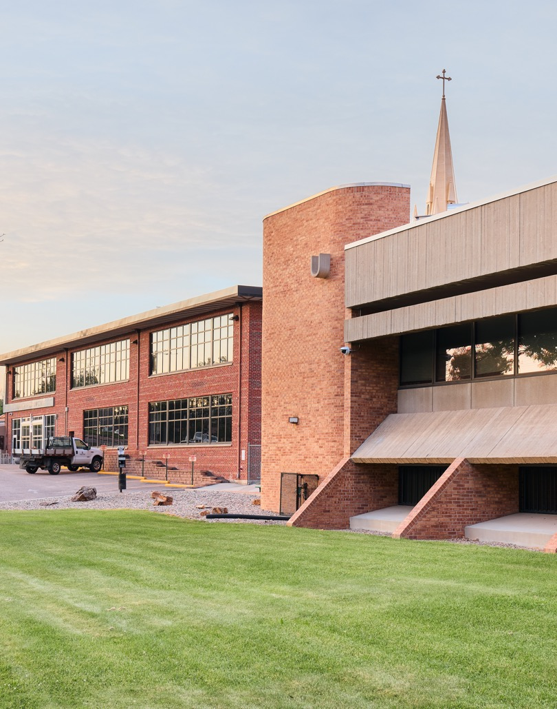
New Focus Goals AY24/25
Downtown Revitalization
  A steering committee of faculty and staff began work in May 2024 to move forward with the Downtown Campus Revitalization project.
Becoming an HSI
  Dr. Enrique Romo, Vice President of Student Experience and Equity, is co-leading a group focused on not only meeting the eligibility requirements for HSI designation, but also on building the infrastructure to best support the success of Latine students.

Slide 49
Downtown Campus Revitalization – Historic Enrollment

Slide 50

Parking, Awareness, Safety & Security - Prerequisite
Summer Accomplishments
Added external lighting to entrance of Studio West
Staffed and stationed a full-time police officer at DTC
Staff security guard in evening shift
Developed new digital scan badges for DTC students (pilot program)
Scheduled a Safety/Risk assessment for area around DTC
Spec’d and ordered DTC signage and wayfinding
Strengthened partnership with Antlers Parking Garage leading to parking garage improvements (new PPSC signage, brighter, cleaner, security guard support &
higher level parking in evenings)
Updated hardware on downtown access doors to accommodate new key card process.
Joined two downtown partnership boards focused on safety and security
Upcoming Work
Resource document for staff – new key card process
Installation of fencing downtown and in partnership with PPLD
Install building & environmental signage
Contract with Security Officer Firm
Pave parking lot behind Studio West
Landscape the Kiowa side of DTC
Continue to research streamlined parking process for students

Slide 51
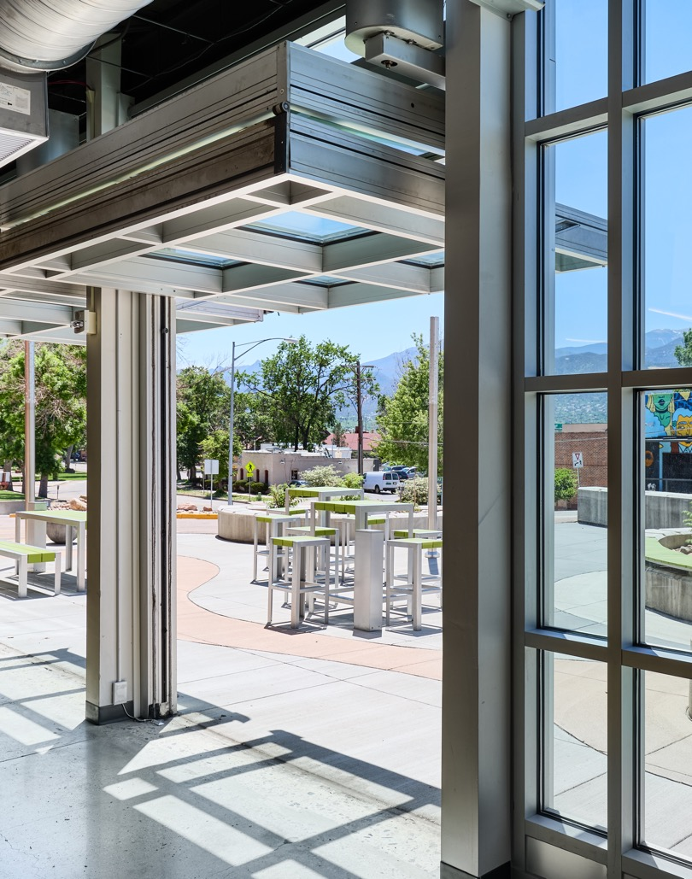
Focus Areas for Downtown
Campus Revitalization
Futures Academy
Non-credit & Short-term Planning
Engagement & Events
Student Support Services

Slide 52
Becoming an HSI
Strategic Commitment and Resource Allocation: PPSC's dedication to becoming an HSI through strategic initiatives and substantial resource allocation strengthens the entire college community by fostering diversity and inclusivity, preparing us to serve an increasingly diverse population.
Responding to Changing Demographics: With Colorado Springs poised to be over 25% Hispanic within the next five years, PPSC is proactively adapting to serve the evolving needs of our community, ensuring readiness to support a diverse student body.
Inclusive and Engaging Campus and Community Environment: By fostering an inclusive campus and community environment with bilingual support and culturally-responsive practices, PPSC enhances the learning experience for all students and promotes a welcoming atmosphere, benefiting the entire college.
Enhanced Opportunities and Support for All Students: Achieving HSI status allows PPSC to expand support services and resources, fostering an environment that improves overall student success and retention rates, benefiting the entire college community.
Educational and Professional Development Initiatives: PPSC's focus on educational initiatives and professional development enriches the teaching practices and cultural competency of the entire faculty, benefiting all students and ensuring a high-quality educational experience for everyone.

Slide 53
HLC Quality Initiative: HSI
Goal: Prepare the College to become a Hispanic Serving Institution (HSI), with special emphasis on creating more inclusive and engaging campus and learning environments for a growing Hispanic-identifying student body .
HLC Feedback Report (Jan. 2002 – May 2024)
PPSC has demonstrated a profound commitment to becoming a Hispanic-Serving Institution through strategic initiatives, substantial resource allocation, and comprehensive engagement across the college community.
PCSC’s efforts reflect a deep dedication to fostering an inclusive environment that supports the academic and personal success of Hispanic/Latine students.
As PPSC continues to build on this progress, it is well-positioned to achieve and maintain its
HSI designation, further enhancing its mission to provide equitable and accessible education
for all students.

Slide 54
Key Initiatives
Promise Programs (D2, D11)
Open Scholarship (La Beca Abierta)
Bilingual Support class
Professional development (Dr. Gina Garcia)
Culturally-responsive teaching practices
Hispanic Heritage month events
(Fiestas Patrias, PTK)
Bilingual (English/Spanish) family summits
(Noches con Pikes Peak)
Partnership with Peak Education
(Concurrent Enrollment Navigator)
Microsite in Spanish
Latino Alliance
  Cultural events
  Partnerships with Hispanic Chamber of Commerce and Colorado Alliance of
  Latino Mentors and Authors
Inclusive hiring model
Disaggregated student outcome data
Multi-cultural space at Centennial
(mural project)
Bilingual signage and wayfinding plans

Slide 55
Foundation

Slide 56
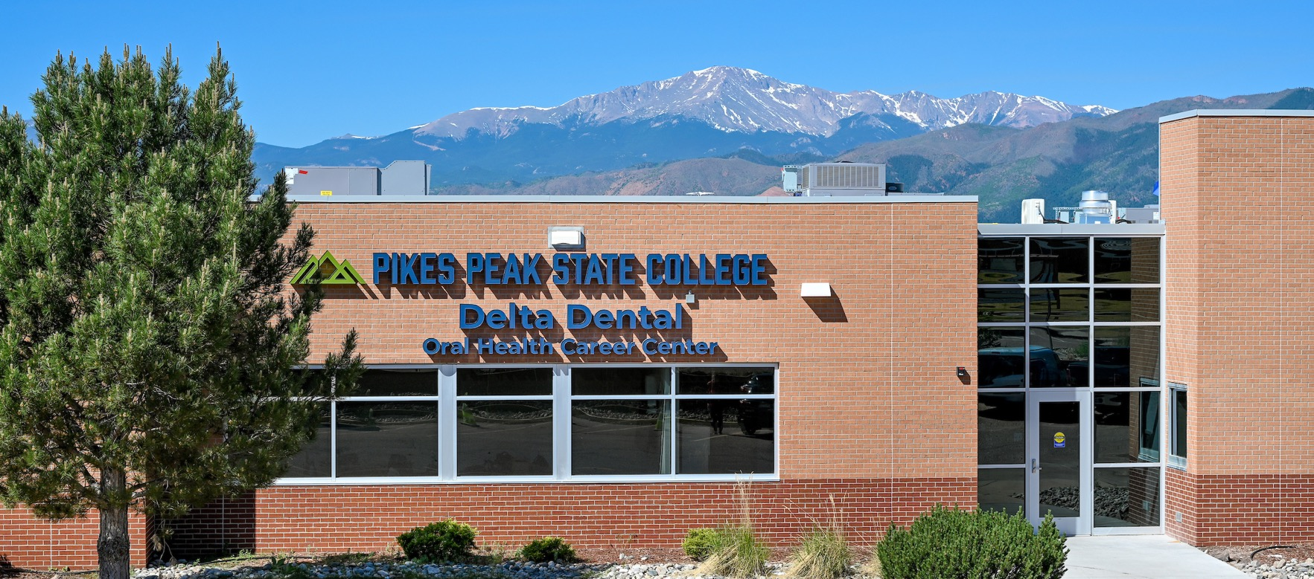
Delta Dental Center Update

Slide 57
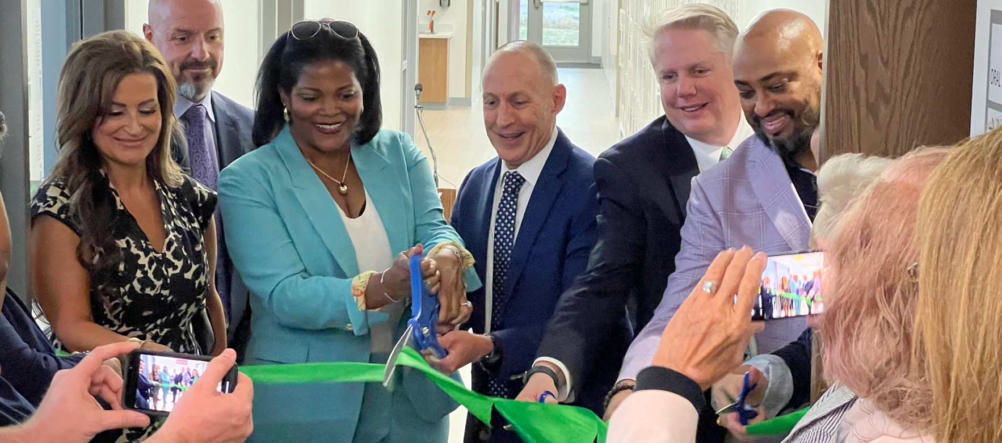
Delta Dental Center Update

Slide 58
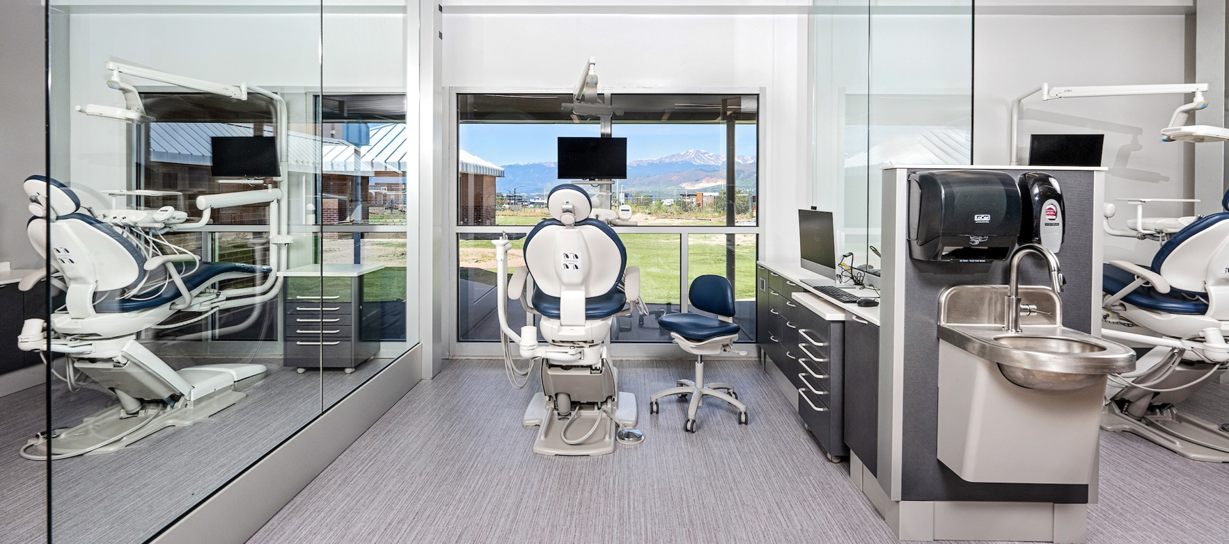
Delta Dental Center Update

Slide 59

Spark Fund
Total amount received: $1,162,500
  $843,750 in FY 23
  $318,750 in FY 24
$250,000 was used to create an endowment.
$193,000 awarded in AY23/24 to over 150 students in CTE Programs.

Slide 60

Partnership with Canvas Credit Union

Slide 61
Wayfinding

Slide 62


Wayfinding
Installation of interior and exterior signage begins this fall
Interior signs will be bilingual and are designed to guide people to major campus destinations
Patching and painting will happen inside to prepare for installation

Slide 63
Big Dates

Slide 64
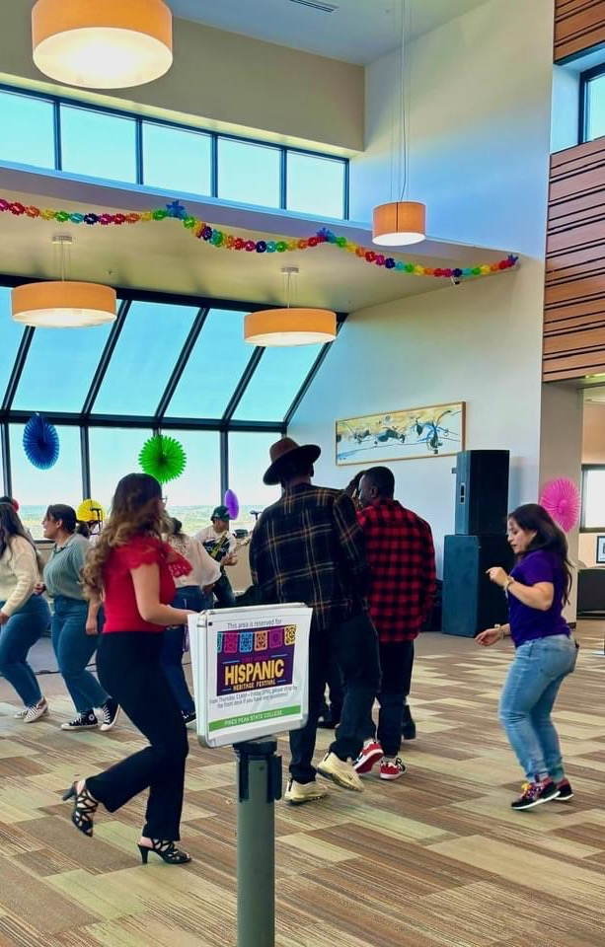

Big Events
Campus Wide
Canvas Community Food Pantry Opening | Late September
Fiestas Patrias | September 14 & 15
Hispanic Heritage Festival | In September
Native American Symposium | In November
Veterans Week | November 11–15
Coming Together
Appreciation Week | November 18–22
4 Town Halls
4 Coffees

Slide 65

Kudos

Slide 66
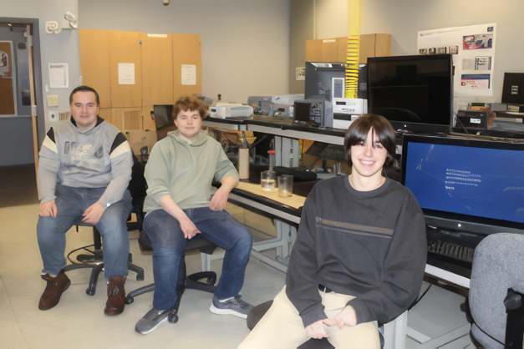
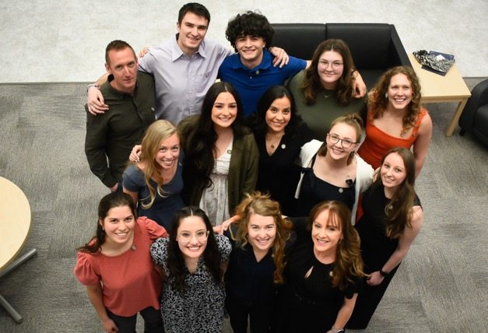
Kudos
Student Blake MacDonald for his work on the Student Spaceflight Experiment Program (SSEP), part of a team who will have an experiment flown to the International Space Station.
Pharmacy Technician had a 100% pass rate on national exams (again)
First Physical Therapist Assistant Program graduation
Nursing Pass Rate
  For our ADN program:
    Fall 23 | 56 students graduated and had an NCLEX pass rate of 96.4%.
    Of this class, all but 2 licensed in Colorado to work.
    Spring 24 | 59 students graduated and 100% passed their NCLEX.
    All licensed in Colorado to work.
      Several nursing students who graduated with their ADN degree in May and pushed forward this summer, completing their BSN degree last week. Quite a few of them are starting new-graduate nursing positions at Children's Hospital this week in the NICU and Emergency Room there
    For our BSN Program we graduated 23 students in Fall 23 and
    19 in Spring of 24.
Blake MacDonald
Physical Therapist Assistant Graduation

Slide 67
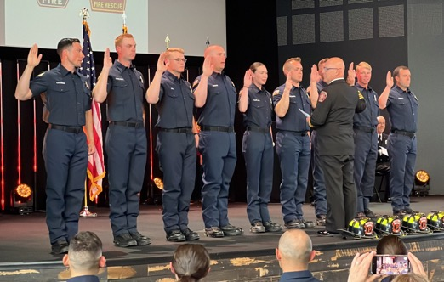


Kudos
Black Forest Fire Graduation May 3, 2024
Culinary graduate Ashely Brown competed on the Food Network’s Chopped on 06/25/25. Ashely currently works at IV by Brother Luck
2023/2024 Multimedia Graphic Design student winners at the American Advertising Federation ADDYs
  Kate Chambers: Student Best in Show, Gold & Silver
  Megan McSwain: Student Judges Award, Gold & Silver
  Rich Herrera: Student Judges Award, Silver
  Cheryl Gauthier: Student Judges Award
TPS hosted the first welding camp for young women (12-15 years old) on June 2nd. 25 girls from the community attended. Only 5% of the welding workforce identifies as being female.
TPS hosted the first automotive workshop for women led by women on August 3rd
Eight PPSC music students and faculty member Shazia Ali for attending a two-week recording arts workshop at Stanford, led by Cory Cullinan, Elizabeth Amaya, and Riley Max.
Black Forest Fire Graduation
Ashley Brown
Weld Like a Girl Camp

Slide 68
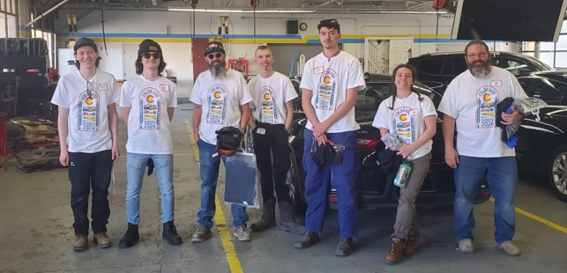
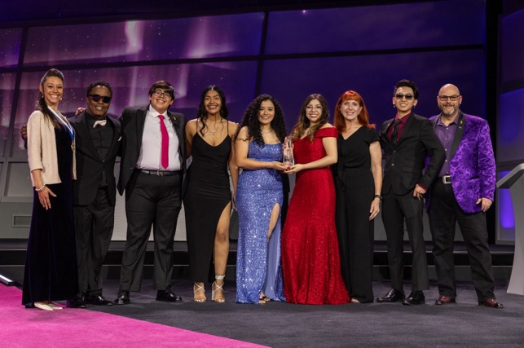
Kudos
SkillsUSA Colorado State Competition winners:
  Liam Stewart: Diesel Tech, Gold
  Ben Blatz: Auto Collision Tech, Silver
  Levi Ellis: Diesel Tech, Bronze
  Eric Stegman: Welding Tech, Bronze
Phi Theta Kappa (PTK) won the Hallmark Award for Distinguished College Project and Distinguished Chapter Award
Because no summer Pell Grant was available due to FAFSA delays, we awarded a little over $70,000 in institutional scholarships to 68 students, including 5 that re-enrolled after dropping their summer classes due to costs.
13th annual Daniels Fund Ethics Initiative Collegiate Program at UCCS Ethics Case Competition: Faculty Advisors: Carol Kurkowski/ Monica Novack
  Micaela Ortiz, Nicholas Jacobs, Bryce Kindall: 2nd Place,
  Pikes Peak State College
SkillsUSA Colorado State Competition Winners
Phi Theta Kappa (PTK)

Slide 69
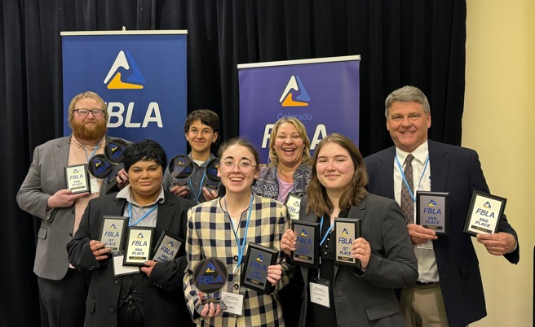
Kudos
Future Business Leaders of America (FBLA)
Faculty Advisors: Clint Schafer/ Carol Kurkowski
  April 20th state competition.
    8 Students took first place; 2 Students took second place; 4 Students took third place; 6 total students were eligible to compete at Nationals
  2024 FBLA National Leadership Conference.
    Elliott Bossetti: Foundations of Computer Science – 3rd Place,
    Pikes Peak State College
    Elliott Bossetti: Foundations of Technology – 6th Place,
    Pikes Peak State College
    Michelle Harris: Foundations of Entrepreneurship – 10th Place,
    Pikes Peak State College
Future Business Leaders of America (FBLA)

Slide 70
Questions?

