Slide 1
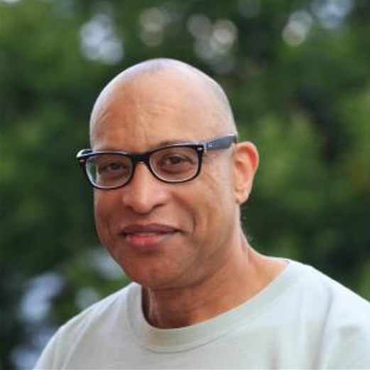
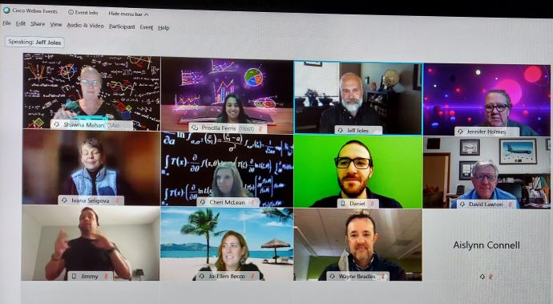
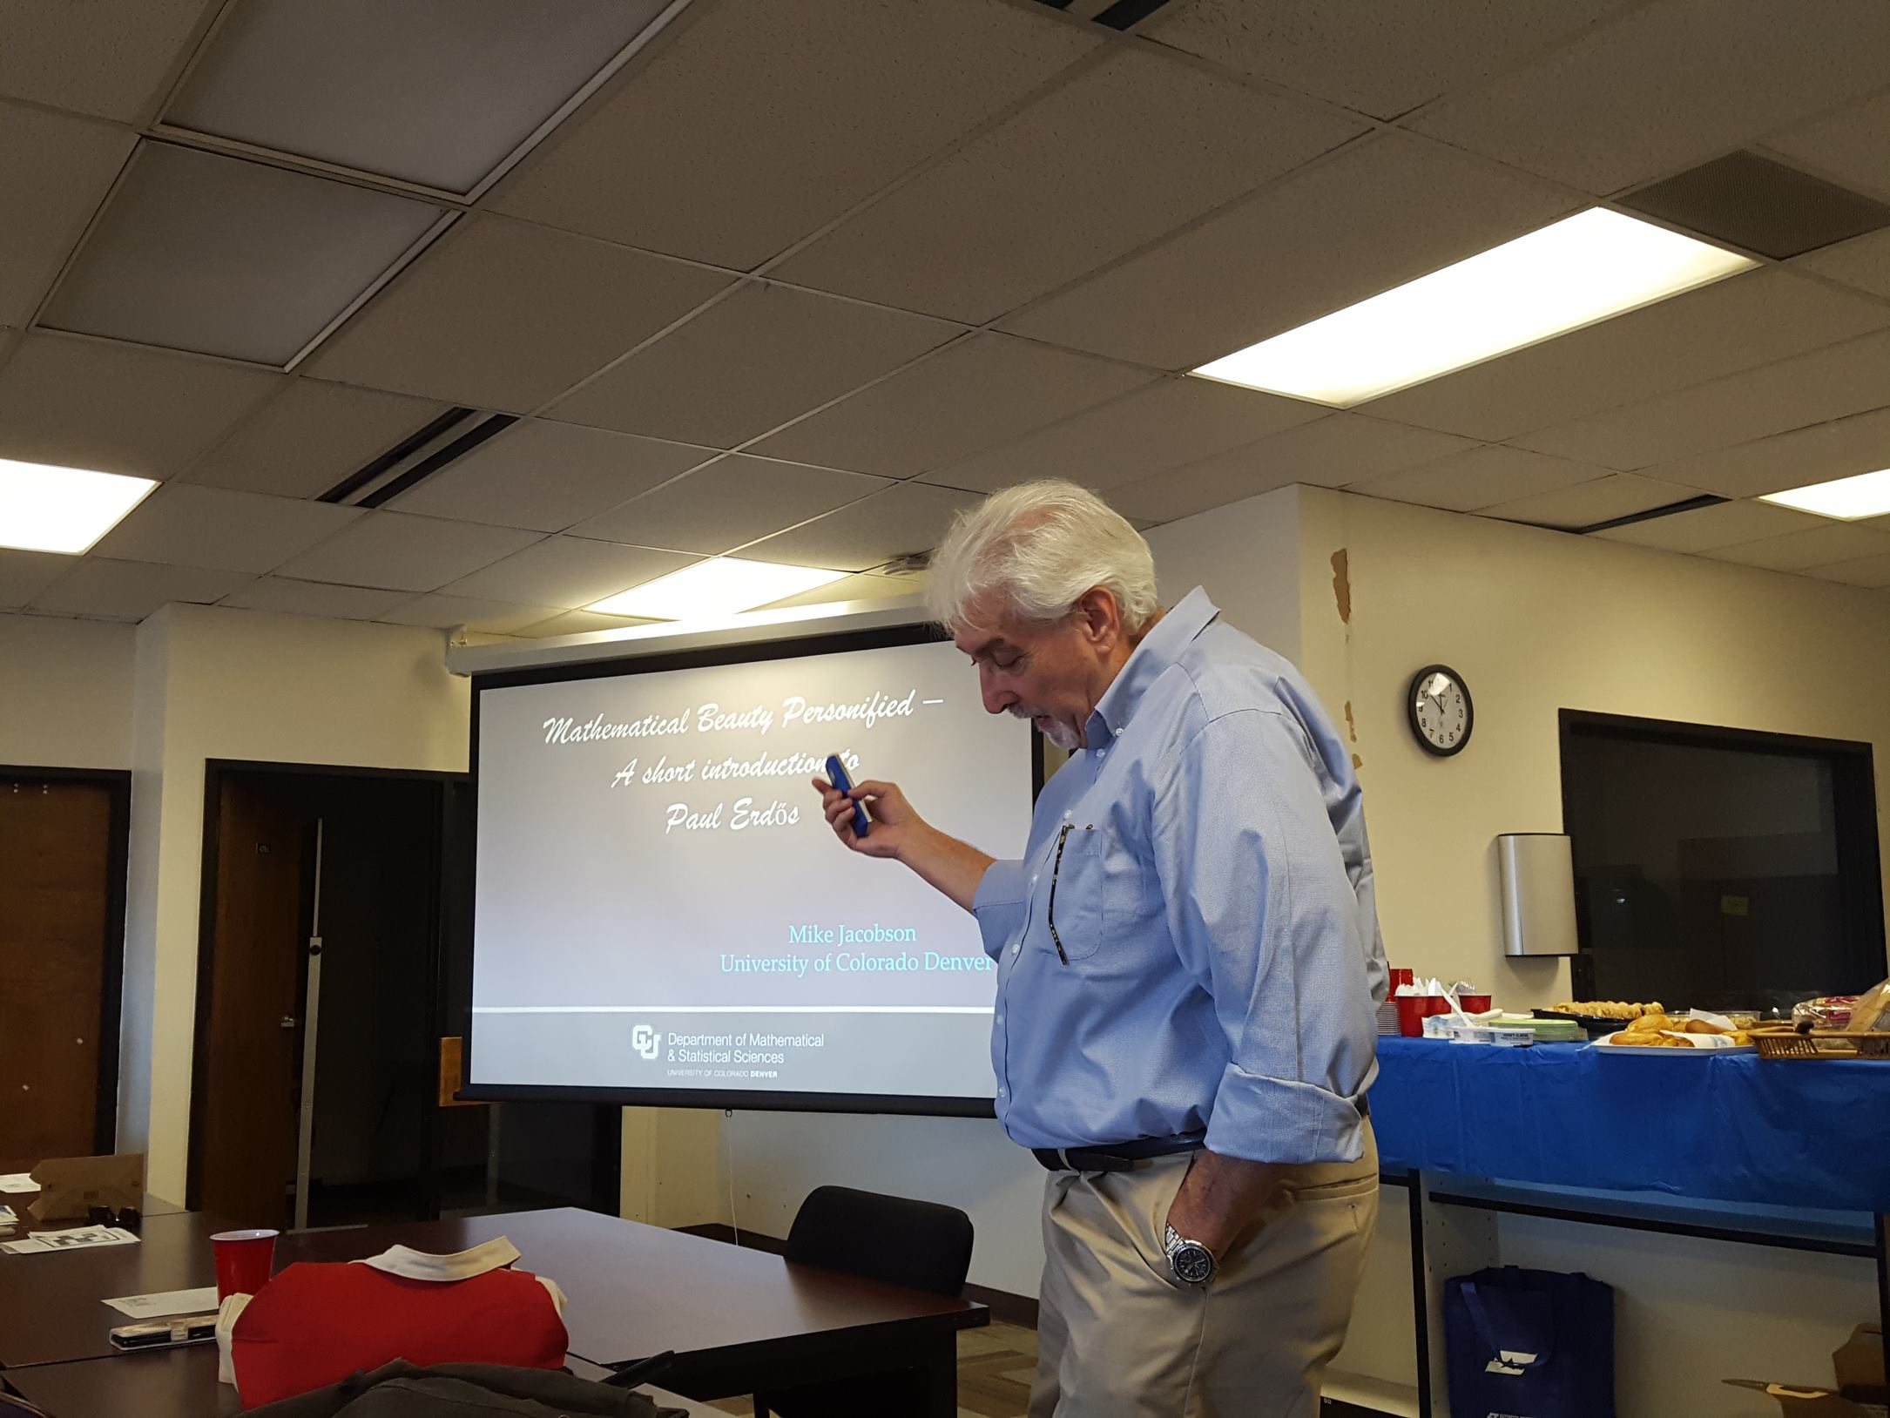
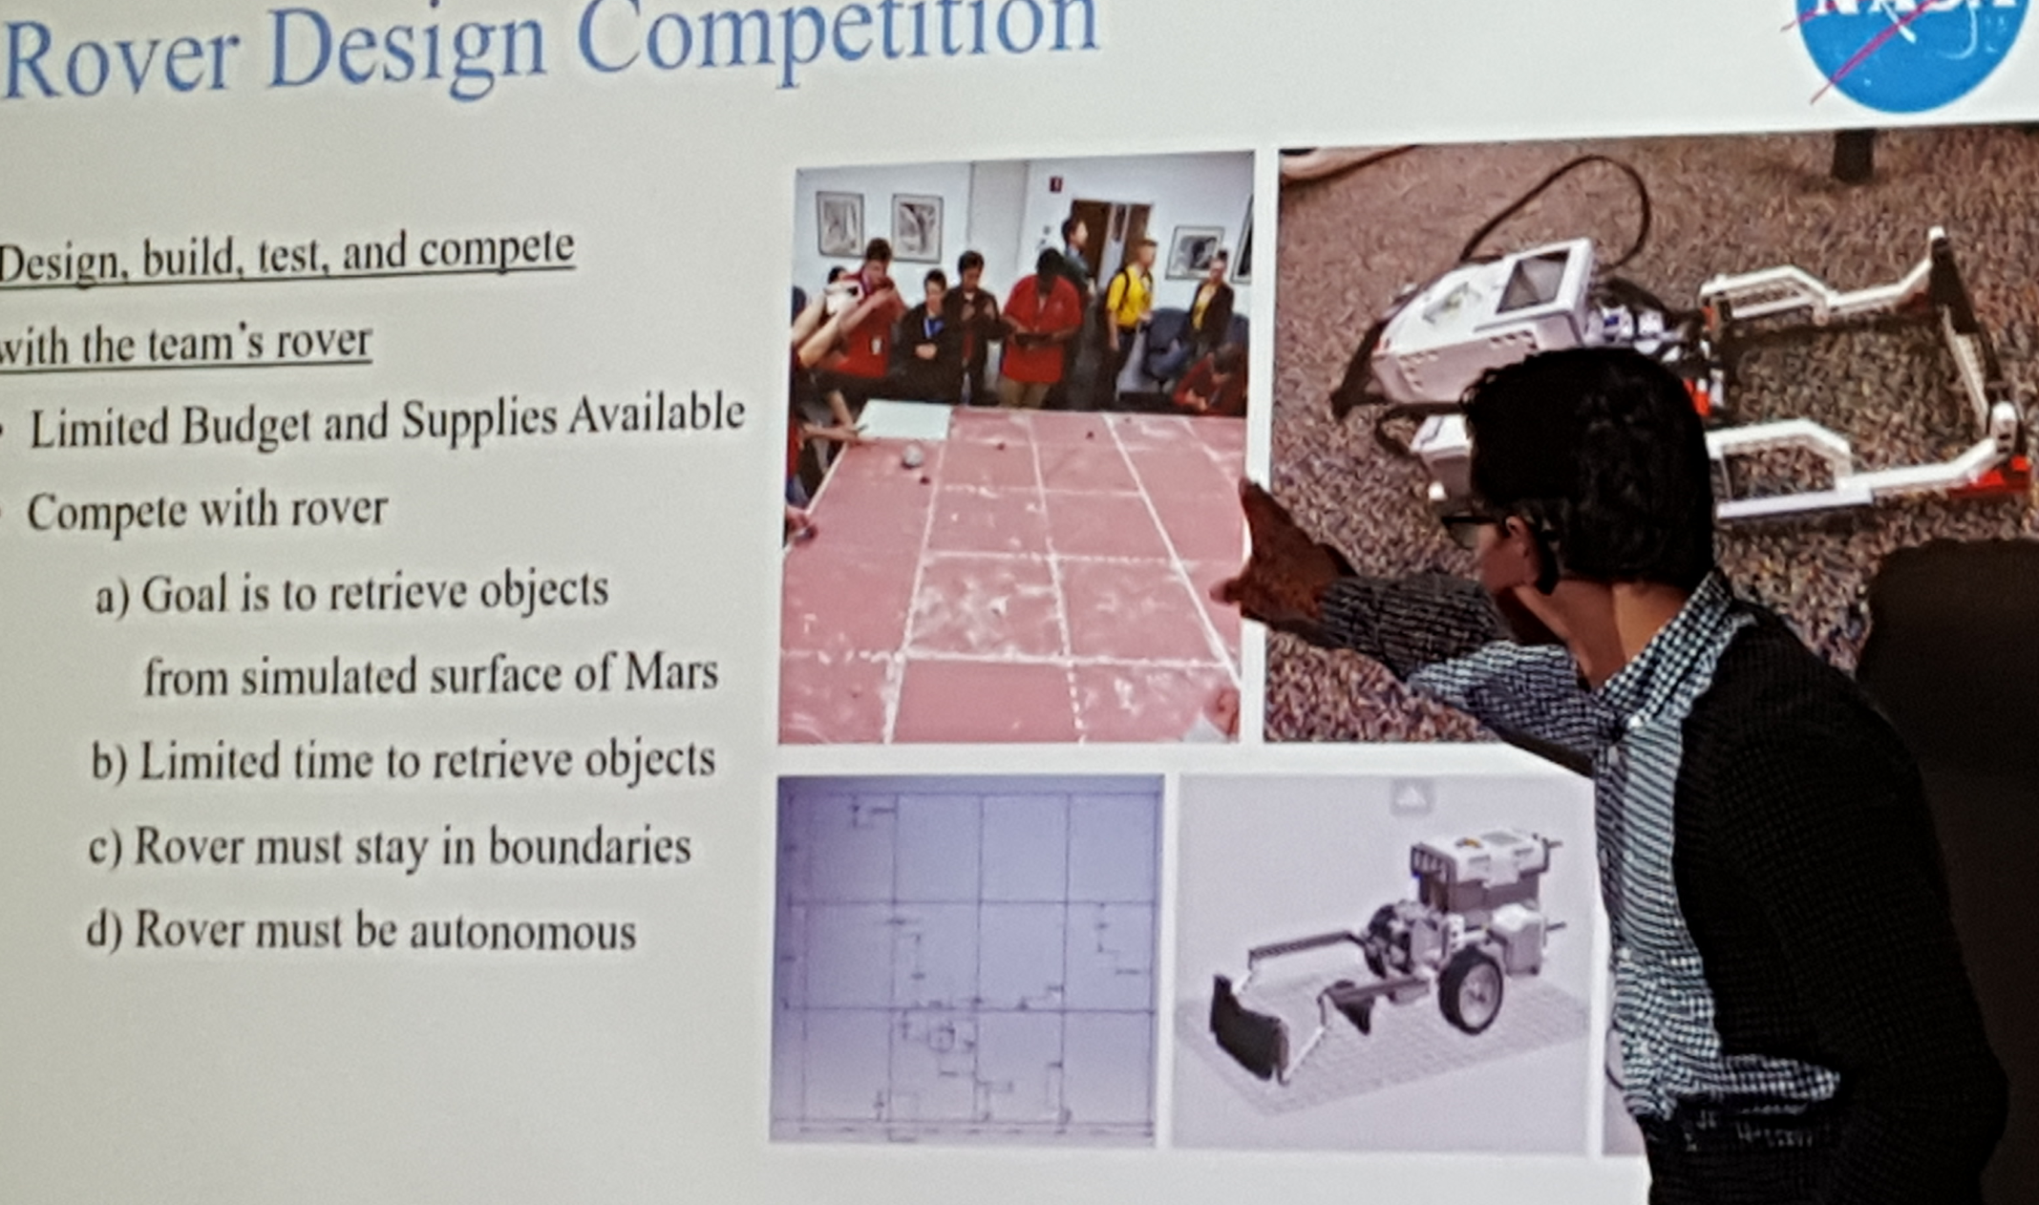
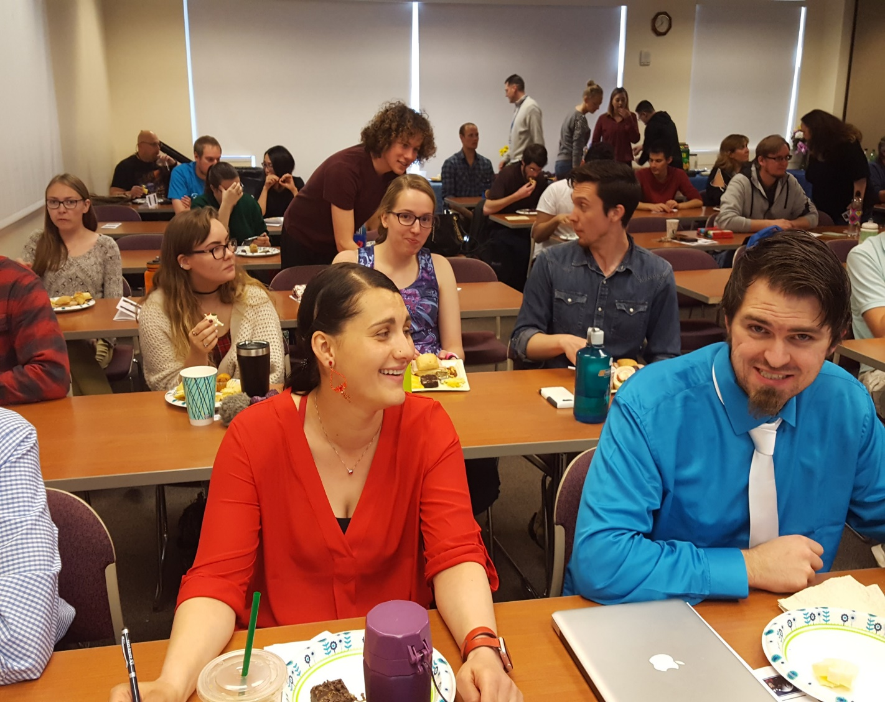
SPRING 2022 MATHEMATICS COLLOQUIUM PRESENTER’S GUIDE
By submitting this poster to HIPs@ppcc.edu , you are giving PPCC the right to share your work publicly.
WHY PRESENT?
Grow professionally Improve your presentation skills Add to your CV Get inspired Learn about new things
Collaborate Have fun Discover beauty of Mathematics Connect with like-minded people Share your passion
Results
WHO can present ?
CELEBRATING OUR STUDENT TALENT
WHAT topics?
R
Any student taking a Mathematics course at PPCC
Prior presenters were students who took courses ranging from MAT 050 to MAT 265
WHEN: Friday, April 15 2022 WHERE: Rampart Campus, room W 101 or WebEx
11:30 am – 3:30 pm
You can present on any math or applied math topics
Prepare a poster using the Expo template and submit it to HIPs@ppcc.edu
Spring 2022 Keynote Address
Dr. Dennis Davenport
Enrichment Programs for Mathematical Science Community College Students
TESTIMONY from a student presenter and instructor
Dennis Davenport received his Ph.D. from Howard University in 1987 and then joined the faculty at Miami University in Oxford, Ohio. At Miami University, he developed the Summer Undergraduate Mathematical Science Research Institute (SUMSRI), an undergraduate research program that targets advanced mathematical science majors from underrepresented groups and women. Davenport was a Regional Director of the MAA Strengthening Underrepresented Minority Mathematics Achievement (SUMMA) program from 1991 to 2000 and directed the Miami University program of the Ohio Science and Engineering Alliance (OSEA). From 2000 - 2002, Davenport served as a program director in the Division of Undergraduate Education (DUE) at the National Science Foundation (NSF). He was the lead program officer for the Presidential Awards for Excellence in Science, Mathematics, and Engineering Mentoring (PAESMEM) in 2010. In 2004 he served as a Visiting Professor at the United States Military Academy (USMA). In 2014, he directed the Summer Program in Research and Learning (SPIRAL) at Howard University. Since 2018 he has directed an REU program for Howard University students which combines summer learning and research.
In the years since he has returned to his alma mater as faculty and held the positions of Graduate Director and Associate Chair, while also serving as the Chair of the American Mathematical Society's (AMS) Policy Committee on Equity, Diversity, and Inclusion.
There are many summer enrichment programs for undergraduate students, such as research experiences for undergraduates (REU) programs, working in government labs, and intern- ships at private industries. A requirement for students who attend a federally funded REU program is that they must return to their institution for at least one more semester of study. The majority of math REUs also require that students have at least one proof-based course, such as abstract algebra, linear algebra, or real analysis. Because of this requirement, most community college students are not eligible for the typical math REU. Having enrichment programs could have a significant impact on students from underrepresented groups including women and first-generation students. In this presentation, we will talk about some current programs and discuss what can be done to increase options for community college students. se options for community college students.
HOW to prepare?
TESTIMONY from previous presenters
“I really enjoyed the Math Colloquium because I think that there is no better way to understand a concept well than teaching others or talking to others about it.”
Select your topic
Engage with your instructor
Do your research
Collect resources
Prepare your Expo Poster
Have your instructor review the poster, make suggested edits
Rehearse in front of your friends
Watch other presenters
See “Giving a Good Presentation” in and previous recordings in LibGuide
https://libguides.ppcc.edu/c.php?g=675604&p=7903739
“As a concurrent enrollment instructor with Harrison School District 2, I viewed the Fall 2019 Math Colloquium as an educational opportunity for the most underserved students in our community. Following the conclusion of the event, I immediately sensed a newfound confidence and bearing in the students. They were so proud of what they had accomplished and spent the remainder of the semester bragging about their experience to their classmates. Many have since chosen to pursue new challenges to further their academic achievement.”
PAST EVENTS
Great collaboration between students and instructors
.
Inspirational Keynote Speakers
Great collaboration between students, faculty, and instructors
Opportunity to grow
Like-minded audience
Dr. Michael Jacobson,
UC at Denver (Fall 2017)
Notes:
Make sure your title matches your abstract. Include your contact information somewhere on the poster. If you use figures make sure all the axes are labeled and easy to read from 6 feet away, and photos are high resolution because this will be printed big. I’ve set the page size to 3’ x 4’ which I think is manageable and I know can print from power point. Your board will let you go bigger if you want to, but much bigger is hard to transport etc. You can completely rearrange this however you like ☺ Also feel free to change the background to whatever suits you. If you use a picture as the background, make sure it doesn’t make it hard to read the text – you may want white/pale text boxes if that is the case. Basically the design is up to you! I find writing the text in word then cutting and pasting helps a bit with typos – typing into a poster this size is hard to read. (You can zoom in though!). One final tip – if you print the poster shrunk to fit the whole page on normal letter head, you should be able to read it. If not, your text is too small!

