Slide 1
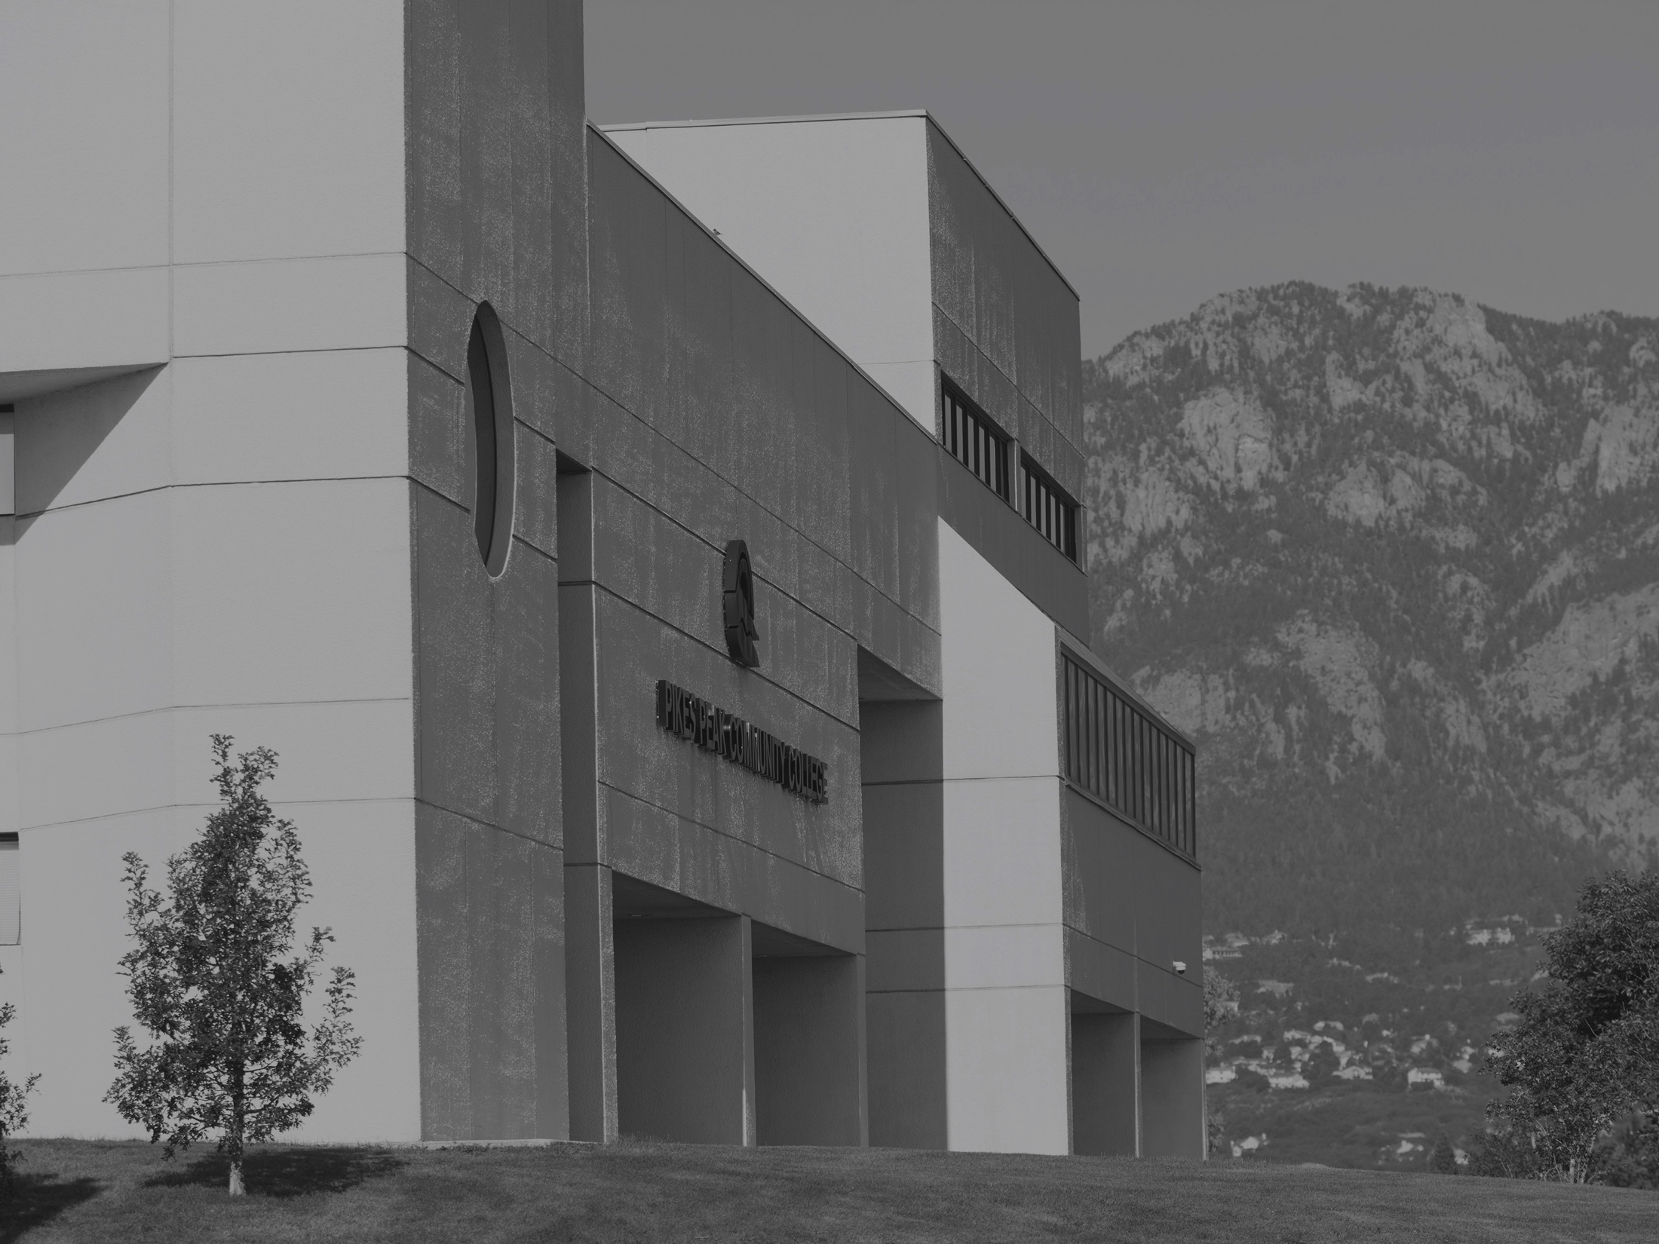

President's Address
PROFESSIONAL DEVELOPMENT WEEK | SPRING 2017

Slide 2
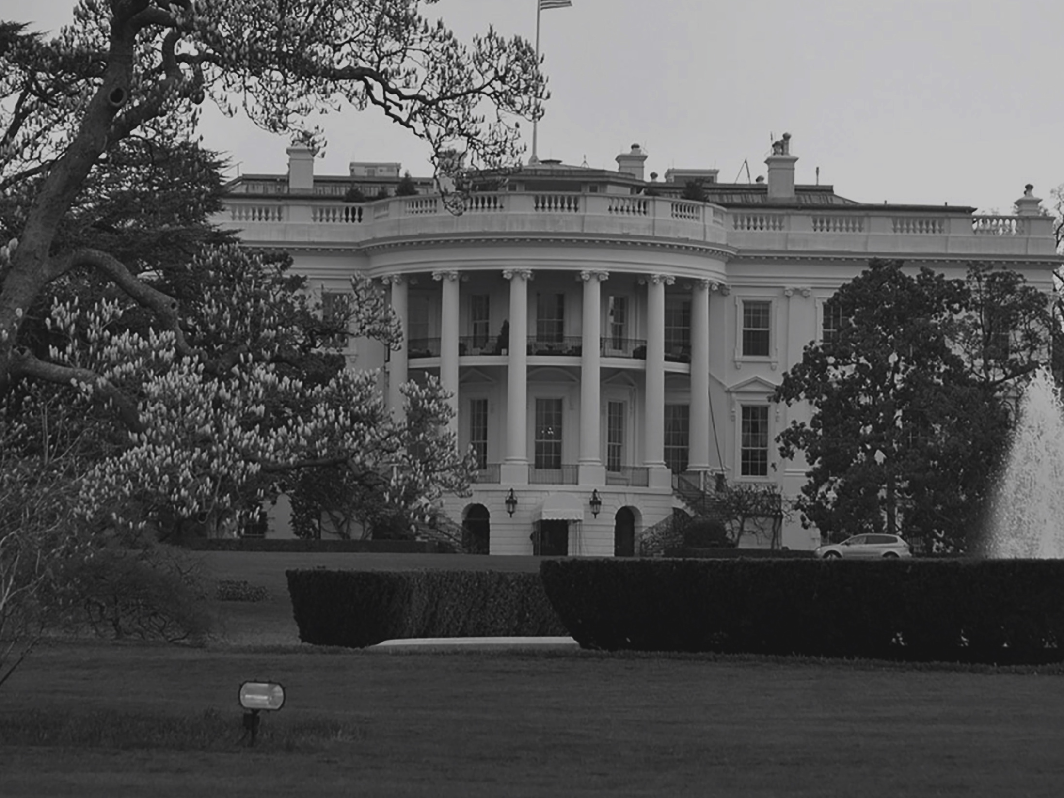
The Big Picture
Notes:
As the national landscapes shifts, with a new incoming president and a new congress, I hear a lot of fear and concern in the educational community. Some schools have declared themselves sanctuary campuses, which suggests (in a totally non-legal way) that they will somehow protect their students from the federal government.
I think that's a little nutty.
But here's the thing. We are a state institution, not a federal one, and we don't expect to see many significant changes at the state level anytime soon.
Certainly, we face some unknowns.
But here's what we do know.
Our commitment to the highest level of education will not waiver. Our commitment to improve our community will not waiver. Our commitment to diversity will not waiver. Our commitment to protecting the rights of every student will not waiver. Our commitment to creating a welcoming, accepting culture can not and will not waiver.
In a few minutes, I'll talk about our new Strategic Plan, and in that plan you'll see an initiative to make Pikes Peak a Hispanic Serving Institution. If you look at the students who are graduating from our high schools today and those who will be graduating in the next five years, embracing this underserved population makes all kinds of sense.
The bottom line is that our future doesn't reside in Washington. It's here. You faculty and staff can make a greater impact in our community and the lives of our students than any politician. Don't let the politics distract us. We control our future, and nobody can take that away from us.
OK, so where are we going?
Over the past three months, we've worked with students, staff and faculty on drafting a new Strategic Plan.

Slide 3
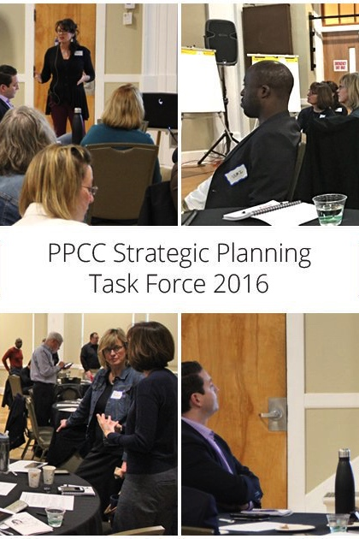
DESTINATION 2022
A road map for the next five years
Our Strategic Planning Task Force, composed of students, faculty, staff and community leaders:
Examined data, including new research
Through an inclusive process, we gathered input, using surveys of the college community and posting updates on the website
Brainstormed goals and tactics
Notes:
Stress what an inclusive process this was. Numbers?

Slide 4
Destination 2022 - Goal 1
1
DEVELOP A MISSION-MINDED CULTURE
Tactic 1: Develop future and existing leaders
Tactic 2: Evaluate and incorporate best practices used by other institutions
Tactic 3: Develop internal communication that keeps stakeholders informed, inspired, and provides a vehicle for feedback
Tactic 4: Establish an innovation incubator where members of the College, the business community, and students will utilize data & metrics to generate ideas and solutions
Notes:
Action Step
Tactic 1.
Drive accountability by rewarding excellent performance, and innovative risk-taking
Conduct leadership training to develop leadership skills & build effective teams
Ask excellent performers to teach their peers
Expose faculty and staff to exciting student experiences to keep them connected to impact PPCC has on students
Empower mid-level leaders to recognize and reward innovative risk-taking among their teams and communicate success stories with rest of institution
Tactic 2.
For example, HR practices of recruiting, minimum job requirements, instructional practices, guided pathways, CTE programming etc.
Tactic 3.
Identify the formats in which PPCC stakeholders will pay attention to information
Share success stories
Tactic 4.
Give members of the innovation incubator real problems to solve (e.g. what are the best ways to communicate with PPCC stakeholders so they attend to the info and feel engaged?)
Provide a mechanism where ideas can be tested

Slide 5
Destination 2022 - Goal 2
2
ASSURE THAT STUDENTS SET AND ACHIEVE THEIR ACADEMIC AND CAREER GOALS
Tactic 1: Identify each student's goals and develop an academic plan
Tactic 2: Review support services to maximize retention
Tactic 3: Ensure excellence in teaching and learning
Tactic 4: Use assessment results to improve teaching learning, and student support services
Notes:
Tactic 1:
Understand a student's goals at the point of enrollment and track and advise accordingly
Every student has an academic plan by end of first semester
Expand student success courses.
For example, college ready students and/or programmatic areas.
Explore meta-majors and Guided Pathways
Each degree seeking student completes his/her math in first year
Tactic 2:
Design a process tailored to identify and address the diverse needs of an entering student (i.e. support tactics would vary by student needs)
Increase engagement through student life programming
Create social connections for students within the college community so that they stay on campus, know people, and be involved
Tactic 3:
Promote high impact learning practices, including, service learning, experiential learning, learning communities, writing-intensive courses, collaborative projects, global studies, internships, and capstones projects.
Use data to drive best practices in developmental education
Invest in professional development to support high-impact learning practices.
Tactic 4.
Promote a culture of assessment leading to continuous improvement in every academic program.
Promote a culture of assessment leading to continuous improvement in student support services including co-curricular experiences.

Slide 6
Destination 2022 - Goal 3
3
DELIBERATELY DRIVE ENROLLMENT TO ENSURE A STRONG FUTURE FOR PPCC
Tactic 1: Streamline admission and enrollment process to increase yield in new students from application to enrollment
Tactic 2: Expand where and how classes are offered to meet students' needs
Tactic 3: Communicate PPCC's academic excellence
Tactic 4: Identify target market segments and develop a segmented marketing and recruitment strategies for each
Tactic 5: Facilities, IT, and infrastructure masterplan will support enrollment growth needs
Notes:
Tactic 1.
Provide clear communication about the path to enrollment
Minimize high-stakes testing for placement
Develop pre-enrollment orientation and advisement appropriate for a variety of student populations
Provide for early financial aid and scholarship award notifications
Connect students to their academic program plan in their first semester (a course or activity in their academic program).
Tactic 2.
Analyze evening, weekend, and online options to ensure students can complete degrees.
Use guided pathways principles to help students navigate the alternative scheduling options
Launch targeted marketing for online, weekend, and evening students
Use AdAstra Analytics, Institutional Effectiveness and other available resources to determine which sections need to be added, considering location, time, and demand
Tactic 3.
Target participation at community-based events that connects us to potential students
Develop universal PPCC messaging and talking points
Showcase student and alumni success stories
Highlight notable faculty and staff and their accomplishments
Tactic 4.
Convert concurrent students to transfer students
Appeal to non-traditional students by increasing offerings and organization of evening, weekend and online programming to meet the diverse needs of students
Increase scholarship funds available for incoming students.
Aggressively market scholarship opportunities to appropriate segments.
Develop recruitment strategies for Latino/Hispanic students and diverse populations that are underrepresented in a particular academic program (Nursing, Cyber Security, STEM, etc.).
Tactic 5.
Update facilities master plan
Develop IT plan to anticipate future needs
Maximize returns on IT infrastructure investments by increasing training

Slide 7
Destination 2022 - Goal 4
4
ANTICIPATE AND RESPOND TO EMERGING WORKFORCE NEEDS AND DEMOGRAPHIC SHIFTS
Tactic 1: Grow the capacity to develop high-demand programming
Tactic 2: Monitor and use data about regional demographic trends (e.g. housing shifts, aging trends, etc.)
Tactic 3: Strengthen and build partnerships with business and industry
Tactic 4: Explore credentialing, competency-based initiatives or other strategies to align student needs with industry standards
Tactic 5: Evaluate and improve our degree portfolio
Notes:
Tactic 1.
During programming development and academic review, use the Workforce Development Division as a resource to understand and analyze workforce demand
Secure adequate resources for high-demand programs
Tactic 2.
Evaluate educational trend data to understand the difference between the needs of highly educated newcomers and those of up-and-coming locals so we can advocate effectively for all learners
Use demographic trend data to determine delivery of services and programs
Identify and promote the diverse educational needs of our service area
Tactic 3.
Develop a systematic plan to educate partners about PPCC and its mission/programming
Incentivize academic departments to use best practices to make student/employer connections
Pilot academic cluster navigators to build a pipeline that starts with potential students and ends with employment
Tactic 4.
Monitor and evaluate current and potential credentialing opportunities in the market place
Effectively communicate student knowledge, skills and abilities to employers
Based on data and employer needs, provide applicable student evaluation and testing
Tactic 5.
Develop a dashboard to conduct an annual academic division review to analyze programs
Work with Workforce Development and industry partners to identify which additional degrees are needed to drive the economy with appropriately trained graduates

Slide 8
Destination 2022 - Goal 5
5
BETTER SERVE A DIVERSE STUDENT POPULATION
Tactic 1: Hire and retain a diverse workforce that represents our community
Tactic 2: Increase the cultural competency of faculty, staff, and students
Tactic 3: Identify ways to improve recruitment, and enrollment, retention, and completion of underrepresented students
This draft will be posted for comment at ppcc.edu/strategic-planning
Notes:
Tactic 1.
Develop recruitment strategies to attract diverse candidate pools
Develop effective candidate selection strategies
Develop effective retention strategies
Evaluate current programming and practices
Tactic 2.
Develop additional initiatives to create a more inclusive or culturally responsive campus environment. For example, increase designated global study sections, develop staff professional development trainings, and increase cultural experience/events on campus.
Orientation of employees and students to build cultural competency
Tactic 3.
Collect and evaluate data that is representative of various student populations
Secure dedicated funding for meaningful scholarships for a diverse student body
Evaluate current programming and practices Identify and pilot new initiatives that promote best practice

Slide 9
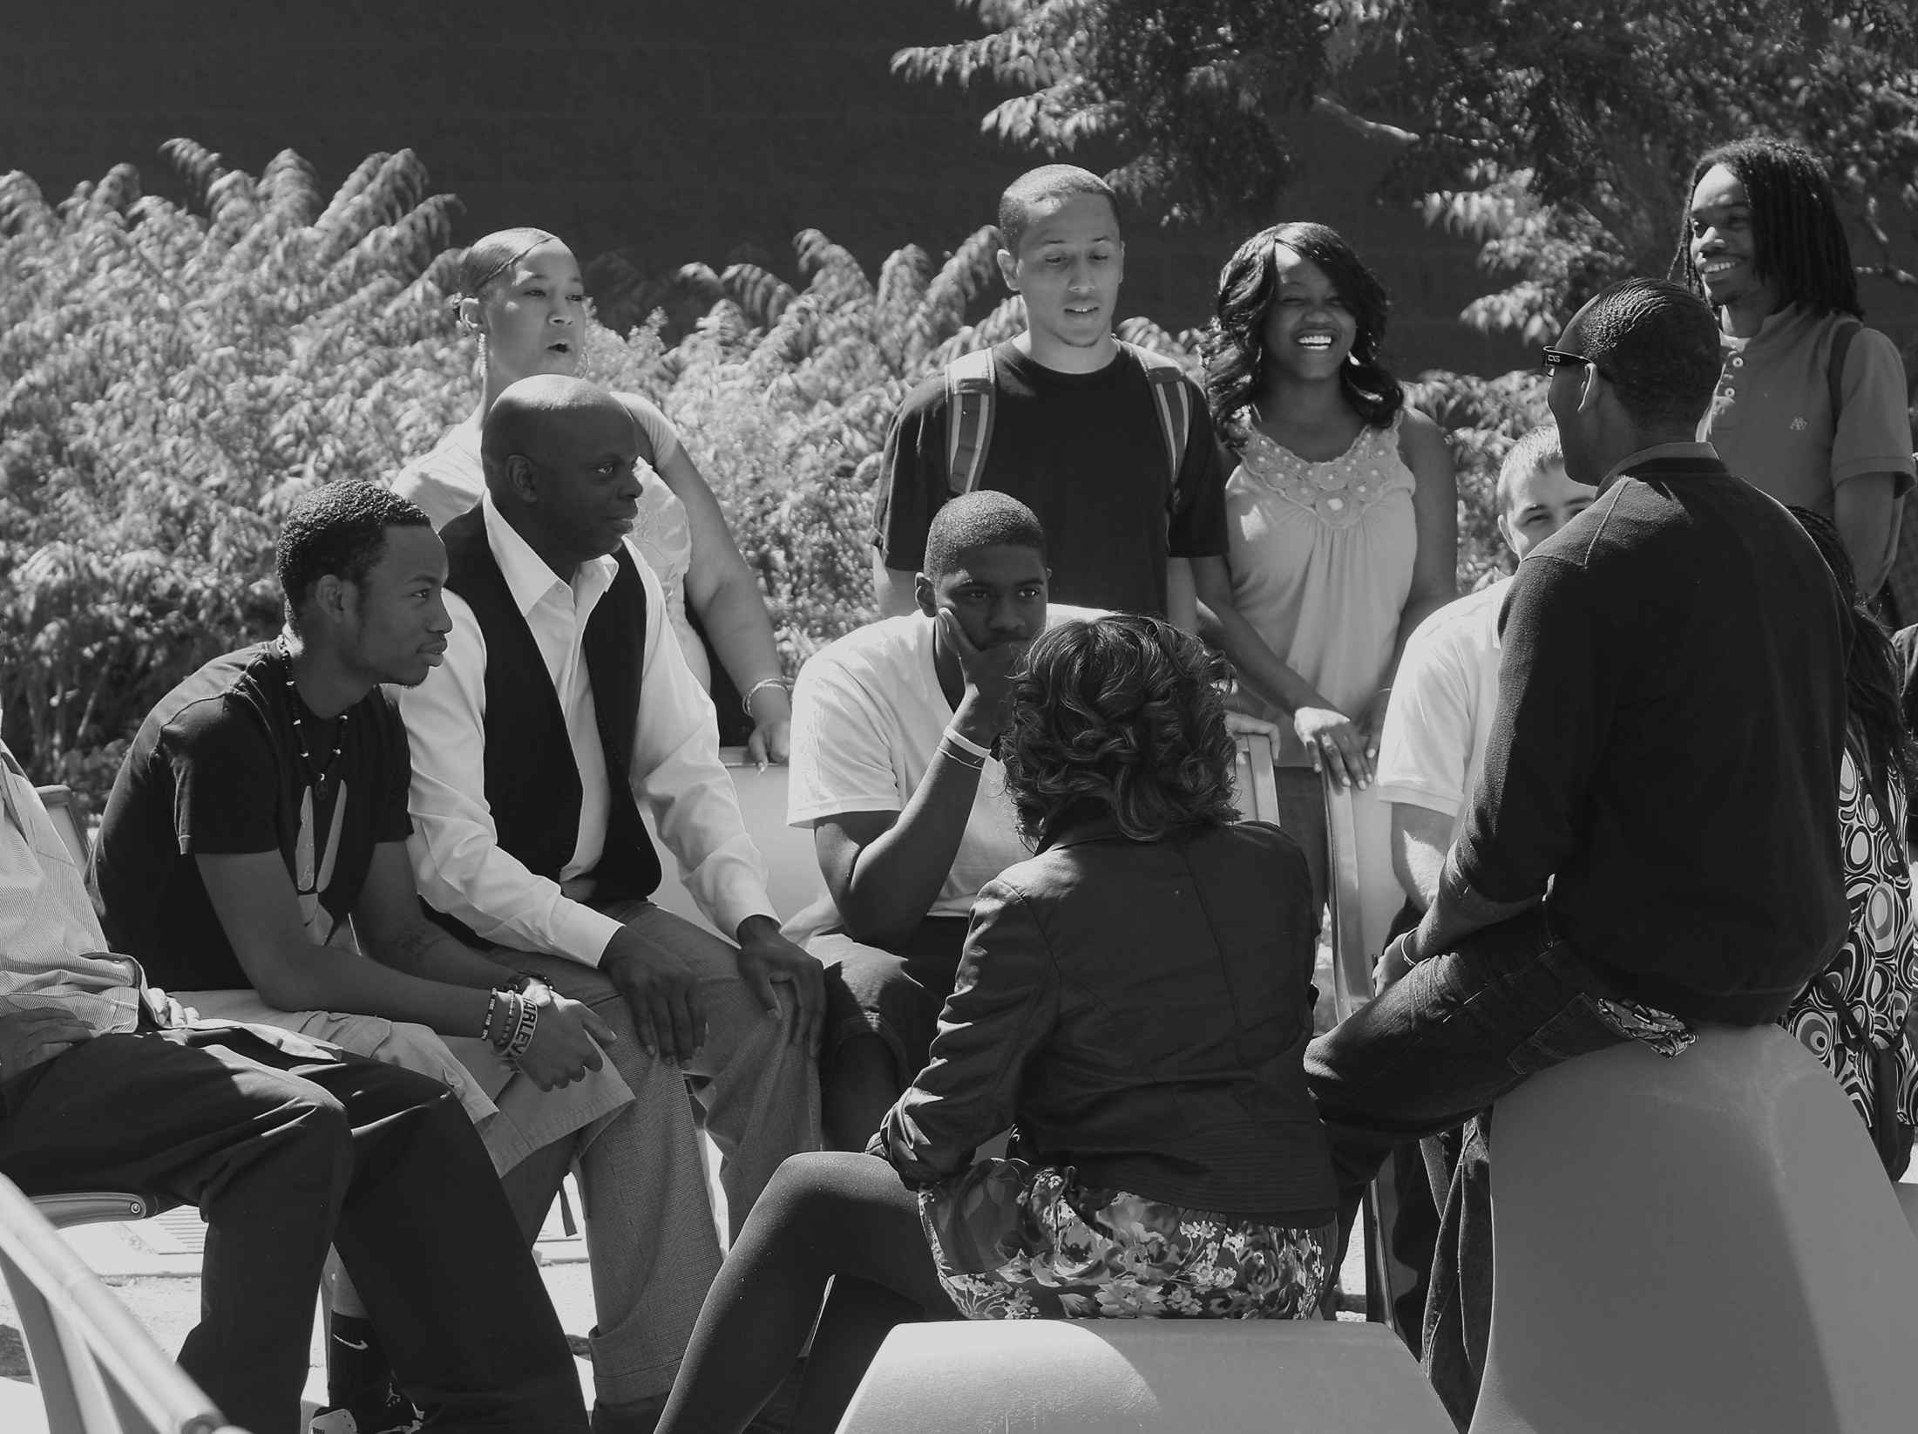
Diversity & Inclusiveness
Notes:
Keith Barnes, our new executive director for diversity, equity and inclusion has been in the process of setting the groundwork and forming strategic diversity teams. If any of you are wishing to join those efforts, please contact him at keith.barnes@ppcc.edu.

Slide 10
Diversity
The teams will include:
Workforce Diversity Commission
Curriculum Development
Cultural Competence Training Consortium
Campus Programs, Events and Observances
Student Recruitment
Student Retention
Multicultural Student Affairs/Organizations
Community Relations
Diverse/Cultural Affinity Groups

Slide 11
Global Studies
Provide and promote opportunities to experience and honor local and global cultures
  Anyone with a global background or outlook is welcome
  Association of students, staff, faculty and community members
  Two events a year
  Weekly round table
Study Abroad
  Costa Rica in May 2017–9 days
  PPCC credit-bearing courses—Late Start Spring 17
  Courses Offered: Business, Communication, English, History, Outdoor Leadership, Photography, Political Science and Spanish
Notes:
As I mentioned in the Strategic Plan, we're already working on an integration of diversity and global study efforts. Here's a look at how faculty can get more involved with that.
By the way, speaking of Global Studies, students can still sign up for Study Abroad through February 7th. Students and faculty will travel to Costa Rica in May 2017. To teach abroad in 2018, submit a faculty Letter of Intent by April 30th. For more information: ppcc.edu/global.

Slide 12

Key Accomplishments

Slide 13
PPCC Foundation
A record $1 million NEW funds raised for Scholarship Campaign in 2016
All new or increased contributions
150 donors
44 donors from faculty, staff and student body
Amounts awarded for FYE16 vs. FYE17 for CTE scholarships.
2016 = $199,066
2017 = $774,482

Slide 14
Scholarship Campaign
Significant Donors
$493,000 Colorado Opportunity Scholarship Initiative
$160,000 GE Johnson Construction Community Foundation *
$75,000 The Anschutz Foundation *
$75,000 El Pomar Foundation
$60,000 Executive Women International *
$16,600 The Richard Petritz Foundation *
$10,000 Pikes Peak Scholarship Club *
* first time donors
Notes:
COSI was the big headline, but not the only one
COSI opened the opportunity but the foundation board and team ran with it
A driver of the effort is to increase scholarship awards to meaningful levels
Important to note that scholarship award strategies are linked to retention and graduation in Student Services
Just broke the records for number of scholarship applications in November
First-ever significant scholarships for CTE students
$1,000 per semester minimum, full-time students
Majority of awards are for $1,250 per semester, full-time students
Most new scholarship awards will renew for up to 4 semesters

Slide 15
EAB (Education Advisory
Board) Navigate
System-wide initiative to assist new entering students with the enrollment process and career planning.
Phase 1: A system to guide careers and choose classes, starts in January
Phase 2: Provides an improved registration and scheduling platform for all students, scheduled for implementation in spring of 2017.
Notes:
As many of you know, the reason the system is moving toward this new career navigational tool is because students need more guidance. They want specific career paths spelling out for them, even to the point of recommended electives for a specific major.
I know not everybody loves this idea. But consider the student faced with nearly 100 art choices. It's overwhelming.
I'm sure many of you know of Barry Schwartz's book The Paradox of Choice - Why More Is Less. Research shows us that by narrowing the choices, possibly through meta-electives, which still leave students with plenty of options, can reduce stress and keep students on more successful paths.
We will soon bring in some EAB representatives from the system office to talk more about this.

Slide 16
PPCC is becoming a leader in cybersecurity
The demand for cybersecurity jobs has grown 90% in the past five years.. In Colorado Springs, about 100 open positions await qualified workers.
Being more nimble than many higher education institutions, PPCC is uniquely positioned to become a major training facility for this growing field.
In 2016, PPCC:
Created a partnership with SecureSet to create fast track to cyber certification
Added to the basic cybersecurity certificates that are part of an IT degree:
  Network+
  Security+
Also, to develop interest in the field, we're now offering regular Cyber Capture the Flag Computer Security Exercises.
Notes:
You’ve probably read about Colorado Springs becoming a center for cybersecurity. This is huge. But we can’t get there without trained workers, and, as the governor pointed out during a talk a few months ago, nobody is in a better position to step up and meet that demand than we are.

Slide 17
A NICE grant helps us expand efforts
National Initiative for Cybersecurity Education (NICE) grant for $199,681
Expands efforts and creates new partnerships with:
Local cyber companies, including rootB and Boecore
Area high schools to start programs at Colorado Springs School District 11, Widefield School District 3 and Fountain-Fort Carson School District 8.
Notes:
$200k goes a long way to propel our cyber efforts forward, and you should know that this grant went to one provider per region of the country. And if you look at the other awardees, you’ll find a lot of technical institutes but not community colleges. It speaks to the amazing efforts of Debbie Sagen and her team.

Slide 18

A new construction program
THANKS TO THE GIFT FROM THE GE JOHNSON CONSTRUCTION COMMUNITY FOUNDATION
Notes:
This couldn’t be possible without the generous gift from the GE Johnson Construction Foundation. We’re currently working on a lease on a warehouse to increase our capacity, making room for the new Construction Program.

Slide 19



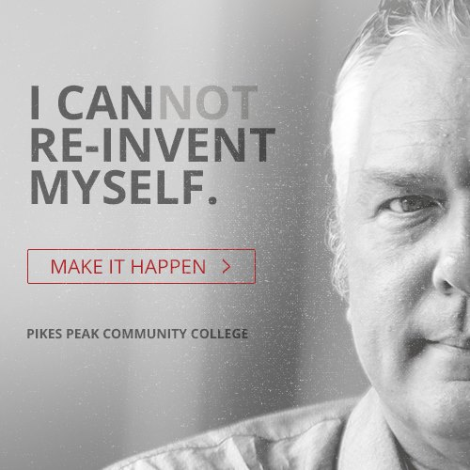
Digital Marketing Campaign
In June, our marketing department launched its first digital campaign, segmenting out nine audiences, from traditional high school students to military to those trying to change careers.
Results
Impressions: 7.4 million
Clicks: 10,643
Notes:
That means that since June, through searches or targeted Google digital ads, these ads have been seen 7.4 million times, driving nearly 11,000 people to click through to special landing pages. This campaign helped drive fall 2016 applications up 6.5% over last year.

Slide 20
Enrollment
By FTE
 | Summer | Fall | Spring | AY
AY 15/16 | 2,347 | 8,170 | 7,703 (as of Jan 10) | 18,221 ( as of Jan 10)
AY 16/17 | 2,175 | 8,025 | 7,515 (as of Jan 8) | 17,715 (as of Jan 8)
% change | -7.3% | -1.8% | -2.4% | -2.8%
Notes:
Enrollment, across the system, has been a struggle. But in relative terms, we’re doing well. …..

Slide 21
Fall-to-fall student retention trends
Notes:
Here’s one of our most important strides. Retention. Always a challenge for community colleges, and we’ve been trending up for six years.

Slide 22

Enrollment by Race
HISPANIC STUDENTS: ENROLLMENT INCREASED BY 4.2% BETWEEN AY11/12 AND AY15/16
College | Year | Asian | Black or African American | Hispanic | More than One Race/Ethnicity | Native American or Alaska Native | Hawaiian | Non-resident Alien | White | Total | Total Minority
PPCC | 2011-12 | 574 | 1,788 | 2,654 | 874 | 282 | 131 | 71 | 12,982 | 19,356 | 6,303
 | 2012-13 | 560 | 1,929 | 2,781 | 1,075 | 250 | 140 | 74 | 13,505 | 20,314 | 6,735
 | 2013-14 | 486 | 1,735 | 2,780 | 1,167 | 187 | 116 | 109 | 13,247 | 20,962 | 6,471
 | 2014-15 | 451 | 1,617 | 2,748 | 1,188 | 177 | 116 | 140 | 12,611 | 19,048 | 6,297
 | 2015-16 | 480 | 1,522 | 2,766 | 1,166 | 174 | 122 | 154 | 11,799 | 18,183 | 6,230
1 Year Change |  | 29 | (95) | 18 | (22) | (3) | 6 | 14 | (812) | (865) | (67)
% 1 Year Change |  | 6.4% | -5.9% | 0.7% | -1.9% | -1.7% | 5.2% | 10.0% | -6.4% | -4.5% | -1.1%
5 Year Change |  | (94) | (266) | 112 | 292 | (108) | (9) | 83 | (1,183) | (1,173) | (73)
% 5 Year Change |  | -16.4% | -14.9% | 4.2% | 33.4% | -38.3% | -6.9% | 116.9% | -9.1% | -6.1% | -1.2%
Notes:
I know those of you in the back are going to have trouble making heads or tails of this slide, but the important take away here is the 4.2% increase in Hispanic students over the past 5 years.

Slide 23
College Reserves
FY 16
FY 13
FY 14
FY 15
Unrestricted Net Assets
$45,863,403
Unrestricted Net Assets
$33,905,898
Unrestricted Net Assets
$ 35,648,025
Unrestricted Net Assets
$ 38,396,402
47%
NET RESERVE
49%
NET RESERVE
51%
NET RESERVE
59%
NET RESERVE
Notes:
Why we’re not really up.

Slide 24
Accreditation
Kristen Johnson and Patricia Diawara officially joined the HLC Peer Corps program after attending the HLC Peer Reviewer training in October
Date of the next Accreditation review: July 29, 2019 (virtual visit)
What do we need to do between now and July 2019?
  Rewrite our 2014 self-study report (now called “Assurance Argument”)
  Collect evidence showing that PPCC meets all 5 criteria (“Evidence file”)
  Prepare a monitoring report on Program Review and Assessment (in both instructional and support services)

Slide 25
Assessment
In AY 16/17
All general education departments will be collecting data on the revised statewide competencies using course-embedded, signature assignments. Most departments will be using the statewide rubrics to assess student learning, thus allowing PPCC to aggregate assessment results across multiple disciplines.
Two additional departments and more than 10 additional courses will start collecting assessment results.
PPCC officially adopted the statewide competencies as its new general education outcomes (Faculty Senate vote). Those include: Critical Thinking, Written Communication, Oral/Presentational Communication, Quantitative Literacy, Inquiry and Analysis.
Two PDW Assessment Workshops
  Tuesday (12:30 p.m. – 1:40 p.m.): How to analyze and report assessment results
  Thursday (8 a.m. – noon): Opportunity to work with colleagues on plans and reports (Two tracks: CTE and Gen Ed)
Notes:
Strides in assessment.

Slide 26
Working to Become 100% ACCESSIBLE
What is accessibility?
Accessibility means much more than elevators and wheelchair ramps. It means assuring we implement best practices so that students with disabilities can be successful in our institution. Not only is it the right thing to do, we must do it by federal mandate.
In April of 2014 the CCCS System President enacted a Web Accessibility Procedure
What does it mean for you?
All external communication and digital educational materials need to comply to accessibility standards.
Notes:
Our accessibility has been working hard on this and with many different divisions and departments, and if you haven’t been contacted about accessibility, you probably will soon.

Slide 27
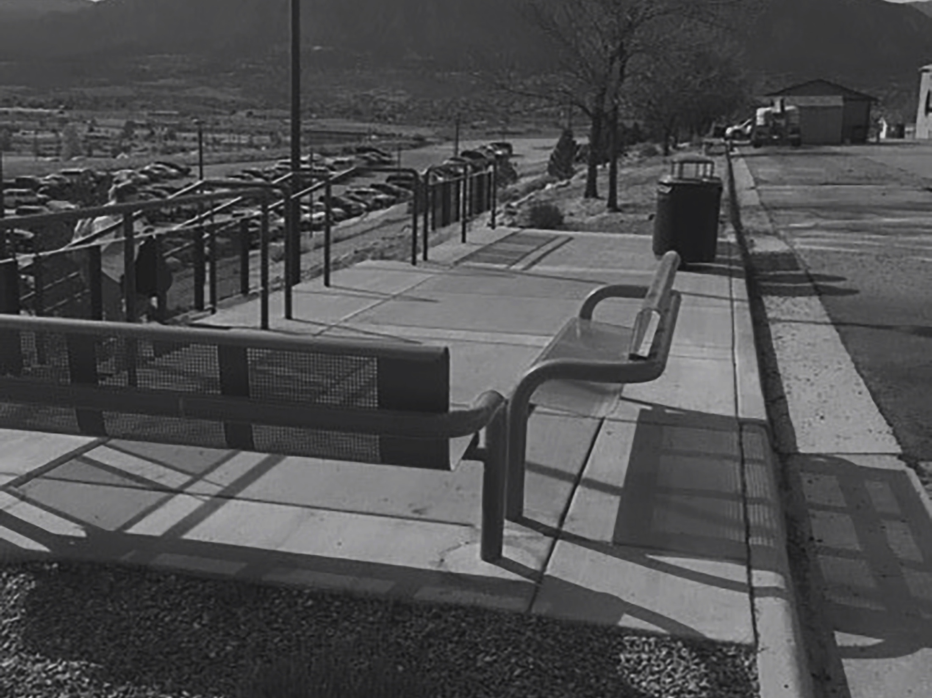
Capital Updates

Slide 28
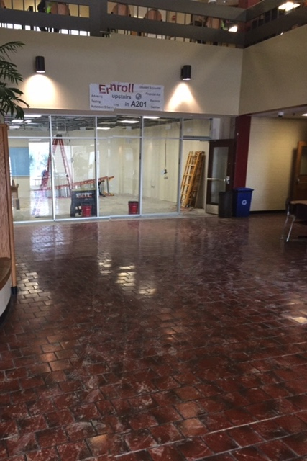
Aspen 1st Floor / Learning Commons:
1st Floor planned move in dates: Feb. 2-13
Begin construction Phase 2 (Learning Commons) –
Feb. 13
Estimated Completion:
June 2017

Slide 29
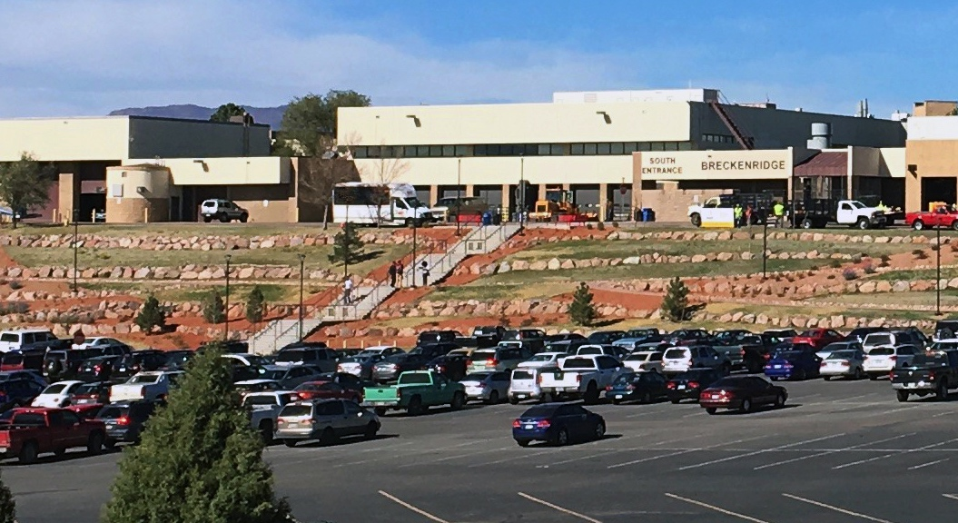
D-Lot Hillside
(completed construction Nov. 1)

Slide 30
Marie Walsh Sharpe
Creative Commons
Completing Final Design
Estimated begin construction – March 2017
Estimated Completion: early August 2017

Slide 31

RRC Walking Path
Construction – 75% complete
Estimated Completion: Spring 2017 (includes vegetation seeding)

Slide 32
DTSC and RRC Learning Commons
DTSC Learning Commons – now located in N204 beginning Spring 2017
RRC Learning Commons – remodel construction during Summer 2017

Slide 33
Classroom and Building Improvements
Centennial
Painting throughout hallways and Rotunda
Building color coding in hallways/doorways for better wayfinding
Continued painting of exterior
Upgrades to equipment in Aspen Café
New corridor flooring in CDC
New FRP wall covering in Culinary Arts
DTSC
S234 – new Student Life Office
S207 – new Student Computer Lab

Slide 34

Questions

