Slide 1
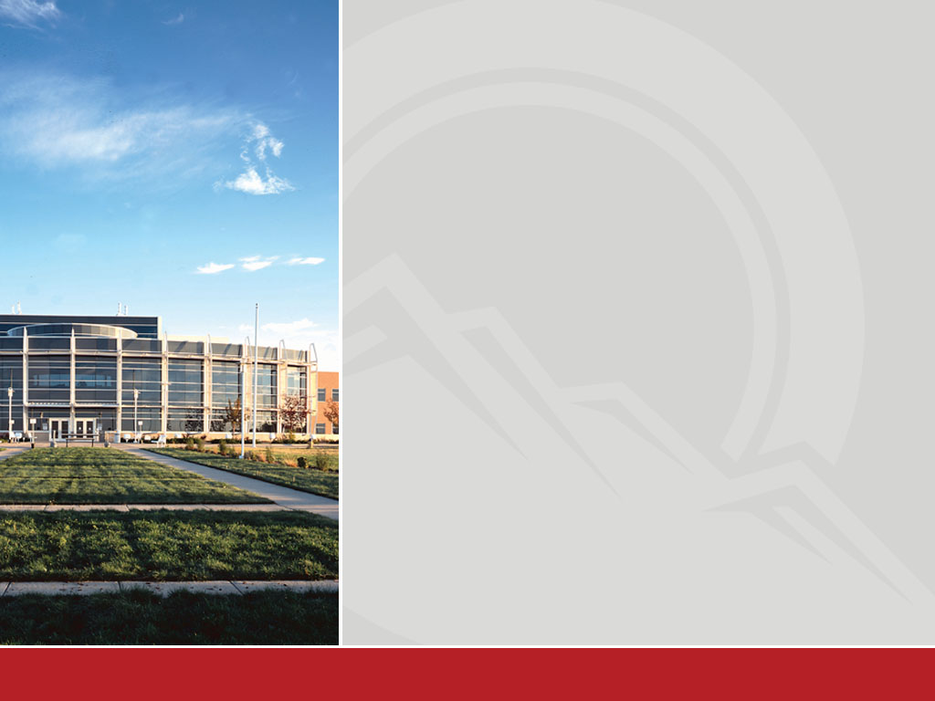

Fall PDW
PIKES PEAK COMMUNITY COLLEGE
Fall PDW | Page 1

Slide 2
Commitment to our Mission & Vision
CETL – Center for Excellence in Teaching and Learning
brings Elizabeth Barkley to PPCC
  Current and ongoing activities through the semester.
  Improving student engagement = more students
  reaching their goals
College-wide commitment to Professional Development –
Coming policy change for high traffic offices to open to
the public an hour late every Friday.
Classified Staff – Employee of the Quarter Program
PIKES PEAK COMMUNITY COLLEGE
Fall PDW | Page 2

Slide 3

HLC Accreditation
March 2014 Team Visit
  Ensuring we serve our mission
  Ensuring we operate with integrity
  Ensuring students receive a high quality and continuously improved education
  Ensuring that we measure and are accountable for student learning.
  Ensuring we are good stewards of our resources and budget according to goals driven by student needs.
Fall PDW | Page 4

Slide 4
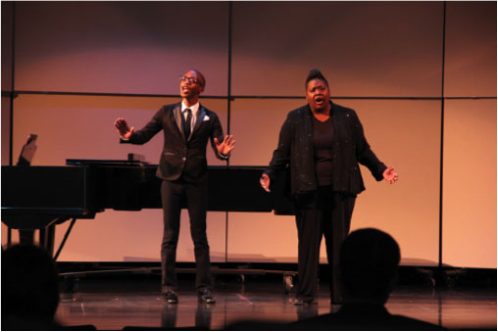
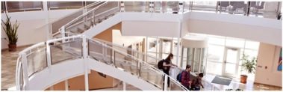
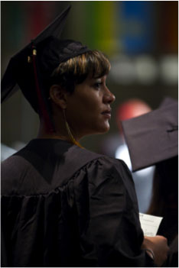
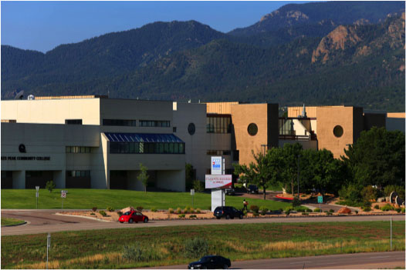
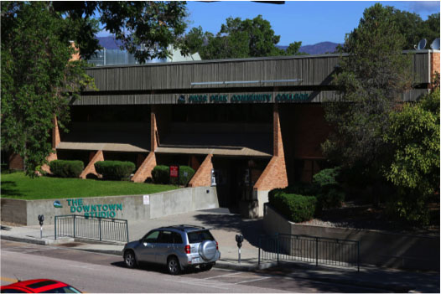
What is your role in helping PPCC achieve its mission?
PIKES PEAK COMMUNITY COLLEGE
Fall PDW | Page 4

Slide 5
Enrollment Trends
Full Academic Years
 | Headcount |  |  |  |  | Annualized FTE
Campus | 2008-09 | 2009-10 | 2010-11 | 2011-12 | 2012-13 | 2008-09 | 2009-10 | 2010-11 | 2011-12 | 2012-13
Centennial | 11522 | 12767 | 13687 | 13236 | 13130 | 3475.3 | 3926.0 | 4280.8 | 4129.8 | 4108.2
DownTown Studio | 2986 | 3533 | 4067 | 3112 | 3228 | 813.8 | 980.5 | 1133.7 | 930.9 | 917.9
Falcon | 616 | 621 | 640 | 549 | 542 | 174.8 | 196.2 | 196.0 | 182.7 | 166.8
Rampart Range | 6918 | 7656 | 8563 | 9036 | 8762 | 1944.7 | 2179.6 | 2455.0 | 2575.5 | 2440.0
Miscellaneous | 461 | 544 | 578 | 714 | 900 | 110.1 | 130.0 | 146.1 | 197.0 | 224.0
Military | 574 | 567 | 575 | 452 | 446 | 118.7 | 117.7 | 132.8 | 99.9 | 83.0
CCCOnline | 3649 | 4192 | 4063 | 3754 | 3952 | 979.3 | 1131.0 | 1178.0 | 1083.1 | 1124.2
PPCC Online | 2150 | 3229 | 4742 | 4898 | 4716 | 594.4 | 896.4 | 1303.8 | 1346.8 | 1267.8
Grand Total | 28876 | 33109 | 36915 | 35751 | 35676 | 8211.2 | 9557.3 | 10826.2 | 10545.8 | 10331.9
PIKES PEAK COMMUNITY COLLEGE
Fall PDW | Page 5

Slide 6

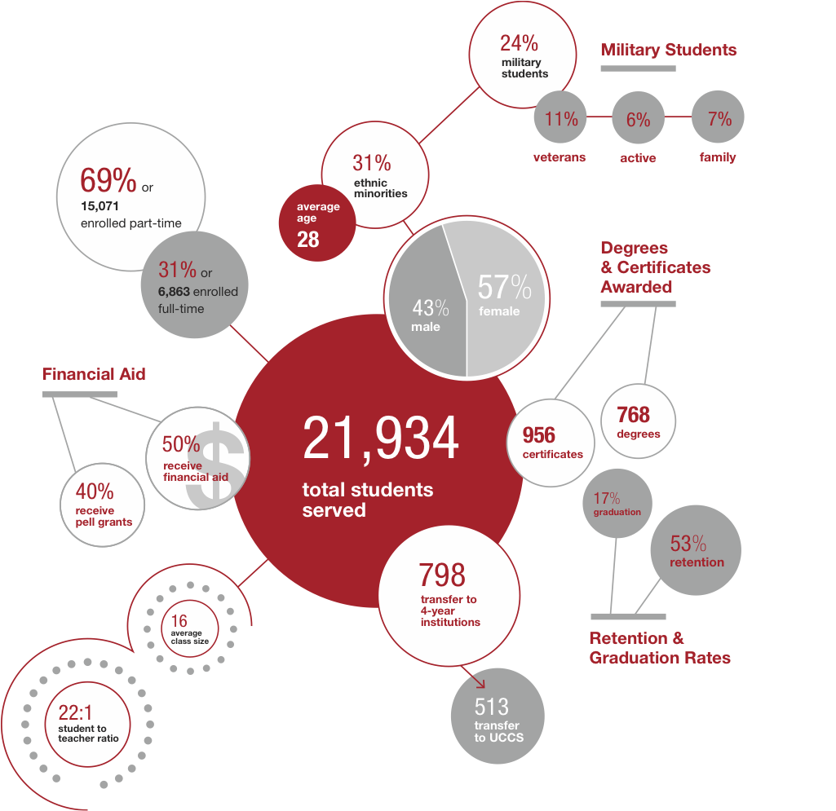
PIKES PEAK COMMUNITY COLLEGE
Fall PDW | Page 6

Slide 7
Students demographics by age
PIKES PEAK COMMUNITY COLLEGE
Fall PDW | Page 7

Slide 8
Students demographics by ethnicity
PIKES PEAK COMMUNITY COLLEGE
Fall PDW | Page 8

Slide 9
Perfect the New Student Experience
Focus Goal Established October 2012
Dean / Instructor Signature Requirements Changed
Electronic waitlist for full courses
Streamlining previously evaluated transfer course equivalency
New Student Orientation – Live & Digital
Program Templates and Student Program Plans
Advising Task Force work underway
PIKES PEAK COMMUNITY COLLEGE
Fall PDW | Page 9

Slide 10
Advancing Student Persistence
Focus Goal Established August 2013
1. Transform our Centennial Campus Library into a dynamic Learning Commons that supports academic success across disciplines with tutoring, technology, educational resources, and facilities that encourage student engagement in the learning process.
2. Identify and implement an electronic Academic Planning Tool designed to engage students with long-range, accurate academic plans and continuous connection to their academic goals, progress, and college support functions, while improving the efficiency of course scheduling and aiding us in maintaining continuity in our connection and communication with students.
PIKES PEAK COMMUNITY COLLEGE
Fall PDW | Page 10

Slide 11
PIKES PEAK COMMUNITY COLLEGE
Fall PDW | Page 11

Slide 12
Budget 2013 / 2014
Total GF budget for the coming year: $63.1 M
  Projecting a 3% enrollment decline
  Tuition increase of 6% or $6.75 per credit hour
    $119.50 per credit hour
  Previous GF Budget actuals were as follows:
    FY ‘11 - $61.8 M
    FY ‘12 - $58.6 M
    Fy ‘13 – $60.9 M
Auxiliary Budget - $12 M
PIKES PEAK COMMUNITY COLLEGE
Fall PDW | Page 12

Slide 13
Reserve Calculations
$33.9 M Current Reserve Balance 7-1-13
Added $3.1 M over the past year
47.4% reserve based on previous year’s actual expenses.
PPCC Procedure is to maintain a 30% reserve
$12.4 M is available
PIKES PEAK COMMUNITY COLLEGE
Fall PDW | Page 13

Slide 14
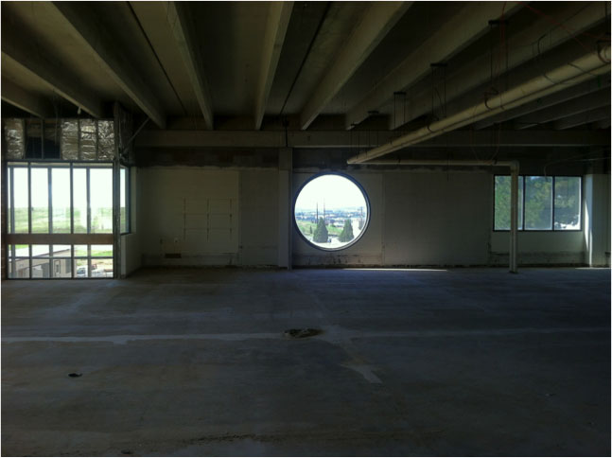
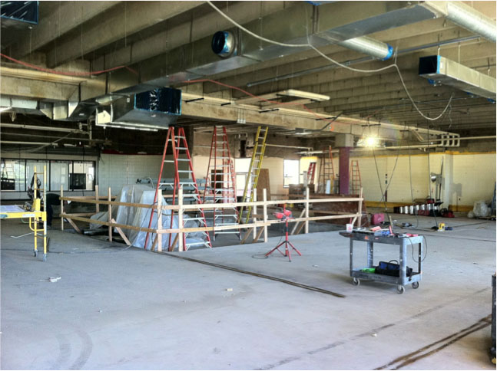
Capital Projects Current at Centennial Campus
Building Renovations
Climax Building
Breckenridge Building
PIKES PEAK COMMUNITY COLLEGE
Fall PDW | Page 14

Slide 15
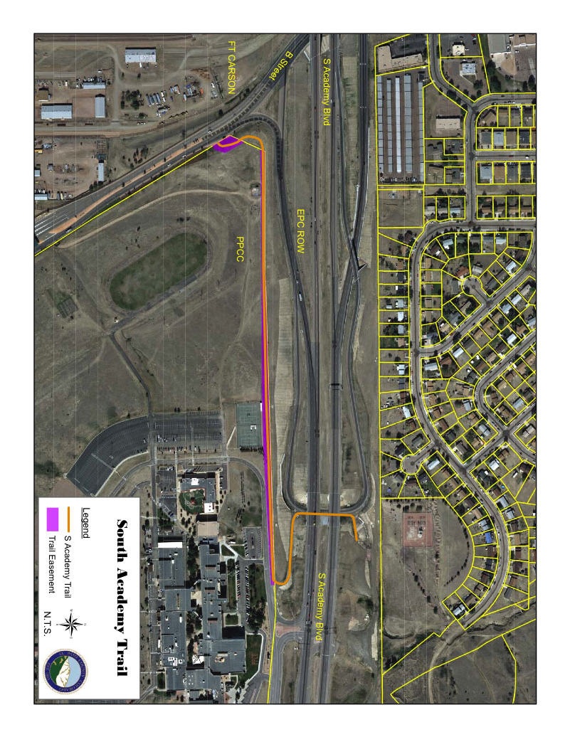
Capital Projects Current at Centennial Campus
Bike / Pedestrian Pathway
PIKES PEAK COMMUNITY COLLEGE
Fall PDW | Page 15

Slide 16
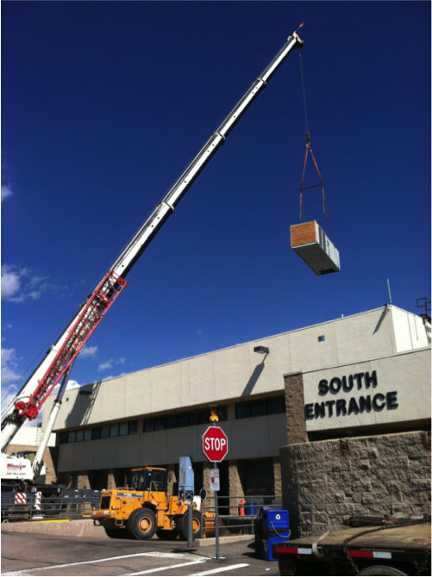
Capital Projects Current at Centennial Campus
HVAC Project
PIKES PEAK COMMUNITY COLLEGE
Fall PDW | Page 16

Slide 17
Capital Projects Current at Centennial Campus
Elevator replacements and addition
  Rotunda – December & January
  Gym – August & September
  Addition of B-Building Elevator driven by ADA needs, but widely useful.
  Timing not established, working currently with Architect / Engineer.
PIKES PEAK COMMUNITY COLLEGE
Fall PDW | Page 17

Slide 18
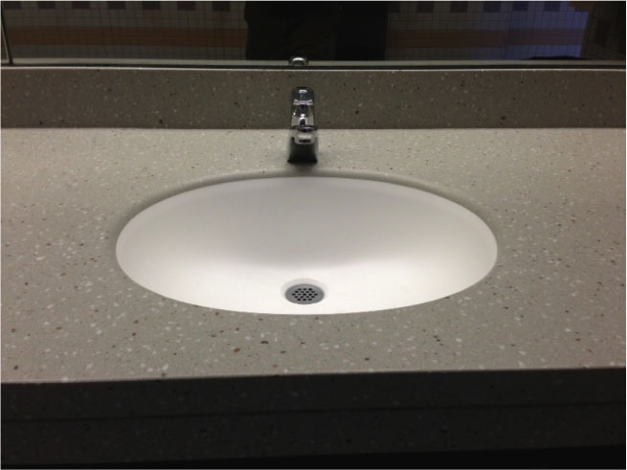
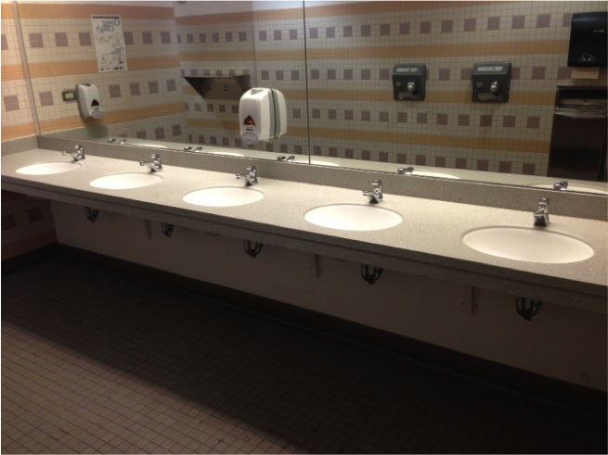
Capital Projects
Current at Rampart Range Campus
Bathroom Counter and Faucet Replacements
Mass Notification System
Sidewalk from CDC to TCA
PIKES PEAK COMMUNITY COLLEGE
Fall PDW | Page 18

Slide 19
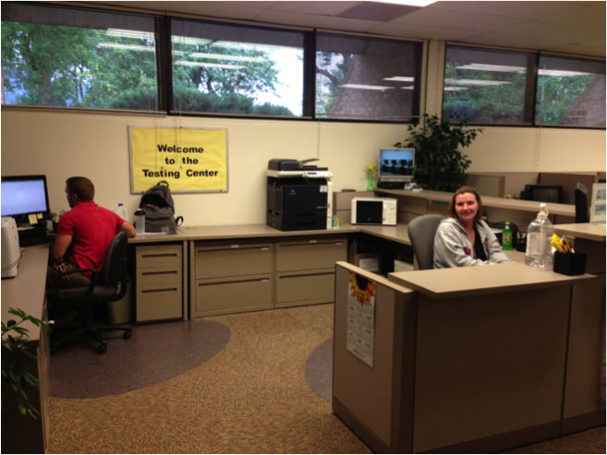
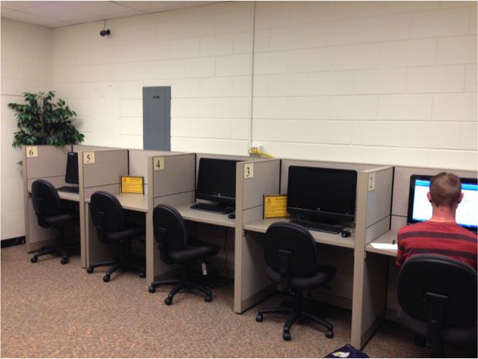
Capital Projects
Current at Downtown Studio Campus
Remodel of Advising & Testing Center
Classroom reconfiguration: S228, S230, and S232.
December & January
PIKES PEAK COMMUNITY COLLEGE
Fall PDW | Page 19

Slide 20
Capital Projects
Classroom and Instructional Space
Strategic focus on critical improvements of classroom and instructional areas is a top priority. One million in funding for the coming year improvements.
After addressing critical instructional space needs will begin a five to seven year process of rotating campus improvements to ensure that all areas of the college are addressed.
PIKES PEAK COMMUNITY COLLEGE
Fall PDW | Page 20

Slide 21
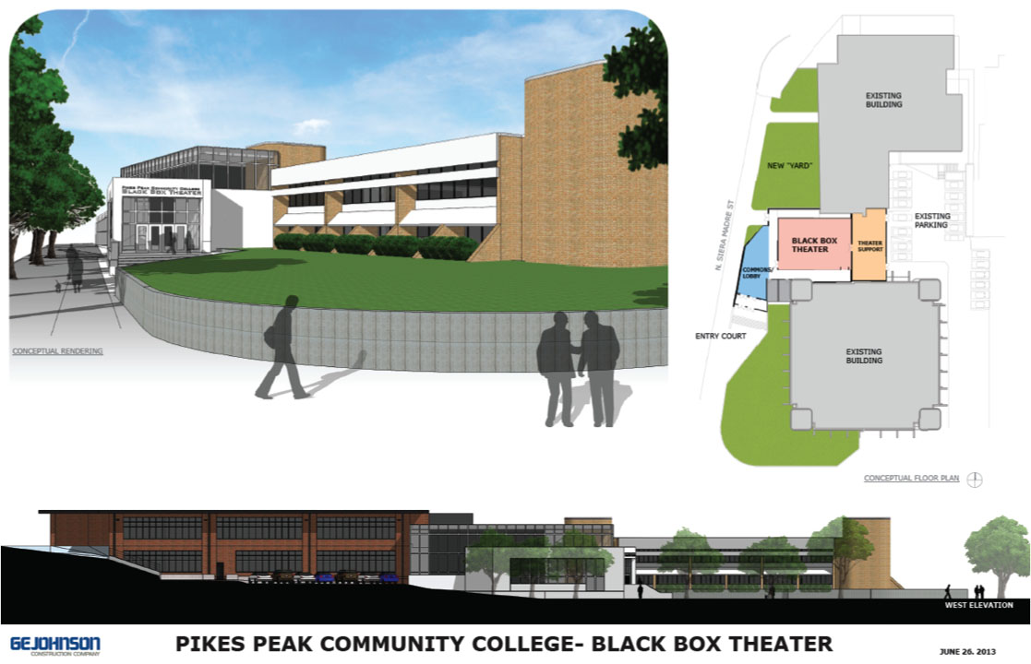
Capital Projects
Future at Downtown Studio Campus
PIKES PEAK COMMUNITY COLLEGE
Fall PDW | Page 21

Slide 22
Capital Projects
Future at Centennial Campus
Aspen Building – Student Services Project
This project will incorporate many improvements including the following:
Alignment of physical spaces to people movement and function
of Enrollment, Testing, Advising, Financial Aid, and Records
Learning Commons Project
Estimated Total - $6.8 M
Estimated Time Frame – Construction beginning in about 1 year.
PIKES PEAK COMMUNITY COLLEGE
Fall PDW | Page 22

Slide 23
Capital Projects
Future at Rampart Range Campus
Fitness Center and expanded instructional space.
Estimated Cost - $6.4 M
Estimated time for beginning the process – 2015 / 2016
PIKES PEAK COMMUNITY COLLEGE
Fall PDW | Page 23

Slide 24
Capital Projects
Future Centennial Campus
Landscaping, people movement, and traffic flow improvements
Improved parking and access to buildings. Improving a front-door
concept where most students park.
PIKES PEAK COMMUNITY COLLEGE
Fall PDW | Page 24

Slide 25

Questions?

