Slide 1
SPRING 2015 | PDW
Engagement Leading to Completion
PIKES PEAK COMMUNITY COLLEGE
Spring 2015 PDW | Page 1

Slide 2
Enrollment Update
 | Headcount |  | FTE
PPCC | 13,954 | 4.82% | 4,270 | 5.71%
CCCS | 82,127 | 4.27% | 23,605 | 4.34%
(PPCC budgeted down 5.75% this year.)
PIKES PEAK COMMUNITY COLLEGE
Spring 2015 PDW | Page 2

Slide 3
AAA 109 Data
College Success Factors Index (CSFI)
Ice House students performed better in 9 of 10 areas
On Course students performed better in all 10 areas
 | STRONGEST | WEAKEST
Ice House | Responsibility/Control | Family Involvement, Precision
On Course | Responsibility/Control, Time Management | Family Involvement
PIKES PEAK COMMUNITY COLLEGE
Spring 2015 PDW | Page 3
Notes:
CSFI Definition: For CSFI, a higher score suggests negative performance.
“Responsibility/Control: If we do not take control over the responsibilities we assume in college, less success is possible.
Competition: The need to compete is part of our culture and thus an aspect of college and career success. For successful students, competition becomes internalized-they compete with themselves.
Task Planning: A strong task orientation and a desire to complete a task in a planned step-by-step manner are very important to college success.
Expectations: Successful students have goals that are related to assignments, areas of study, and future careers.
Family Involvement: Family encouragement and/or participation in planning and decision making are factors in a student's success.
College Involvement: Being involved in college activities, relating to faculty and developing strong peer relationships are important factors in retention.
Time Management: How people maximize their time and prioritize class assignments affects their productivity and success.
Wellness: People need ways to handle their problems. Stress, anger, sleeplessness, alcohol/drug use, inadequate diet and lack of exercise are deterrents to college success.
Precision: To approach one's education by being exact, careful with details and specific with assignments is a measure of success.
Persistence: To face a task with diligence, self-encouragement and a sense of personal urgency even when some tasks take extra effort and are repetitious is a mark of academic success.”

Slide 4
AAA 109 Data
Students in traditional classes have a higher pass rate than students in online classes
Younger students (<24) in Ice House had statistically significant lower pass rate than older students (>25)
Minority (Hispanic, Black, Asian or Pacific Islander) students have a lower pass rate than Caucasian (white) students
PIKES PEAK COMMUNITY COLLEGE
Spring 2015 PDW | Page 4

Slide 5
AAA 109 Data
Students who took DevEd courses and AAA 109 have a higher average GPA than students who took a DevEd course and didn’t take AAA 109. (*skewed by AAA109)
Students who passed AAA 109 are more likely to pass DevEd courses than students who failed AAA 109, and vice versa. 83% vs. 21%
Students who passed AAA 109 are more likely to pass DevEd courses than students who didn’t take AAA 109. 83% vs. 64%
Re-enrollment is positively related to final grade.
This suggests students who passed AAA 109 are more likely to enroll in spring 2015 than students who failed AAA 109.
PIKES PEAK COMMUNITY COLLEGE
Spring 2015 PDW | Page 5

Slide 6
Legislative Action
Capital Development Committee
Governor’s Budget Proposal
President Obama’s free Community College Proposal
PIKES PEAK COMMUNITY COLLEGE
Spring 2015 PDW | Page 6

Slide 7
Focus Goal Process
PIKES PEAK COMMUNITY COLLEGE
Spring 2015 PDW | Page 7

Slide 8
Focus Goal 1: Recap
“Improve the New Student Experience”
adopted in AY 2012/2013
RESULTS
Dean/Instructor Signature Requirements
Adoption of SARS Software
Software supported transcript evaluation
New Student Orientation (NSO)
Program Templates and Student Program Plans
New Academic Advising Model
PIKES PEAK COMMUNITY COLLEGE
Spring 2015 PDW | Page 8

Slide 9
PPCC New Student Orientation (NSO)
Fall orientation
77 sessions
974 students served
average size 13 students
Students attending fall ‘13 orientation returning fall ‘14
Full-time students retained 8.3% higher
Part-time students retained 15% higher
Fall ‘13 Cohort
Full-time NSO = 266 vs. Non-NSO = 852
Part-time NSO = 199 vs. Non-NSO = 1,125
PIKES PEAK COMMUNITY COLLEGE
Spring 2015 PDW | Page 9

Slide 10
Focus Goal 2: Recap
“Advance Student Persistence”
Increase Retention Rates to
60%
Strategies
Academic Planning Tools (Degree Works)
Learning Commons
PIKES PEAK COMMUNITY COLLEGE
Spring 2015 PDW | Page 10

Slide 11
Focus Goal 2
ACADEMIC PLANNING TOOL
Academic Planning Tool Task Force has campus representation from:
Instructional Services
Enrollment Services
Administrative Services
Student Success Division
The Academic Planning Tool Task Force:
Identified attributes of electronic academic planning tool
Reviewed and rated software demonstrations
Provided comparative data
Presented the charge, process and results to Leadership Council
Recommended Degree Works as the academic planning tool
PIKES PEAK COMMUNITY COLLEGE
Spring 2015 PDW | Page 11
Notes:
We use DegreeWorks to store the full-time and part-time templates academic departments built. From them, students' academic plans are built. It allows the professional advisors to make sure students are enrolling in the right courses on the right sequence. It also is our degree audit tool, so a plan can be audited to make sure the degree/certificate requirements are being met (much quicker and more accurate than pencil & paper).
Once Banner XE registration is rolled out (still not sure of a timeline), students will be able to pull the DegreeWorks classes they selected for the semester and select from sections of those courses only to determine their schedule. This will be much less intimidating than having to use the current search tool.

Slide 12
Focus Goal 2
ACADEMIC PLANNING TOOL
Recommendation: Degree Works
Academic planning tool that maps out academic plans for students to keep them on-track and on-time for goal completion.
Next Steps
CP&A advisors currently building electronic academic plans for all new students.
Academic Divisions are creating and updating program templates in order for advisors to build full-time and part-time electronic degree templates into Degree Works.
PIKES PEAK COMMUNITY COLLEGE
Spring 2015 PDW | Page 12
Notes:
We use DegreeWorks to store the full-time and part-time templates academic departments built. From them, students' academic plans are built. It allows the professional advisors to make sure students are enrolling in the right courses on the right sequence. It also is our degree audit tool, so a plan can be audited to make sure the degree/certificate requirements are being met (much quicker and more accurate than pencil & paper).
Once Banner XE registration is rolled out (still not sure of a timeline), students will be able to pull the DegreeWorks classes they selected for the semester and select from sections of those courses only to determine their schedule. This will be much less intimidating than having to use the current search tool.

Slide 13
Focus Goal 2
LEARNING COMMONS
Learning Commons Committee:
Traveled and studied high performing facilities nationally & regionally
Presented findings to Leadership Council
Design firm hired and work presented to tutoring staff, library staff, enrollment teams, faculty, staff and student meetings
A&E hired & construction to begin late fall 2015 (project includes 1st floor of Aspen)
PIKES PEAK COMMUNITY COLLEGE
Spring 2015 PDW | Page 13
Notes:
We use DegreeWorks to store the full-time and part-time templates academic departments built. From them, students' academic plans are built. It allows the professional advisors to make sure students are enrolling in the right courses on the right sequence. It also is our degree audit tool, so a plan can be audited to make sure the degree/certificate requirements are being met (much quicker and more accurate than pencil & paper).
Once Banner XE registration is rolled out (still not sure of a timeline), students will be able to pull the DegreeWorks classes they selected for the semester and select from sections of those courses only to determine their schedule. This will be much less intimidating than having to use the current search tool.

Slide 14
Focus Goal 2
Ad Astra
Goals for Ad Astra
Highly functional, editable and efficient schedules
Newly realized physical and financial resources
Exploration of new programs and student service
Ad Astra Committees/Workgroups
Reviewing maximum enrollments
Updating room capacity inventory
Creating scheduling grid for: CTE, transfer, morning, evening, weekend college, weekend classes and hybrid
Preparing data integration for a spring 2016 go-live date
PIKES PEAK COMMUNITY COLLEGE
Spring 2015 PDW | Page 14
Notes:
We use DegreeWorks to store the full-time and part-time templates academic departments built. From them, students' academic plans are built. It allows the professional advisors to make sure students are enrolling in the right courses on the right sequence. It also is our degree audit tool, so a plan can be audited to make sure the degree/certificate requirements are being met (much quicker and more accurate than pencil & paper).
Once Banner XE registration is rolled out (still not sure of a timeline), students will be able to pull the DegreeWorks classes they selected for the semester and select from sections of those courses only to determine their schedule. This will be much less intimidating than having to use the current search tool.

Slide 15
Focus Goal 3: Using Data
Improve institutional (divisional, departmental, individual) effectiveness by integrating data to drive decision making and resources.
Implement HLC Open Pathways Model
Support and improve college-wide assessment activities and report to HLC on progress
Integrate data into scheduling to improve efficiency, providing resources for new growth opportunities
PIKES PEAK COMMUNITY COLLEGE
Spring 2015 PDW | Page 15

Slide 16
Focus Goal 3: HLC Accreditation
TRANSITION TO OPEN PATHWAYS
PEAQ | Open Pathways
10 year Reaccreditation | 10 year Reaccreditation
Self-Study Submission Review: shows criteria has been met; and developed in years just prior to visit. | Assurance Review: evidence file submitted during 4th year; and document created in years preceding.
 | “Quality Initiative” developed, implemented and reported (during 5th – 9th years).
Visit with peer team Culminates with a final report (during 10th year). | Assurance Review and comprehensive evaluation visit (during 10th year).
PIKES PEAK COMMUNITY COLLEGE
Spring 2015 PDW | Page 16
Notes:
We use DegreeWorks to store the full-time and part-time templates academic departments built. From them, students' academic plans are built. It allows the professional advisors to make sure students are enrolling in the right courses on the right sequence. It also is our degree audit tool, so a plan can be audited to make sure the degree/certificate requirements are being met (much quicker and more accurate than pencil & paper).
Once Banner XE registration is rolled out (still not sure of a timeline), students will be able to pull the DegreeWorks classes they selected for the semester and select from sections of those courses only to determine their schedule. This will be much less intimidating than having to use the current search tool.

Slide 17
ASSESSMENT
Aligned with Focus Goal 3
COAT – 10+ years of outstanding leadership
Executive Director of Institutional Effectiveness Integrating assessment into work/culture
Enrollment and Student Success adoption of assessment methods
PIKES PEAK COMMUNITY COLLEGE
Spring 2015 PDW | Page 17
Notes:
We use DegreeWorks to store the full-time and part-time templates academic departments built. From them, students' academic plans are built. It allows the professional advisors to make sure students are enrolling in the right courses on the right sequence. It also is our degree audit tool, so a plan can be audited to make sure the degree/certificate requirements are being met (much quicker and more accurate than pencil & paper).
Once Banner XE registration is rolled out (still not sure of a timeline), students will be able to pull the DegreeWorks classes they selected for the semester and select from sections of those courses only to determine their schedule. This will be much less intimidating than having to use the current search tool.

Slide 18
KEY INITIATIVE UPDATES
PIKES PEAK COMMUNITY COLLEGE
Spring 2015 PDW | Page 18
Notes:
We use DegreeWorks to store the full-time and part-time templates academic departments built. From them, students' academic plans are built. It allows the professional advisors to make sure students are enrolling in the right courses on the right sequence. It also is our degree audit tool, so a plan can be audited to make sure the degree/certificate requirements are being met (much quicker and more accurate than pencil & paper).
Once Banner XE registration is rolled out (still not sure of a timeline), students will be able to pull the DegreeWorks classes they selected for the semester and select from sections of those courses only to determine their schedule. This will be much less intimidating than having to use the current search tool.

Slide 19
CETL Update
Flipped Classroom Workshops
Adjunct Advancement Process
New Faculty Orientation
On-boarding adjunct faculty improvements
Shift focus from student engagement to impacting completion
PIKES PEAK COMMUNITY COLLEGE
Spring 2015 PDW | Page 19

Slide 20
PPCC Budget Process
Pilot Projects and Campus Improvements
Set aside $200K (probably)
Immediately seeking proposals due March 15th
Open to all PPCC employees
Formal process announced by email next week
PIKES PEAK COMMUNITY COLLEGE
Spring 2015 PDW | Page 20

Slide 21
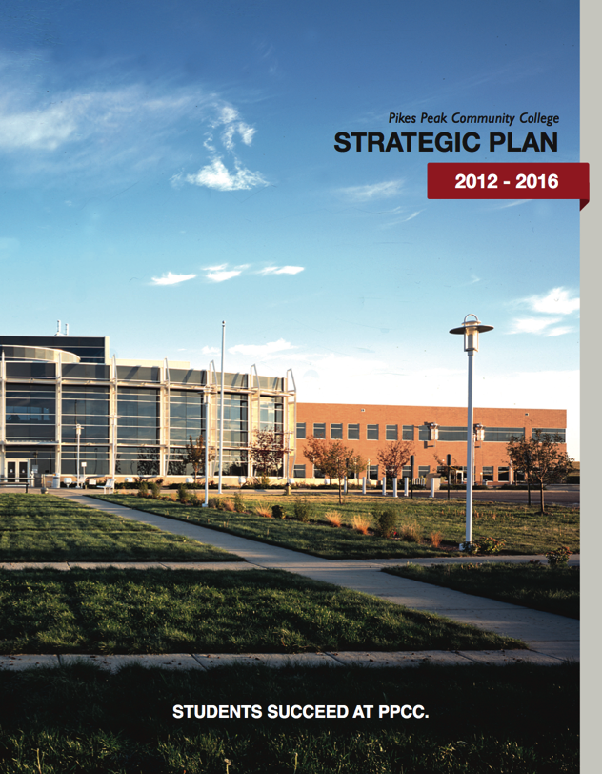
PPCC Strategic Planning
PPCC will initiate a strategic planning process to update the work accomplished in 2011.
PIKES PEAK COMMUNITY COLLEGE
Spring 2015 PDW | Page 21

Slide 22
Web Accessibility Team
All people, especially those with disabilities, must have universal access to perceive, understand, navigate and interact with a web site. Currently most sites have barriers making universal access difficult and sometimes impossible.
PPCC & Web Accessibility
A Web Accessibility team formed to ensure all information and services conform to the Web Accessibility Guidelines 2.0. They will work with all areas of the college.
Accomplishments
PPCC Web Accessibility Plan submitted to CCCS Dec. 31, 2014
Next Steps
Planning Phase: January – June 2015
Implementation: 2016 – 2018
PIKES PEAK COMMUNITY COLLEGE
Spring 2015 PDW | Page 22

Slide 23
PPCC Website
Evolving and Improving
Pilot trainings conducted fall ‘14
Ten department sites scheduled to publish sites this semester
Multiple trainings scheduled for spring
All academic departments trained by July 2015 to manage content and publish live sites
PIKES PEAK COMMUNITY COLLEGE
Spring 2015 PDW | Page 23

Slide 24
PPCC Grants Update
$6.3 M in awarded grants
$1.5 M in pending grants
$3.4 M grants in development
PIKES PEAK COMMUNITY COLLEGE
Spring 2015 PDW | Page 24

Slide 25
Capital Projects Completed
CC Phase I Boiler Replacement $725,000
CC B208 HVAC Classroom
CC Smoking Structure $20,000
CC Relocated Archives
PIKES PEAK COMMUNITY COLLEGE
Spring 2015 PDW | Page 25

Slide 26
Capital Projects Upcoming
DOWNTOWN STUDIO CAMPUS
STILL COMING!
PIKES PEAK COMMUNITY COLLEGE
Spring 2015 PDW | Page 26

Slide 27
Capital Projects Upcoming
LEARNING COMMONS/ENROLLMENT SERVICES
PIKES PEAK COMMUNITY COLLEGE
Spring 2015 PDW | Page 27

Slide 28
Capital Projects Upcoming
Classroom Improvements
Year Two
CC | DTSC | RRC
A156, A172, A216b, A216c, A250, A254 | N214, N216, N218, N220, N222, N224, N226, S205, S215 | E102, E109, E112, W113
Painting and new ceiling tiles installed in some rooms. Waiting for new color scheme and carpet choices.
Some upgrades completed during Spring Break.
PIKES PEAK COMMUNITY COLLEGE
Spring 2015 PDW | Page 28

Slide 29
Capital Projects Upcoming
CC Hillside $600,000
Physical Plant Building for Centennial Campus
CC A229 Suite: Workforce Dev., CETL, IR, eLearning, HSP $250,000
CC Phase II Boiler Replacement $509,000
CC ADA Locker room improvements and elevator on Breckenridge Building $735,000
DTSC Gowdy Temporary Parking
CC ADA Parking $80,000
PIKES PEAK COMMUNITY COLLEGE
Spring 2015 PDW | Page 29

Slide 30
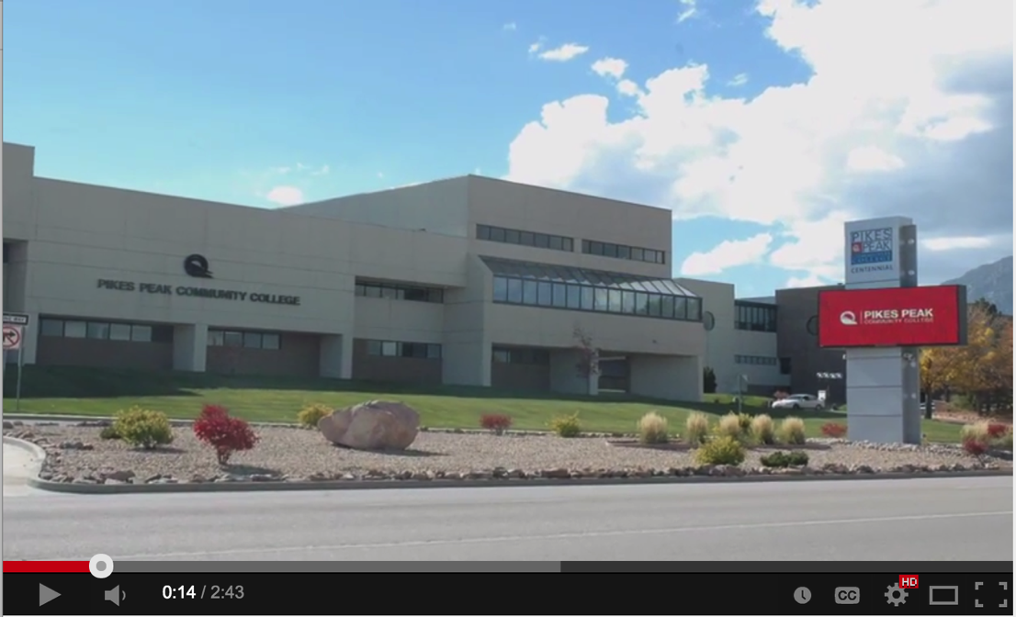
Classroom Improvements
PIKES PEAK COMMUNITY COLLEGE
Spring 2015 PDW | Page 30

Slide 31
QUESTIONS?
PIKES PEAK COMMUNITY COLLEGE
Spring 2015 PDW | Page 31

