Slide 1
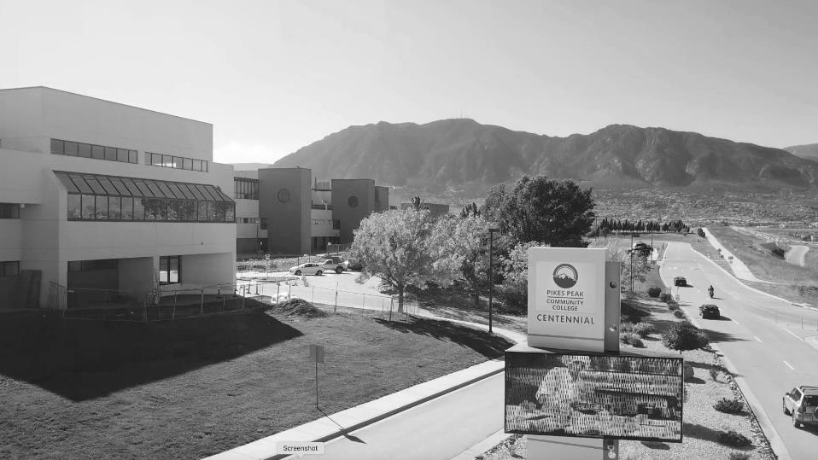

PRESIDENT’S
ADDRESS
2022 SPRING PDW
LIVING WITH
THE PANDEMIC

Slide 2
NEW COVID TESTING PROTOCOL
Get Weekly Testing OR Get Vaccinated
Face covering will continue to be required
in all public indoor spaces.
Notes:
What this means for spring and beyond
- Hopeful themes about opening back up for regular classes sometime during Spring ‘21 semester. Including a grand opening of our really lovely Studio West.
- Vaccine rollout. 1B. What that means and how we'll be notified.
- Graduation might be in-person
- Challenges our students and employees are facing during the pandemic and our efforts to support people.

Slide 3
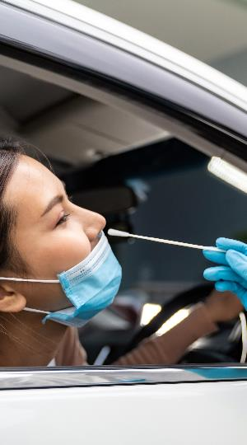
FREE COVID TESTING SITES
The college is offering free testing for employees and students. Free testing is also available at many sites in Colorado Springs, including:
El Paso County Public Health South in Fountain
Chapel Hills Mall
Citadel Mall
Anyone 2 years old or older is qualified,
no symptoms required.
Notes:
What this means for spring and beyond
- Hopeful themes about opening back up for regular classes sometime during Spring ‘21 semester. Including a grand opening of our really lovely Studio West.
- Vaccine rollout. 1B. What that means and how we'll be notified.
- Graduation might be in-person
- Challenges our students and employees are facing during the pandemic and our efforts to support people.

Slide 4

TESTING & REPORTING PROTOCOLS
PPCC will follow the CCCS Chancellor’s guidance in implementing the COVID-19 Testing Protocols.
Deadline for submitting the first test results will be next week for students, this week for faculty, and it was last week for staff.
Anyone who is showing signs or symptoms of COVID should get tested.
All employees and students who will be on campus must undergo weekly testing, unless they are fully vaccinated. Fully vaccinated individuals who uploaded documentation to PPCC’s voluntary vaccination registry are exempt from testing requirements, and no further action is required. The current mask requirements remain in place.
The PPCC Voluntary Vaccine Registry is now available for students and employees. ​​​
The PPCC Testing Registry is now available for students and employees. ​​​
Notes:
What this means for spring and beyond
- Hopeful themes about opening back up for regular classes sometime during Spring ‘21 semester. Including a grand opening of our really lovely Studio West.
- Vaccine rollout. 1B. What that means and how we'll be notified.
- Graduation might be in-person
- Challenges our students and employees are facing during the pandemic and our efforts to support people.

Slide 5
TESTING & REPORTING PROTOCOLS
All students and employees who test positive for COVID-19 must stay off campus and complete a reporting form.
The Pandemic Response Team (PRT) will continue to communicate with faculty and supervisors about confirmed positive COVID-19 tests or confirmed diagnoses.
In on-campus student cases, the PRT will continue to direct effected classes to monitor symptoms.
In employee cases, Human Resource Services will continue to communicate with the employee and supervisor.
Notes:
What this means for spring and beyond
- Hopeful themes about opening back up for regular classes sometime during Spring ‘21 semester. Including a grand opening of our really lovely Studio West.
- Vaccine rollout. 1B. What that means and how we'll be notified.
- Graduation might be in-person
- Challenges our students and employees are facing during the pandemic and our efforts to support people.

Slide 6

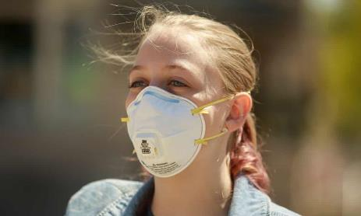
MASKS
Free KN95 and N95 masks will be available

Slide 7
ONGOING PROTOCOLS
Limiting public gatherings
May change as we get past the winter surge
Notes:
What this means for spring and beyond
- Hopeful themes about opening back up for regular classes sometime during Spring ‘21 semester. Including a grand opening of our really lovely Studio West.
- Vaccine rollout. 1B. What that means and how we'll be notified.
- Graduation might be in-person
- Challenges our students and employees are facing during the pandemic and our efforts to support people.

Slide 8

FLEXIBLE WORKPLACE
FlexPlace
FlexTime
COMPENSATION
Notes:
What this means for spring and beyond
- Hopeful themes about opening back up for regular classes sometime during Spring ‘21 semester. Including a grand opening of our really lovely Studio West.
- Vaccine rollout. 1B. What that means and how we'll be notified.
- Graduation might be in-person
- Challenges our students and employees are facing during the pandemic and our efforts to support people.

Slide 9

THE NUMBERS

Slide 10
ENROLLMENT
SEMESTER FTE | SUMMER | FALL | SPRING | AY
AY 20/21 | 2,110 | 7,5660 | 6,923 | 16,593
AY 21/22 | 1,829 | 7,074 | 6,312 | 15,215
% Change | -13% | -6.5% | -8.8% As of 1/13/22 | -8.3% As of 1/13/22

Slide 11
RETENTION RATES BY ETHNICITY
Notes:
That last included one of the best faculty art shows ever and the current discipline presentation, "Still Moving," which is still available to view. And the Foundation's Scholarship Event may be the best virtual event we've ever produced. The video thank you's from students were especially moving.

Slide 12
3-YEAR GRADUATION RATE
First-Time, Full-Time Cohort

Slide 13
GROWTH IN HISPANIC ENROLLMENT
GOAL
25%
Notes:
That last included one of the best faculty art shows ever and the current discipline presentation, "Still Moving," which is still available to view. And the Foundation's Scholarship Event may be the best virtual event we've ever produced. The video thank you's from students were especially moving.

Slide 14
EFFORTS TO IMPROVE ENROLLMENT
More advisors, enrollment specialists and coaches
Free Textbooks
More Financial Aid
Dynamic marketing campaign on TV, radio, direct mail, digital, bus benches, billboards
Texting Platform Engagement
More Course Options:
Real-Time Remote, Hyflex, Online, In-Person, Hybrid

Slide 15
RETENTION
55%

Slide 16
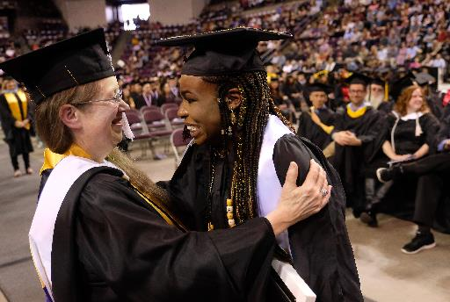
GRADUATION
Degrees and Certificates
3,970 | 17/18
4,060 | 18/19
3,879 | 19/20
3,562 | 20/21

Slide 17

LOOKING FORWARD

Slide 18
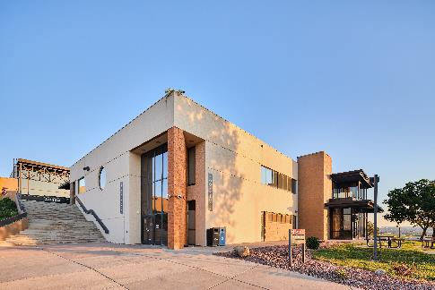

Slide 19
STRATEGIC PLANNING
Formation of Core Strategy Team
Listening sessions began late in the fall semester, and will continue through mid-spring. So far, we have had listening sessions with:
Admissions, Enrollment and Recruitment staff
MVP staff
Student Ambassadors
Academic coaches

Slide 20
STRATEGIC PLANNING
What's Next?
Future sessions will include the Faculty Senate, the Deans, Leadership Team as well as faculty, staff, students and community members.
The Core Strategy Team has broken into small working groups based around several themes that we anticipate the finished strategic plan will address:
Academics
Assessment/Data/Administrative Processes
Employee environment
Enrollment
Equity and Inclusion
Student issues

Slide 21
STRATEGIC PLANNING
Destination 2022
We are currently gathering information and data to report out on (and close out) the current strategic plan, Destination 2022.
We expect a draft of the new strategic plan to be shared in the late spring/early summer, and once we gather feedback on that, we plan on publishing a final strategic plan in the fall.

Slide 22
EQUITY
Equity and Inclusion practices embedded throughout the strategic plan
HSI Taskforce
Adoption of the National Association of Diversity Officers in Higher Education (NADOHE) Anti-racism Framework
ESL Scholarships
Data-driven virtual town halls

Slide 23

FOUNDATION UPDATES
$5.7 million in funding for two programs:
Back to Work
Finish What You Started

Slide 24
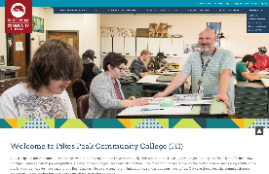
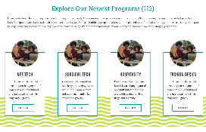
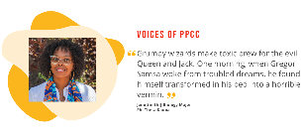


NEW WEBSITE
LAUNCHING THIS WINTER
The result of more than a year of engaged feedback from students, staff and faculty.
The new website will focus on:
Improved experience for prospective students
Academic Pathways
Career Options
Self-Assessment Tools
An improved calendar
All images and content are placeholder only.

Slide 25






ACADEMIC PATHWAYS
Science, Technology, Engineering & Math
(STEM)
Public Service
& Social Sciences
Medical Sciences
Business, Design
& Hospitality
Arts & Humanities
Applied Technology

Slide 26

GRADUATION 2022
In person at The World Arena
Cheering aspects from the drive-in
Virtual ceremony sent out afterward

Slide 27
UPCOMING PROGRAMS
Interior Design
Physical Therapy Assistant
Industrial Mechatronics Maintenance Technology
Degree & 3 Certificates
Environmental Science AS
Health, Wellness, and Fitness
  Degree & 3 Certificates
Advance Pharmacy Practice
  Certificate
Mechanical Engineering
  Degree
Dietary Management
  2 Certificates
Outdoor Leadership & Recreation Technology
  Certificate

Slide 28


CAPITAL RESERVES
FY19
FY20
FY21
$33,889,597
39.2%
$31,119,838
33.9%
$41,694,660
42.7%

Slide 29
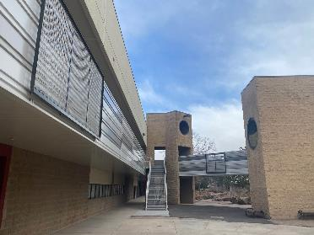
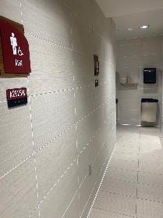
CAPITAL PROJECTS: NEARLY COMPLETED
Aspen bathrooms
Centennial stairs and walkways
Roof replacement
CDC roof replacement

Slide 30

CAPITAL PROJECTS: UPCOMING
Learning Commons at DTSC
(in design phase, target August, 2022)
CHES, Phase II
(in construction, target August, 2022)
Breckenridge restroom upgrade (TBD)
Wayfinding and signage (TBD)
First Responder Emergency Education Complex (TBD)

Slide 31
CONSTRUCTION / PARKING AT CHES
Ideas to relieve parking:
Shuttle from Rampart
Dedicated spaces for carpooling
Partnerships with nearby businesses and New Life
Autonomous e-shuttles, i.e. School of Mines

Slide 32

NEW PARTNERSHIPS

Slide 33
COLORADO PUBLIC RADIO AND KEPC
A signal trade that gives our old signal at 89.7 FM to Colorado Public Radio and moves our rebooted eXtra Music station to 102.1 FM and 1490 AM will provide the college with:
Internships on KRCC and CPR's new indie music station.
Five years worth of free public service spots on both stations.

Slide 34
CYBERSECURITY PUENTE PROGRAM
EARLY CHILDHOOD EDUCATION
This grant-funded initiative that partners with CSU-Pueblo, Pueblo Community College, and area high schools to recruit more women and LatinX students into Cybersecurity.
Joint initiative to promote the field of early childhood with our partners in the field:
Joint Initiatives for Youth and Families
Early Connections
CPCD
Pikes Peak Workforce Center
A new ECE apprenticeship
program starts this spring.

Slide 35

KUDOS

Slide 36

CYBER CLUB
PPCC is ranked first in Colorado (39th in the USA behind only two other community colleges) in the Fall 2021 National Cybersecurity League Power Rankings.

Slide 37
KUDOS
The Centennial Campus Child Development Center has been reaccredited by the National Association for the Education of Young Children. The accreditation is good for 5 years. The center received an overall score of 96.4% and is considered to be in the top 25% of all programs in the nation evaluated by the National Association.
The first two cohorts of Surgical Technology students achieved 100% pass rate on national certification exams.
Nursing BSN program officially accredited by CCNE

Slide 38
2021 STAFF & FACULTY EMPLOYEES OF THE YEAR
APT of the Year
Michael Madson
Associate Dean of Natural and Physical Sciences
Classified Employee of the Year
Jess Martinez
Accounting Technician III | Financial Services, Student Accounts.
Faculty of the Year
Kristy Callihan
CHTS
Instructor of the Year
Lori Salgado
BPS

Slide 39
THANK YOU.
QUESTIONS?

