Slide 1





Professional Development Week
President’s Address | Spring 2023

Slide 2
Enrollment | AFTE

Slide 3
Retention
53.5%
52.0%

Slide 4
Retention By Ethnicity

Slide 5

Graduation
Degrees & Certificates
3,970 | 17/18
4,060 | 18/19
3,879 | 19/20
3,562 | 20/21
3,051 | 21/22*
*Includes 26 BSN/BAS degrees

Slide 6
Achieving HSI Designation

Slide 7
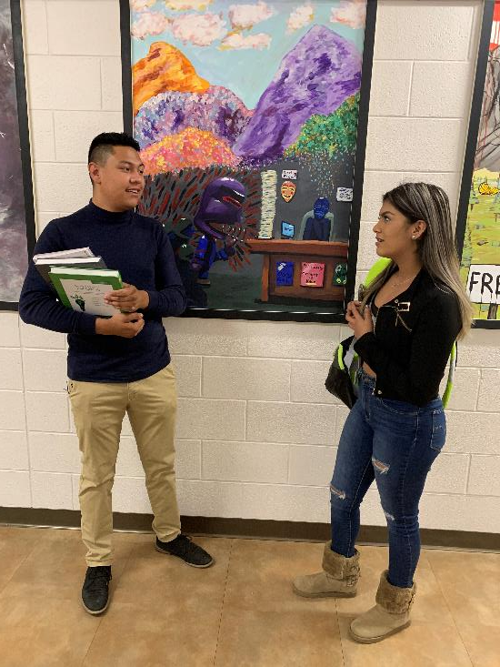
Achieving HSI Designation
Increased from 16% to 24% between Fall 2016 and Fall 2022
We are officially an Emerging Hispanic Serving Institution.
We will hopefully be an HSI within a year.

Slide 8
Name Change
The process is moving ahead. Since the Governor's signing the name change bill in April, our team has:
Worked with external agencies, organizations and CCCS system to implement change widely.
Worked with CCCS-IT to implement email, portal, and website changes.
Run an aggressive multi-platform "new state of college" advertising campaign
Changed the main sign at Centennial, and erected banners with the new name
Put out an RFP to change the rest of the community college signs
Gotten most of the state and municipal signage changed
Ordered new swag, though in limited supply, at the book store

Slide 9
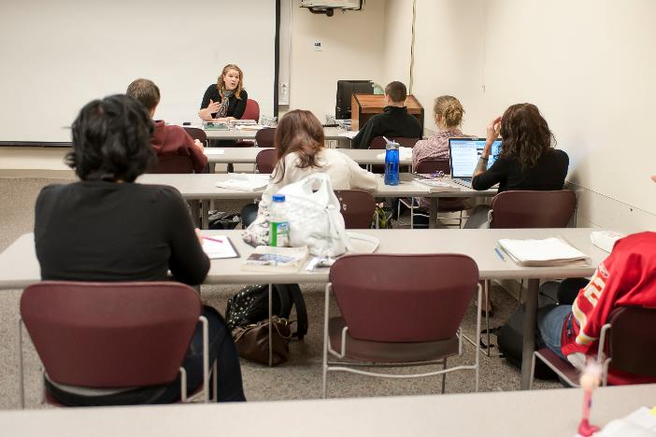
Efficiency Model
Fall enrollment was stable relative to last year—0.5% increase YTY
We reduced number of sections offered by a net of 10% (down to 2,102 total sections in FA22 from 2,338 total in FA21)
Our overall seat-fill rate went up year over year—up to 61% from 56.6%
Every campus location saw an increase in fill, with Rampart Range growing the most in fill rate year over year—reaching 79.4% average fill up from 70.1%), Downtown grew to 58.6% up from 53.3%, Centennial grew to 57.5% up from 51%.
The estimated expense reduction for fall alone was more than $800,000. PPSC has reduced total expense by roughly ~$1.8M because of the growth schedule initiative and other non-instructional efficiencies.
We estimate that nearing our 80% fill target across all campuses could generate $2M to $3M in additional savings.

Slide 10
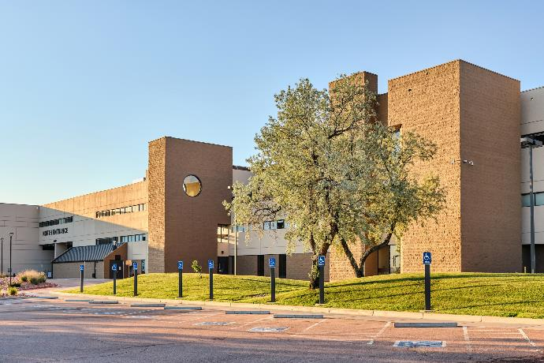
Why the Budget Remains Tight
Huge increases in operational costs.
We planned for a more than 10% increase in operating in our initial budget, but real expenditures are outpacing that estimate.
General Operating expense is projected to increase by 16%
Utilities are increasing by 19%
Travel expense is projected to more than double year over year.
Expect travel restrictions next year

Slide 11
Academic Organizational Structure | Campus & Program Alignment
CENTENNIAL CAMPUS Business, Public Service & Applied Technology | DOWNTOWN CAMPUS Art, Humanities, and Social Sciences | RAMPART CAMPUS Science, Engineering and Math | CHES CAMPUS Medical Science
Accounting (ACC) | American Sign Language (ASL) | Agriculture (AGY) | Dental Assisting (DEA)
Business (BUS) | Art (ART) | Astronomy (AST) | Emeregncy Medcial Services (EMS)
Busines (Technology)BTE | Communication (COM) | Bioology (BIO) | Health Professional (HPR)
Computer and Networking Technology (CNG) | Dance (DAN) | Chemistry (CHE) | Medical Assisting Professional (MAP)
Computer Information Systems (CIS) | French (FRE) | Dietetic Technology (DIT) | Medical Office Technology (MOT)
Computer Web-Based (CWB) | German (GER) | Environmental Science (ENV) | Nursing (NUR)
Criminal Justice (CRJ) | History (HIS) | Geography (GEO) | Nursing Assistant (NUA)
Culinary Arts (CUA) | Humanities (HUM) | Geology (GEY) | Pharmacy Technician (PHT)
Early Childhood Education (ECE) | Interior Design (IND) | Meteorology (MET) | Physical Therapist Assistant (PTA)
Education (EDU) | Interpreter Prep Program (IPP) | Natural Resources (NRE) | Radiologic Technology (RTE)
Emergency Management and Planning (EMP) | Japanese (JPN) | Outdoor Studies (OUT) | Surgical Technology (STE)
Emergency Services Admin (ESA) | Multimedia Graphic Design (MGD) | Physics (PHY)
Finance (FIN) | Music (MUS) | Recreation (REC) | Health and Wellness (HWE)
Fire Science Technology (FST) | Philosophy (PHI) | Science (SCI) | Integrative Health Professions (IHP)
Fire Science Wildland (FSW) | Photography (PHO) | Veterinary Technology (VET) | Physical Education (PED)
Hospitality (HOS) | Radio and Television (RTV) | Water Quality Management (WQM)
Law Enforcement Academy (LEA) | Russian (RUS) | Zoo Keeping (ZOO)
Management (MAN) | Spanish (SPA)
Marketing (MAR) | Theatre (THE) | Computer Science (CSC)
Paralegal (PAR)
Public Security Management (PSM) | Anthrothopology (ANT) | Math (MAT)
 | Counselling (CSL)
Architectural Engineer/Construction Management (AEC) | Economics (ECO)
Automotive Collision Trechnology (ACT) | Entrepreneurship (ENP)
Automotive Service Technology (ASE) | Political Science (POS)
Carpenty (CAR) | Psychology (PSY)
Computer Aided Drafting (CAD) | Social Work (SWK)
Construction Technology (CON) | Sociology (SOC)
Diesel Power Mechanics (DPM) | Women and Gender Studies (WST)
Electricity Industrial Commercial (EIC)
Electronics (ELT) | Advancing Academic Achievement (AAA)
Engineering Technology (EGT) | English (ENG)
Heating and Air Conditioning (HVA) | English as a Second Language (ESL)
Machining (MAC) | Journalism (JOU)
Manufacturing Technology (MTE) | Literature (LIT)
Occupational Safety Technician (OSH)
Plumbing (PLU)
Welding (WEL)
Engineering (EGG)

Slide 12
Strategic Plan Update
Draft plan distributed in mid-October
We had six listening sessions with faculty/instructors, staff and the SGA to gather feedback.
Based on that feedback, revised the plan. The revised plan will be published next week.
As with the last strategic plan, we will begin a focus goal process. Focus Goal task force will be assembled to determine the first focus goals, and new working groups will be formed for those goals. That work will start this spring.
Strategic Plan in Broad Strokes
First Year Experience
Workforce Development/Adult Learners
E&I
Thriving and Energizing Employee Environment

Slide 13

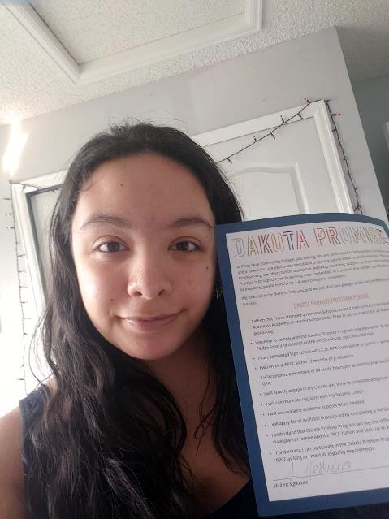
Plans to Extend and Expand
D2 extension
Michell High School
What's next?

Slide 14
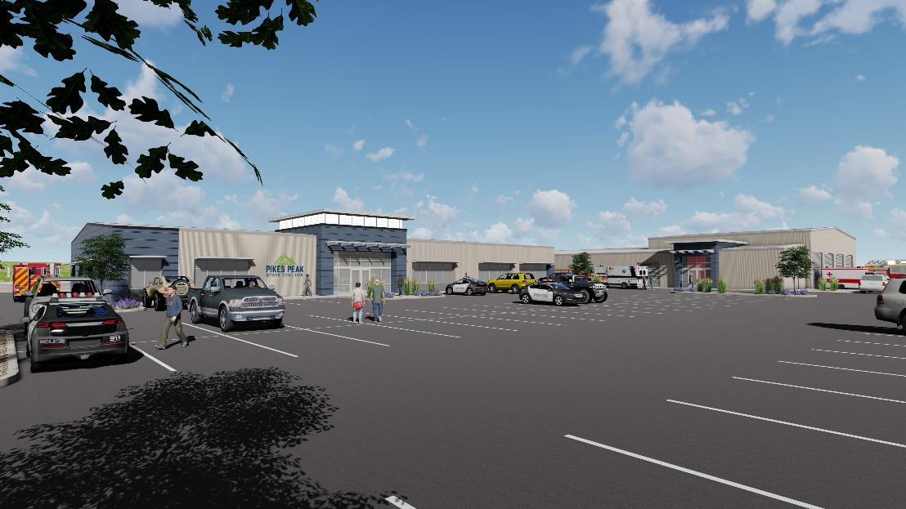
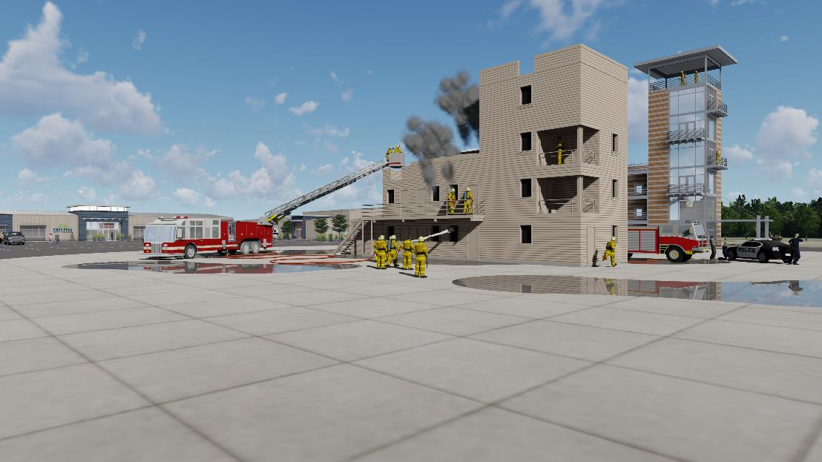
FIRST RESPONDER
TRAINING COMPLEX

Slide 15
“
Colorado Springs Fire Chief Randolph Royal
"As the Fire Chief of the Colorado Springs Fire Department, I would like to share our support for the proposed First-Responder Training Complex at PPSC. Being the largest department in southern Colorado, we have over 600 employees and hire at least 60 new firefighters per year. This facility will be a valuable addition not only for meeting our needs as a department, but will also be a benefit to the City of Colorado Springs, and El Paso County, as well as, southern Colorado, as a whole.
Within El Paso County alone, there are over 25 smaller fire departments and districts, that are constantly looking for new staff and volunteers. These smaller fire agencies don’t have the facilities and equipment to provide the needed training to their staff. This facility would greatly increase their capabilities, and would positively impact departments all across southern Colorado, helping both with recruitment and sustainability."

Slide 16
Details About the First Responder Complex
Serve over 1,000 students per year.
The numbers below represent how many students we serve now/
and how many we’ll be able to serve with the new complex.
170/300
fire science students
500/1,000 in
criminal justice
75/100
police cadets
50/105 in
emergency services

Slide 17

Project Cost
$39 million plus
Tentative Completion Date
February 2027

Slide 18
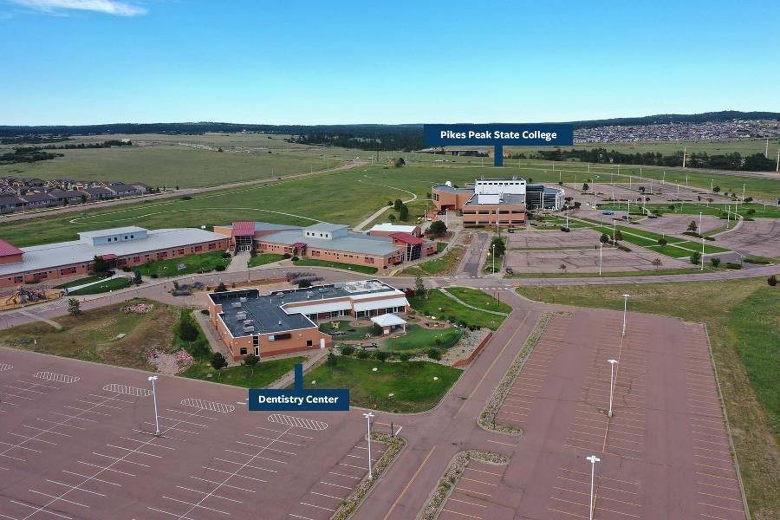
Delta Dental Oral Health Career Center
$2.5 million from the Delta Dental of Colorado Foundation
Total cost: $9–$10 million (fundraising and college reserves)
Housing a new Dental Hygiene program at Rampart Range in former Child Development Center
Feeding urgent need for hygienists
Target completion: August 2024

Slide 19


CSU-Pueblo Partnership
Win win for students:
More choices
More conveniences

Slide 20
SB 18-086 Cybersecurity Summary
For Fiscal Year 2022, PPSC received $300,000 from the legislature as part of the college’s fee for service allocation to support our efforts in offering Cybersecurity degrees and certificates.
FY22 Funding Highlights:
PPSC awarded 12 $2,500 scholarships
All other monies funded salaries for three full-time Cybersecurity faculty.
PPSC Awarded 27 Associate of Applied Science (AAS) degrees in Cybersecurity and 61 Certificates—all a result of increased capacity of instruction.
5 Year Completion Trends in Cybersecurity*
Academic Period | Degree Completers | Certificate Completers
AY 21–22 | 27 | 61
AY 20–21 | 29 | 30
AY 19–20 | 10 | 35
AY 18–19 | 1 | 28
AY 17–18 | 0 | 15
*Since the initiation of these funds, PPSC has more than tripled the number of degrees awarded in Cybersecurity—Certificates have doubled.

Slide 21

The Larger Cyber Picture
Increased staff capacity in Cybersecurity has allowed more significant engagement with industry partners in the form of competition and event participation:
PPSC has participated in more than 50 competitions and events to promote cybersecurity.
PPSC students have won and placed in events nationwide, to include the Rocky Mountain Collegiate Cyber Defense Competition, CyberMaryland competitions, and other regional cyber competitions. PPSC students have consistently outperformed and placed alongside students at 4-year institutions (UCCS, USAFA, etc.)

Slide 22

New & Upcoming Programs
New
Public Health
Physical Therapist Assistant
Upcoming
Yoga Teacher Training Certificate
Engineering Technician
Licensed Practical Nurse (LPN)
Dental Hygiene
Logistics Management
BAS Business Core (title may change)
BAS Cyber Security

Slide 23


College Reserves
FY20
FY21
FY22
$31,119,838.60
33.9%
$41,694,660.69
42.7%
$24,600,000
23.4%

Slide 24

Kudos
Pikes Peak State College is proud to be one of only nine programs worldwide to receive the status of Endorsed for their Core Four Standards: Prebriefing, Debriefing, Facilitation, and Professional Integrity by The International Nursing Association for Clinical Simulation and Learning.
Multimedia Graphic Design Chair Peter Strand was honored by The local American Advertising Federation with its Icon Award for Best Educator in Advertising.
Mark Vickers, Nursing Assistant faculty, won one of 12 Nightingale Awards presented by the Colorado Nurses Foundation.
Pikes Peak State College made the 2022 Military Times "Best for Vets: Colleges" list. It ranked 6th in the country for two-year schools and 47th overall.
And, PPSC has earned the Gold Designation as No. 2 in the Top Ten Schools for all Large Community Colleges for 2022-2023, the highest designation that Military Friendly® Schools has.

Slide 25
Questions?

