Slide 1


Slide 2
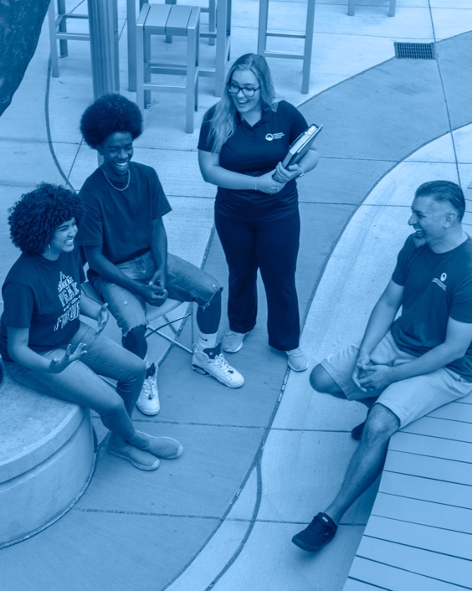
STATUS REPORT

Slide 3
DEGREES & CERTIFICATES
3,970
Number of degrees and certificates awarded in AY17/18
4,063
Number of degrees and certificates awarded in AY18/19

Slide 4
RETENTION
8 Years of Growth

Slide 5
ENROLLMENT
Semester FTE | Summer | Fall | Spring | AY
AY 18/19 | 2,223 | 8,129 | 7,655 (as of Jan. 8, 2019) | 18,007
AY 19/20 | 2,187 | 8,369 | 7,815 (as of Jan. 13, 2020) | 18,371
% Change | -2% | +3% | +2.1% | +2.0%

Slide 6
Dakota Promise
Our recruiters have had multiple events at all 4 schools and have done direct communication with students and parents through various channels.
Gov. Polis visited Harrison High School, widely praising the Dakota Promise and saying he thinks this should be scaled up to go statewide.
Progress so far:
265 applicants from D2 High Schools, a 70% increase over same time last year.

Slide 7

PPCC Foundation Fundraising Successes
Money raised for CHES: $2.6 million
Major donors:
  Colorado Springs Health Foundation
  Mary K. Chapman Foundation
  Colorado Health Foundation
  El Pomar Foundation
  Inasmuch Foundation
  COPIC Medical Foundation
  Colorado Opportunity Scholarship Initiative
ReFUND Colorado

Slide 8

Spring DEI Events
Equity Project
Onboarding Project
Upcoming Activities
  MLK Observance on Jan. 20
  Diversity Team Meetings
  Real Talk Women’s Forum
  CEO Action Pledge for Diversity and Inclusion on Feb. 6
  Courageous Campus Conversations Lecture Series
  DEI Awards on May 7

Slide 9
Diversity
We've created new information on the website about pronouns.

Slide 10

First Year Experience
FYE Symposium
Monday, January 27

Slide 11

Near Completers
Initiative to encourage students who earned at least 45 credits before leaving to come back.
We have:
Sent an email to alert them to their increased earning potential (average of $124/week based BLS figures)
Offered them a $248 tuition credit (equivalent to two weeks of that increased earnings) to return
Case managed their particular issues

Slide 12
Results From a Cohort of More Than 600
52
75
5
Former Students Responded
Auto-Conferred
(mostly AGS degrees)
Students Registered for Spring 2020

Slide 13
Texting
Through Signal Vine, which we implemented in the fall,
we had:
3,966 applicants opt in to receive messages.
Fall 2017 applied to enrolled yield rate was 35.6%
Fall 2018 applied to enrolled yield rate was 37.2%
Fall 2019 applied to enrolled yield rate was 38%
  The yield rate for the group of applicants who received texts was 44.6% (6.6% increase)

Slide 14
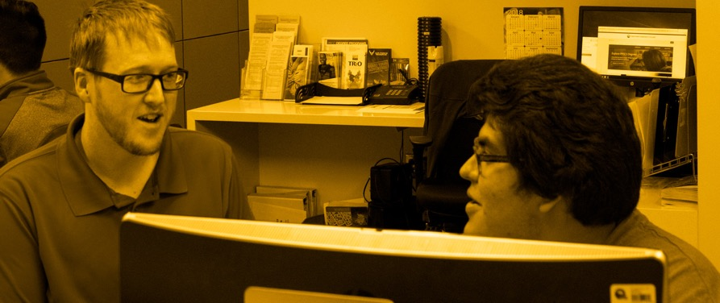
Extended Advising Hours
Fall Advising Sessions
YEAR | TOTAL ADVISED (Unduplicated) | % CHANGE
2016 | 7,271 | N/A
2017 | 7,444 | +2%
2018 | 6,698 | -10%
2019 | 8,990 | +34%

Slide 15

Student Employment
Purple Briefcase, a new student employment tool, went live July 1. Since then:
We have posted 152 jobs
667 students have submitted applications for employment
86 PPCC supervisors have used Purple Briefcase
External employers will be able to post jobs, internships and apprenticeships by end of January

Slide 16

A LOOK AHEAD

Slide 17
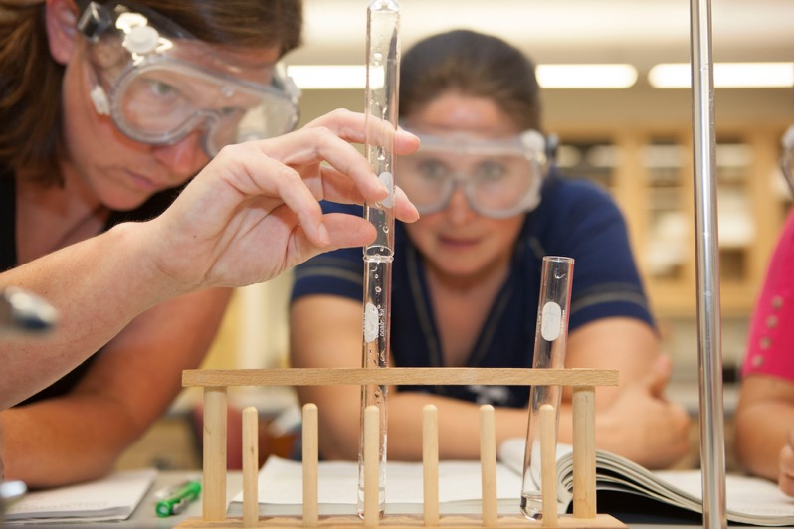
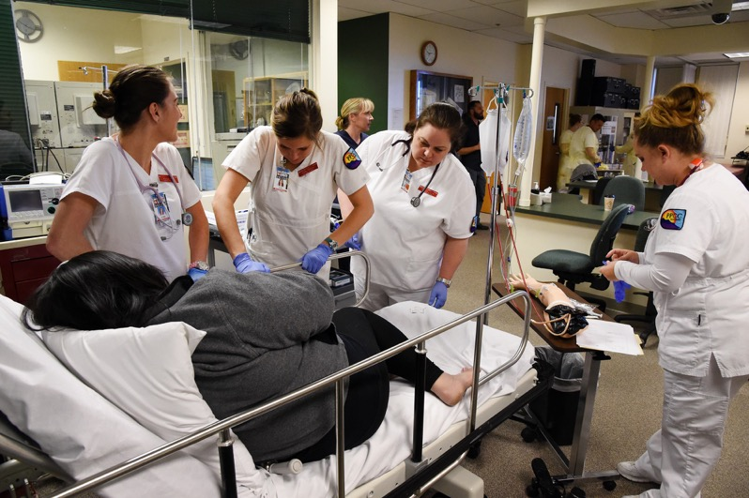
New Divisions | Health Sciences is Now…
Natural and Physical Sciences
Medical Sciences

Slide 18
Upcoming Programs
Spring 2020 | Fall 2020 | Beyond
Emergency Management and Planning | AGS | Hospitality | AGS | Facilities Maintenance | AAS TBD
Surgical Tech | AAS | Secure Coding | AGS | Veterinarian Technician | AA Fall 2021
 | Paramedicine | BAS (tentative) | Physical Therapy Assistant | AA Fall 2022
 | Vet Assistant Certificate

Slide 19
Need For Hispanic Outreach
17.5%
El Paso County’s Hispanic population as of the 2010 Census
32%
52.3%
D11
K–12
D2
K–12

Slide 20
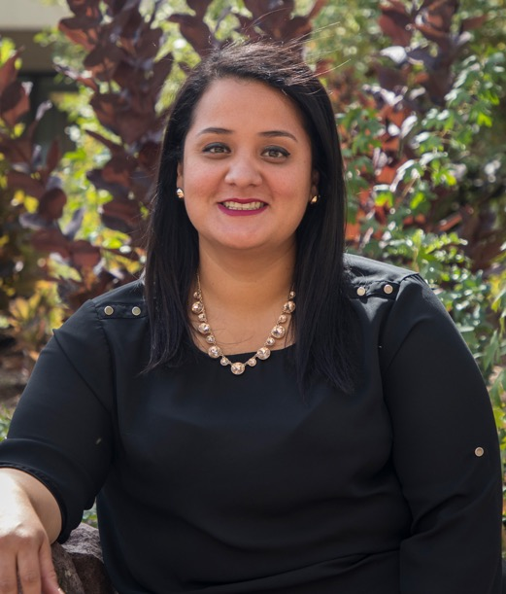
Hispanic Serving Institution Goal
Hispanic Recruiting Events
Yuri Grijalva-Perry, Bilingual Recruitment and Admissions Specialist, has conducted a variety of Spanish language recruitment events in the community, area high schools and on campus.
9 Spanish-speaking PPCC Visits 2019
(67 total participants)
12 Spanish-speaking Campus Visits planned for 2020
135 total participants in high schools

Slide 21


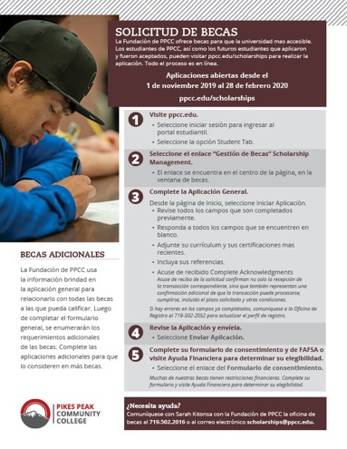
Hispanic Marketing Campaign
In January, the Marketing and Communications Department will launch an aggressive Hispanic Ad Campaign.
Based on extensive market research, they will be reaching out to potential Hispanic students through:
Google Display
YouTube
Facebook
Telemundo
Univision
KRYE (94.7 FM) | Tigre Radio
Southeast Express | The new newspaper on the southwest side of Colorado Springs
Bus benches
And special events, such as Cinco de Mayo
They have created new Spanish-language videos, radio spots, posters, digital ads, a viewbook and a microsite to support this campaign.

Slide 22
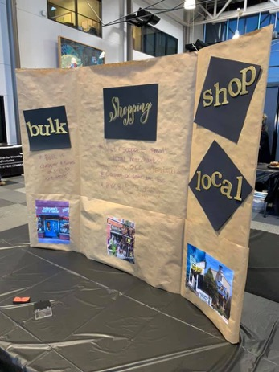
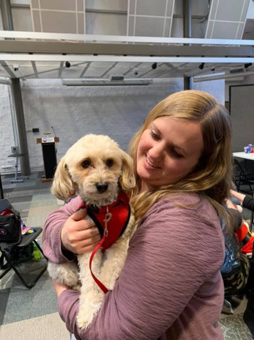

Student Life Programming
Student Life has provided a schedule of planned activities in advance of each semester to encourage faculty to incorporate activities into their syllabi.
SGA and Student Life partnered to offer 70-plus events and programs, including: Video Game Championships, Mystery Luncheon, Sustainability Holiday Fair, and the Afternoon Tea (which drew in students who are more comfortable with introvert-oriented activities)
Co-curricular partnerships for this academic year includes: Around the World in 90 Minutes (fall) Multicultural Awareness Conference (spring).
Attendance at larger events:
De-Stress Fest Fall 2019 | 1368 attendees (all campuses)
Welcome Week Fall 2019 | 836 (all campuses)

Slide 23
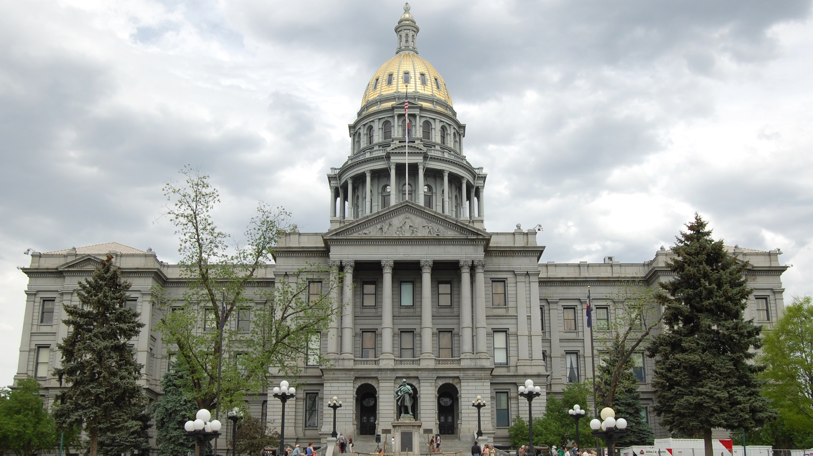
2020 Legislation & Budget

Slide 24

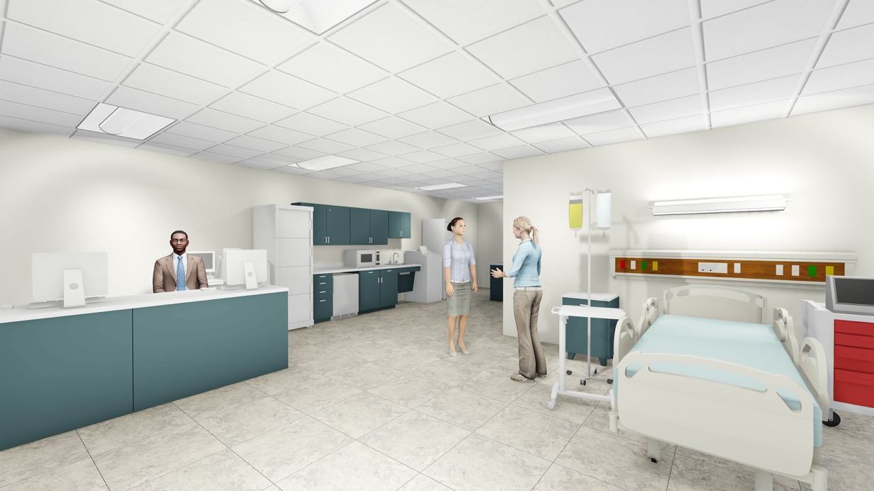
Center for Healthcare Education & Simulation
Phase I of the CHES building has been completed.
45,000 sq. ft. of space remaining to renovate.
Phase II will begin in March with a December completion date.

Slide 25
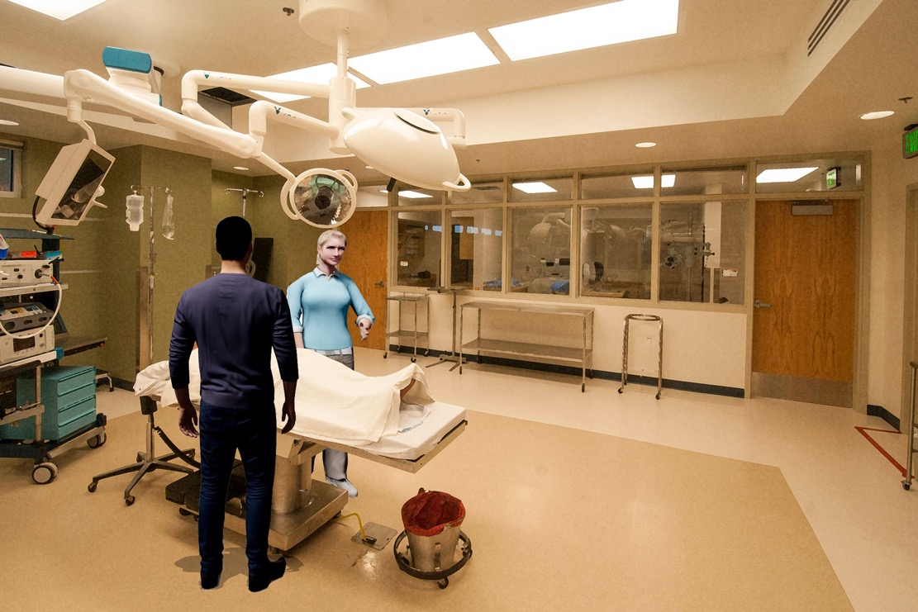
Center for Healthcare Education & Simulation
Phase II will contain programmatic space for Pharmaceutical Tech, EMS, Surgical Tech, Dental Assisting, Medical Assisting, staff and faculty office space, and a number of additional classrooms.

Slide 26
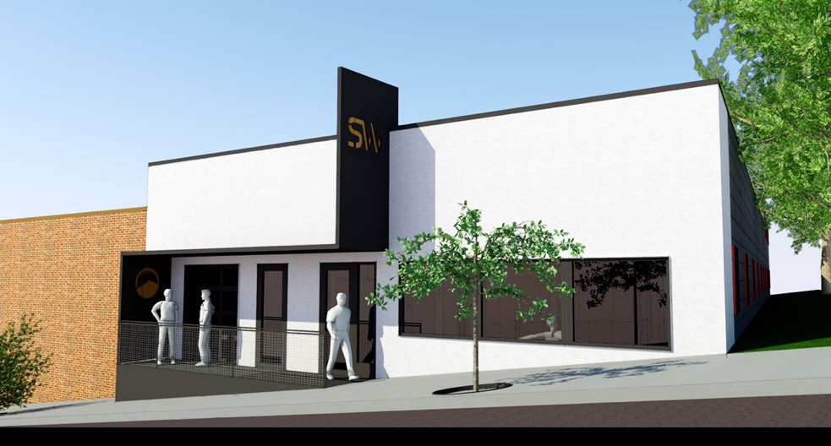

Studio West
Project will be complete for spring 2020 and will house the following:
  Taffy & Steve Mulliken Black Box Theatre
  Kristen Kane Faricy Dance Studio/Performance Space
  Expanded Art Gallery
  Two classrooms

Slide 27
Centennial Experience Upgrade: Spring Student Vote
Working with HB&A Architects to provide conceptual design.
  80,000 sq. ft. building housing construction trades and facilities.
  Rotunda remodel
  Courtyard redesign
  B-Building renovation

Slide 28
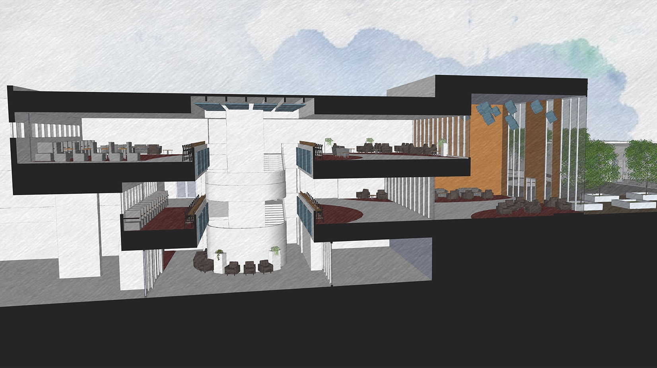

Slide 29
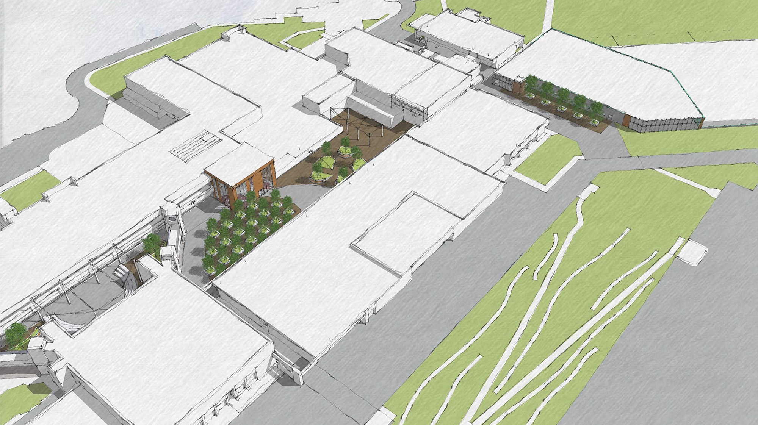

Slide 30
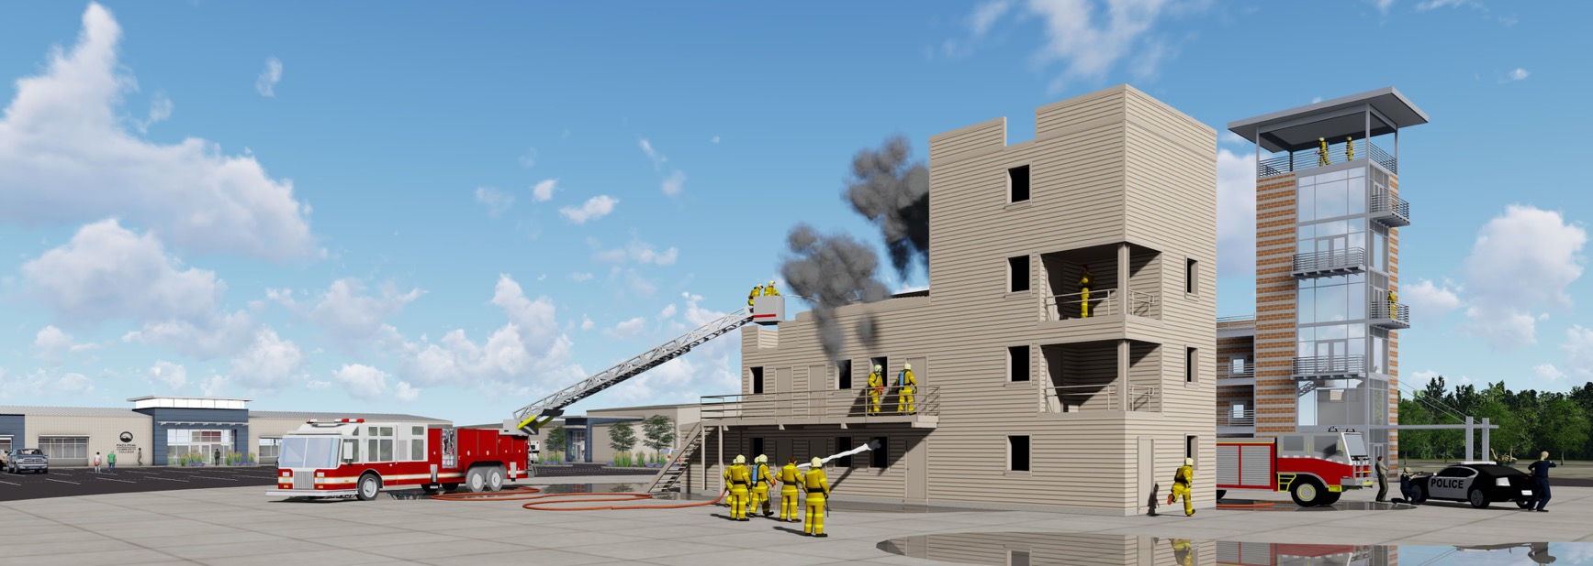
First Responder Emergency Education Complex

Slide 31
Other Upcoming Projects
Roofing Project | CC | Completion: 2021
Emergency Power | CC | Completion: August 2020
Restroom Upgrades | CC | Completion: October 2021
Fire Sprinkler | DTS | Completion: March 2021
Bridges, Walkways and Exterior Stairwell improvements | CC
Completion: December 2020
Downtown Studio Campus Learning Commons | TBD
Rampart Range Learning Commons | TBD

Slide 32
Assessment and Accreditation
PPCC successfully completed its mid-cycle (Year 4) Assurance Review with no recommended monitoring.
PPCC has made satisfactory progress toward the three areas of improvement identified during the 2014 Comprehensive Evaluation visit.
Workforce Diversity
Program Review
Student Learning Assessment

Slide 33

Assessment
Turning assessment into more effective practices
Help students learn more effectively
Help faculty design learning activities that reinforces student learning
Help PPCC achieve its mission

Slide 34
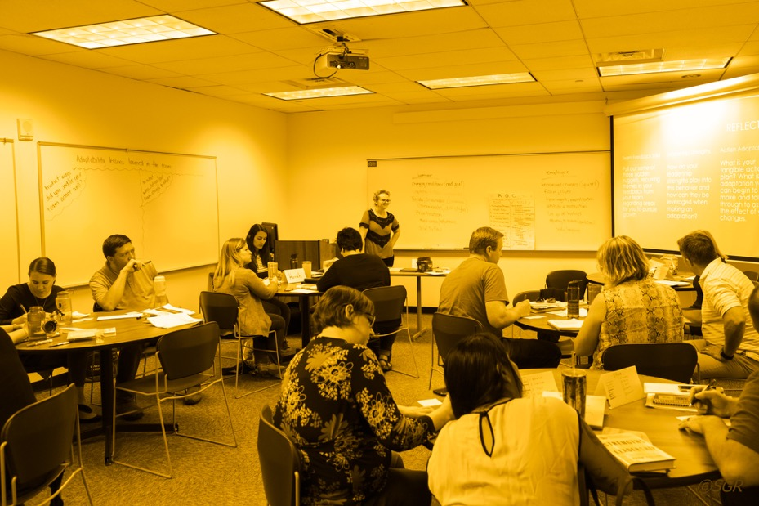
Assessment
PDW Workshops (Tuesday)
Faculty Focus Day (Thursday)
One-on-One sessions with Assessment Coaches (throughout the semester)
Professional Development Events
(to be announced)

Slide 35
College Reserves

Slide 36
Questions?

