Slide 1


Slide 2


Slide 3

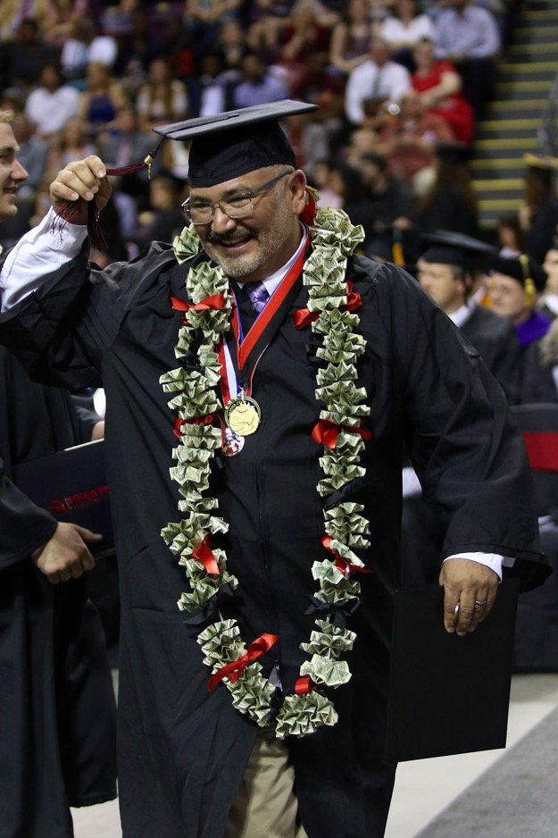
2017/18 Focus Goal 1
Improve Fall-to-Fall Retention to 55%
Tactics:
Ensure every student has a semester-by-semester plan
Use data to ensure best practices in the classroom
Align math pathways
Create a sense of belonging
Goal achieved!

Slide 4
Retention
From the lowest in the system to the highest.

Slide 5
Graduation Numbers
Our 5th record year in the last 6 years

Slide 6
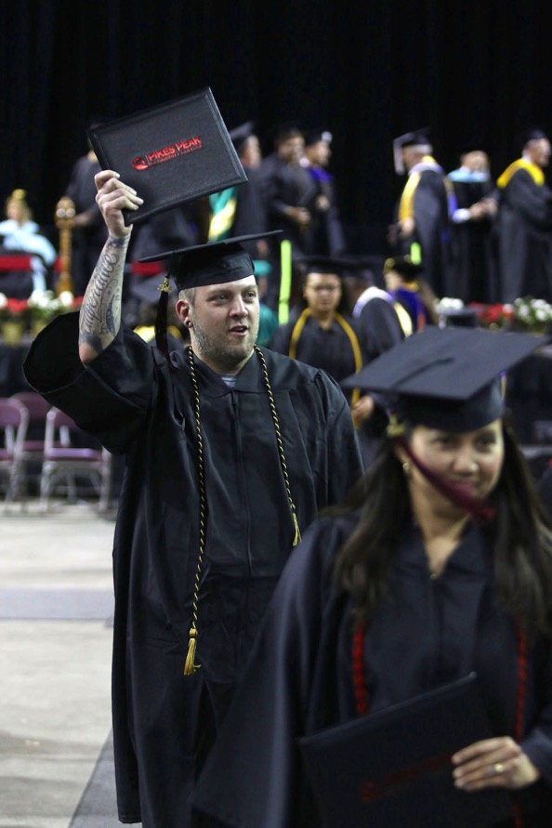
Dream Big
PPCC is pursuing a role as a national leader in student success

Slide 7
Enrollment
Semester FTE | Summer | Fall | Spring | AY
AY 17/18 | 2134 | 8167 | 8104 | 18,405
AY 18/19 | 2220 | 8164 | 7843 (as of Jan. 8) | 18,227
% Change | +4% | 0% | -3% | -1%

Slide 8
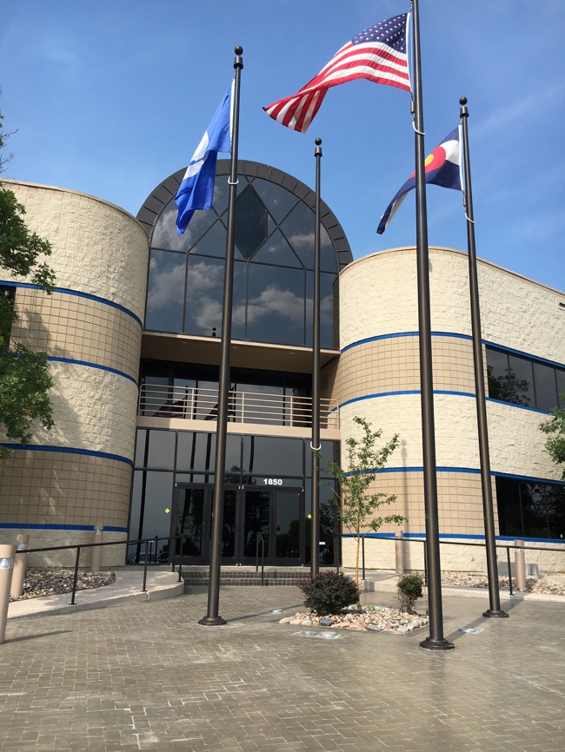
Capital Projects | PPCC Health Education Center
This $10 million investment (for the building and the renovation) will house:
The region's first Interdisciplinary Simulation Lab.
Phase I: Moving Nursing, Pharm Tech and Surgical Tech
Phase II: Moving EMS, Dental Assisting and Medical Assisting
Nursing Assistant will remain at both Rampart and Centennial campuses

Slide 9
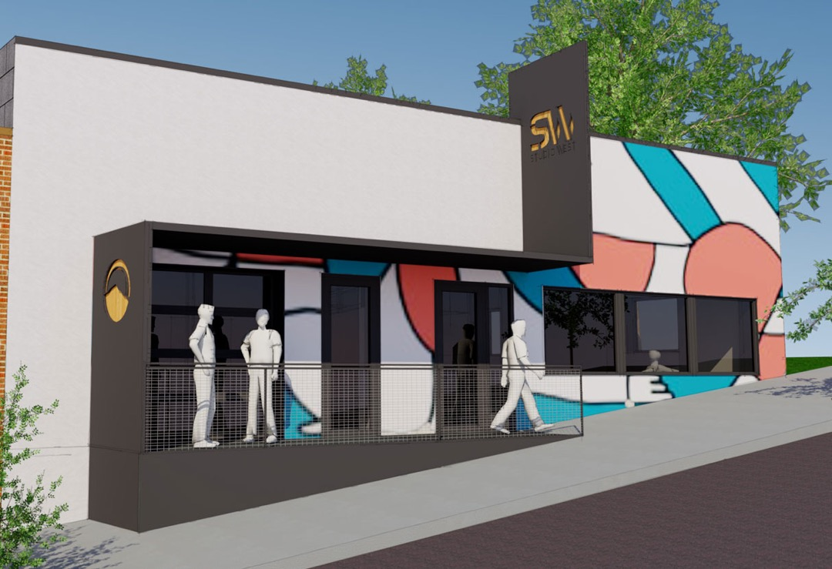
Capital Projects | Studio West
Black Box Theatre
Dance Studio/Performance Space
Expanded Gallery

Slide 10
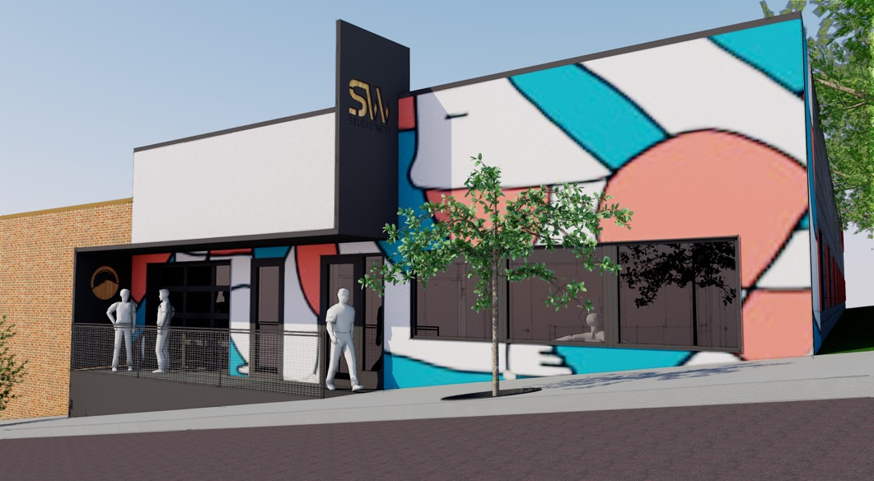

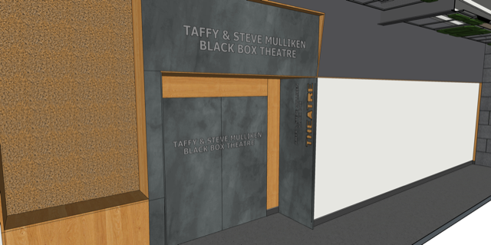

Slide 11
Capital Projects | Upcoming
Other Capital Projects in the Works:
Technical Education Center
Aspen Space Remodel (Rooms 312, 316, 362, 365, 367)
Downtown Learning Commons
Rampart Learning Commons

Slide 12
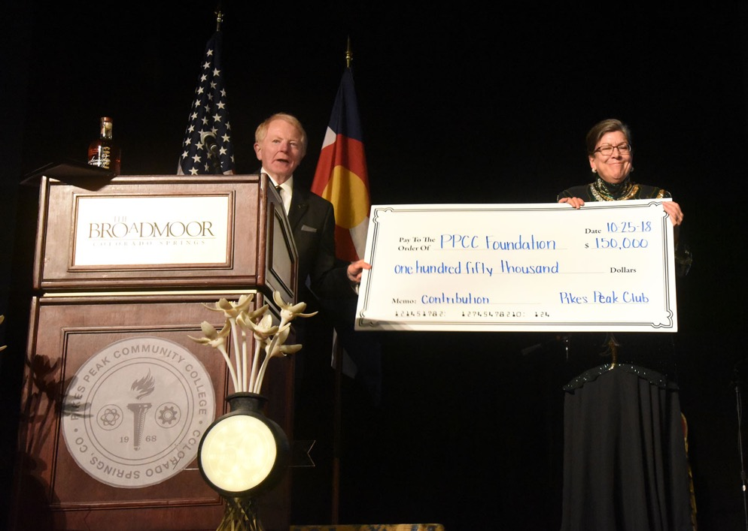
Foundation | 50th Anniversary Golden Gala
$270,000
Raised for the new Pikes Peak 50th Promise Scholarship
15% INCREASE

Slide 13




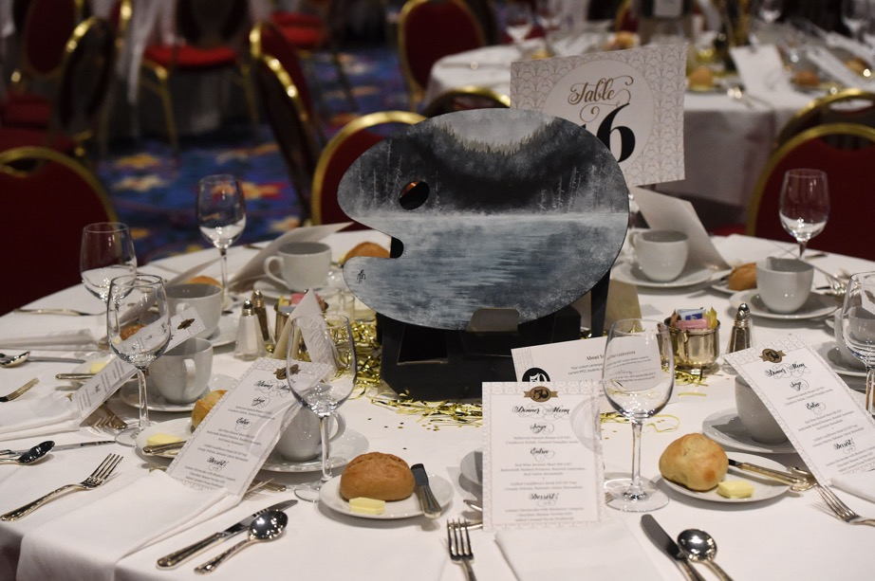

15% INCREASE

Slide 14
Foundation
Naming gifts for Studio West:
Taffy and Steve Mulliken Black Box Theatre
Kristen Kane Faricy Dance Studio
Significant new scholarship gifts:
Ent Credit Union
AFCEA | Cybersecurity
Fran Folsom Dinner
The annual fund-raiser for Culinary students moves to: Garden of the Gods Club on April 14
Other Chef Dinners
First will be at Smorbrod by Chef Jay Gust, Jan. 22. Benefits the Community Table
Others TBA

Slide 15
Campus Climate Survey
Improvement
81%
In 81% of the questions, the response improved over 2016.

Slide 16
Campus Climate Survey
Staff
64% | +22 Pts.
My institution is innovative.
68% | +17 Pts.
I am provided with the resources to
do my job well.
53% | +15 Pts.
I feel like I am informed about what is going on at my institution.
67% | -11 Pts.
Retirement benefits.

Slide 17
Campus Climate Survey
Faculty
65% | +24 Pts.
My institution is innovative.
62% | +25 Pts.
I trust and have confidence in the leadership of my institution.
66% | +21 Pts.
I feel like I am informed about what is going on at my institution.
65% | -16 Pts.
I feel like I know what to do if an emergency occurs at work (e.g. natural disaster, active shooter, etc.).

Slide 18

Diversity, Equity and Inclusion
CEID (Cultural Excellence Ideas and Dialog)
CEID Training is required for participation on faculty hiring committees
Part of diversifying workforce efforts
Gender Inclusiveness
New form in Banner asks for preferred name and pronoun
Preferred pronoun added as an email signature option

Slide 19


Diversity, Equity and Inclusion
"Black Klansman" author
Ron Stallworth
A new milestone of student engagement
Drew a crowd of more than 500 students, faculty, staff and community members
PPCC alum Stallworth posed for photos, gave interviews to the college and community newspapers, and signed autographs for hours.

Slide 20
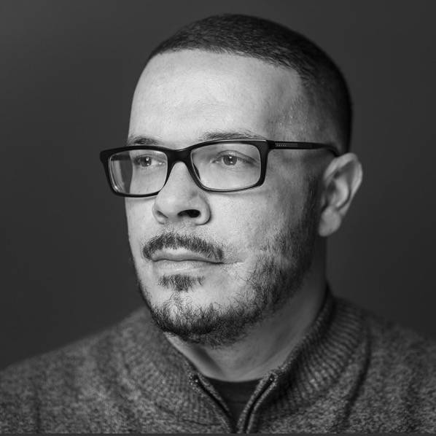
Diversity, Equity and Inclusion
Upcoming
CETL is showing Spike Lee's film based on the book, "BlacKkKlansman," 6 p.m. Jan. 25 at Centennial A140—a fund-raiser for the Black Student Union
Black Lives Matter activist and author, Shaun King, coming to PPCC on February 20
Multicultural Awareness Conference
A number of events related to the theme: The American Dream

Slide 21

Diversity, Equity and Inclusion
Achievement Gap
Pikes Peak United Men of Color
This Mentorship Program is designed to develop:
Self-advocacy
Leadership skills
Resiliency
Ultimate goal of program is retention of cohort to persist into second year and will track individuals through degree/certificate completion.

Slide 22

Food Insecurity | PPCC Cares: New Community Table
3,457
Visits During Fall Semester
203
Average Visits Per Week

Slide 23
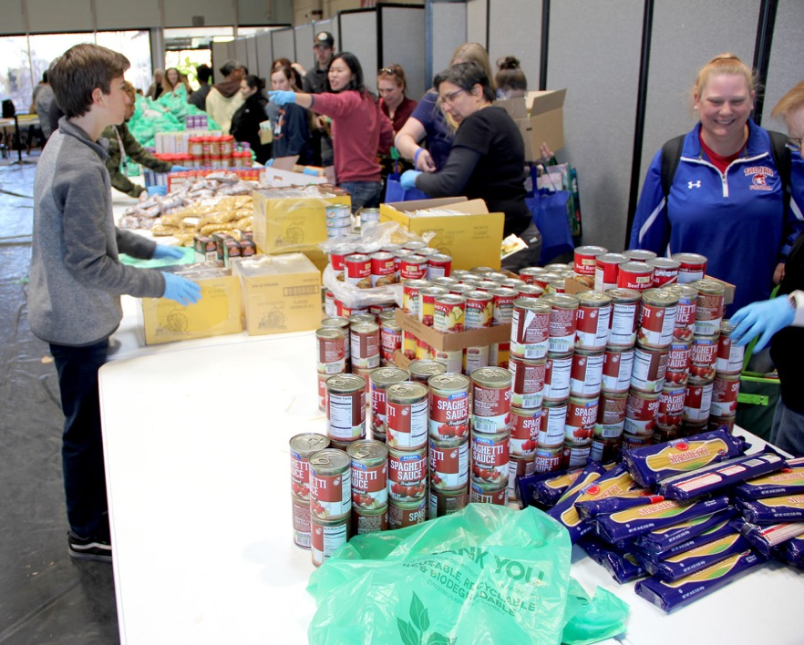
Food Insecurity | PPCC Cares: Mobile Food Market
863
Volunteers Enlisted
119,936
Pounds of Food
10,972
Students and Others Served
Photo credit Dwan Petti

Slide 24


Slide 25


Partnerships | SNAP Market
PPCC a pilot distribution point for SNAP Market, an online grocery store project. Those in need can:
Order reduced-price food at ppcc.snapmarket.org
Pick up at the Atrium 1-5 p.m. Wednesdays and Thursdays.
A partnership with the Food Maven and the USDA, the U.S. government department that oversees SNAP

Slide 26

Partnerships | The QUAD Innovation Partnership
Latest projects have included:
Innovations in Aging Collaborative: Develop a model for affordable senior housing.
Pikes Peak Community Foundation/Venetucci Farm: Identify a viable operating model to preserve the property.
Colorado Springs Utilities: Conduct research and analysis to inform the future of energy production and consumption in our region.

Slide 27
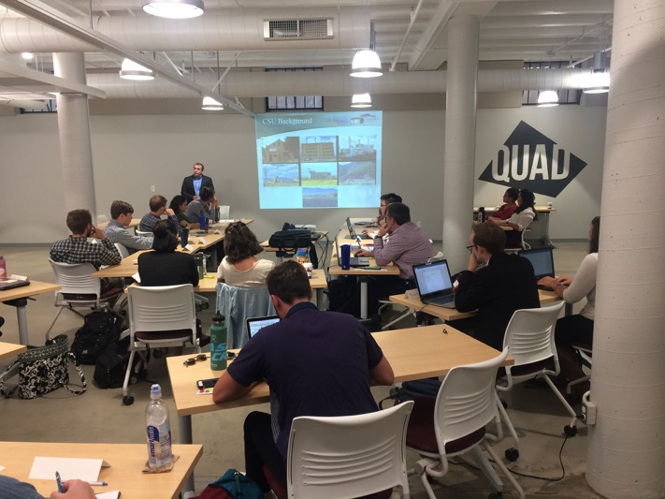
Partnerships | The QUAD Innovation Partnership
Latest projects have included:
Altia: Conduct a market survey of augmented reality technology to inform the launch of a new product.
El Paso County Public Health: Design viable interventions to improve access to healthy food in priority neighborhoods

Slide 28


Slide 29


Focus Goals 2018-2019
Diversity in Hiring
HIPS
DevEd and 1st Year Experience Redesign
PPCC Website Redesign

Slide 30
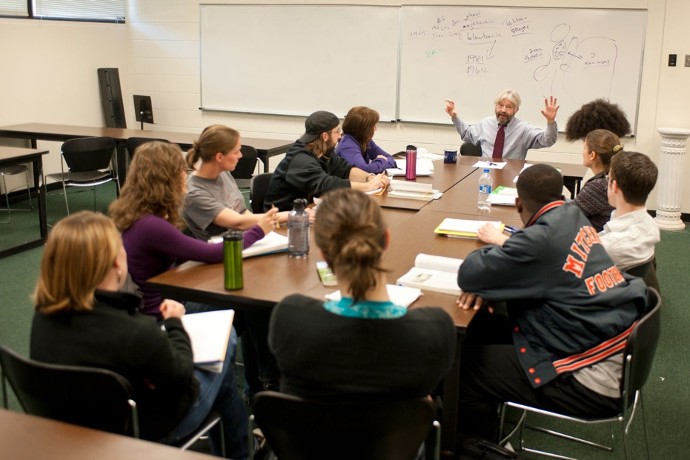
HLC Assurance Review
HLC Assurance Review
Will be conducted in Summer 2019 (virtual visit)
All employees will be invited to provide input/feedback on the draft Assurance Argument in January – February

Slide 31


Slide 32

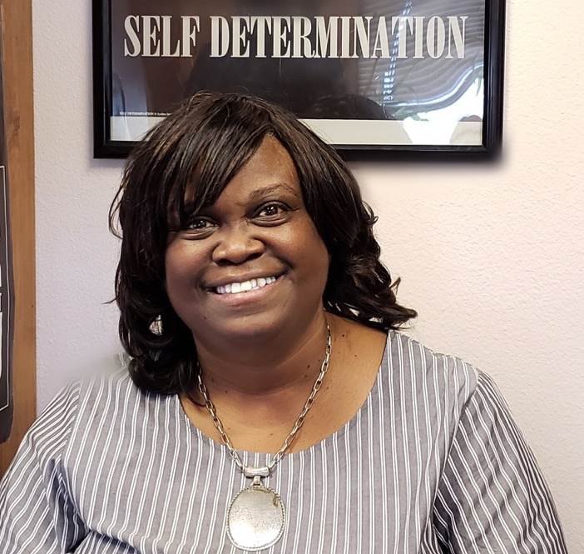
Kudos
Jacquelyn Gaiters-Jordan
PPCC’s Dean of Math and English
honored with the Colorado Association for Developmental Education’s
Lifetime Achievement Award.
Photo credit Re’nesia Mills and Evelin Rivera-Cabral

Slide 33
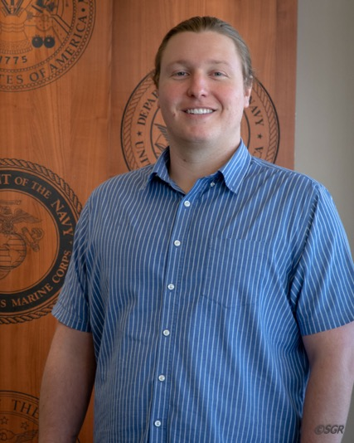
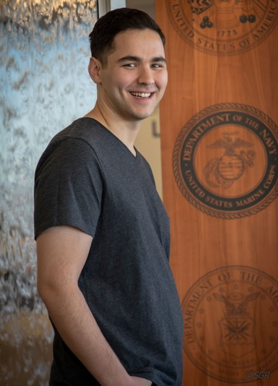
Student Success Stories
Mickey Jackson
Going to Amherst College
Thomas Johnson
Now attending
Princeton University
Photo credit Sondra Glovan

Slide 34
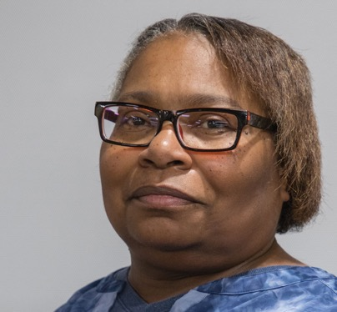
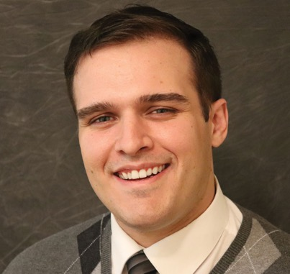
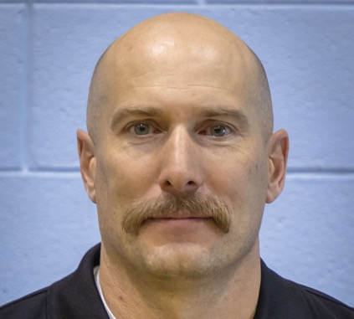
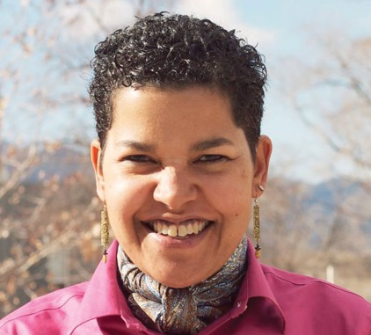
Kudos
Cynthia Theard
Classified Employee of the Year
Student Services Specialist II
Financial Aid Dept.
Alberto Teixeira
APT Employee of the Year
Business, Public Services and Social Sciences
Keith Williams
Adjunct Instructor
of the Year
Fire Science
Ann-Marie Manning
Faculty of the Year
Social Work

Slide 35
Questions?

