Slide 1
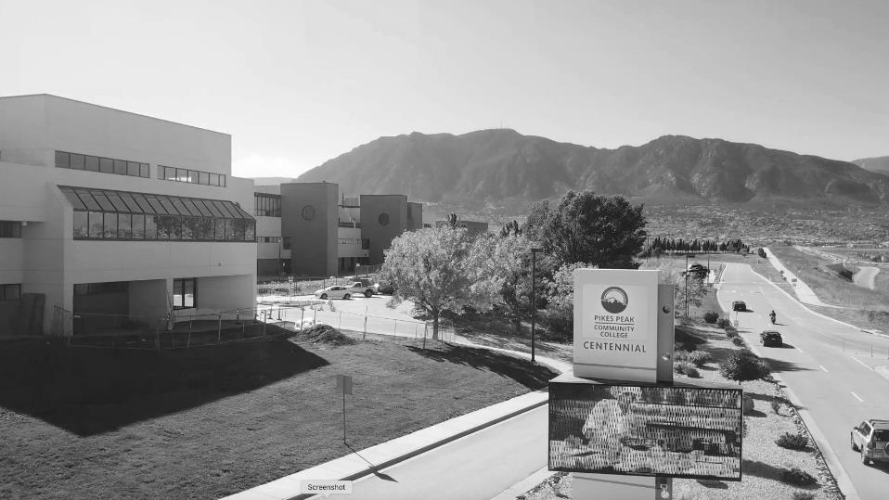

PRESIDENT’S
ADDRESS
2021 FALL PDW
REVIVE. REUNITE.
REINSPIRE.

Slide 2

NEW COVID PROTOCOLS
Masks Required (except for private offices)
Vaccines Recommended
Notes:
What this means for spring and beyond
- Hopeful themes about opening back up for regular classes sometime during Spring ‘21 semester. Including a grand opening of our really lovely Studio West.
- Vaccine rollout. 1B. What that means and how we'll be notified.
- Graduation might be in-person
- Challenges our students and employees are facing during the pandemic and our efforts to support people.

Slide 3

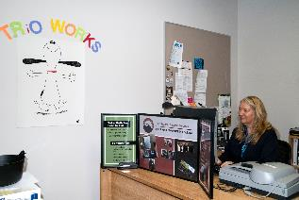
NEW ALTERNATIVE
WORK ARRANGEMENTS

Slide 4
FLEXTIME
FLEXPLACE
An arrangement that gives employees flexibility on how hours and days are structured within the work week.
An arrangement that gives employees flexibility on the ability to work from home. But, except for extraordinary circumstances, it must be a minimum of three days in the office.
Notes:
That last included one of the best faculty art shows ever and the current discipline presentation, "Still Moving," which is still available to view. And the Foundation's Scholarship Event may be the best virtual event we've ever produced. The video thank you's from students were especially moving.

Slide 5
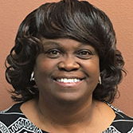
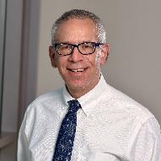
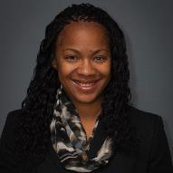
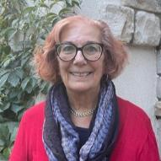
NEW LEADERSHIP
Jacque' Gaiters-Jordan
Vice President
for Instructional Services
Jim Mancall
Executive Director
of Strategic Initiatives
Kim Hennessy
Interim Vice President for Human Resource Services
Tiko Hardy
Chief Diversity Officer

Slide 6
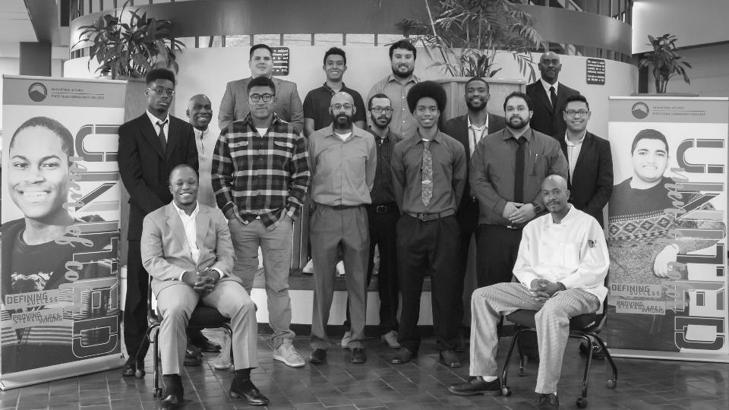


DIVERSITY, EQUITY, AND INCLUSION

Slide 7
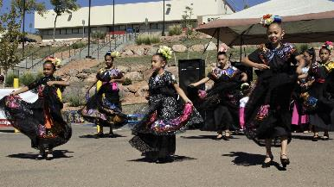
WHY EQUITY WORK MATTERS
PPCC represents the greatest tool for diversity and equity in our region
Inclusion includes YOU
Organizations that embrace diversity are more successful
Students succeed at PPCC
Covid has left new inequities

Slide 8
THE EQUITY PROJECT

Slide 9
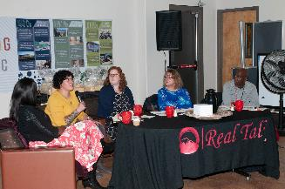
WHAT OUR EFFORTS WILL LOOK LIKE
Identify opportunities and priorities necessary for systemic change
Create a framework that can be used to assist faculty and staff by looking at models like The Equity Project
Facilitate data-driven conversations to improve cultural competence…facilitate conversations and/or book clubs to improve cultural competence and responsiveness
Host Town Halls with the President, CDO, Leadership Team and other stakeholders

Slide 10
RELEVANT READING
Read more. Consider books like:
“The Conversation
“From Equity Talk to Equity Walk”
“What Inclusive Instructors Do”
“Beyond Inclusion: Reimagining the Future of Work”
“Work, Workers, and the Workplace”
“The New Jim Crow”

Slide 11
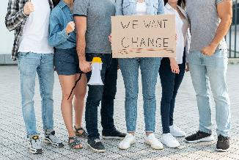
HOW CAN YOU HELP?
Join these efforts. Organizational change includes everyone. Get engaged, help us create an inclusive working and learning environment, we need everyone at the table!
Broaden your understanding and honor the lived experiences of others.
Look for opportunities to participate.

Slide 12


STRATEGIC PLANNING

Slide 13

Destination 2022 has served as a fine roadmap.
It's time for us to plan for 2027
We will begin creating that new roadmap in the fall. It will be:
Coordinated by Jim Mancall
Transparent and inclusive
How do we continue to build toward our mission?
Open to revision

Slide 14

NEW INSTRUCTIONAL MODE
Hyflex (how Covid changed how we teach)
60 classrooms now outfitted

Slide 15

COLORADO ONLINE

Slide 16
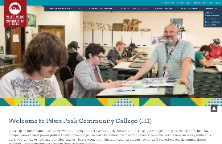

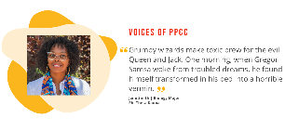
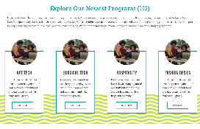

NEW WEBSITE
LAUNCHING THIS WINTER
The result of more than a year of engaged feedback from students, staff and faculty.
The new website will focus on:
Improved experience for prospective students
Academic Pathways
Career Options
Self-Assessment Tools
An improved calendar
All images and content are placeholder only.

Slide 17






ACADEMIC PATHWAYS
Science, Technology, Engineering & Math
(STEM)
Public Service
& Social Sciences
Medical Sciences
Business, Design
& Hospitality
Arts & Humanities
Applied Technology

Slide 18
ENROLLMENT
SEMESTER FTE | SUMMER | FALL | SPRING | AY
AY 19/20 | 1,054 | 8,369 | 7,776 | 18,332
AY 20/21 | 913 | 3,780 | 6,637 | 16,305
% Change | -13% | -9.5% | -14.7% | -11%

Slide 19
RETENTION
55%

Slide 20
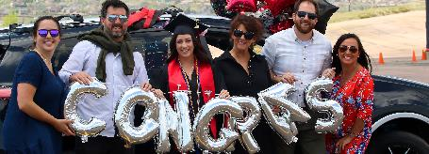
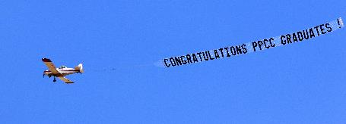
GRADUATION
Degrees and Certificates
3,970 | 17/18
4,060 | 18/19
3,879 | 19/20
3,562 | 20/21
Number of Graduates
AY 2020–2021
2,783

Slide 21
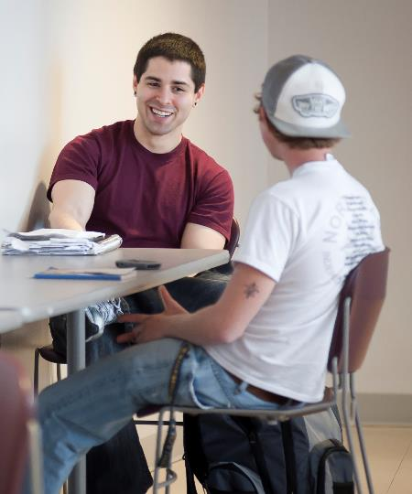
RESPONSE TO
STUDENT NEED
Hired more advisers, enrollment specialists, and coaches
Forgive student debt | $3 million
$500 school prep assistance
Expanded Child Development Center hours
Free textbooks

Slide 22

CHANGES AT THE
BOOKSTORE
Starting in October, PPCC bookstores will be operated by Barnes & Noble Booksellers.
No layoffs.
Better pricing (after the free-textbook initiative, books will be the same or cheaper.)
No changes in adoption systems (faculty can keep the same books.)
Notes:
That last included one of the best faculty art shows ever and the current discipline presentation, "Still Moving," which is still available to view. And the Foundation's Scholarship Event may be the best virtual event we've ever produced. The video thank you's from students were especially moving.

Slide 23

FOUNDATION
UPDATES
$1,723,596.97
Scholarships Awarded
This was a record year in terms of
number of students supported
and funding provided.

Slide 24
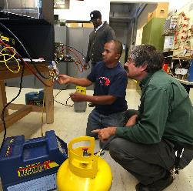
FOUNDATION UPDATES
Foundation and College are partnering on major
recovery programs:
Back to Work
$850,000 requested; + $900,000 of ARP funding
Scholarships and wrap around student support for CTE students whose household income decreased in the last year as a result of COVID
Emphasis on Upskilling through certificates for better economic returns
Finish What you Start
$3,724,241 requested
4-year program to help students who stopped out to be able to complete their degrees/certificates

Slide 25

UPCOMING PROGRAMS
Mechanical Engineering
This new Associate of Engineering Science degree connects directly to a Mechanical Engineering program at UCCS.
Bachelor of Applied Science in Interior Design
Target Fall 2022
Associate of Applied Science in Physical Therapy Assistance
Target Fall 2022

Slide 26

UPCOMING PROGRAMS
Associate of Applied Science in Industrial Mechatronics and Maintenance Technology (IMMT)
Waiting for approvals from state, financial aid, HLC.
Will begin to offer courses this fall.
Soft launch without official approval.
Target Spring 2022
IMMT AAS: IMMT Certificate—Electrical Pathway and IMMT Certificate—Electronics Pathway
Launch courses this fall, full launch spring 2022.
Associate of Applied Science in Health, Wellness, and Fitness
No date yet

Slide 27

EMPATHY PROJECT
Uses Virtual Reality technology to teach empathy, putting future officers into the shoes of suspects.
Already working in classrooms (great discussions generated)
Hope to spread to other colleges and police academies

Slide 28


CAPITAL RESERVES
FY19
FY20
FY21
$33,889,597
39.2%
$31,119,838.60
33.9%
$41,694,660.69
42.7%

Slide 29
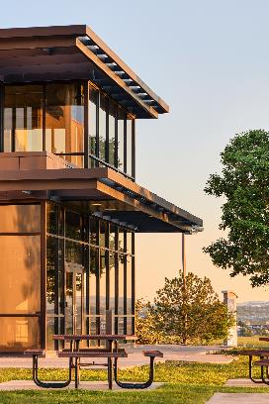
CAPITAL PROJECTS
Project | Campus | Completion Date
Fire Sprinkler | DTS | March 2021
Gymnasium | CC | March 2021
Partial Emergency Roof Replacement | RRC | August 2021
Main Electrical & Emergency Generator | CC | September 2021
Walkway Repairs | CC | September 2021
Restroom Upgrade Aspen Phase 1 | CC | October 2021
Roof Replacement | CC | April 2022
Emergency Chiller Replacement | CC | March 2022
DTS Learning Commons | DTS | August 2022
Restroom Upgrade Breckenridge Phase 2 | CC | December 2022
Dental Remodel | RRC | TBD
CHES Phase II | RRC | August 2022
Main Electrical & Emergency Generator | DTS | TBD
First Responder Emergency Education Complex | CC | TBD

Slide 30

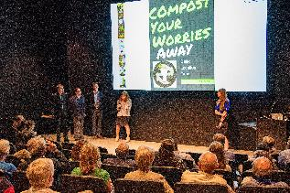
PARTNERSHIPS

Slide 31
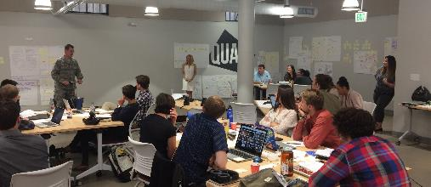
New director soon to be announced
Among recent projects:
  Exploring trust in local police and other institutions
  Finding new viable business options for Venetucci Farms
  Expanding opportunities for Silver Key

Slide 32
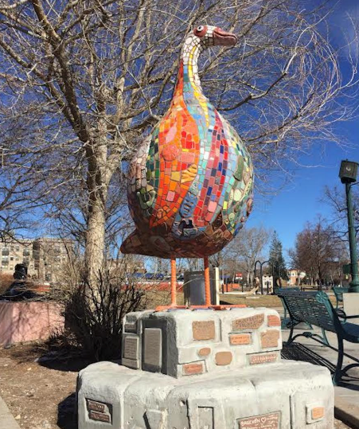
CONCRETE
COYOTE
The non-profit Concrete Couch has created an outdoor art and performance space.
Our students and instructors developed their skills in trash art and more there.

Slide 33
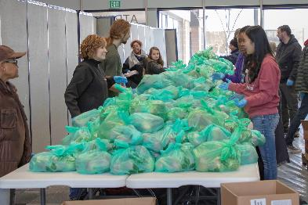


OTHER PARTNERSHIPS
Care and Share
Colorado Public Radio
Youth Documentary Academy

Slide 34



KUDOS

Slide 35
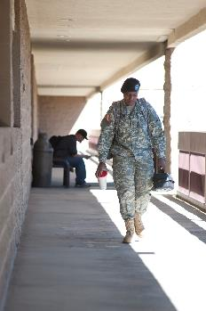
KUDOS
2021–2022 Military Friendly® School bronze designation for its successful support of military, veteran, and dependent students.
Nationally ranked as a "Best for Vets: Colleges 2021" by Military Times magazine.
College took Silver in The Colorado Springs Business Journal's Best of Business 2021: Education/Career category.
Placed 32, the highest in the state, in the National Cyber League's Power Ranking. Every year, more than 10,000 students from more than 300 colleges and universities across the US participate in the NCL competitions.

Slide 36
CONGRATULATIONS
ALPHA GAMMA ALPHA
Congrats to PPCC’s Alpha Gamma Alpha Chapter of Phi Theta Kappa who received several awards during the CO/WY Regional conference, including the Five Start Chapter award; Distinguished Chapter Advisor Team Award: Glenn Rolfing and Ilah Jackson; College Project: 7th place; Honors In Action: 2nd place; Distinguished Chapter Officer Awards: 1st place went to Ariana Bustos, Chapter VP of Scholarship and 2nd place went to Alysa Wieman, Chapter VP.

Slide 37
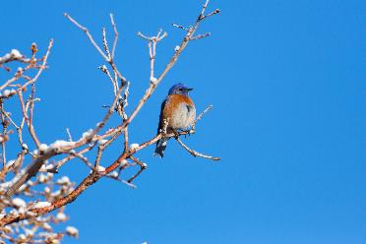
KUDOS
PPCC zookeeping students are collaborating with Colorado Parks and Wildlife to install bluebird nest boxes. This initiative monitors nesting success of western bluebirds and tree swallows. It allows our students to participate in local conservation as citizen scientists.
Jaycie Allen has been selected out of 900 applicants as a 2021 Coca-Cola Leaders of Promise Scholar and will receive a $1,000 scholarship. Phi Theta Kappa members around the country are selected based on outstanding academic achievement and demonstrated leadership potential.
PPCC staff Erica Fuller, Carrie Baldwin and Nate Wadman are among the Colorado Community College System's (CCCS) Commitment to Excellence Award winners.

Slide 38
THANK YOU.
QUESTIONS?

