Slide 1


Slide 2
STATUS
REPORT

Slide 3
Record Graduation
4,060
Number of degrees and certificates awarded in AY18/19
Our 6th record year in the last 7 years
+ Four-year graduation rate = 29.6% (exceeds our goal of at least 25% of first-time, full-time students graduating within four years of entry)

Slide 4
Retention
From the lowest in the system to the highest.

Slide 5
Enrollment
Semester FTE | Summer (End of Term Data) | Fall (As of Aug. 18, 2019)
2018 | 1,112.9 | 4,435.3
2019 | 1,096.8 | 4,340.9
% Change | -1.4% | -2.1%

Slide 6
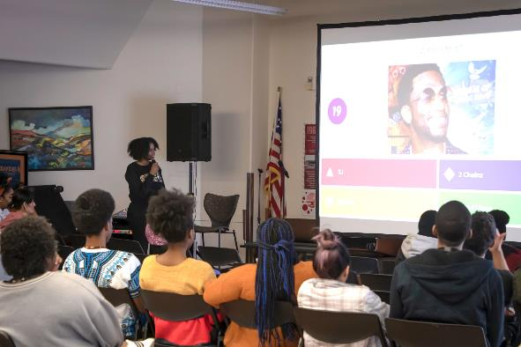
Diversity Efforts
The Center for Diversity, Equity, and Inclusion has a new vision statement: A campus and community where everyone belongs and everyone succeeds.
Team expanded, including a new multicultural student success coach.
Diversity efforts also will be boosted by a new special assistant to the president, who will be managing CEID Trainings, supporting courageous conversations.
Expanded affinity groups: New Hispanic Advisory Council, LGBTQ Committee, Interfaith Council, Real Talk Women's Forum joining United Men of Color.

Slide 7

Diversity Efforts
The College has been awarded the HEED Award for the second year in a row. It recognizes colleges that attain the highest level of "achievement and intensity of commitment in regard to broadening diversity and inclusion on campus through initiatives, programs, and outreach; student recruitment, retention, and completion; and hiring practices for faculty and staff."

Slide 8

Foundation
$6 million campaign, the largest in the College's history. To invest in an expansion of the healthcare workforce.
$4.5 million for sim lab equipment and $1.5 million for scholarships. The Foundation has raised $1.5 million to date.
The Foundation received a $900,000 grant from The Colorado Springs Health Foundation to help fund the sim lab. Along with a combined total of $590,000 from Mary K. Chapman Foundation, El Pomar Foundation, and COPIC Medical Foundation.

Slide 9
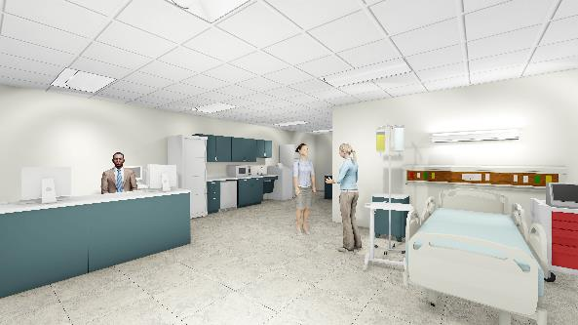
Capital Projects
Center for Healthcare Education & Simulation
Phase I of the CHES building will be completed August 26th and will house Nursing, Interdisciplinary Simulation Lab, BJ Scott Nursing Fundamentals Lab, EMS temporary space, and two general-purpose classrooms.

Slide 10
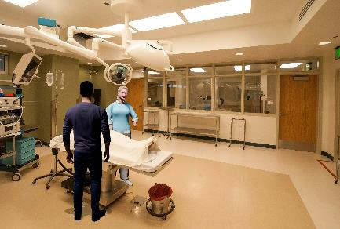
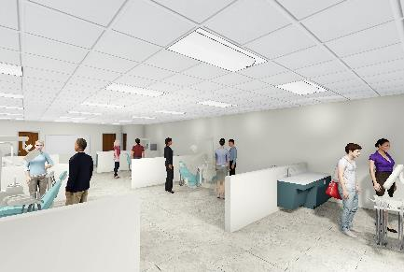
Capital Projects
Center for Healthcare Education & Simulation
Phase II will be begin construction January 2020.
Phase II will contain programmatic space for Pharmaceutical Tech, EMS, Surgical Tech, Dental Assisting, Medical Assisting, staff and faculty office space, and a number of additional classrooms.

Slide 11

All staff and faculty are invited to help celebrate the official opening of the new facility. Enjoy a reception with snacks and refreshments, tours and a video about interdisciplinary education.

Slide 12
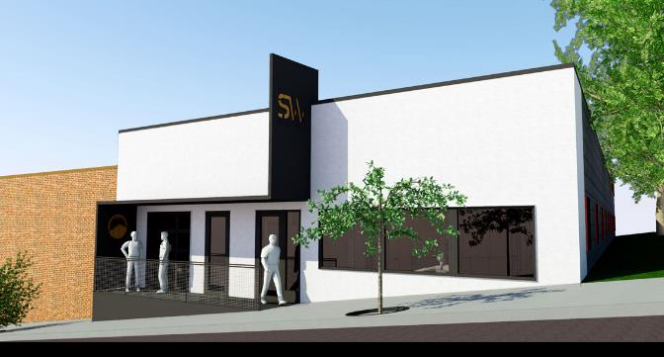
Capital Projects
Studio West
Project will be complete for spring 2020 and will house the following:
  Taffy & Steve Mulliken Black Box Theatre
  Kristen Kane Faricy Dance Studio/Performance Space
  Expanded Art Gallery
  Two classrooms
Completion Date: December 2019

Slide 13
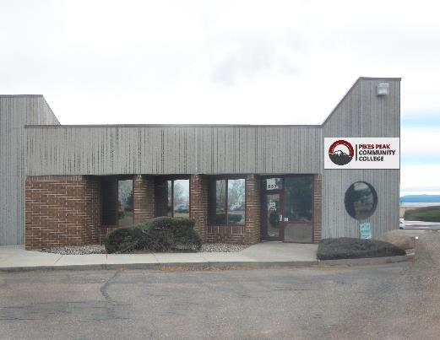
Capital Projects
Technical Education Center (TEC)
The TEC space will house the following programs:
  Building Construction Trades (BCT)
  Robotics
  Electronics
  CAD
  Machining
Completion Date: Spring 2020

Slide 14
Capital Projects
TRC-B Project: Fall Design / Spring Student Vote
TEC building on Centennial Campus
Rotunda remodel
Courtyard redesign
B-Building renovation

Slide 15
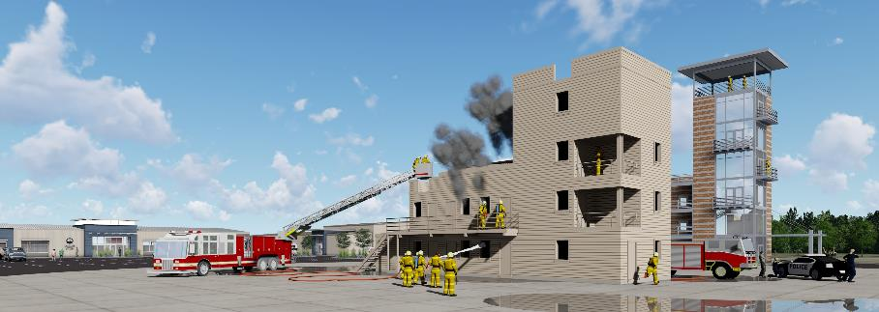
Capital Projects
First Responder Emergency Education Complex

Slide 16
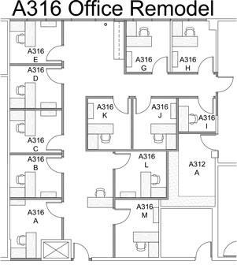
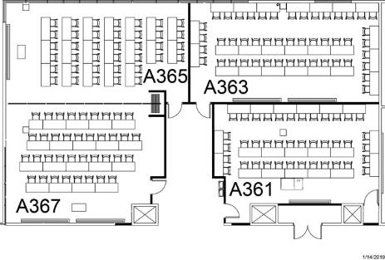
Capital Projects
Aspen Space Allocation
Four new classrooms
Two computerized classrooms
Two general purpose classrooms
12 new offices in A316
Completion Date: Fall 2019
A364
A363
A366

Slide 17
Capital Projects
Upcoming Projects
Roofing Project | CC | Completion: Dec. 2020
Emergency Power | CC | Completion: March 2020
Restroom Upgrades | CC | Completion: October 2021
Fire Sprinkler | DTS | Completion: March 2021
Bridges, Walkways and Exterior Stairwell improvements | CC Completion: March 2020
Downtown Studio Campus Learning Commons | TBD
Rampart Range Learning Commons | TBD

Slide 18
College Reserves

Slide 19
Focus Goals AY 2018/2019
Improve diversity in hiring, especially among faculty and college leadership positions
Redesign of Developmental Education to also include the potential impact on First Year Experience Programs including AAA109 and Student Success Seminars
Standardize academic websites for all college programs
HIPs

Slide 20
Focus Goals AY 2019/2020
Develop a national best-practice Military PLA website and service
First-year Experience and Meta-Majors – Improved academic wayfinding for students, advising, and AAA101 implementation along with continued progress on Co-requisite Math and English
Experiential Learning through work: Apprenticeships, Internships, Employment Assistance
Closing the achievement gap for male students of color

Slide 21
Parking
In the spirit of fairness:
The fee that APT, faculty and classified staff pay for parking is going up starting this month, from $1.25/month to $3.65/month.
The raise in fees, the first in recent memory, makes employee fees the same as student fees.
The fee does not affect adjuncts, hourly or temporary employees.

Slide 22

Meet the New Arnie
Developed in collaboration with Marketing and Student Government
Created by PPCC MGD alum, Laura Tiller

Slide 23
QUAD Updates
Recent Projects:
  Venetucci Farms
  Altia
  Innovations in Aging
Pending Projects:
  Composting as social enterprise
  School-based behavioral health programs to address teenage suicide
  Computer science and tech support for space and cyber work

Slide 24
AN AMBITIOUS
FUTURE

Slide 25
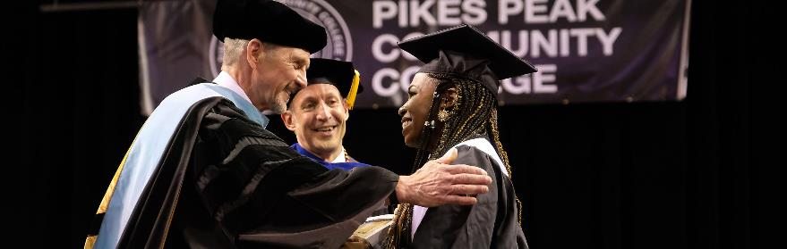
An Ambitious Future
Dakota Promise
This historic, unique scholarship & support program:
Free tuition to every graduate in Colorado Springs Harrison School District 2 (after Pell).
Assigned academic coaches to each cohort.
This has been made possible by a grant from the Dakota Foundation.

Slide 26
An Ambitious Future
Dakota Promise Eligibility
Participants must:
Graduate from a District 2 high school (Harrison, Sierra, Atlas, or James Irwin)
Have a 2.5 or better GPA (junior and senior years)
Enroll at PPCC within 12 months of high school graduation
Complete Federal Student Aid (FAFSA) application, required for Pell Grant funding
For continued eligibility, participants must enroll in, and complete (2.0 or better GPA), 24 credit hours per year. (Participants may include summer semesters to make their 24 credit hour goals.)

Slide 27
An Ambitious Future
New Programs
Summer 2019
Apprenticeship Medical Assistant
Fall 2019
AAS Construction converting to CBE
BSN
AAS Surgical Tech
World Language (new title/same languages)
Spring 2020
AGS Emergency Management and Planning
Fall 2020
AGS Hospitality
AGS Secure Coding
Facilities Maintenance
BAS Paramedicine (TBD)
Beyond
Occupational Therapy Assistant
Physical Therapy Assistant
Vet Tech

Slide 28
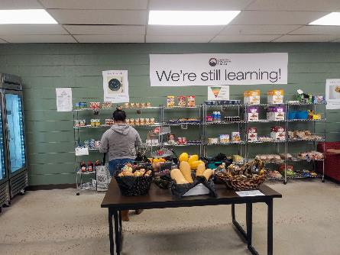
An Ambitious Future
Student Success Center
A new commitment and consolidation of several support services:
The Community Table (47,000 pounds given)
SNAP Market
HIPs
The Retention and Career Center (restructured with Purple Briefcase)
COSI Coaches
Center for Diversity, Equity and Inclusion
How you can help:
Payroll deductions—$20 buys more than 100 pounds of food.

Slide 29

An Ambitious Future
Face It Together
A community partner that provides peer couching to those with substance addiction and abuse.
They provide:
Emotional support
Practical skill development to manage addiction
Ways to address barriers
Extra support after setbacks

Slide 30
New Student Texting Platform
97% opt-in rate (beginning with new application in December 2018)
9,928 students texted
50% responded to texts (high engagement—industry average is 30%)

Slide 31
Open Educational Resources (OER)
Saved students $427,000 in 2018/19 with 7 courses participating.
This year's targets: $2 million saved and 17 courses participating.

Slide 32
Led by Ashlee Dutton
MANAGER OF DEVELOPMENT AND LEADERSHIP ADVANCEMENT
PPCC Cultivates, along with CETL, reflects the college’s serious ongoing commitment to grow leadership skills and create more advancement opportunities for all employees.
The current Cultivates programs include:
Enhancing Leadership | A 9-month program focused on leadership through excellence, acquiring skills, and developing strategies.
Supervisor Development | An 8-week summer 2019 mini leadership program for new, current, potentially struggling supervisors to further develop skills needed to become a 5-Star Supervisor.
Core Competencies Passport | Opportunities to learn 6 core professional competencies.

Slide 33
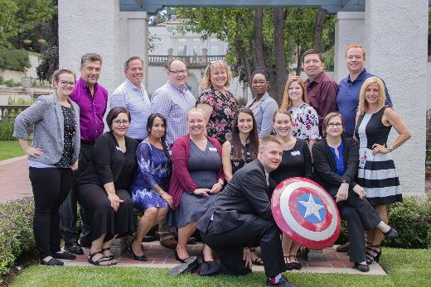
PPCC Cultivates | NEW Enhancing Leadership Program
PPCC is launching its first Enhancing Leadership Program on September 26th, 2019 and we want you to be a part of it!
What: The Enhancing Leadership Program is a foundational leadership development program designed for individuals who want to become a leader within their current position and create opportunities for future advancement.
Time frame: 9-month program, 1-2 days a month
Applications Due: Saturday, August 31

Slide 34
Accreditation Updates
Accreditation Updates
Assurance Argument and embedded monitoring report (program review and student learning assessment): submitted to the Review Team on July 26
Team Report: will be sent to the HLC Institutional Actions Council (IAC) by the end of September
PPCC will be notified of the IAC final decision in October/November
  No follow-up if all Core-Components are “met”
  Monitoring report if one or more Core-Components are “met with concerns”
Next steps
Multi-location visit in AY2021/22
Submit a Quality Initiative proposal no later than June 2022 (year 7 of the 10-year accreditation cycle)

Slide 35
Questions?

