Slide 1


Slide 2


Slide 3



50th anniversary events
The Golden Gala
An elegant fundraiser
for scholarships at
The Broadmoor | Oct. 27
Jingle Mingle:
The Half-Century Soiree
Inviting faculty, staff, former employees and retirees at
The Antlers | Dec. 8

Slide 4
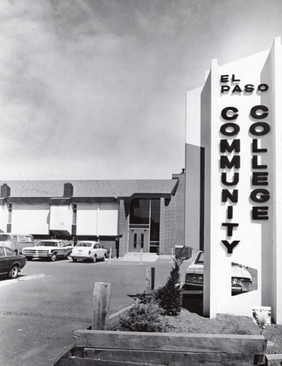
More 50th anniversary events
Spirit Week
Student Life and the SGA are planning a series of student-focused events
Oct. 1-5
The week will culminate in a Homecoming party for students and alumni at Centennial | Oct. 5
City Proclamation
The mayor will declare Oct. 7-13
PPCC week, honoring our impact in the community

Slide 5
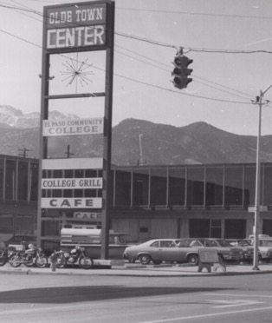
50th anniversary displays
Displays and Remembrances
Faculty and students are working with Pioneers Museum staff to develop a small exhibition of PPCC historic artifacts—Starting in October.
Each campus will have banners and other visual celebrations of our 50th.
A printed guide with highlights of our first 50 years, with speculations on our next half century.
A website will be our showcase of historical content, including a timeline, oral histories and more.

Slide 6
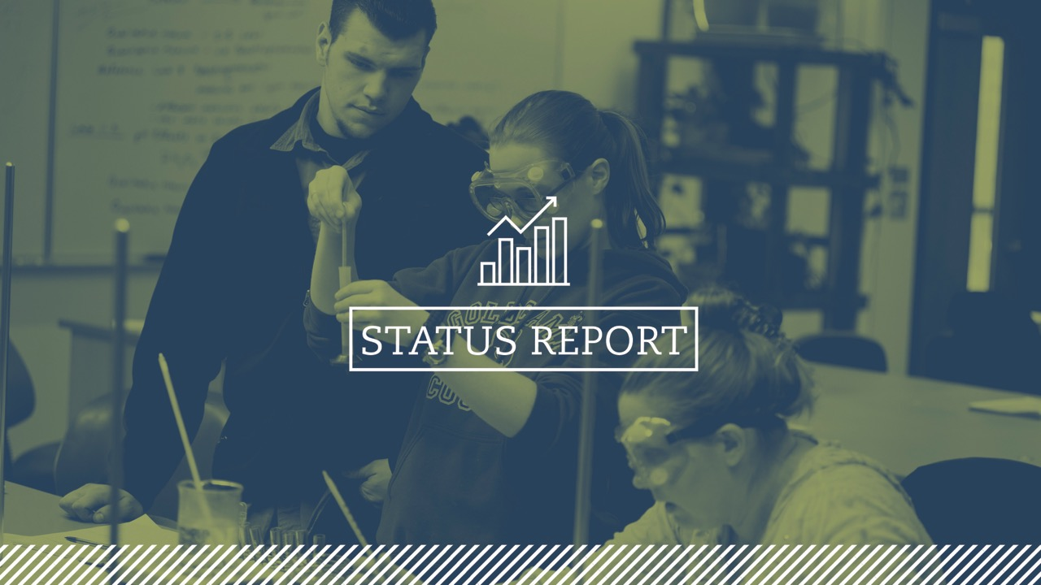

Slide 7

Enrollment

Slide 8
Retention
Seven years
of retention increases
From the lowest retention rate in the system to the highest
54.4%
53.6%
51.1%
49.9%
49.5%
48.7%
47.3%

Slide 9
Graduation Numbers
Our 5th record year in the last 6 years

Slide 10
College Reserves

Slide 11
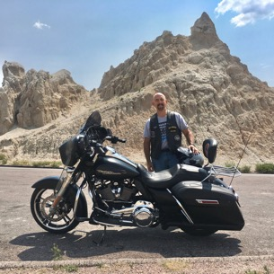
New Leadership at CCCS
Background
President of The Western Interstate Commission for Higher Education
Lt. Governor of Colorado and Executive Director of the Colorado Department of Higher Education
President of Colorado State University-Pueblo
President of Pikes Peak Community College
Cabinet member of Gov. Roy Romer administration
White House appointee under
President Bill Clinton
Joe Garcia, J.D.
President of the Colorado Community College System

Slide 12

Diversity
HEED (Higher Education Excellence in Diversity) Award
Recognizes outstanding commitment to diversity and inclusion
Only community college with the designation
Only college in our region

Slide 13
Diversity - Latinx
Latinx Enrollment Initiative
Hispanic Advisory Council guiding major marketing campaign
Cultural Competency on campus
Goal of becoming Hispanic Serving Institution (HSI)
El Puente / The Bridge

Slide 14
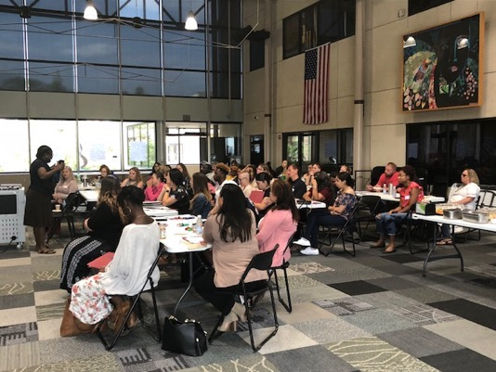
Diversity - Initiatives
Male Students of Color
COSI Coaches
Working with the University of Southern California and Center for Urban Education (CUE) – A project designed to create tools and competencies to improve equity outcomes in mathematics.

Slide 15
CCSSE Results
Student Satisfaction with PPCC
95%
87%
would recommend PPCC to a friend or family member.
rated their overall satisfaction as good or excellent

Slide 16
CCSSE Results | How Would You Rate Your Experience at this College?

Slide 17
CCSSE Results | PPCC Vs. Large Colleges
PPCC outperforms its peer group (100 large colleges) on four of the five CCSSE benchmarks: Active and Collaborative Learning, Student Effort, Academic Challenge and Student Faculty Interaction

Slide 18
CCSSE Results | Active & Collaborative Learning
Since 2015, notable improvements have been made on all seven “Active and Collaborative Learning” items and on all six “Student-to-Faculty Interaction” items
Often + Very Often, % | 2015 PPCC | 2018 PPCC | +/-
4a. Asked questions in class or contributed to class discussions | 68 | 74 | +6
4b. Made a class presentation | 37 | 44 | +7
4q. Discussed ideas from your readings or classes with others outside of class (students, family members, co-workers, etc.) | 53 | 56 | +3
4f. Worked with other students on projects during class | 48 | 56 | +8
4i. Participated in a community-based project as part of a regular course | 3 | 9 | +6
4h. Tutored or taught other students (paid or voluntary) | 6 | 8 | +2
4g. Worked with classmates outside of class to prepare class assignments | 17 | 24 | +7

Slide 19
CCSSE Results | Student-Faculty Interaction
Since 2015, notable improvements have been made on all seven “Active and Collaborative Learning” items and on all six “Student-to-Faculty Interaction” items
Often + Very Often, % | 2015 PPCC | 2018 PPCC | +/-
4n. Received prompt feedback (written or oral) from instructors on your performance | 65 | 71 | +6
4k. Discussed grades or assignments with an instructor | 50 | 54 | +4
4l. Talked about career plans with an instructor or advisor | 29 | 33 | +4
4p. Worked with instructors on activities other than coursework | 7 | 10 | +3
4j. Used email to communicate with an instructor | 64 | 65 | +1
4m. Discussed ideas from your readings or classes with instructors outside of class | 13 | 17 | +4

Slide 20
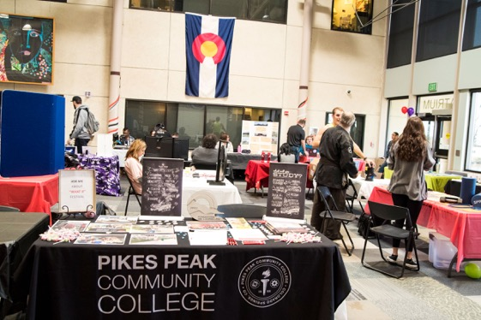
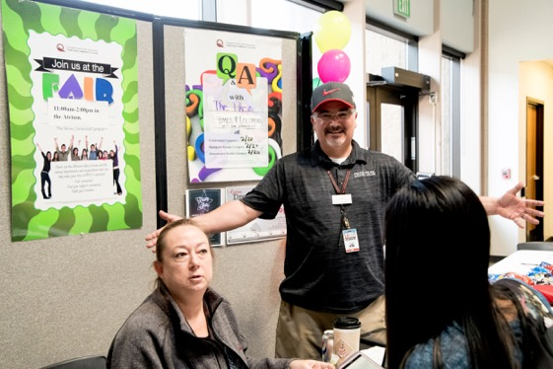
CCSSE Results - Improvements
Areas for Improvements
Usage of student organizations is low (statistically below our peer group average) (same as 2015)
Photo by PPCC student Dwan Petti
Photo by PPCC student Dwan Petti

Slide 21
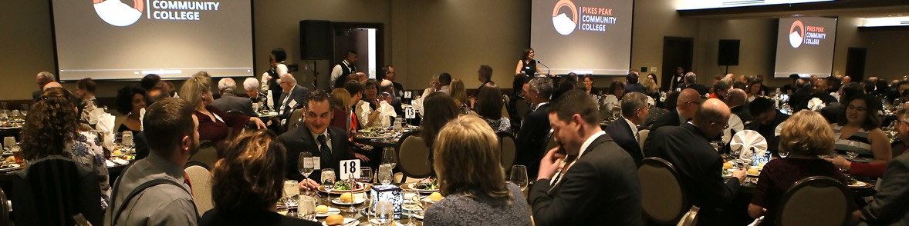
Foundation
Total Contributions and Income
$2.4M
$2.1M
15% INCREASE
FY17
FY18

Slide 22
Foundation - Successes
Student Success Rate
3-year average is 84%
Decline from last year
Many more incoming freshman scholarshipped in Fall 2017
Response: COSI STUDENT SUCCESS PROGRAM
$420K grant
Wrap around support for all COSI scholarship recipients
Three coaches working directly with students

Slide 23

Learning Commons
 | Unique Users | Tutoring Sessions | Tutoring Hours | Disciplines
2018 | N/A | 24,834 | 48,435 | Support All Divisions
2017 | 2,856 | 13,345 | 26,046 | Support All Divisions
2016 | 2,385 | 11,944 | 19,419 | Math, English/Writing, Science
Photo by PPCC student Dwan Petti

Slide 24
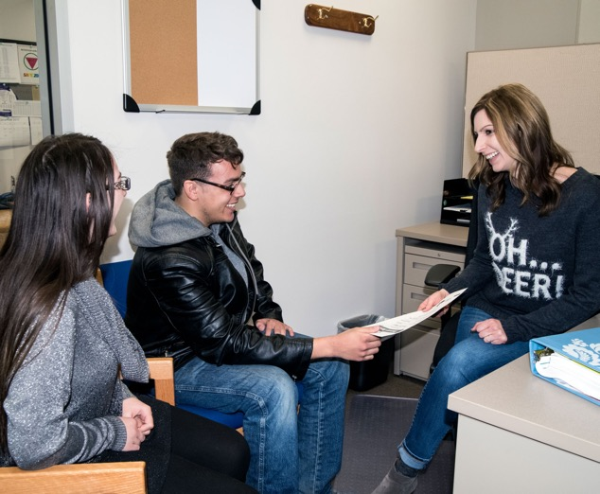
Student Services
EAB Navigate update
Advising to provide four-semester plan for all entering students
Photo by PPCC student Dwan Petti

Slide 25
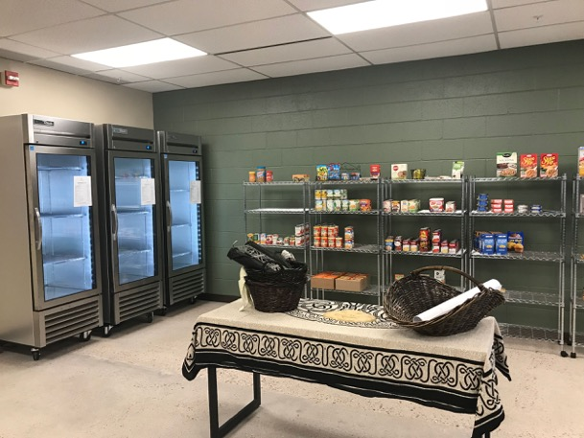
Community Table | A312
  Food Pantry to support students and staff in need
  United Way 2-1-1 at PPCC navigators to connect with community resources
  A Living Lab where students experiment with academic concepts outside of class, including undergraduate research

Slide 26
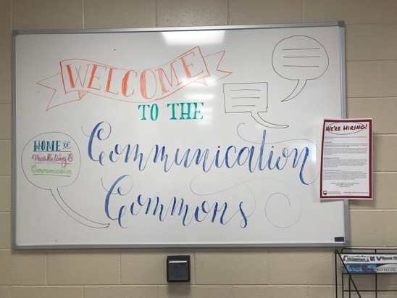
Communication Commons | A212
The Communication and Marketing team has an expanded space to better collaborate with:
The student newspaper
Student Life
Work studies
Anyone who wants help with promoting a program, initiative or event

Slide 27

Student Learning Assessment
Academic Programs/Departments
15 Assessment Coaches (6 in AY15/16)
Workshops
  Aug. 21: Transparent assignments
  Sept. 14: Focus on assessing Quantitative Literacy and Inquiry and Analysis
  Sept. 21: Refining assignments, planning for the next three years, curriculum mapping
  Sept. 20-22: HLC Workshop on Assessing General Education (5 attendees)

Slide 28

Student Learning Assessment - Support
Support Services
8 Assessment Coaches (5 in AY15/16)
Focus on employability skills (e.g. problem solving, collaboration, cultural competency)
New areas: Student Clubs and Organizations, Leadership Scholars Program, Work-Study Program
Professional Development Day (October) covering all phases of the assessment cycle

Slide 29
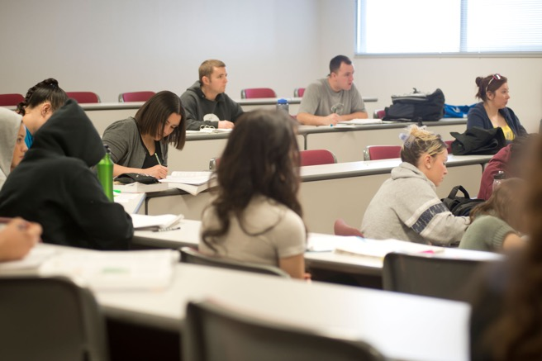
Faculty Growth
7 New Faculty Positions
  Emergency Medical Services
  English
  Outdoor Leadership
  Nursing
  Geography
  Machining
  Theatre

Slide 30
Accreditation Updates
Assurance Review (July 2019)
Introduction, Criteria 1 and 2 are done
Criteria 3, 4 and 5 are in process
Monitoring entire report for college-wide review by the end of Jan. 2019
Goal: send the entire report for college-wide review by the end of Jan. 2019
New approved location
UC Health Community
Education Center

Slide 31


Slide 32


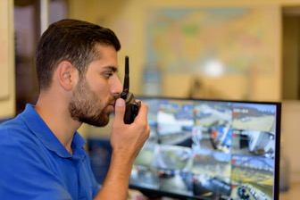

New and Upcoming Programs
Bachelor of Applied Science in Emergency Service Administration
Starts Fall 2018 | 16 students
Cyber Security
Started Spring 2018 | 124 students
Received $300K from legislature for
all cyber programs
Certified Dietary Manager
Started Spring 2018
Social Innovation
A partnership with BBB
Upcoming
Nursing BSN, as soon as Fall 2019
  Big win in legislature to get approval
Surgical Technology

Slide 33


Slide 34

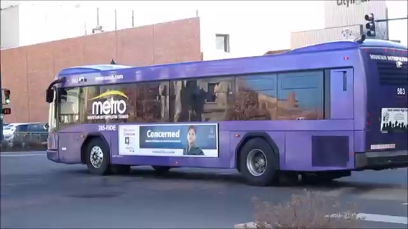
Partnerships
Partnerships
Mountain Metropolitan Transit: College Bus Pass Program
The Quad Innovation Partnership
Catalyst Campus Cyber Range
UC Health Community Education Center
  Regional American Heart Association Training Center – CPR
  Paramedic

Slide 35


Slide 36

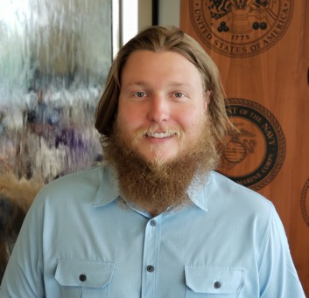
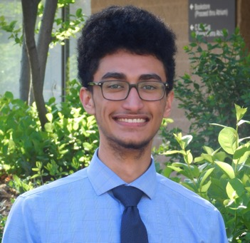
Kudos
Mickey Jackson
Veteran, STEM Fellow Lead, and Tutor has been named the National College Reading and Learning Association (CRLA) Outstanding Tutor for 2018
Jordan Wright
Winner of Coca-Cola Leaders of Promise scholarship
PTK Scholar Program

Slide 37


Slide 38

Division Realignment
Guiding Question
Can we align our academic divisions to be more effective?
Guiding Principles in the Process
Do no harm. Eliminating or reducing positions is not on the table.
Feedback is needed.
Transparency
Proposed Process
An official avenue for feedback will be presented in late August or early September.
We would like to receive all feedback by December/January.
We anticipate an official decision coming in mid-late Spring, allowing us 3-4 months to plan and execute prior to the Fall 2019 Semester.

Slide 39

2017/2018 Focus Goal I: Ensuring Every Student Has an Academic Plan in 1st Year
Recommendations:
Mandatory advising
Mandatory orientation
Publish 2-year plans on website

Slide 40

2017/2018 Focus Goal II: Systematizing Best Practices in our Classrooms to Improve Retention
Student focus groups suggested students found most important:
A clear syllabus
Instructor provided timely feedback
Class time spent applying the material

Slide 41
2017/2018 Focus Goal III: Aligning Math Pathways
Revamped requirements in course catalog, program-specific math requirements
BEFORE (PPCC Catalog 2017 – 2018)
20 of the 74 degrees (AA, AS, AAS) had no recommended basic skills standards math course.
Selected College Prep Math courses listed as a recommended basic skills were not the prerequisite for the College Level Math course.
15 out of 28 AA degrees did not prefer, recommend, require, or suggest a math course.
AA degrees designated as Degrees with Designation (DwD) recommended College Level Math courses that do not match the Statewide Transfer Articulation Agreement.

Slide 42
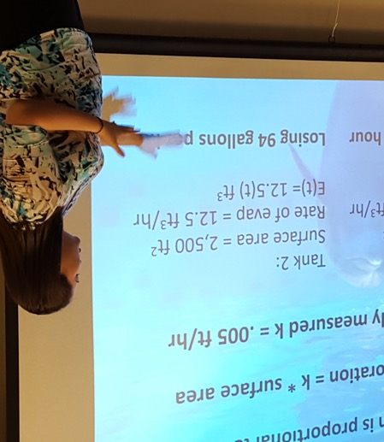
2017/2018 Focus Goal III - Aligning Math Pathways
AFTER (PPCC Catalog 2018 – 2019)
Every degree (AA, AS, AAS) has a recommended basic skills standards math course.
Dev. Ed. & College Level courses are aligned
Every degree has a preferred, recommended, or required college level math course.
Every AA DwD and AS DwD matches the Statewide Transfer Articulation Agreement.

Slide 43
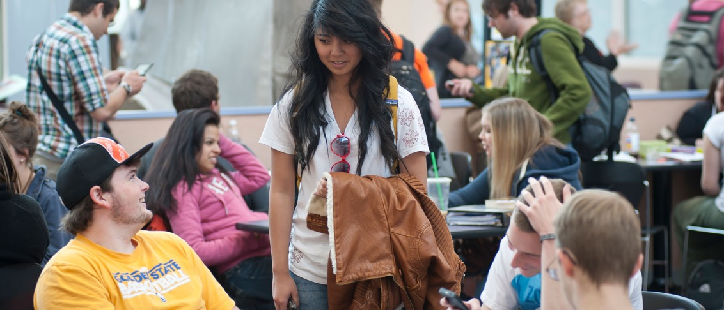
2017/2018 Focus Goal IV: Creating a Sense of Belonging

Slide 44
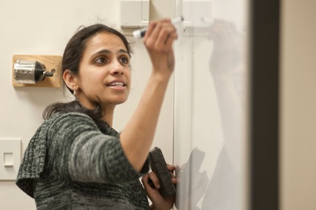
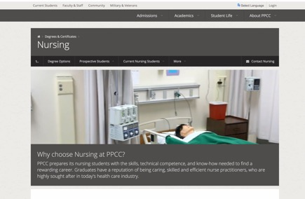
2018/2019 Focus Goals
Improve diversity in hiring, especially among faculty and key leadership positions.
Redesign of Developmental Education to also include the potential impact on First Year Experience Programs including AAA109 and Student Success Seminars
Standardizing academic websites for all college academic programs
High Impact Practices (HIPs)

Slide 45
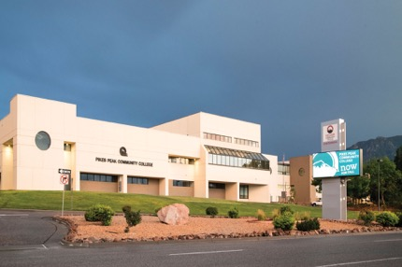
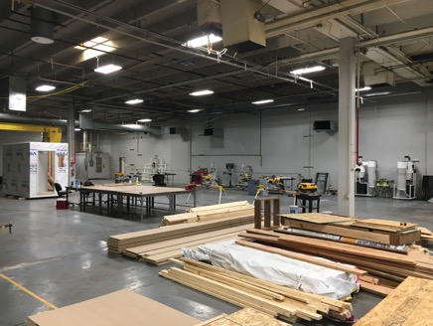
Capital Projects | Completed
Fire Sprinklers - Centennial
Access Control – all campuses, 10/30
Various concrete walkway repairs (safety & accessibility)
Stairs to Atrium - Centennial
Wayfinding Upgrades (continuing)
Parking Lot Signage at CC
Various Classroom & Office Upgrades - Centennial
Relocated Call Center - DTSC
W119 Remodel Faculty Offices at RRC
New Adjunct Space at F300
Stair Removal & Safety Railing at DTS
Aspen West End Corridor Flooring
Springs Fab - Construction

Slide 46
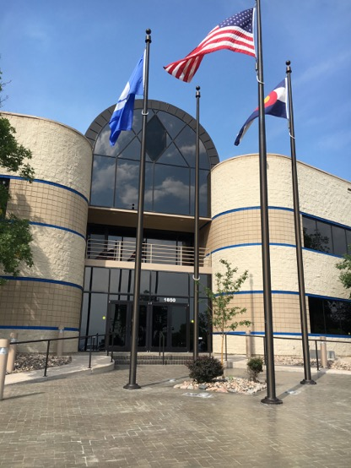
Capital Projects | Upcoming
Allied Health Building
Operational Fall ’19
Program Highlights
Nursing Expansion
BSN
Paramedic and EMT Expansion
Surgical Technology
Physical Therapy Assistant
Dental Assisting

Slide 47
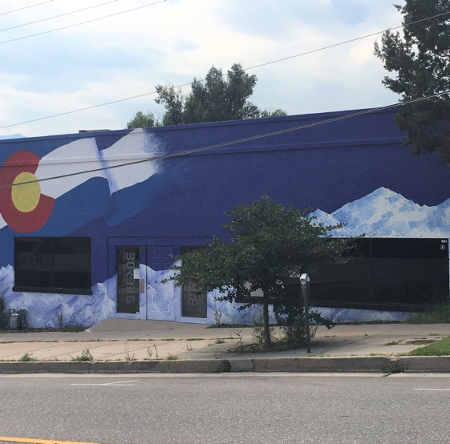
Capital Projects | Gateway
The Gateway Arts Center
Operational Fall ’19
Black Box Theatre
Dance Space
Art Gallery

Slide 48
Capital Projects | More
Rampart Range Learning Commons
Rotunda Mixed Community Spaces (Focus Goal IV)
Window Replacements at the Aspen Building, Enrollment Services, Learning Commons – November
Aspen Elevated Walkway Repairs

Slide 49
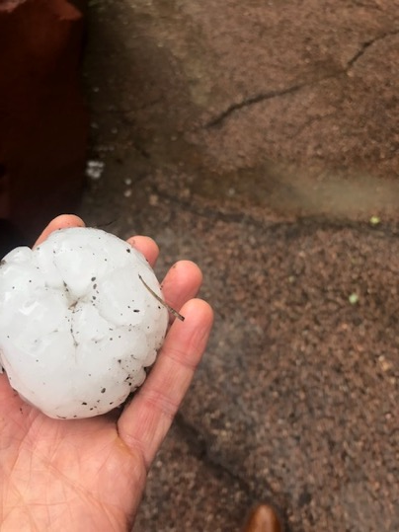
Centennial Campus | Roof Replacement
Hail Happens.
Be patient during the repair process.

Slide 50
Questions?

