Slide 1



Professional Development Week
President’s Address
FALL 2023

Slide 2
Numbers

Slide 3
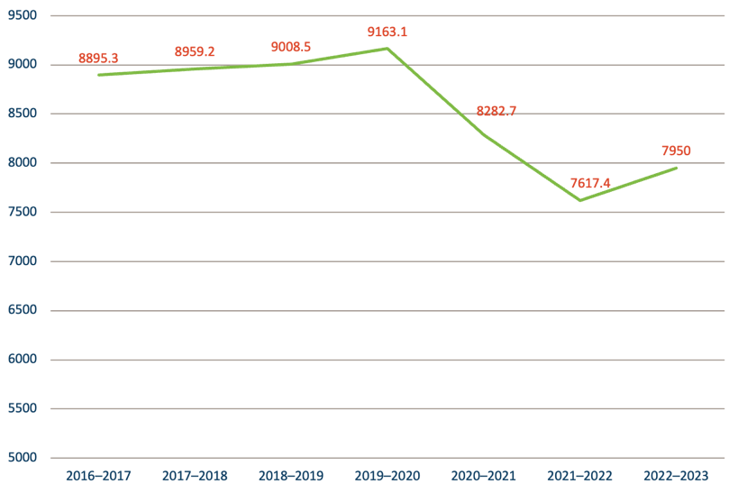
Enrollment | AFTE
Unduplicated Headcount
AY21/22 = 16,399 students
AY22/23 = 17,381 students
Difference: 982 students

Slide 4
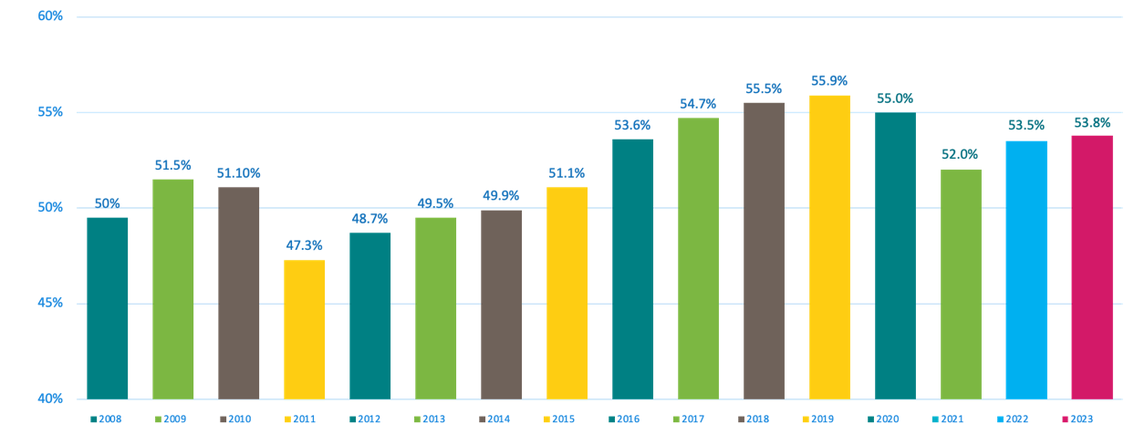
Retention Rate

Slide 5
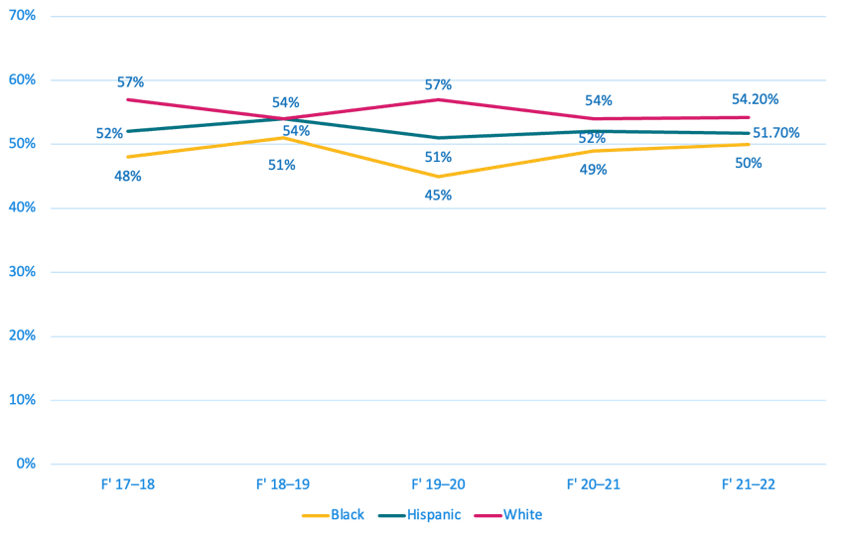
Retention By Ethnicity

Slide 6


Graduation
Degrees & Certificates
3,970 | 17/18
4,060 | 18/19
3,879 | 19/20
3,562 | 20/21
3,051 | 21/22
3,246 | 22/23*
*Includes 56 BSN/BAS degrees

Slide 7
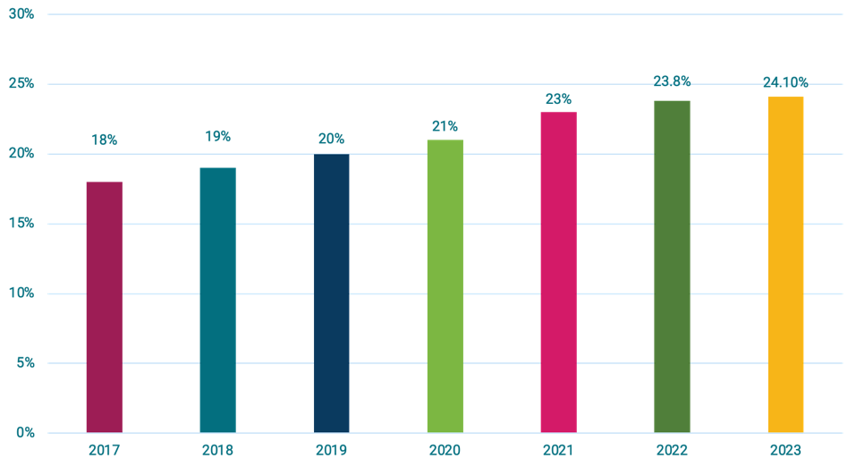
Achieving HSI Designation

Slide 8

Budget Outlook for FY24
PPSC is in a strong position but we’re not 100% back yet.
Efficiencies gained in scheduling and operational streamlining continue to place the college in a strong growth position – efficiencies in scheduling reduced our expenses by nearly $1.7M+ in the past year even while we grew in enrollment.
We should be enthusiastic about our growth in enrollment, but also need to maintain the good habits that strengthen our financial position.
Notes:
Darlene – Budget:
Budget Outlook for FY24:
PPSC is in a strong position as we continue to recover from the pandemic, though we’re not 100% back
The college collectively responded to warning signs on growing expenses. In FY23, and through hard work, we came in under expected operating increase – resulting in a reduction in anticipated non-personnel operating expense of 3M+
Enrollment grew by more than ~5% from 2022 to 2023. And our strong enrollment numbers for Summer 23 & Fall 23 are indicative of a growing and brighter outlook - exceeding preliminary growth estimates for each of those semesters.
It may take some time, 1 to 2 years, of steady growth to recover to pre-pandemic enrollment peaks of ~9k+ FTE
We no longer have HEERF pandemic funds available, some expenses that had been HEERF are being absorbed into the operating budget as our operations realign – the college received and utilized more than 22M in scholarships and 31M in intuitional funds
Efficiencies gained in scheduling and operational streamlining continue to place the college in a strong growth position – efficiencies in scheduling reduced our expenses by nearly ~1.7M+ in the past year even while we grew in enrollment.
Our greatest challenge will be tempering enthusiasm with gains in enrollment and maintaining the good habits that continue to place us in a strong financial position – maintaining some efficiency measures can grant to college greater flexibility and allow us to invest in our future

Slide 9


College Reserves
FY21
FY22
FY23
$41,694,660.69
42.7%
$31,899,872.01
31.9%
$23,281,297*
24.9%
*FY24 through planned spending the college is using $7,500,000.00 toward the Delta Dental Oral Career Health Center out of FY23 reserves.
Notes:
Darlene – Reserves:
On the “College Reserves” slide, please remove FY20 and add FY23 $40,242,660.29 43.9% (also in FY24 through planned spending the college is using $7,500.000.00 toward the Delta Dental Oral Career Health Center) out of FY23 reserves.

Slide 10
Efficiency of Scheduling for S23 and SU23
For SP23 we reduced the number of course sections YTY by 10%
SP23 course fill rates increased by ~8% - up to ~72% fill for all courses
We served ~8% more students in SP23, while reducing our expenses by approximately ~500k
For SU23 we Increased the number of course sections YTY by 12%
SU23 fill rates did not change YTY, we remained at ~65% fill for all courses
We served ~6% more students in SU23, but our expenses rose approximately ~300k
Before implementing growth scheduling, we filled ~56% of our seats annually
In the past year (FA22 - SU23), we are filling more than ~70% of our seats
We have reduced expense by ~2M+ since implementing growth/efficiency scheduling

Slide 11
Instructional Services

Slide 12
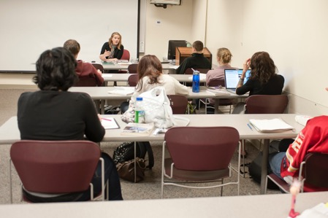
Reorganization
  We've established new divisions and corresponding administrative structures.
  A Campus Reorg Task Force met three times over the summer. Working on a lot of the procedures and back-end processes.
  Three Executive Deans appointed; two Interim Deans appointed.
    (Science, Engineering and Math, and
    Health Sciences)
  Two Executive Dean positions reposted.
  The Executive Deans are working collaboratively to determine space needs and coordinate office moves.
  Full transition of new divisions could take the entire academic year.

Slide 13

Pathway video

Slide 14


Business, Technology and Public Service (BTPS)
CENTENNIAL CAMPUS | EXECUTIVE DEAN ROB HUDSON
Accounting | Fire Science Technology
Business Technology | Fire Science Wildland
Business | Hospitality
Computer Information Systems | Law Enforcement Academy
Computer Networking | Management
Criminal Justice | Marketing
Computer Science | Paralegal
Culinary Arts | Public Security Management
Computer Web Based | Social Work
Early Childhood Education | Women and Gender Studies
Economics
Education
Emergency Management and Planning
Entrepreneurship
Emergency Services Administration
Finance

Slide 15

Technical and Professional Studies (TPS)
CENTENNIAL CAMPUS | EXECUTIVE DEAN HEATHER PIERCE
Automotive Collision Technology
Architectural Engineer/Construction Management
Automotive Service Technology
American Sign Language/Interpreter Preparation
Building and Construction Technology
Broadcasting and Electronic Media
Computer Aided Drafting
Diesel Power Mechanics
Electronics/Electricity Industrial Robotics
Heating Refrigeration and Air Conditioning
Industrial Mechatronics
Interior Design
Multimedia Graphic Design
Welding
Machining Technology
Engineering Graphics Technology
Metrology

Slide 16


Arts, Humanities and Social Sciences (AHSS)
DOWNTOWN CAMPUS | EXECUTIVE DEAN DEIDRE SCHOOLCRAFT
Anthropology | Political Science
Art | Psychology
Communication | Russian
Dance | Sociology
English | Spanish
English as a Second Language (ESL) | Theatre
French
German
History
Humanities
Japanese
Journalism
Literature
Music
Philosophy
Photography

Slide 17

Science, Engineering and Math (SEM)
RAMPART CAMPUS | INTERIM DEAN MICHAEL MADSEN
Astronomy | Science
Biology | Veterinary Technology
Chemistry | Zoo Keeping Technology
Dietary Management
Engineering
Environmental Science
Geography
Geology
Health and Wellness
Math
Meteorology
Natural Resources
Outdoor Leadership
Physical Education
Physics
Recreation

Slide 18
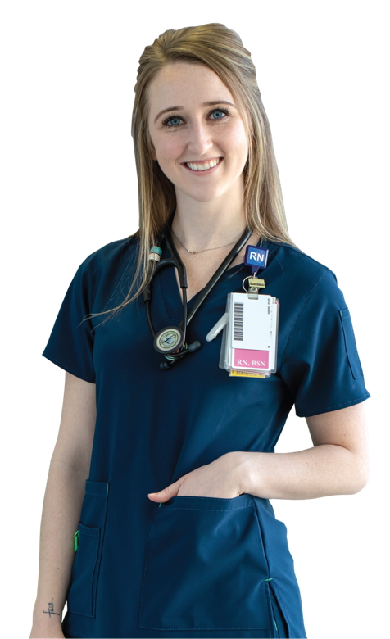

Health Sciences (HS)
CENTER FOR HEALTHCARE EDUCATION & SIMULATION
INTERIM DEAN NICHOLE BARRIERA
American Heart Association Training Center
Associate Degree in Nursing
Bachelor of Science in Nursing
Dental Assisting
Emergency Medical Services
Health Professional
Licensed Practical Nurse
Medical Assistant
Medical Office Technology
Nursing Assistant
Pharmacy Technician
Radiology Technology
Surgical Technology

Slide 19
Care Forward/ Career Advance
Care Forward
Provides first dollar funding for in-demand
short-term healthcare credentials.
PPSC has exhausted funding and will sunset
this program after fall 2023.
Care Forward has allowed us to provide over $3M in aid to nearly 1,250 students in 16 in-demand healthcare fields like CNA, Phlebotomy, and Emergency Medical Services.
Career Advance
Provides last dollar funding for in-demand
career credentials.
We have around $5.3M in funding.
This fall we're launching with certificates in
these programs:
  Early Childhood Education
  Fire Science
  Law Enforcment Academy
  Building and Construction
  Certified Nursing Assistant
We want to invest these funds in programs students can start and finish to fill high demand jobs, without depleting funds too quickly.

Slide 20


Cynthia Krutsinger, MA
DEAN OF ONLINE LEARNING
Cynthia is the lead point person for Colorado Online.
Any questions, please feel free to reach out to
her directly.
Email: Cynthia.Krutsinger@PikesPeak.edu

Slide 21
Colorado Online
  37 disciplines transitioned at least one course by Fall 2023
Term Transitioned​ | Number of Courses Transitioned (PPSC)​
Spring 2023​ | 7​
Summer 2023​ | 16​
Fall 2023​ | 60​
Total​ | 83​
As of 8/7/2023:
  2,457 PPSC students enrolled in Home College Sections
  1,105 PPSC students enrolled in pooled sections

Slide 22
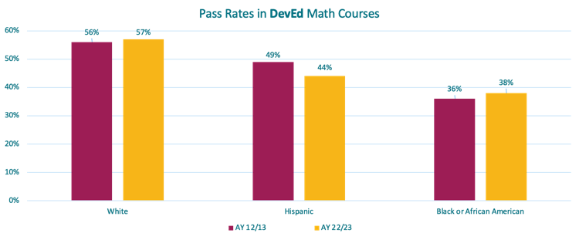
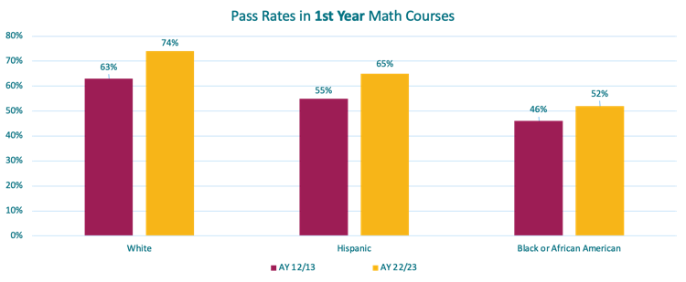
Math Success
In AY23, only 10% of students taking at least one Math course took a DevEd course (compared to 57% in AY13).
Overall, MAT pass rates increased from 56% in AY12/13 to 67% in AY22/23.

Slide 23

AI
Our goal is that in May 2024, every graduate will understand the ethical use of AI in their career field.
A.I. Team, led by Professor Dennis Natalie and Sylva Miller, will visit:
  Faculty Senate
  All Deans and Department Chairs
PPSC is the go-to A.I. trainer for the local News, business, nonprofit, and government agencies.

Slide 24

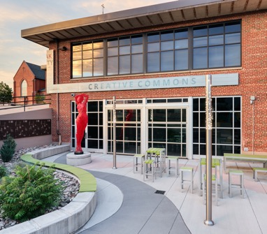
HLC Multi Location Visit
Random locations selected for a visit every 5 years.
In spring of 2023 visited:
  The Downtown Campus
  The Technical Education Building
  Falcon High School
PPSC achieved the highest rating,
in all 8 inspection criteria.
"Overall, the pattern of PPSC's operations at its additional locations [makes] no further review
or monitoring by HLC necessary."

Slide 25



Promise Program
Notes:
Krista Wallace
Promise Programs has hired a new coordinator who is working on growing and expanding the Promise Programs. Primarily expanding the knowledge and information to everyone on campus and to our partnering districts.
Our goal is to get Promise Programs back on the map in a positive way this next academic year
Mitchell Promise will be the new incoming program this fall to join Dakota Promise
We are anticipating 32 incoming Mitchell HS students this fall
Dakota Promise is still running strong with 135 continuing students and getting our first 2020 cohort to graduate (50 graduates total) and transfer to four-year institutions
We currently can see 178 incoming students from HSD2 meet the 2.25 GPA requirement, but of those, 79 students have registered for fall and have completed their FAFSA and CASFA

Slide 26


CSU-Pueblo
5-year agreement which allows students to get a PPSC degree and CSU degree under one roof.
Located at Centennial A223.

Slide 27
New & Upcoming Programs
Approved Programs:​
AS Environmental Science ​
AAS Health, Wellness and Fitness ​
Personal Trainer Preparatory Program Certificate ​
Health and Wellness coach preparatory program ​
Yoga Teacher Training Program Certificate ​
Core Animal Care Certificate
In Development:
BAS Cyber Security
BAS Business Administration
AAS Hospitality
9 new short certificates in culinary arts
3 new short certificates in fire science
Multiple certificates in cyber security
Sterile Processing Department Technician
Colorado Licensed Paralegal Practitioner Apprenticeship
Pharmacy Technician Program at Vista Ridge High School

Slide 28
Student Assistance Fee

Slide 29

Counseling Center Expansion
Hiring another Licensed Mental Health Counselor and employing interns.
Renewed our contract with Bettermynd Teletherapy Services.

Slide 30

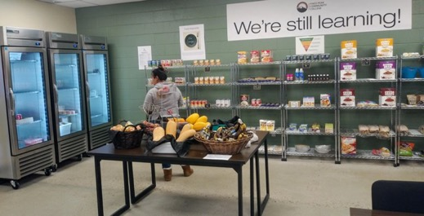
Single Stop Program Transformation
Single Stop is transforming into an institutional department.
Creating two Student Resource Specialist positions in addition to a Single Stop
director position.
Community Table and all campus pantries will now be managed by Single Stop.

Slide 31


Student Scholarships
Student Assistance Fee will provide for:
  Childcare
  Academic materials & equipment
  Basic needs
The application process is currently under development.

Slide 32
Strategic Plan

Slide 33

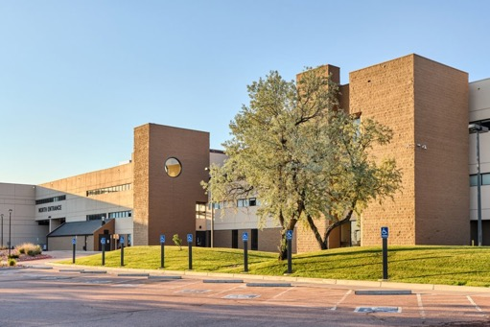
Focus Goals
Focus Goal Task Force met three times over the summer to determine Year 1 focus goals:
Four Focus Goals
Strategic Scheduling
Adult Learners and the Adult Learner Task Force
Employee Engagement and Campus Culture
New Tuition Plan for PPSC Employees
Small groups charged with implementing these
focus goals are forming now to launch this fall.

Slide 34
Foundation

Slide 35

Spark Fund
$843,750 scholarship fund made possible through a generous donation from an anonymous donor.
Notes:
Elligible students will receive up to two $2,500 scholarships.
Students must live in El Paso county, have a high school diploma or equivalent, maintain 2.0 GPA, enroll in at least 6 credits per semester, and write an essay to get funds.
Scholarship funds can be used for tuition, books, supplies, housing, food, and transportation.
Part of the donation will be used to create an endowment to make the Spark Fund a permanent scholarship available for Pikes Peak Students.

Slide 36
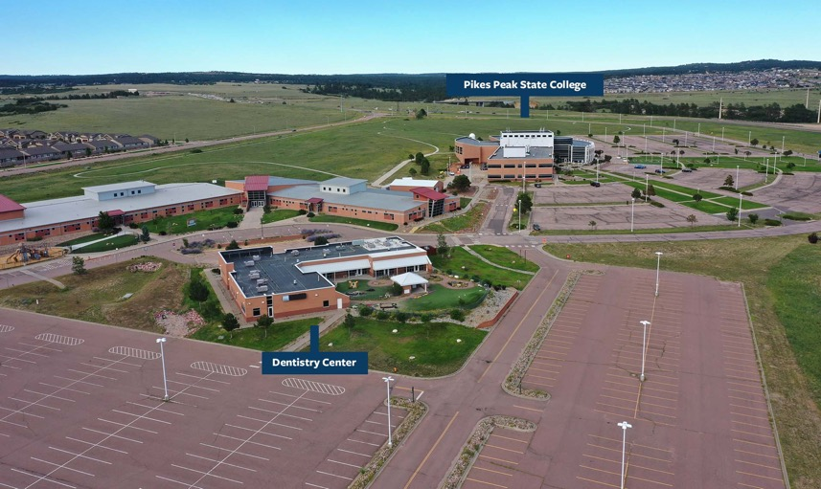
Delta Dental Center Update
Notes:
Construction/demolition is to start September 1st in the old Rampart child development center.
The construction completion date is on schedule for May 2024.
The Dental Assisting Program will move in over summer semester 2024.
We modified the original construction plans to expand the cohort size from 24 to 30 for the Dental Hygiene Program.
To accommodate that expansion, we've added two additional dental operatories in the clinical space. 20 total from original 18 planned.
We will have state of the art facilities including a 12-unit + 1 instructor (13 total) dental simulation space.
We will be the only dental hygiene/dental assisting school in Colorado (and one of a handful in the country) to pioneer the advanced simulation technology into a dental educational setting.
We're on schedule to submit CODA accreditation packet for the Dental Hygiene program
Once the CODA application is submitted, the approval process takes approximately 12-18 months. We're hoping this sets us up to open student applications in early 2025 for the 1st cohort to commence in Summer or Fall 2025.

Slide 37

Opportunity Now Grant
PPSC was awarded a 6 month,
$50K planning grant.
PPSC was the only lead partner community college to be awarded
a planning grant.
The grant is designed to build a more robust and diverse pathway for engineering technicians, projected
to be a high-demand, high-wage field.
Notes:
This grant is a first-stage grant, designed to gather data on industry needs and the experiences of engineering technicians working in the field. We are working with and bringing together partners in industry, K-12 and local non-profits.
We plan on applying for a second stage grant that will enable us to implement plans based on the data we gather this semester.
Thanks to Chelsy Harris, Michele Koster, McKenna Lovejoy, Jim Mancall, Donna Nelson and Heather Pierce for working on this project.

Slide 38
Facilities & Operations

Slide 39

Wayfinding
We are working with Innerface Architectural Signage, Inc. to develop a college-wide plan to update signs and wayfinding at each of our campus locations, Centennial, Downtown and Studio West, CHES, and Rampart.
We intend for this process to be culturally inclusive, incorporating bilingual signage
where appropriate.

Slide 40

Kudos
Chelsy Harris, Michele Koster, McKenna Lovejoy, and Heather Pierce on their work with the Opportunity Now Grant.
Summer Law Enforcement Academy Cadets who met with Governor Polis and Mayor Mobolade
Rich Christensen, Maria Mesa, Kandy Ruiz, and their team for stepping up to keep the community table open.
Military and Veterans Programs continues their streak of ranking Pikes Peak with the top institutions nationally for "Best for Vets"
Theatre Department Chair Sarah Sheppard Shaver received a best supporting actor Henry award from the Colorado Theatre Guild

Slide 41
Questions?

