Slide 1



Stronger Than Ever
2022 Fall PDW

Slide 2
Name Change Process
Public Process Begins This Week

Slide 3

The Pikes Peak State
College Celebration
Sept. 16 | 4–5 p.m.
Centennial Atrium

Slide 4
Enrollment | AFTE

Slide 5
Retention
53.5%

Slide 6
Retention By Ethnicity

Slide 7
Achieving HSI Designation

Slide 8
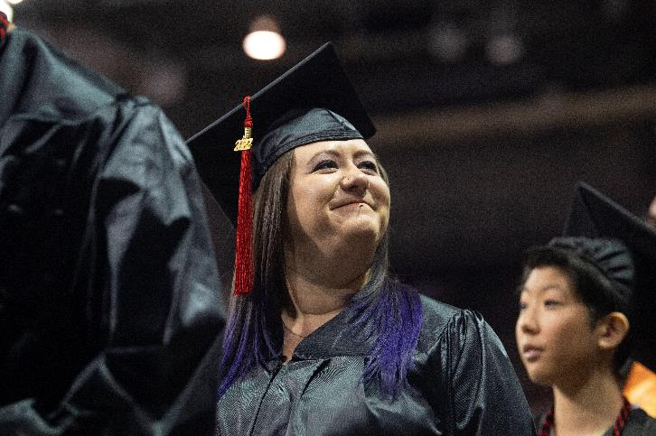
Graduation
Degrees & Certificates
3,970 | 17/18
4,060 | 18/19
3,879 | 19/20
3,562 | 20/21
3,050 | 21/22

Slide 9
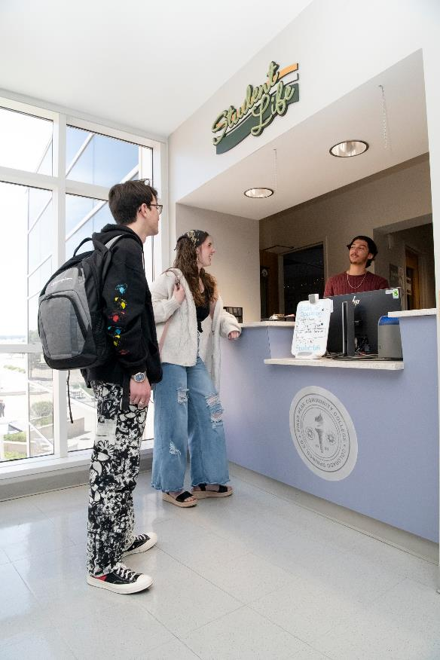
Meeting Our
Staffing Challenges

Slide 10

Growth Model Scheduling
After-action report
  How did we do on reducing section numbers and increasing average course fills for Summer?
    27% fewer sections, reduced sections by ~200
    Fill rate improved from 43% to 56%
    Financial impact is approx. $1 million improvement

Slide 11

Campus Safety
Workshop on Thursday at 9:30 am
C200

Slide 12
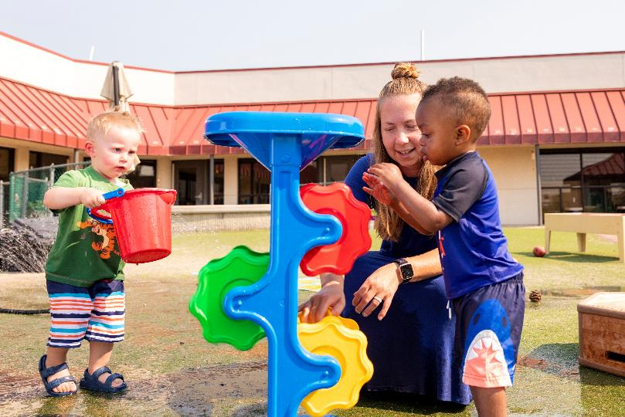
Child Development
Center Update

Slide 13
Construction Plans & Updates

Slide 14
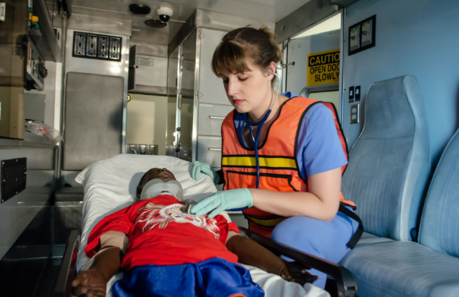
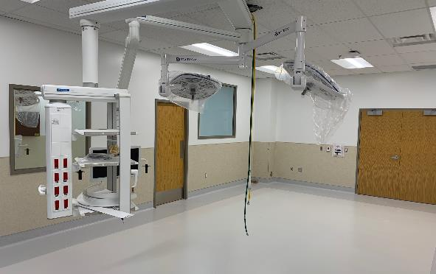
CHES Phase 2
CHES Houses
  EMS
  Medical Assistant
  Med Office
  Nursing (ADN)
  Pharm Tech
  Phlebotomy
  Physical Therapy Asst.
  Surgical Tech
  Spaces will be functional for the upcoming fall semester

Slide 15
Free Shuttle | Rampart » CHES
Free to students
Runs every 7–10 minutes when classes are in session
Monday–Friday | 7:30am–5:30pm

Slide 16
Downtown Campus Changes
Learning Commons
Other Changes
Interior spaces are complete. Some miscellaneous furniture (casual furniture for commons areas) will arrive later
Four new roof top air handling units were delayed by manufacturer supply chain issues
We're dropping the "Studio" from the name.
We're moving computer sciences classes there.
We're planning a grand-reopening celebration later this fall. (Details to come.)
The city has plans for upgrading Antler's Park, including the addition of a dog park.

Slide 17
Upcoming Projects

Slide 18
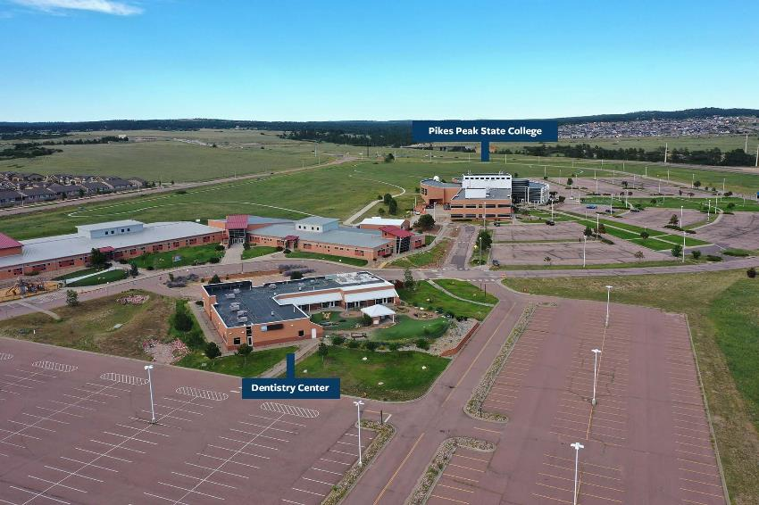
Dentistry Center
Possible opening date: Fall ‘24
Project Cost: $8,505,000
  Launch a Dental Hygiene program
  Fall of '25
  Grow our Dental Assisting program
  Renovate the former Child Development Center to serve as The Dentistry Center
  Raise $3–$4 million to fund capital improvements and startup

Slide 19
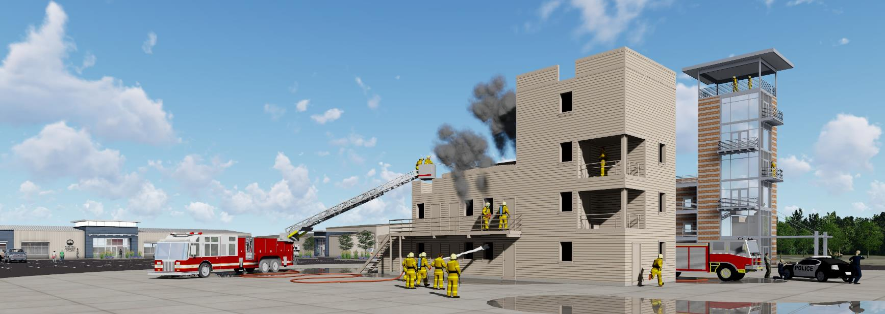
First Responder Emergency Education Complex
Fire Science & Law Enforcement

Slide 20

New Programs Starting This Fall
Industrial Mechatronic Maintenance | AAS
Health, Wellness & Fitness | AAS
Health & Wellness Coach | Cert
Personal Trainer | Cert
Physical Therapy Assistant | AAS

Slide 21
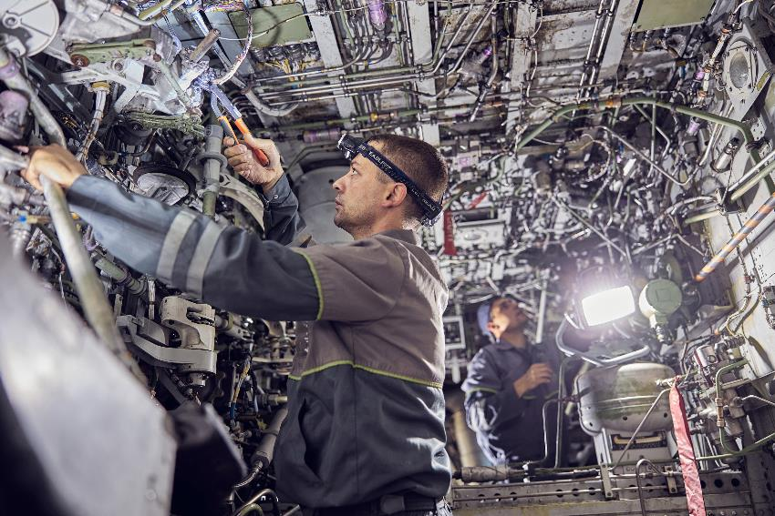
Upcoming Programs
Aerospace Engineering: Expected Fall 2023
Remote Pilot (Drone) Certificate: In planning phase
Mechanical Engineering: In planning phase
General Engineering: In planning phase

Slide 22
Bachelor’s Degrees—What’s Next?
Current Degrees
Working On
Advanced Paramedic
Nursing
Emergency Services Administration
Radiology: Tentative 2024
Healthcare Management: In planning phase
Healthcare Informatics: In planning phase
Respiratory Therapy: In planning phase
Cybersecurity: 2024
Education: 2024
Business: 2024

Slide 23
Dakota Promise Update
Two years in—what have we accomplished?
Numbers of students who enrolled in the fall:
137 students from the HS grad class 2022
73 students from HS grad class 2021
51 students from HS grad class 2020 (first Dakota entry year)
Of the 182 scholars, 23 have earned a degree or certificate. (Final numbers available after the third year)
44.5% (81/182) students are on track to graduate

Slide 24
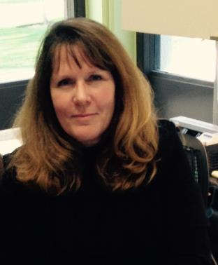
New Leadership
Darlene Melby, our new vice president for administrative services

Slide 25
Strategic Plan

Slide 26
Strategic Priority Areas
Improve the First Semester Experience
Engage Adult Learners and Strengthen Workforce Development
Build our Equity and Inclusion Efforts
Improve Employee Recruitment and Retention

Slide 27

Colorado Online Updates

Slide 28


College Reserves
FY20
FY21
FY22
$31,119,838.60
33.9%
$41,694,660.69
42.7%
$31,899,872.01
31.9%

Slide 29

Accreditation Upcoming Visit
Spring 2023 | HLC multi-location visit (Downtown Campus, Falcon High School, TEC Campus)
2024 | Full visit

Slide 30
Kudos
The College has earned a Gold Designation as No. 2 in the Top Ten Schools for all Large Community Colleges for 2022-2023; gold is the highest designation that Military Friendly® Schools has.
Grant for SB-226 for healthcare programs
Our chapter of Phi Theta Kappa, Alpha Gamma Alpha, won big at the at the CO-Wy Regional Conference, taking home awards for Most Distinguished Officer, Most Distinguished Chapter in the Region, Honors in Action, and Continuing Advisor Excellence.
Mark Vickers, Nursing Assistant faculty, won one of 12 Nightingale Awards presented by the Colorado Nurses Foundation.
Joseph Poelstra is one of 207 Phi Theta Kappa members selected as a 2022 Coca-Cola Leaders of Promise Scholar and will receive a $1,000 scholarship. Scholars are selected based on scholastic achievement, community service, and leadership potential. More than 1,300 applications were received.
Congratulations to PPCC’s Phi Beta Lambda Business Club for their victories at the State PBL Conference/Competition in Boulder this summer.
Ryan Johnson was named national Chemistry Professor of the Year by the American Association of Chemistry Teachers.

Slide 31
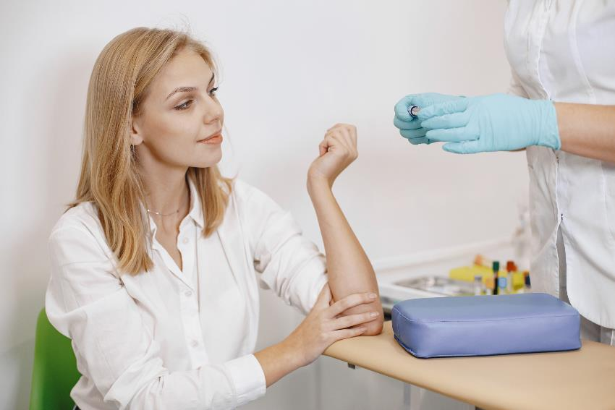
SB22-226 | Care Forward Colorado Program
The bill will give $3.8M of funding from the state for short-term healthcare programs:
  Certified Nursing Assistant
  Emergency Medical Technician
  Phlebotomy Technician
  Pharmacy Technician
  Medical Assistant
  Dental Assistant
Programs are recommended to be under 30 credit hours and completable within 6 months.

Slide 32
Questions?

