Slide 1

President’s Address | 2020 Fall PDW
Weathering the Storm

Slide 3
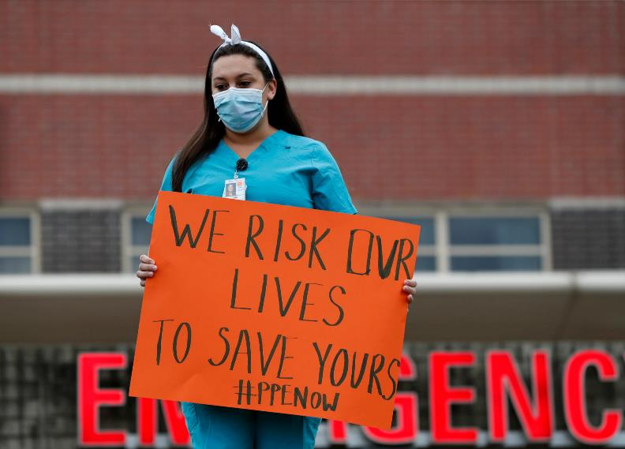

Where We Are Now
A time of upheaval and change

Slide 4
Status Report

Slide 5
Enrollment
Semester FTE | Summer (End of Term Data) | Fall (As of Aug. 18, 2020)
2019 | 1,094 | 4,341
2020 | 1,057 | 3,431
% Change | -3.4% | -16.4%

Slide 6
Retention
56.9%
From the lowest in the system to the highest.

Slide 7
Retention Disaggregated
49.5% | Black Males
58.4% | White Students
50.9% | Black Students

Slide 8
Graduation
4,060
Number of degrees and certificates awarded in AY18/19
3,881
Number of degrees and certificates awarded in AY19/20
+ Four-year graduation rate = 28.2% (exceeds our goal of at least 25% of first-time, full-time students graduating within four years of entry)

Slide 9
Graduation Disaggregated
30.2% White Students
14.5% | Black Students
7.1% | Black Males

Slide 10
College Reserves

Slide 11
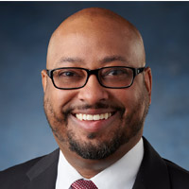
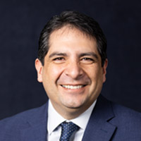
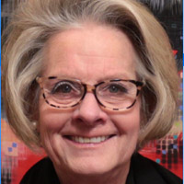


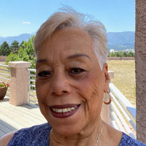


Foundation Update
Foundation awarded 455 scholarships, 100 more than
last year—a record $1.3 million
28% increase in the number of students served
PPCC Foundation Board of Directors
Row 1: Jordan Ayers, Jason DeaBueno, Taffy Mulliken
Row 2: Tyson Nunn, Michael Schroeder, Shirley Stewart
Row 3: Murray Weiner, Joel Yuhas

Slide 12
A Look Back
Change at Light Speed

Slide 13
Grade Comparisons
Course Outcome | Spring 2019 End-of-Term | Spring 2020 End-of-Term | Spring 2020 As of 08.07.20
Passing Grade (A, B, C, S) | 27,843 (77%) | 27,646 (75%) | 28,033 (76%)
Failing Grade (D, F, U) | 5,638 (16%) | 5,622 (15%) | 5,595 (85%)
Withdrawal | 2,440 (6.8%) | 2,784 (7.6%) | 2,794 (7.6%)
Incomplete | 73 (0.2%) | 757 (2.1%) | 369 (1.0%)
The overall courses pass rates are 77% for Spring 2019 and 76% for Spring 2020.

Slide 14
Survey of Students
Overall, how would you rate PPCC’s efforts to help you transition to online learning following spring break?
53%: “highly successful” or
“very highly successful”
8%: “not successful”
Their suggestions for improvement:
Communicate better
Reduce homework
Better guidance in instruction
More live video and recordings
Clearer guidelines for assignments

Slide 15
CARES Act Funding
Initial Funding
$3.75 million to assist student from the CARES Act
$3.75 million to assist PPCC from the the CARES Act
$20.4 million total CARES Act funding

Slide 16
CARES Act Funding: Students
 | Summer 2020 |  |  | Fall 2020
Momentum Scholarships | Awarded | 1,190 | $1,198,200 | Awarded | 3,016 | $3,016,000
 | Paid | 957 | $957,000 | Paid | 0 | -
Emergency Grants | Awarded | 73 | $51,100 | Awarded | 99 | $69,600
 | Paid | 71 | $48,700 | Paid | 0 | -
Emergency Grants
  Food, Housing, etc.
Computers
  Foundation Total: 48
  CARES Act Total: 212

Slide 17
CARES Act Funding: Institution
Plexiglass and other barriers
PPE
Signage
Extra temporary custodial staff
Online student services support
Hyflex Technology
CDC Teachers
Online Orientation

Slide 18
PPCC’s Curbside Pantry
  Virtual Pantry service has allows students to use the pantry/community table at a low contact service.
  A pantry order is placed by the student, indicating any allergies or restrictions and then, using safe handling processes, bags are pre-made by our staff members. Appointments are made to ensure that only one student is picking up at a time.
  Since May 15th we served:
    726 households
    30 items each
    21,780 food items have been given

Slide 19
Advising & Testing
From Drop-In to Appointment-Based Model
A record 39,000 interactions April–July
(more than previous 9 months)

Slide 20
DEI News
DEI Virtual Communities
HEED Award

Slide 21

Virtual Commencement

Slide 22
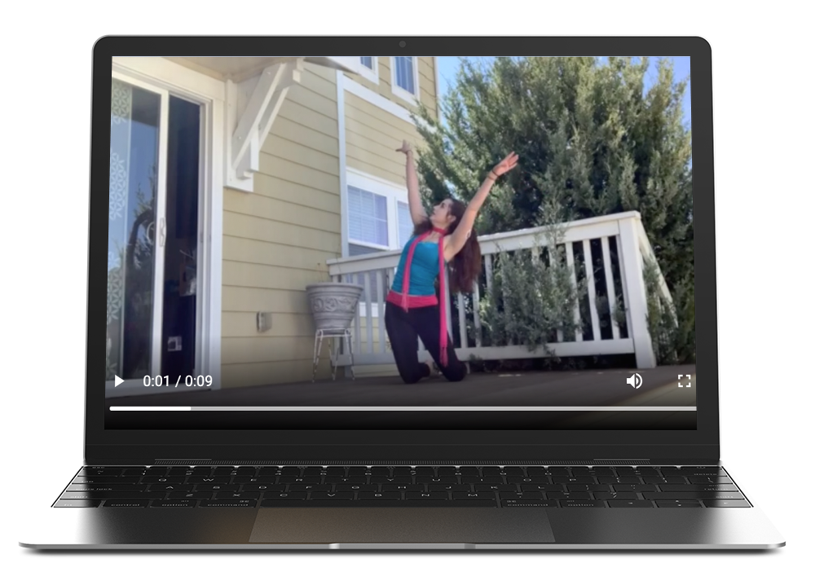
Virtual Dance Performance

Slide 23
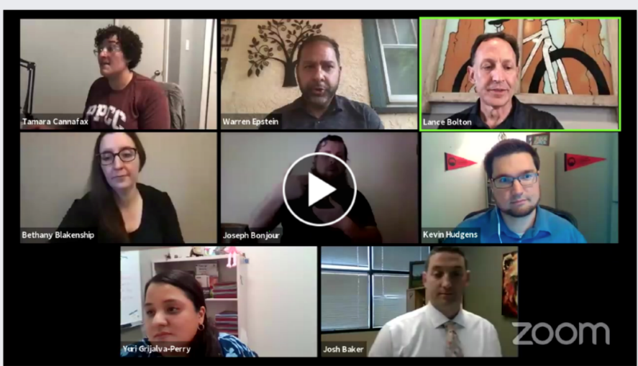
Virtual Townhall Recruitment Events
Live views: Just over 100 between the two events
Views on Facebook afterward: 17,616

Slide 24

Facebook Live
Timely info
Great engagement
Variety of voices/faces
Personal touch

Slide 25

Student Life Drive-In Movie Nite
About 450 students and their families attended.
SOLD OUT!!!!

Slide 26
Open Educational Resources (OER)
Leading our system
As of Fall 2020, 28 courses (reaching nearly 26,000 students)
Saved students about $2.3 million in textbook costs during AY19 (SU19-SP20).
We will be adding another 9 courses to utilize OER in spring of 2021, bringing our total number of courses to 37.

Slide 27
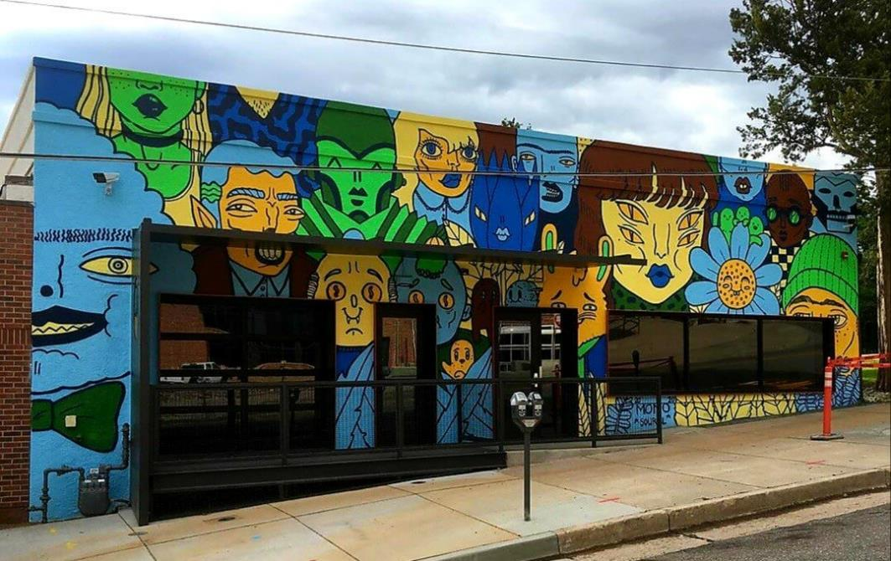
Studio West
“The Crowd" by Maxilie Martel, a.k.a Mono Sourcil of Montréal
One-year installation, part of the Downtown Partnership's Art on the Street project

Slide 28
Where to From Here

Slide 29

PPCC’s Commitment to Be an
Anti-Racist Institution
What Anti-Racist Work Means for Us
Closing achievement gaps, aiming for equal outcomes.
Closing diversity hiring gaps in faculty and staff to reflect our student population.
Examine behaviors and systemic processes that serve inequality, and work toward reform.
Build a culture that is more welcoming, so that all feel a greater sense of belonging.
This work is not meant for one race or ethnic group. We're all in this together.

Slide 30

Gaining a Better Understanding of
Anti-Racism
10 a.m. Tuesday, September 29 for the kickoff event via Zoom Video Conference. Regina Lewis is finalizing plans with noted author/activist/educator Tim Wise to be the keynote speaker.
We have 100 copies of the book, “How to Be an Anti-Racist” by Dr. Ibram X. Kendi

Slide 31
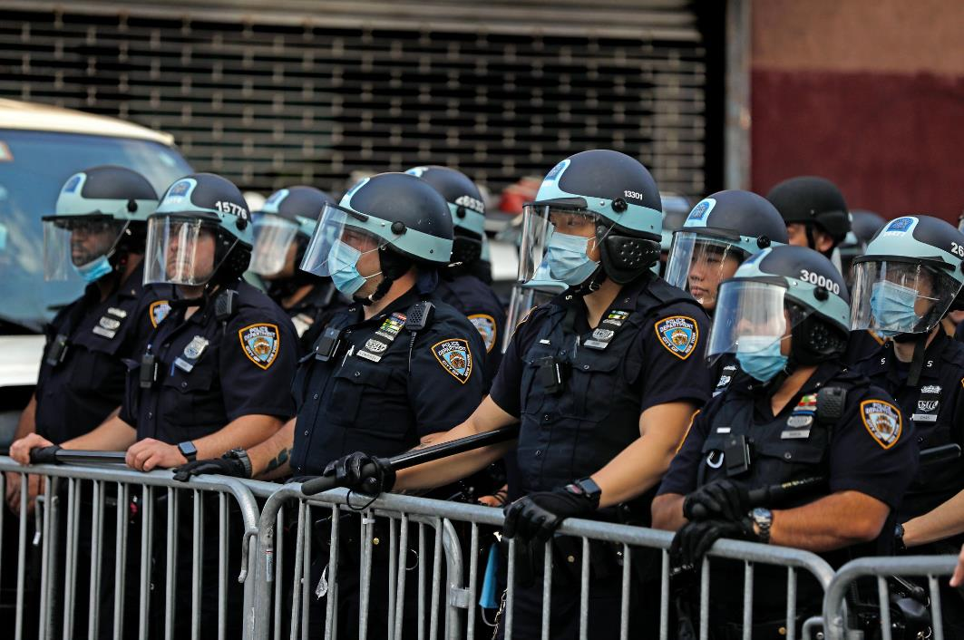

Empathy Development Project

Slide 32




Instructional Plans for Fall
Live Video Classes | Traditional Online | In-Person | Hyflex

Slide 33
Capital Projects on Hold
CHES Phase II on hold
Centennial upgrades on hold

Slide 34

New ITSS Installed Tech for Hyflex
Number of Classrooms Equipped
6 | Centennial
8 | Rampart Range
1 | Downtown

Slide 35
COVID-19 Protocols
Everyone on our campuses must wear a mask in public spaces.
Social distancing is mandatory, and guidance stickers have been placed in many common areas.
If you have symptoms? Stay home
If you or someone else in the campus community has symptoms:
  Go to the ppcc.edu/covid and fill out the "Report Symptoms" form.

Slide 36
COVID Hygiene Protocols
All high-touch surfaces are sanitized twice daily using a virus killing chemical and special sprayer for 360 degree contact.
Plexiglass shields have been placed in all high-traffic student service areas including Advising & Testing and Enrollment Services as well as in some one-on-one service areas.

Slide 37
Facilities Upgrades
Roofing on Centennial (progress but no completion date yet)
Electrical upgrades (same)
Fire sprinkler project (underway by end of August)
Walkway project (ready to put out to bid)
Restroom upgrades (scheduled to begin by the end of this year)
Gymnasium project (designed and out for bid)

Slide 38
New and Future Programs
Surgical Technology | Hospitality | Emergency Management and Planning | Secure Coding | Vet Tech | Physical Therapy Assistant | Industrial Maintenance

Slide 39

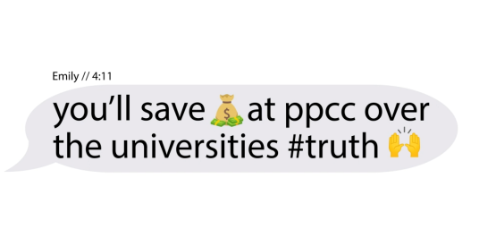
New Marketing Campaign
A record 2 weeks from concept to market
0 actors or models needed
YouTube, Facebook, Instagram

Slide 40


Mask Campaign

Slide 41
Dakota Promise
Total D2 (Atlas, Career Readiness Academy, Harrison, James Irwin, Sierra) Applications from HS Grad class 2020: As of 8/14: 409
Number of students who officially “qualify” for Dakota (defined as having a 2.25 GPA and having submitted a FAFSA): As of 8/14: 125
Total students registered for fall classes: As of 8/14: 109
On August 15, Dakota Promise Scholars received a laptop.

Slide 42
Election Protocols
Polling locations for drop-off ballots and live voting will be at Centennial and Rampart campuses
Employees are prohibited from using college resources (computers, time, copy machines, etc.) to advocate for candidates or ballot measures

Slide 43
Assessment
Coaches are available
Friday Workshops
Assessment 101
Improving Assignments through Transparent Design
Developing Rubrics for Grading and Student Learning Assessment
Interpreting and Using Assessment Data

Slide 44
Sick Leave
Adjunct instructors no longer have pay deducted for sick leave

