Slide 3
Degrees & Certificates
That’s the most degrees and certificates PPCC has ever awarded!

Slide 4
Fall-to-fall Retention Data

Slide 5
Enrollment 10-year trend

Slide 6
College Reserves

Slide 7
Foundation
Impact of Million Dollar Scholarship Campaign (2016)
$1.1 million of scholarships awarded
332 students supported
$3,300
average scholarship size
868 students submitted
4,500 scholarship applications
 | Foundation Financial Performance
 | AY 15-16 | AY 16-17
Total Contributions | $1.76 Million (includes $1 million contribution for Marie Walsh Sharpe Creative Commons) | $1.53 Million
Total Revenues | $1.991 Million | $2 Million + $22,000 from PPCC Faculty, Staff and Students

Slide 8
Foundation Contributions

Slide 9
Diversity & Inclusion
Vision: To strive for a more unified campus where all people are valued, treated fairly, and possess a sense of belonging.
Mission: To support the success of all Pikes Peak Community College students, employees and other affiliates by exercising culturally responsive teaching and providing programs and initiatives designed to create an inclusive and equitable campus environment that reflects and enriches the communities that we serve.
Enrollment Management Team
Using Diversity goals to devise new tactics to drive enrollment Created the
Underrepresented Student Sub-committee, tasked with identifying best practices to close the achievement gap.

Slide 10
Diversity & Inclusion Goals
1 | 2 | 3 | 4 | 5
Create opportunities to increase the pool of qualified employee applicants from underrepresented populations. | Administer workforce diversity training sessions for all search committee members. | Increase employee and student participation in cultural competence training sessions. | Disaggregate all campus data by various diverse student populations and identify achievement gaps. | Establish recruitment, enrollment, retention, and completion initiatives for underrepresented students in order to close achievement gaps.
6 | 7 | 8 | 9 | 10
Sponsor programs and initiatives to increase underrepresented student engagement and student intergroup interaction. | Increase external funding for campus diversity programs and initiatives. | Administer assessment tools to measure the impact of campus diversity programs and events. | Create more opportunities to recognize and reward PPCC stakeholders for their outstanding achievements and contributions to campus diversity programs and initiatives. | Increase marketing and communication outlets to promote campus diversity programs, initiatives, and achievement.

Slide 11
Accreditation
PPCC will be hosting two site visits in fall 2017 (dates TBD)
Multi-location Visit
Three locations: Aspen Valley Ranch, Downtown campus, and Early College High School.
Purpose: confirm the continuing effective oversight of HLC- approved additional locations
Mid-cycle Review
Scheduled July 29, 2019 (virtual visit)
Will include a monitoring report on Program Review and Assessment (in both instructional and support services)
Rewrite of our 2014 self-study report started over the summer (Criteria 1, 2 and 5)

Slide 12
Assessment of Student Learning
AY17/18 Focus areas
Aligning signature assignments with general education outcomes
Using assessment results to improve student learning (closing the loop)
Upcoming workshops
Fall PDW: 5 workshops facilitated by Assessment Coaches (rubrics, alignment, and closing the loop)
September: 2 workshops on aligning signature assignments with general education outcomes
October 20: PD Day facilitated by Elizabeth Barkley (signature assignments and rubrics)

Slide 14
Learning Commons
The former Centennial Campus library space has been transformed into a 16,000-square-feet integrated learning center. In the Learning Commons, students will be able to access in one place:
Tutoring
Technology support
Library services

Slide 15
Learning Commons App
This innovative app, developed with our ITSS and Learning Commons staff, enables students to request tutoring services no matter where they are within the new Learning Commons. This technology was developed by ITSS for PPCC. No one else in Colorado is using it, and we’re exploring licensing the technology.

Slide 16
Marie Walsh Sharpe Creative Commons
Thanks to a record-breaking $1 million gift from the Marie Walsh Sharpe Art Foundation, we're developing the Downtown Studio Campus into a cornerstone for regional arts education as well as a major destination for cultural events in downtown Colorado Springs.
The centerpiece of the project is the Marie Walsh Sharpe Creative Commons, a 2-D studio with state-of-the-art digital as well as traditional art tools. It will be accompanied by a garden/outdoor studio, a 3-D sculpture studio and a jewelry studio. Large garage doors will open to Pikes Peak, taking full advantage of the view.

Slide 17
Other Capital Projects
Projects |  |  | Completion
Centennial Campus
 | Aspen Remodel | → | Fall Semester 2017
 | Enrollment/Student: | → | Opened Spring 2017
 | North Entrance Drop Off | → | End of September 2017 (weather permitting)
 | Classroom Improvements: B302 & B304 - Cyber Classrooms | → | January, 2018 - Ready for spring semester start
 | Aspen Café: All-hours access Vending Area (former coffee area) | → | Fall semester start
Rampart Range Campus
 | Range Café: New Coffee/Front Counter | → | January, 2018 - Ready for spring semester start
Downtown Studio Campus
 | Black Box Collaboration with PPLD | → | Spring 2018
College-wide
 | Signage & Wayfinding | → | Ongoing. Significant progress (inside/outside) planned throughout FY2018

Slide 18
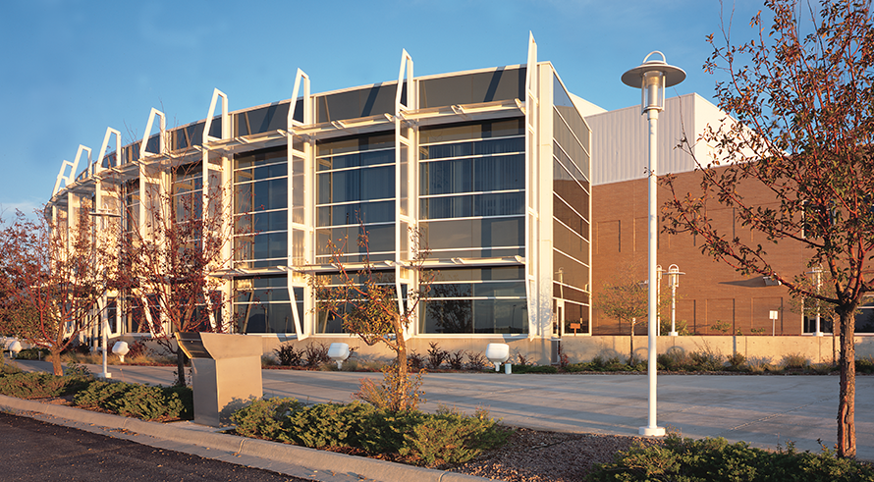
Facilities Master Planning

Slide 20
Pilot Programs
Extraordinary ideas we make happen.
This Year's Selections: | Online Student Newspaper | Online Catalog Database | Flipped Science Classroom
 | Hidden Figures Project | RRC Auto Door Opener | Passport to Completion

Slide 21
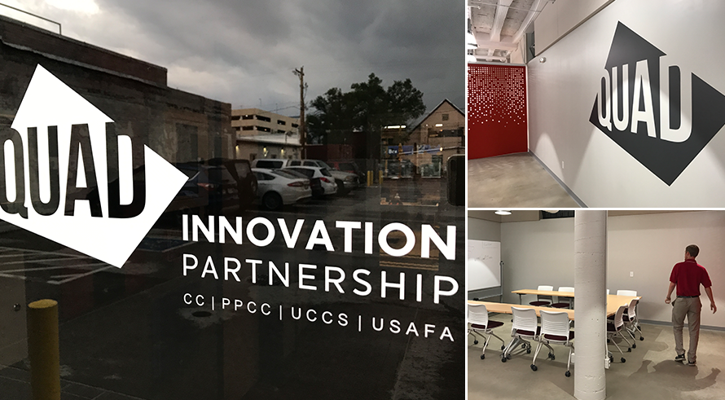
The QUAD

Slide 23
New Programs
Cybersecurity
Construction

Slide 24
Construction
Building and Construction Technology - AAS degree 2 certificates: Building and Construction Advanced Applications Certificate Building and Construction Fundamentals Certificate

Slide 25
Cybersecurity
Here are the totals for our Cybersecurity grants so far:
RAMPS Cyber Prep grant (to get high school students into cyber careers): $199,681
Department of Defense OEA Grant: $891,935 of which $303,174 is for PPCC and $588,761 goes to the Chamber and EDC
The total awarded to PPCC in cybersecurity grants is $1,091,616 and the total awarded for work that PPCC will do for programs at the college (minus the EDC part) is $502,855.

Slide 26
Other New Degrees
In the fall of 2018, we will introduce PPCC's first bachelor's degree - a BAS in Emergency Services Administration. We are updating our college's mission to reflect that we now are more than a two-year institution.
—
Classes start Sept. 18.
Also: Certified Dietary Manager certificate program starts in the spring.

Slide 27
Career Boost
Thanks to a $4.5 million grant from the Department of Education, our Workforce Development division has joined with Colorado School District 11 and the Pikes Peak Workforce on Career Boost. This innovative job-training program is designed to help undereducated, underemployed groups - those significantly below the level of the usual PPCC freshman - teaching basic math and English skills along with skill trades in:
Manufacturing
Information Technology
Child Development

Slide 28
Career Boost Funding
$295,024 from the WORK Act (Colorado Department of Labor and Employment) for 1 year of funds to promote Career Boost and recruit students
$195,377 from the Colorado Department of Education for 3 years of funds to teach Career Boost classes in manufacturing, IT and child care
TOTAL: $490,401 in funding for PPCC.
In addition, School District 11 is receiving $164,500 in Colorado Department of Education funds to manage Career Boost as part of its Adult and Family Education program, which serves all of El Paso and Teller counties.

Slide 30
Strategic Plan
Last fall, staff, faculty, students and community members came together to create a new Strategic Plan – Destination 2022, a roadmap for where the college will go in the next five years. It’s an ambitious set of five goals, with accompanying tactics and action steps.
We plan on addressing all the goals and tactics, but, after an in-depth planning session this summer, we’ve decided to focus primarily on a key issue to our success and student success: retention.

Slide 31
Strategic Plan Focus Goals
Focus Goal 1 | Creating smarter schedules
Focus Goal 2 | Improving faculty engagement
Focus Goal 3 | Improving math success
Focus Goal 4 | Creating a more strategic 1st semester academic success plan

Slide 32
High Impact Practices

Slide 33
Future Program Growth
PPCC leadership worked with Gray Associates, an educational consulting firm out of Concord, Mass., to analyze current and potential programs, looking for the greatest opportunities for growth so that we can better serve our students and the community.
Gray looked at,
among other things:
Salary potential
Employment potential
Market trends
Market competition
Program costs
Student Demand
—
The data, as well as our own leadership analysis, suggests that some of our greatest potential lies in expanding medical-related programs.
—

Slide 34
Internal Communications
Our Communications Team will expand and bring more focus to internal communications through the work of two groups:
Campus Collaborators: Ambassadors of information, the members of this group will create new connective tissue within the college to make sure that everybody is kept apprised of major college initiatives.
Campus Communicators:
This group will work with the Communications Team to make sure that every piece of material we produce, be it paper or digital, adheres to our high design and brand standards in a consistent and compelling way.

Slide 35
Updated Logo
The updated logo changes generic-looking mountains for Pikes Peak, contains the mountain inside the circle and is easier to read both small and at a distance.
What This Means
Don't throw away your name tags, business cards, shirts, water bottles or stationary.
—
As you order new branded material, it should have the new logo on it.
—
Please update your email signature. The logo is available to download on the Marketing website.

Slide 37
Adjunct Advancement May Institute
This year's Adjunct Advancement presenters included:
Tier 2 | Tier 3
Angela Anderson | Betsy Tuma
Bill Ledford | Brandi Kraft
Cynthia Holling-Morris | Brandon Ridgeway
Dave Seyfert | Chris Swanson
Iveta Holeckova | Jennifer Hopper
Jennifer Winslow | Julie Lindsey
Megan Sanders | Matthew Conner
Misty Colgrove | Mustafa Akcadogan
Roberta Crownover
Presenting at May Institute is the final gate for adjuncts to showcase teaching excellence in the PPCC classroom.
Each presentation included the following:
Teaching techniques learned through professional development
Implementation in the PPCC classroom
Assessment for effectiveness

Slide 39
CCCS Updates
Dr. Nancy J. McCallin's retirement - July 31. Site visit and public forum at PPCC on Oct. 5 Details to come.

