Slide 1

Spring 2014 PDW
President’s Address
PIKES PEAK COMMUNITY COLLEGE
Spring 2014 PDW | Page 1
Notes:
Welcome to Spring Semester.
Jay Yeakley, representing the Faculty Scholars Program:
Introduced and congratulated the three students who received the Faculty Scholarships
Linda Kohn is a single mom with 10 kids. She expressed the scholarship has given her the confidence to change paths and enter into the nursing program and she asked faculty to keep giving to the scholarship program because it is an inspiration for students.
Maria Raczyowski is a mom with a 2 1/2 year old special needs daughter. She expressed that the scholarship makes attending so much easier and also helps encourage her to reach her dream of becoming a nurse.
Damon Stickney expressed the scholarship helps him stay committed and inspired and it’s not just a monetary check, but a reminder of what is right and what is good. He asked faculty to please continue to donate.
Informed the audience that this year the scholarship program was able to increase the scholarships to three $1,000 awards.
Provided feedback that what really helps students get selected for this award is 1) they prove how hard they are working in the community for a job and they are truly going above and beyond at the school and 2) detailed narratives, the more detail faculty can provide in the narratives, the better chances a student has in the scholarship selection.
Expressed the goal of the faculty scholarship committee is to have three faculty members from each division and to also have 100 percent of faculty donating, whatever amount they can, to the PPCC Foundation for the Faculty Scholars fund.

Slide 2

HLC ACCREDITATION
10 Years of Preparation
  2 years intensive work
Messaging
  Campus-wide and specifically in departmental and division meetings
Mock Visit
  February 13 & 14
Spring 2014 PDW | Page 2
Notes:
10 Years of Prep
The purpose of Accreditation is to:
Show how the college is fulfilling its mission, essentially doing what we say we are doing
Receive advice and assistance from the consultants to help in the areas where the college is struggling
Serve as an opportunity to reflect and improve
“I know we are doing a good job. I’m confident we are going to do well. This shouldn’t make us nervous. We are in good shape.”
HLC Messaging
There has been a great deal of messaging informing and advertising accreditation such as email contests, campus electronic and environmental signage. Going forward there will be more messaging in division and departmental meetings. Please keep discussing this topic and keep the conversations going.
HLC Accreditation Dates
March 10 – 12, 2014 is the PPCC Site Visit, where the HLC consultants will be visiting our campus, holding forums and talking with individuals, students, faculty, staff and community partners, one-on-one.
February 13 – 14, 2014, is a “mock visit” with three individuals from the CSSS who are versed in accreditation. These individuals will visit, and then provide feedback and coach PPCC on changes, edits and tweaks than can be made.

Slide 3
HLC ACCREDITATION
KUDOS
  Steering Committee
  Criterion Writers
  Institutional Research
  College Leaders
Spring 2014 PDW | Page 3
Notes:
Thanks to the whole college!! This is a college-wide effort and everyone deserves a great deal of thanks!
There are a few specific people and groups I would like to recognize for their outstanding efforts and work:
Jim DeHerrera, Carole Olds, Gayle Krzemien– they have done a fantastic job leading us.
The five lead criterion writings and their support teams.
Institutional Research: Our IR department is such a strong team – Patricia, Stephanie and Rebecca have done a great job!
When I talk about college leaders, I don’t just mean the executive leadership team, what I mean is all the people who stepped up and led the various parts – college leaders means everyone who has stepped up.

Slide 4



HLC ACCREDITATION
Your Role During Team Visit
How do you support the PPCC mission?
Spring 2014 PDW | Page 4
Notes:
Interactive HLC Exercise
When the HLC Team visits in March, our goal is that faculty and staff can answer three questions. The first is part of this exercise. Please take a few minutes to write your answer to the question on the card that was provided to you: How you help to support the PPCC mission?
For those not at the presentation, you will be doing this exercise in Division and Departmental meetings. The cards will be collected and a display with all the answers will be created on each campus. Please be sure to answer this thoughtfully and include your name and department.
For example, if you are a custodian, your answer could be, “I support the mission by providing a safe and clean environment where staff and students can move around and focus on learning.”

Slide 5
HLC ACCREDITATION
Your Role During Team Visit
Provide a real story of the impact of your work.
  Ex: “Last semester I met one-on-one with a student struggling with his resume writing assignment. He just recently emailed me saying what he learned has given him a leg-up during his internship search.”
Know and understand how your voice is heard in the governance of the college.
  Ex: “As a Director, I can share ideas, concerns, wins and challenges with my PPCC Leadership Council Director Representative, Cheri Arfsten.”
Spring 2014 PDW | Page 5
Notes:
The other two questions we want faculty and staff to be prepared to answer are:
What is the story behind what you do – especially what is in the impact of your work?
How can you use the college’s governance to ensure your voice is heard?
Please make sure you have a story.

Slide 6
HLC ACCREDITATION
Full written report – Covers the 5 Criteria
Availability of the Executive Summary (Cheat-Sheet)
Questions about the HLC Accreditation Visit?
Spring 2014 PDW | Page 6
Notes:
The written report is finished and online at ppcc.edu/hlc
Each section within the report has a summary. Those summaries will soon be made available online as well in a “cheat sheet” format.
Please review them or read the entire report to prepare yourself for the Evaluation Visit.

Slide 7


2014 Colorado Legislative Session
Bachelor’s of Applied Science
Governor’s Budget Proposal
  $60 Million in new operating funds for Higher Education representing an 11% increase over current year.
  $13.6 Million is allocated to the CCCS
  $1.5 Million is PPCC’s estimated increase
  $40 Million increase in Financial Aid (42% increase)
    $30 Million slated for need-based aid
    $5 Million for work study
    $5 Million to restore merit-based aid
PIKES PEAK COMMUNITY COLLEGE
Spring 2014 PDW | Page 7
Notes:
Bachelor’s of Applied Science (BAS)
We are seeing the authority to offer Bachelor of Science (BAS) degree. We are feeling good about the legislation. Last year this proposed legislation died in house education committee but we received strong support from senate. This year we have a majority signing on as sponsors so we feel certain it will be approved.
If this legislation passes, we will be able to offer degrees in areas where there are gaps in skill and education levels in the workforce. Areas like culinary arts, zoo keeping technology and water quality. I encourage you to think about this to determine gaps so we can act on this if it passes. Any of our applied AAS degrees would be eligible to become bas degrees.
There are at least 18 other states where Community College offers BAS degrees . . . . Florida is probably the most popular. There are many types of approaches to this.
These two gaps were the drivers to change this:
Sign language - There is no four year program in Colorado. There are workforce needs for this because a Bachelors degree is required for these jobs.
Dental Hygiene – No degrees are offered in Colorado.
As leadership talked about this –they felt it would be a better move to request full authority so we don’t have ask each time a program is determined to be a workforce need. We wanted blanket authority.
Gov. Budget Proposal
Before sessions starts the Governor released his proposal for the year. He asked for the largest ever increase in this financial aid for Higher Education.
The Joint Budget Committee (JBC) decides how to spend the money – they often stay consistent with what the Gov. has asked – but there is some tweaking. We are hopeful that what is proposed is what is adopted. We won’t know until May, that is when the long bill is signed.
We are appreciative of the Governor’s recommendation that we need to better serve students and keep college affordable.
The Gov. has asked for a pledge from all colleges in the state not to increase tuition by more than 6 percent.
We are moving into a shift in the funding model for higher ed. Pre-recession 2/3 of funding came from state and 1/3 came from tuition. During recession we went to the exact opposite of that and our revenue never when down. The Governor is showing his commitment to shift back. We will probably never go back to old model, but if we could get back to 1/2 and 1/2 over next five years, it will be a good thing for our students because they took on the burden of tuition and this change will help make them more successful.

Slide 8
Fall 2013 Enrollment
Enrollment Declines
  PPCC -3.1%
  CCCS -4.7%
  National Postsecondary -1.5%
    For-profits -9.7%
    Two-year public colleges -3.1%
Enrollment Increases
  Four-year public colleges +0.3%
During the next four semesters the impact of Developmental Education changes will be known.
PIKES PEAK COMMUNITY COLLEGE
Spring 2014 PDW | Page 8
Notes:
Enrollment Declines/Increases
We are currently seeing an enrollment decline
Enrollment is going down, but we are receiving increased funding from state. We will do well in the formula for funding, because our enrollment wasn’t as far down as some of our sister colleges. We’ll receive 12 – 13 percent of CCCS funding.
I’m not excited about a decline in enrollment but I’m not losing sleep over it.
The message is that as the economy swings community college are affected more than private and four year colleges. We are more likely to grow when economy is down and lose some enrollment during recovery. That is exactly what is playing out right now.
Development Ed.
We don’t know how the changes in Development Ed. will impact us. Fall 2014 we will be moving from tiered remedial classes to having one developmental class. This will impact our enrollment. Other colleges that did this saw some negative enrollment trends. PCC did this and we can learn a lot from them. Our goal is that more people will complete this course. If more students complete developmental work and enroll in college, we will still benefit.
Summary
Overall our college is in a very strong financial position. Still running reserves over stated goal of 30 percent. We are about 9 to 10 million over that goal. This money is only used on one time projects and we have a number of projects in the works.

Slide 9
Strategic Plan & Focus Goal Updates
Focus Goal 1: Improve first-year student experience
  New Academic Advising Model Proposed
    Focus is on student goal identification and progress tracking
    Case management model is part of recommendation
    Training and certifying advisors will be key component
    Providing tiers of support beginning with a team of trained professional advisors and continuing to faculty advisors and support position advisors (i.e. Military Affairs)
  New processes for signatures, wait-listing and transfer course evaluation
  New Student Orientation: A total of 1,382 students participated in fall orientation during 60 sessions
PIKES PEAK COMMUNITY COLLEGE
Spring 2014 PDW | Page 9
Notes:
We are two years out from completion of our Strategic Plan and last year we realized we needed to get it into bite size pieces we could work on. We picked a focus goal of improving the first year student experience.
Key things coming from Focus Goal 1:
Accepted academic advising model - sent the ok just yesterday to Dr. Weber and we are moving forward with implementation. This will be key to helping more students succeed at PPCC. Students who don't have goals or degree plans don’t complete. This new model will help with that. We know case management works because people connecting with people works. The new model will have college funding and have a full time advisor. We need people working directly with students.
Certifying advisors – Each semester things change and we want our advisors to be well trained. So, there will be a certification process for the people doing advising to make sure they have the information they need to support students.
We have done a great deal of streamlining for signatures, wait listing and transfer course evaluation. These new processes will decrease obstacles in navigating the the enrollment process. (by decreasing the paper chase)
Orientation - First year we had more than 300 students. This year more than 1,282 students with roughly 23 or 24 students per session. Thanks to VP Lopez – he and his teamed changed orientation from a big show to frequent small gatherings. We now hold orientation every day in small classes so students can better interact and ask questions. We have one orientation leader running these so the information stays consistent. We will now track these students to see how this impacts graduation and retention rates. We are still enthusiastic about the idea of mandatory orientation, but we just don’t have a mechanism to have mandatory orientation. Because we don’t have a mechanism, it’s strongly encouraged and not mandatory. The advisors have done a wonderful job at encouraging this.

Slide 10
Strategic Plan & Focus Goal Updates
  New Focus Goal: Advance Student Persistence to 60%
  Established on Aug. 13, 2013
  Measures Fall-to-fall Retention Numbers for ALL students
  Current Fall-to-Fall Retention Numbers
    All students – 48%
    51% for 2011/12 IMPROVED TO 55% for 2012/13 (IPEDS)
Review of goals and budget processes published in an email from me to PPCC on August 21, 2013.
PIKES PEAK COMMUNITY COLLEGE
Spring 2014 PDW | Page 10
Notes:
New Focus Goal
This past year leadership came together to create a new focus goal. Now that we are developing better processes for getting students enrolled, how do we keep them here?
Our aim – based on the leading colleges persistence rates – is 60 percent. We would be the highest performing college in the state if we achieved this.
We increased four percent just this year . However, this number does bounce, but I feel like this is due to a shifting culture here around student success.
How are we going to achieve this? We have established two strategies that were detailed in an email from August 21, 2013…transform the library into a learning commons and implement the use of an academic planning tool.

Slide 11
Strategic Plan & Focus Goal Updates
Focus Goal 2: Learning Commons
  Transform Centennial Campus Library into a dynamic Learning Commons that supports academic success across disciplines with tutoring, technology, educational resources and facilities that encourage student engagement in the learning process.
    Architect/Engineer identified and on board
    Recommended design features due Jan. 13, 2014
    Construction to commence late 2014
  Currently piloting some of the Learning Commons concepts
PIKES PEAK COMMUNITY COLLEGE
Spring 2014 PDW | Page 11
Notes:
Learning Commons
When I think about the Learning Commons I think of a place where students want to spend time. Finding ways to encourage students to spend more time on campus will help them be more successful. It will be a comfortable place. Have food and snacks. It will also be a high tech place where students connect immediately with support and tutoring needs.
I have this vision of those Brazilian restaurants where you put the green sign up to get more food or the red sign to stop the food from coming. Imagine a place where students sit down to work and then use technology to convey their needs. Maybe you need help with Algebra or a paper you are writing….there will be no standing at a counter or in a line or announcing it in front of people. Rather, the help you need will come to you, and we will harness technology to make that happen.
We already have great resources, the challenge is getting students to connect. Cindy Buckley is leading this charge. They are looking at best practices nationwide.
This is going to be a big project and we know it is going to be difficult. We are going to have to shut down the Centennial Library space to do this project. There is no great time to do this. We will expedite the work and it will probably during summer – but it will be challenging. Construction starts in a year.
It will be really transformative for how students access support services at our college.

Slide 12
Strategic Plan & Focus Goal Updates
Focus Goal 3: Academic Planning Tool
  Identify and implement an electronic Academic Planning Tool designed to engage students with long-range, accurate, academic plans and continuous connection to their academic goals, progress and college support functions while improving the efficiency of course scheduling and aiding us in maintaining continuity in our connection and communication with students.
    Task Force recommendations due and publicly communicated by Jan. 13, 2014
    Budgeting for implementation during FY15
PIKES PEAK COMMUNITY COLLEGE
Spring 2014 PDW | Page 12
Notes:
Academic Planning Tool
The concept is that when students enroll they should get a semester-by-semester plan that shows them how to get from where they are today to graduation day and we should be able to monitor where they are in that plan. Because this tool is interactive, we get alerts when students take missteps in classes and scheduling.
Many students in community colleges take way more credit hours than they need. If we could streamline the courses they take to keep them on track we have a significant opportunity to improve graduation rates.
This tool will also allow us to plan better. It’s not a perfect tool, but it will help us to determine the number of sections and classrooms that we need and what expenditures we will experience.
We are looking at the best of the tools available and have had challenges getting vendors in to demo products. We are hoping we can bring something in that increases the efficiency of how we operate. Bree Langemo is leading this task force.

Slide 13

KUDOS to CETL Leadership
  College commitment to CETL
Adjunct Faculty Advancement Program
  Tiered compensation
  Connected to participation in professional development and teaching experience
Faculty Evaluation Process Completed – Led by Faculty Senate with participation from CETL
Workshops provided by PPCC faculty and following up on the past two PDW speakers Kay McClenney and Elizabeth Barkley
PIKES PEAK COMMUNITY COLLEGE
Spring 2014 PDW | Page 13
Notes:
CETL
I’m the number one fan of CETL. They are doing fantastic work. I believe they do such meaningful work because they are a faculty based, faculty run professional development organization.
My commitment to CETL is…
They will be funded so support their vision, we will provide release time for people working on it and we’ll provide support for funding for speakers.
They will have physical space. CETL and E-learning will share space being vacated by Military and Veterans Programs. This will be CETL and E-Learning Headquarters.
CETL will always be faculty led. Faculty is best at determining faculty needs and responding to them.
Things coming out of CETL are the adjunct faculty advancement program - we’ve always paid adjuncts the same, but perhaps that shouldn’t be the case. The way we compensate doesn’t encourage participation in professional develop so we want to provide an incentive. Tiers only go up from where we are today and this will be in place by fall 2014. The outline is in place, but key details need to be figured out. We need to work details around CTE, lab classes and clinical nursing. We will be rolling out details of this program over next few months.
Faculty Evaluation Plan
Our college participated well. We also made a great showing of professionalism.
Workshops
We will continue to bring in top-notch advisors.

Slide 14



External Work in the Pikes Peak Region
Newly formed & growing partnerships:
Lessons from Kirkwood Community College
  Less than 20,000 enrolled credit students
  More than 70,000 enrolled non credit students
Building capacity to recognize and rapidly respond to community, industry and specific business needs.
Increased focus on developing internships and work experience opportunities for PPCC students.
PIKES PEAK COMMUNITY COLLEGE
Spring 2014 PDW | Page 14
Notes:
New Partnerships
There are so many opportunities to better serve our community and better serve our students through business and community partnerships. We recently established new partnerships with Goodwill, District 11 and Aspen Pointe.
Kirkwood Community College (KCC)
PPCC, along with UCCS and the Colorado Springs Strategic Business Alliance, traveled to Iowa City to learn how their community college operates with the University of Iowa and how they are working to meet the workforce needs of the region.
Our schools are similar in size: PPCC serves 22,000 students and KCC serves about 18,000. However KCC also serves nearly 70,000 non-credit seeking students and we are only at 20,000. In addition, KCC’s metro area is only 100,000.
KCC does have local tax support. For example, they asked the public for an increase in funding to give their college more money to operate and more than 80 percent supported the bond measure to give the college more funding.
How did that happen? Almost everyone in the community is touched by the community college. We need to do this here. We have so many untapped opportunities to build support for the college. Building partnerships to meet community and workforce needs is a big interest for us.
Internships
We recognize that internships are a great way to partner with the community to meet their needs while helping our students to succeed by providing them with workforce experience. We need to put an increased focus on internship opportunities.

Slide 15
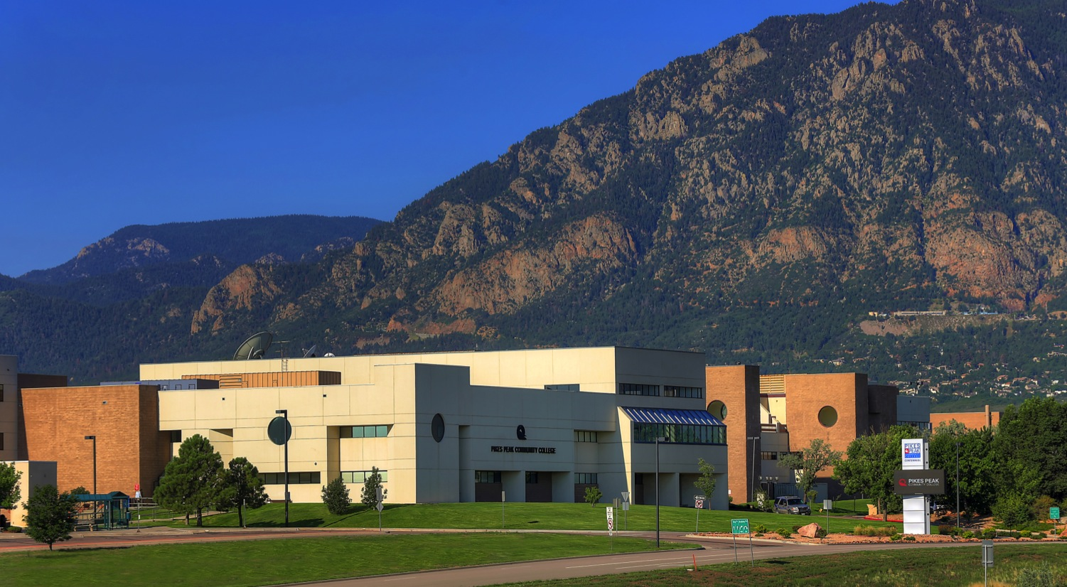
Physical Plant Updates
Centennial B & C Buildings
  All PPCC faculty and staff invited to an Open House to tour the new spaces on Feb. 5, noon – 4 p.m.
  A public reception with invited military and political leaders is planned for Feb. 6.
Downtown Campus Funding Request
Centennial Parking Changes
Falcon Campus
PIKES PEAK COMMUNITY COLLEGE
Spring 2014 PDW | Page 15
Notes:
Centennial Building
I sent out an email about the specifics of the move. Please participate in the Open House on Feb. 5.
Downtown Campus
We requested $4 M from the state for a $5 M project. The project: a Black Box Theatre and a Learning Commons. The space is 4,000 square feet with glass windows looking to the west at Pikes Peak – it will be quite spectacular.
Because we only request $4 M, the other million will come from reserves. If the state doesn’t fund this project we will move forward anyway. It is really important we develop the DTSC. The project will happen – just a matter of when and how.
Centennial Parking
There will be a significant increase to the pick up/drop off spaces on north side of campus in Lot A. The rest of that lot will be for handicapped parking… although we meet the state regulations, we don’t have nearly enough spaces there. We are in the process of working with outside consultant to best determine how to use this space.
Falcon Campus
District 49 is very enthusiastic about getting their building back. We have asked to use our option for staying one additional year- we need that year to transition out. The contract with Falcon School District will end in 2015. We will continue to hold classes at Falcon through June 30, 2015 and then vacate the building. We are currently exploring new options of how we can we better serve our entire service area of Elbert, Teller and El Paso County. All our campuses are in El Paso County so we are looking at opportunities to better serve Teller County and the east side of our service area. Our next venture may not be full service campus, it may be a satellite campus, but that is all to be negotiated and figured out. That is the path we are on.

Slide 16
Happenings
Teaching Entrepreneurship – Kauffman Foundation “Ice House Curriculum”
“On Course” curriculum
  Comparison study to run over the coming year
Expanding International Programs
VPI Listening Tour
PIKES PEAK COMMUNITY COLLEGE
Spring 2014 PDW | Page 16
Notes:
Teaching Entrepreneurship
In 2013, we had the opportunity to meet and talk with the author of the book, “Who Owns the Ice House”. We were evangelized by this guy.
The book, about teaching entrepreneurship and the role entrepreneurship plays in curricula, clicks with us.
PPCC will be bringing this curricula to our college. There will be an info session mid-February and then a training in April. Individuals from the Kaufman Foundation will come do the training.
On Course
The ME Division is rolling out the “On Course” curriculum. We are setting up a randomized trial that will start in Fall 2014 where 1/3 of classes will get the entrepreneurship course and 2/3 will get “On Course”. We will track the progress to see if we can see a difference and throw our weight behind what has the most impact.
International Programs
For decades we have participated in the Dutch student exchange program - to date a very small programs. We are looking to expand this program, because we know students can be enriched by travel and studying in another culture. This initiative is still in the planning stages.
VPI Listening Tour
VP Cindy Buckley is retiring. To help answer the question, “How will we fill her shoes?” I’ll be holding a Listening Tour at each campus and am inviting all faculty and staff to participate. The goal is to hold listening tours at each campus and learn what you you care about and what the college needs to move forward. We need to be ready to act because we don’t want to spend a year or even semester without a VPI.

Slide 17
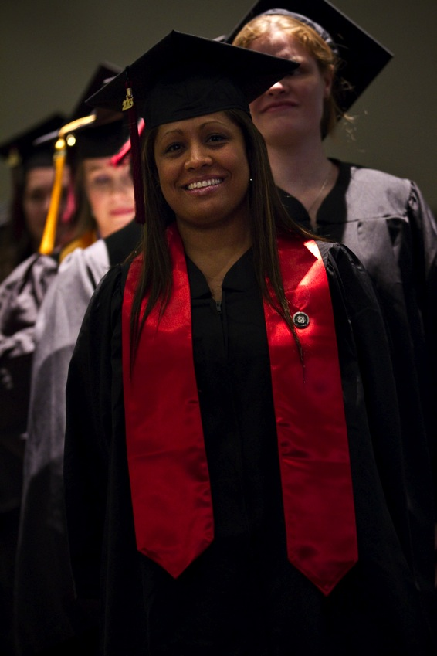
Happy News
PPCC Foundation
  More than 60 employees pledged to the PPCC Employee Giving Campaign raising more than $20,000.
Graduations
  During academic year 2012/2013 we reached an ALL TIME HIGH of 2,319 graduates!
PIKES PEAK COMMUNITY COLLEGE
Spring 2014 PDW | Page 17
Notes:
Although the college got a late start to giving program, the Foundation was still able to raise more than $20,000 thanks to the dedication and support of our employees. This means a lot and is incredibly meaningful. Thanks to all who have participated.
In addition, we graduated the most students ever this past year!

Slide 18
QUESTIONS?
PIKES PEAK COMMUNITY COLLEGE
Spring 2014 PDW | Page 18
Notes:
Please feel free to contact me if you have any questions after reviewing this presentation.

